Slide 1
Windows Kernel Internals
User-mode Heap Manager
David B. Probert, Ph.D.
Windows Kernel Development
Microsoft Corporation

Slide 2
Topics
Common problems with the NT heap
LFH design
Benchmarks data
Heap analysis
Notes:
Microsoft Confidential

Slide 3
Default NT Heap
Unbounded fragmentation for the worst scenario:
  External fragmentation
  Virtual address fragmentation
Poor performance for:
  Large heaps
  SMP
  Large blocks
  Fast growing scenarios
  Fragmented heaps

Slide 4
Goals For LFH
Bounded low fragmentation
Low risk (minimal impact)
Stable and high performance for:
  Large heaps
  Large blocks
  SMP
  Long running applications

Slide 5
LFH Design
Bucket-oriented heap
Better balance between internal and external fragmentation
Improved data locality
No locking for most common paths

Slide 6
Tradeoffs
Performance / footprint
Internal / external fragmentation
Thread / processor data locality
Using prefetch techniques

Slide 7
Block Size
0
1K
16 K
512 K
LFH
NT Heap
NT Memory Manager

Slide 8
128
Buckets
8
16
16 K
NT Heap

Slide 9
Allocation Granularity
Block Size | Granularity | Buckets
256 | 8 | 32
512 | 16 | 16
1024 | 32 | 16
2048 | 64 | 16
4096 | 128 | 16
8196 | 256 | 16
16384 | 512 | 16

Slide 10
128
Buckets
8
16
16 K
NT Heap

Slide 11
Active segment
Segment
queue
User data area
Descriptor
Unmanaged segments

Slide 12
Alloc
Active segment
Segment
queue
User data area
Descriptor
Unmanaged segments

Slide 13
Free
Active segment
Segment
queue
Unmanaged segments

Slide 14
8
16
16 K
Buckets
Large segments cache
Descriptors
cache
NT Heap

Slide 15
Free
Active segment
Segment
queue
Unmanaged segments

Slide 16
8
16
16 K
Buckets
Large segments cache
Descriptors
cache
NT Heap

Slide 17
Improving the SMP Scalability
Thread locality
Processor locality

Slide 18
Thread Data Locality
Advantages
  Easy to implement (TLS)
  Can reduce the number of interlocked instructions
Disadvantages
  Significantly larger footprint for high number of threads
  Common source of leaks (the cleanup is not guaranteed)
  Larger footprint for scenarios involving cross thread operations
  Performance issues at low memory (larger footprint can cause paging)
  Increases the CPU cost per thread creation / deletion

Slide 19
Processor Locality
Advantages
  The memory footprint is bounded to the number of CPUs regardless of the number of threads
  Expands the structures only if needed
  No cleanup issues
Disadvantages
  The current CPU is not available in user mode
  Not efficient for a large number of processors and few threads

Slide 20
MP Scalability
16
16
8
16
16 K
Descriptors
cache
Descriptors
cache
Affinity
manager
Large segments cache
Descriptors
cache
NT Heap

Slide 21
Better Than Lookaside
Better data locality (likely in same page)
Almost perfect SMP scalability (no false sharing)
Covers a larger size range (up to 16k blocks)
Works well regardless of the number of blocks
Non-blocking operations even during growing and shrinking phases

Slide 22
Benchmarks
Fragmentation
Speed
Scalability
Memory efficiency

Slide 23
Fragmentation test for 266 MB limit
 | Default | LFH
Uncommited | 235 MB | 39 MB
Free | 4 MB | 7 MB
Busy | 26 MB | 224 MB
Fragmentation | 88% | 14%

Slide 24
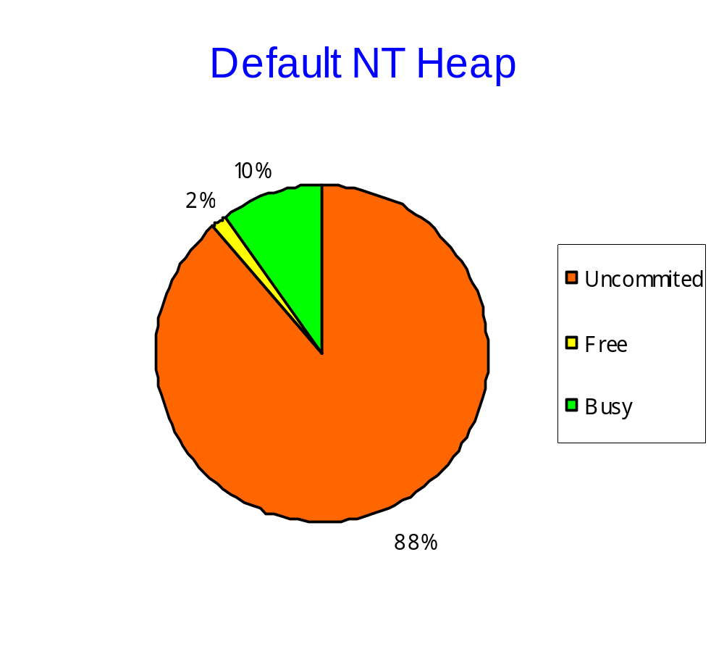

Slide 25
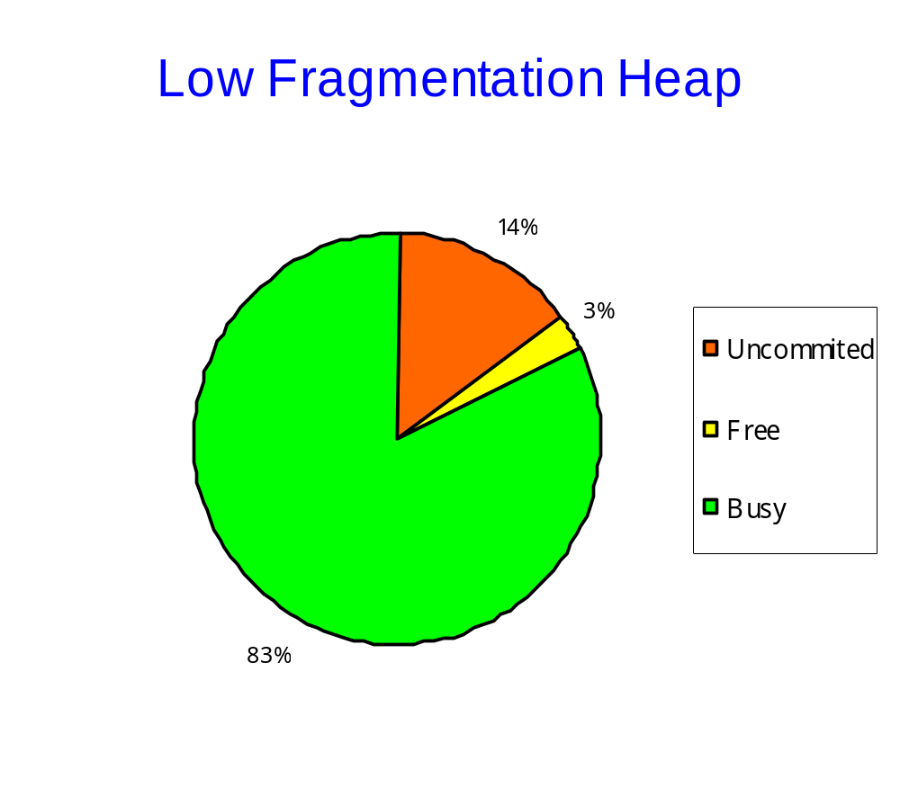

Slide 26
External Fragmentation
Test (70 MB)
 | Default | LFH
Uncommited | 25 MB | 7 MB
Free | 32 MB | 8 MB
Busy | 12 MB | 46 MB
Fragmentation | 46% + 36% | 14% + 12%

Slide 27
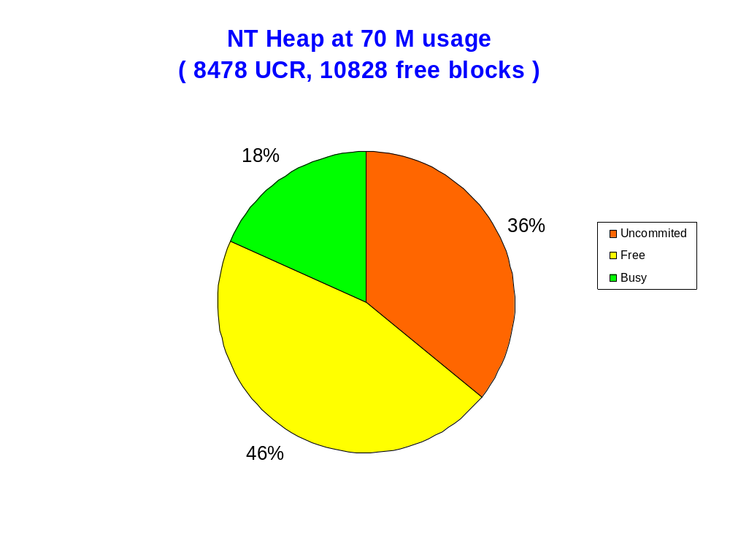

Slide 28
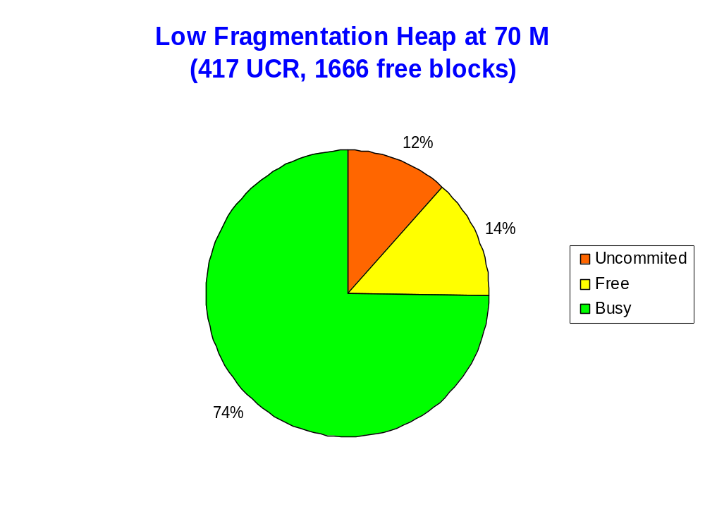

Slide 29
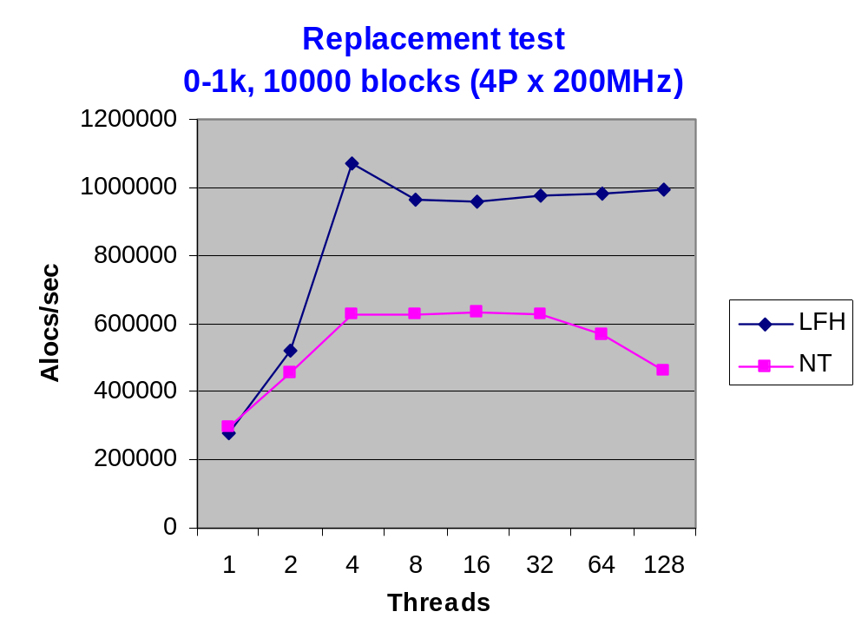

Slide 30
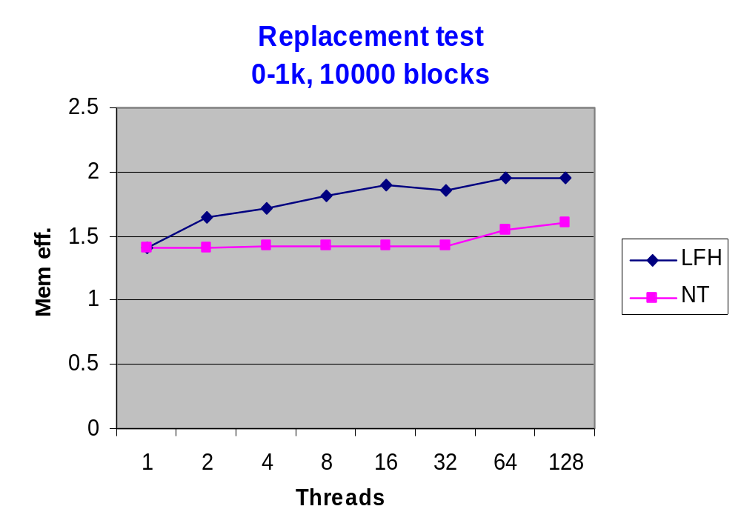

Slide 31
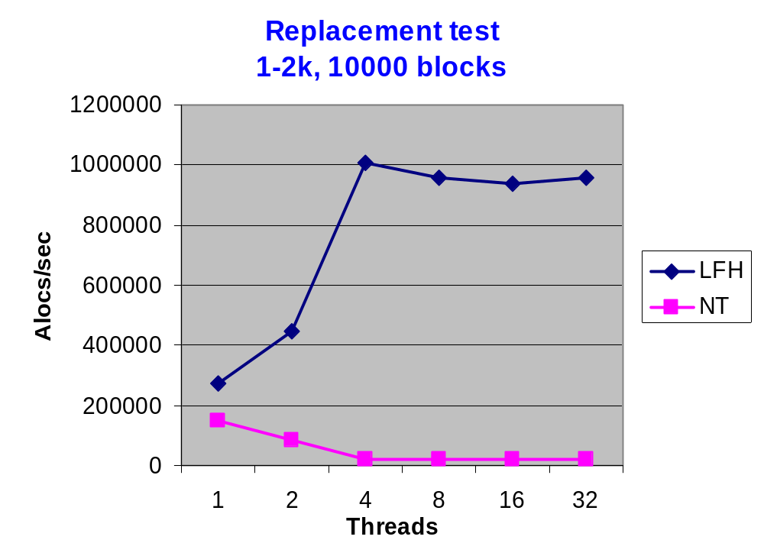

Slide 32
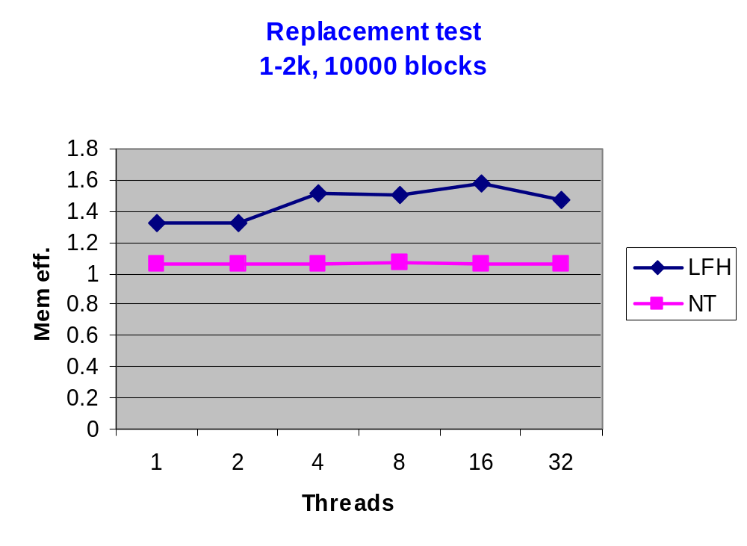

Slide 33
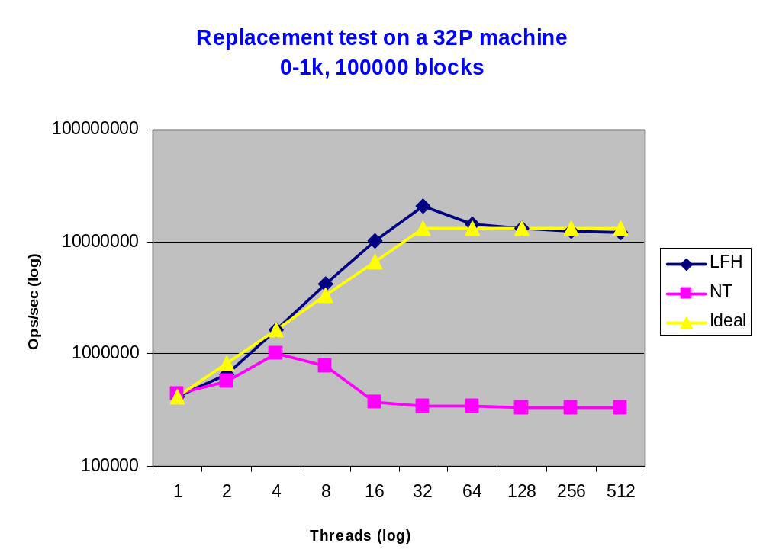

Slide 34
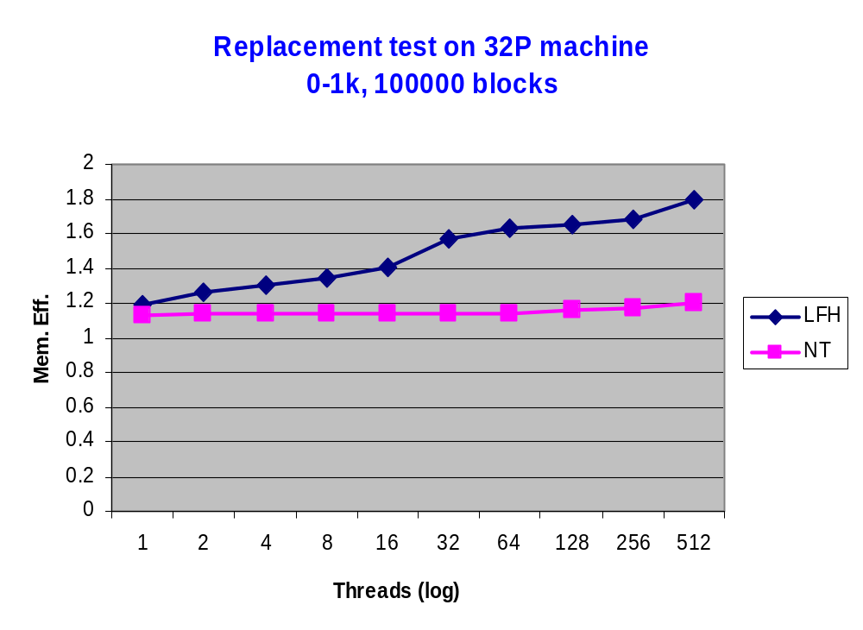

Slide 35
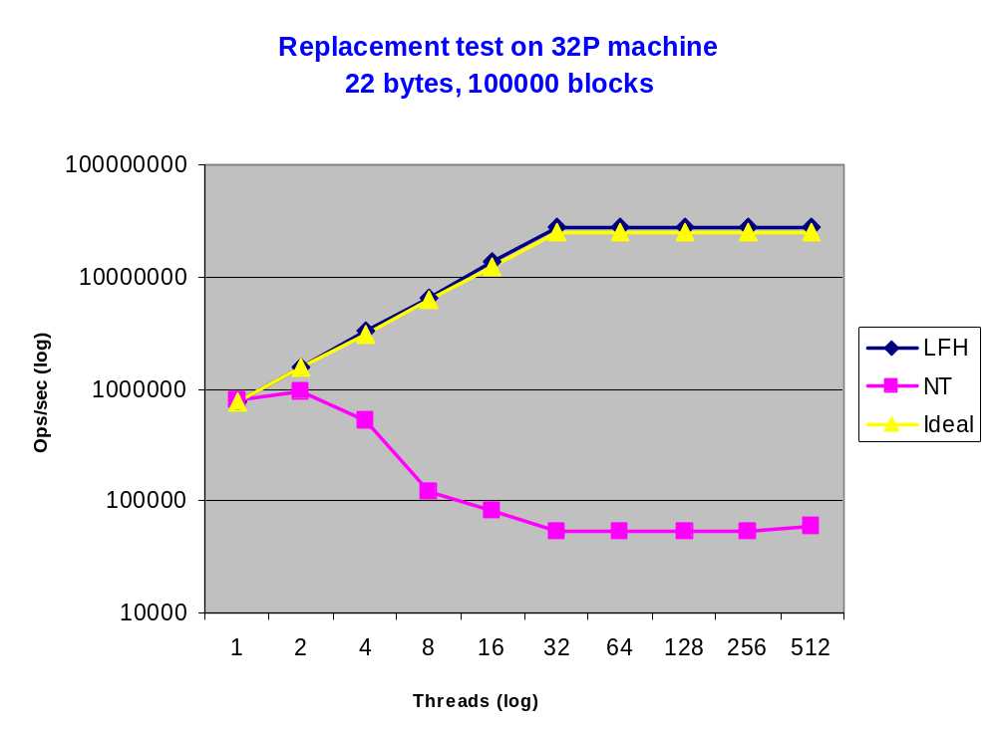

Slide 36
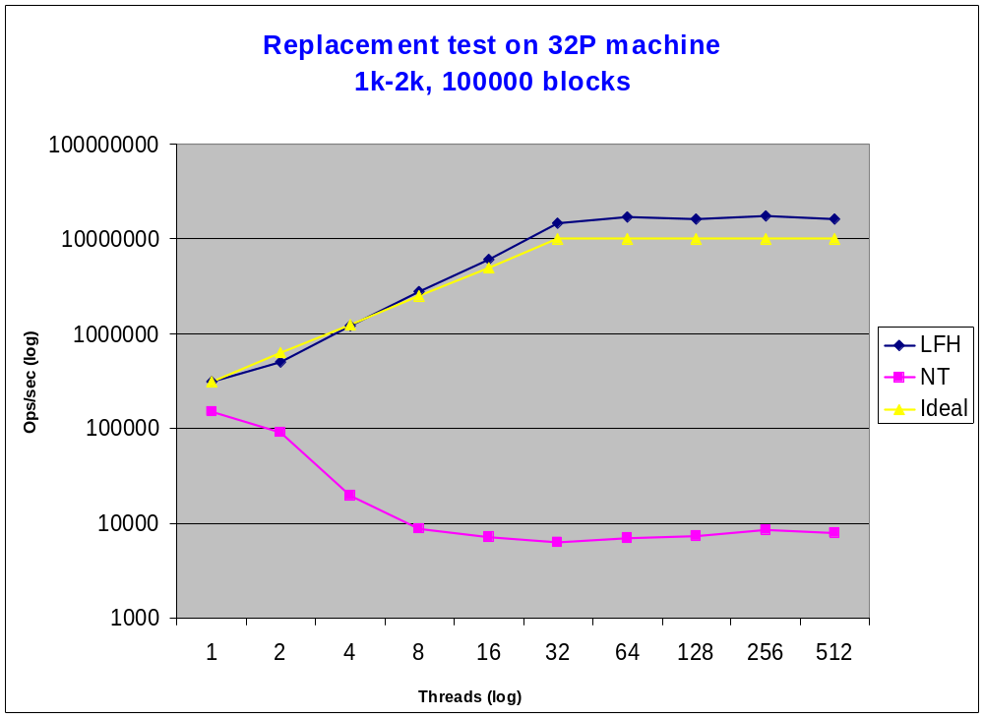

Slide 37
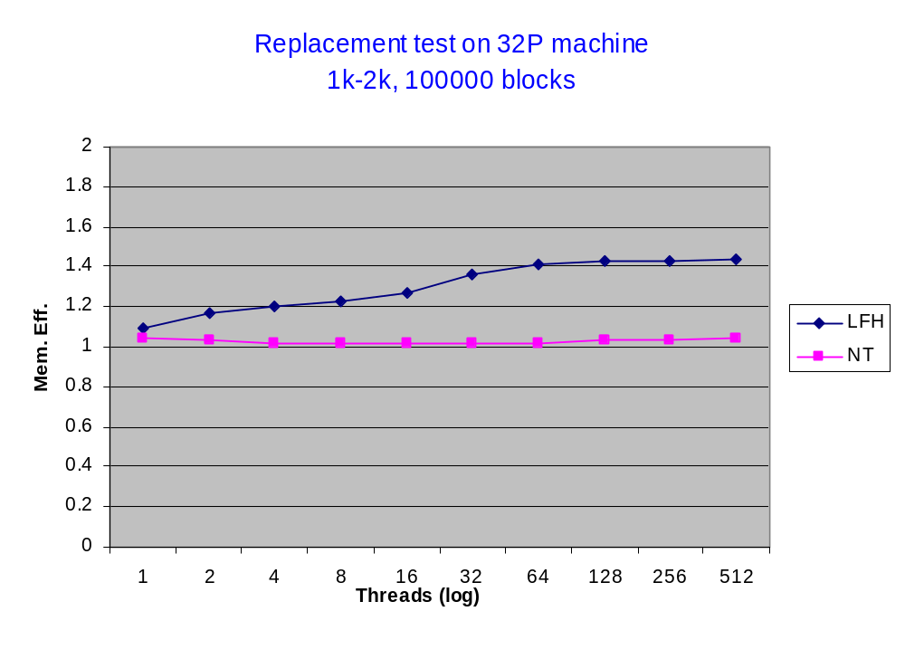

Slide 38
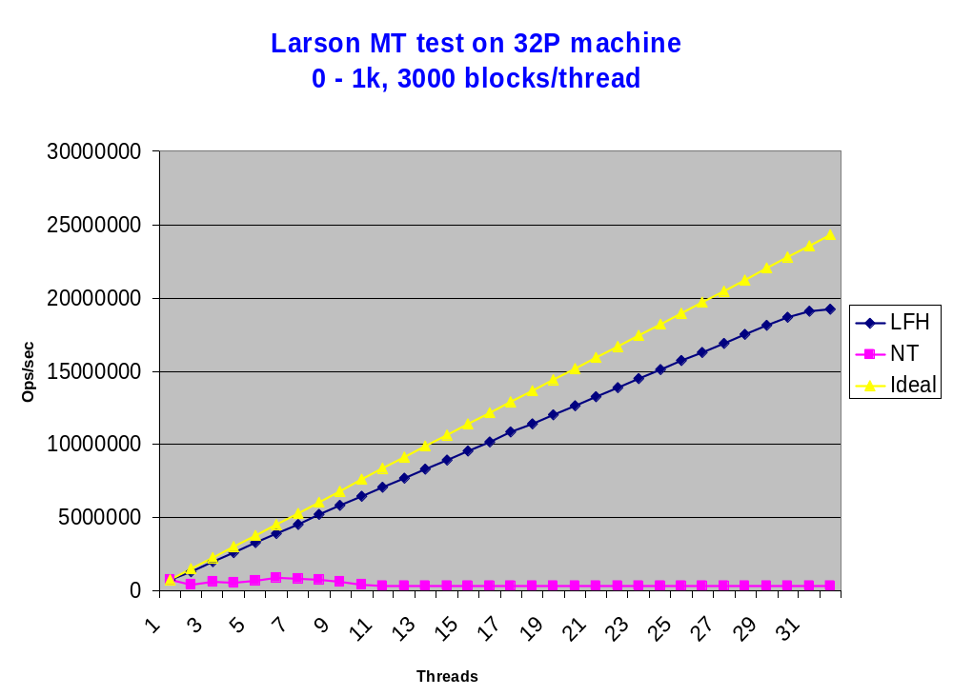

Slide 39
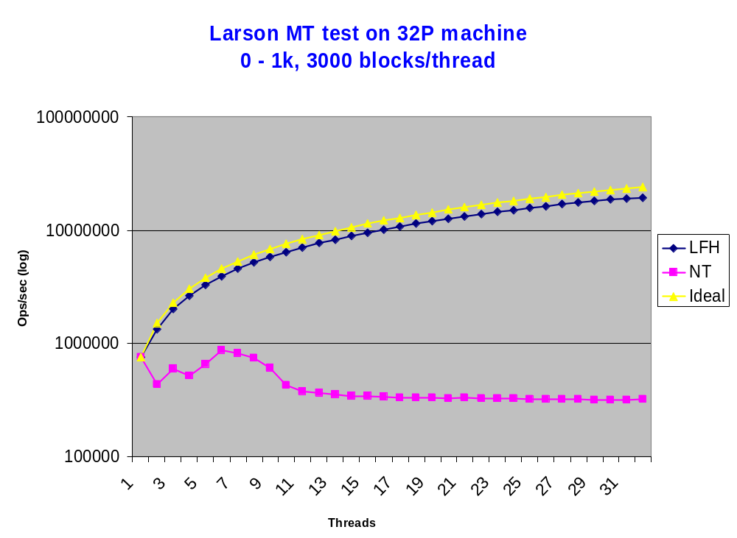

Slide 40
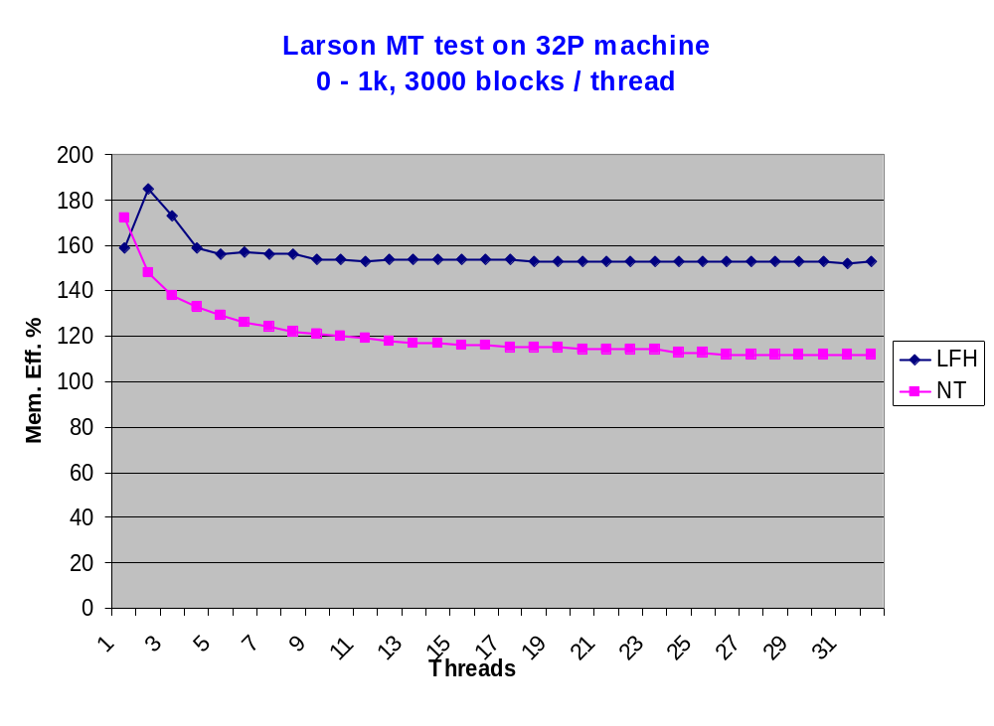

Slide 41
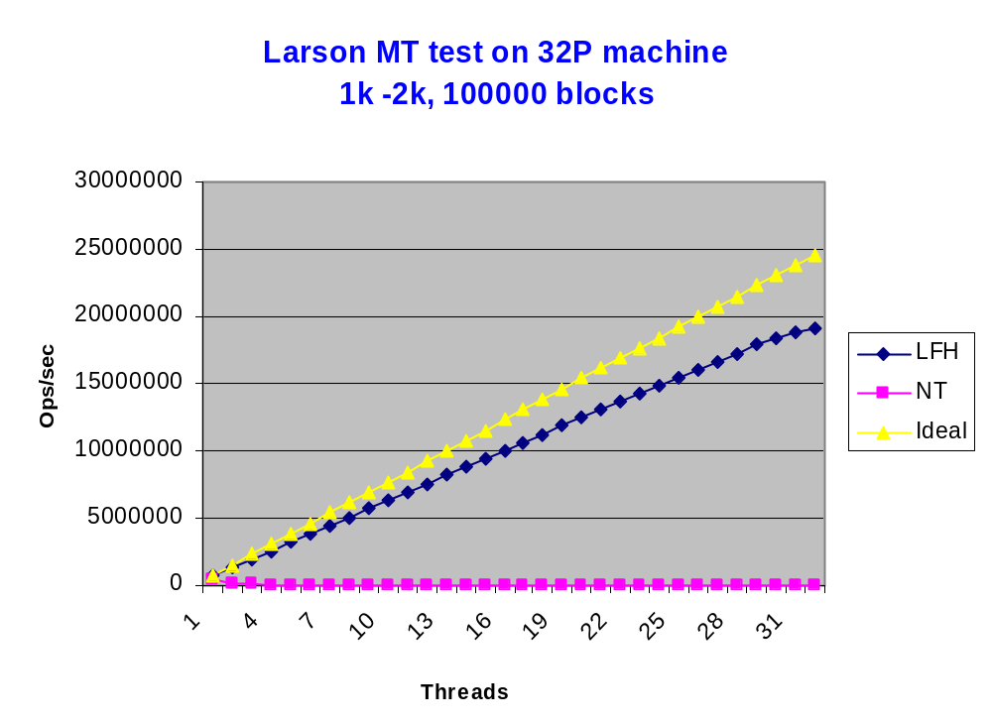

Slide 42
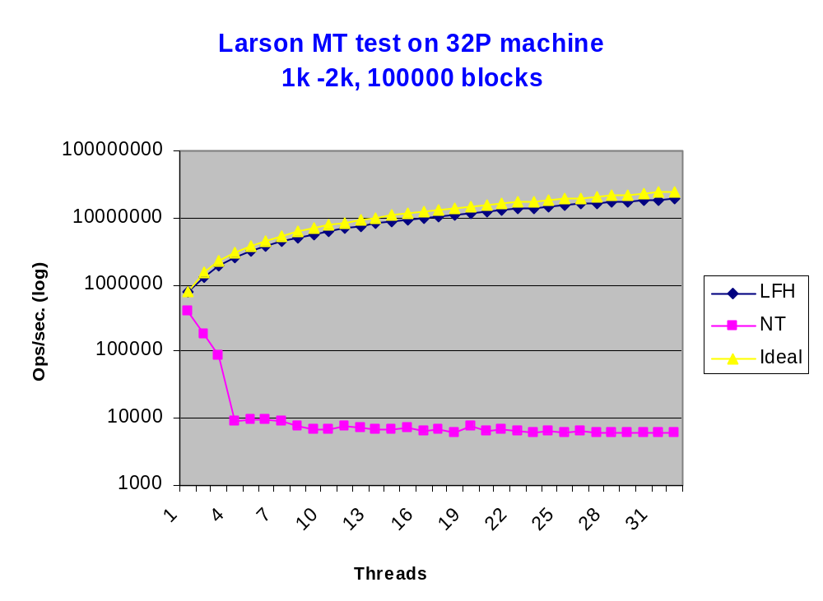

Slide 43
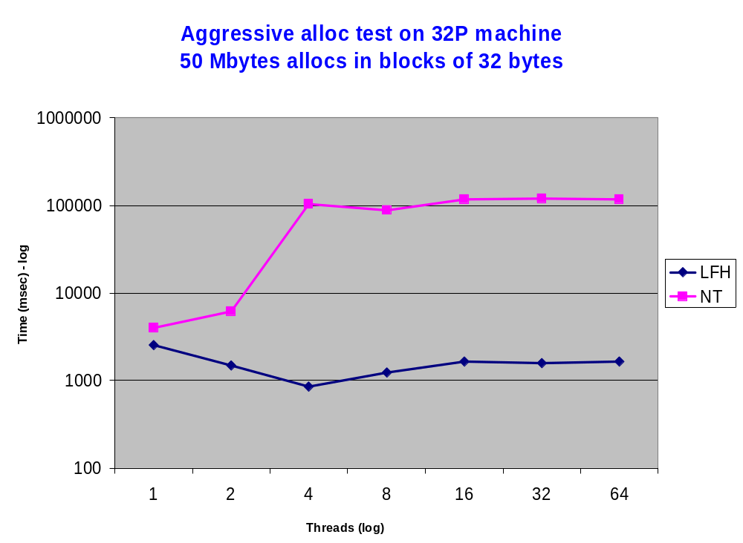

Slide 44
When is the Default Heap Preferred
~95% of applications
The heap operations are rare
Low memory usage

Slide 45
Where LFH is Recommended
High memory usage and:
  High external fragmentation (> 10-15%)
  High virtual address fragmentation (>10-15%)
Performance degradation on long run
High heap lock contention
Aggressive usage of large blocks (> 1K)

Slide 46
Activating LFH
HeapSetInformation
  Can be called any time after the heap creation
  Restriction for some flags (HEAP_NO_SERIALIZE, debug flags)
  Can be destroyed only with the entire heap
HeapQueryInformation
  Retrieve the current front end heap type
    0 – none
    1 – lookaside
    2 – LFH

Slide 47
Heap Analysis
!heap to collect statistics and validate the heap
  !heap –s
  !heap –s heap_addr –b8
  !heap –s heap_addr –d40
Perfmon

Slide 48
Overall Heap Stats
0:001> !heap –s
Heap Flags Reserv Commit Virt Free List UCR Virt Lock Fast
(k) (k) (k) (k) length blocks cont. heap
-----------------------------------------------------------------------------
00080000 00000002 1024 28 28 14 1 1 0 0 L
00180000 00008000 64 4 4 2 1 1 0 0
00250000 00001002 64 24 24 6 1 1 0 0 L
00270000 00001002 130304 58244 96888 36722 10828 8478 0 0 L
External fragmentation 63 % (10828 free blocks)
Virtual address fragmentation 39 % (8478 uncommited ranges)
-----------------------------------------------------------------------------

Slide 49
Overall Heap Stats
0:000> !heap –s
Heap Flags Reserv Commit Virt Free List UCR Virt Lock Fast
(k) (k) (k) (k) length blocks cont. heap
-----------------------------------------------------------------------------
00080000 00000002 1024 28 28 16 2 1 0 0
00180000 00008000 64 4 4 2 1 1 0 0
00250000 00001002 64 24 24 6 1 1 0 0
00270000 00001002 256 116 116 5 1 1 0 0
002b0000 00001002 130304 122972 122972 1936 67 1 0 14d5b8
Lock contention 1365432
-----------------------------------------------------------------------------

Slide 50
Overall Heap Stats
0:006> !heap -s
The process has the following heap extended settings 00000008:
- Low Fragmentation Heap activated for all heaps
Affinity manager status:
- Virtual affinity limit 8
- Current entries in use 4
- Statistics: Swaps=18, Resets=0, Allocs=18
Heap Flags Reserv Commit Virt Free List UCR Virt Lock Fast
(k) (k) (k) (k) length blocks cont. heap
-----------------------------------------------------------------------------
00080000 00000002 1024 432 432 2 1 1 0 0 LFH
00180000 00008000 64 4 4 2 1 1 0 0
00250000 00001002 1088 364 364 1 1 1 0 0 LFH
00370000 00001002 256 212 212 3 1 1 0 0 LFH
003b0000 00001002 7424 5720 6240 43 3 26 0 f LFH
-----------------------------------------------------------------------------

Slide 51
Default NT Heap Side
0:006> !heap -s 003b0000
Walking the heap 003b0000 ....
0: Heap 003b0000
Flags 00001002 - HEAP_GROWABLE
Reserved 7424 (k)
Commited 5720 (k)
Virtual bytes 6240 (k)
Free space 43 (k)
External fragmentation 0% (3 free blocks)
Virtual address fragmentation 8% (26 uncommited ranges)
Virtual blocks 0
Lock contention 15
Segments 4
2432 hash table for the free list
Commits 0
Decommitts 0
... Page 1/3

Slide 52
LFH Heap Side
Low fragmentation heap 003b0688
Lock contention 4
Metadata usage 76800
Statistics:
Segments created 2236
Segments deleted 733
Segments reused 0
Conversions 0
ConvertedSpace 0
Block cache:
Free blocks 0
Sequence 0
Cache blocks 0 0 14 37 70 74 19
Available 0 0 79 252 517 795 74
... Page 2/3

Slide 53
Default NT Heap Side
0:006> !heap -s 003b0000
Walking the heap 003b0000 ....
0: Heap 003b0000
Flags 00001002 - HEAP_GROWABLE
Reserved 7424 (k)
Commited 5720 (k)
Virtual bytes 6240 (k)
Free space 43 (k)
External fragmentation 0% (3 free blocks)
Virtual address fragmentation 8% (26 uncommited ranges)
Virtual blocks 0
Lock contention 15
Segments 4
2432 hash table for the free list
Commits 0
Decommitts 0
... Page 1/3

Slide 54
Blocks Distribution
Default heap Front heap
Range (bytes) Busy Free Busy Free
-----------------------------------------------
0 - 1024 18 83 49997 9118
1024 - 2048 113 0 0 0
2048 - 3072 70 1 0 0
4096 - 5120 74 0 0 0
8192 - 9216 19 2 0 0
16384 - 17408 9 0 0 0
32768 - 33792 8 0 0 0
104448 - 105472 1 0 0 0
-----------------------------------------------
Total 312 86 49997 9118
Page 3/3

Slide 55
Discussion

