Slide 1
Training – Bluetooth low energy
CSR Synergy BT 18 series

Slide 2
Scope of slides
This presentation provides a quick overview of the GATT API in Synergy BT.
API document contains more detailed information.
This presentation is intended for technical users familar with Bluetooth, who want to use the Synergy BT stack for Bluetooth low energy (LE) applications
Please take time to get familar with LE. As a minimum, browse through the training material from the Bluetooth SIG (https://www.bluetooth.org/Events/Training/LowEnergyTraining.htm ).

Slide 3
Bluetooth low energy is attractive
Bluetooth low energy is attractive as
It will be present anywhere for no or low cost
It is an open industry standard
HW advantages
Bluetooth low energy is supported by all new Bluetooth chips in CSR’s roadmap
No extra HW or antenna
No extra space
No change in PCB layout
SW advantages
Bluetooth protocol stack is already integrated as a must have in the phone market
Bluetooth low energy is a protocol add-on to existing Bluetooth protocol stack
We provide a full dual-mode and qualified stack subsystem

Slide 4
What is done
Design criterias
Comparison to CSR Synergy BT 18.0.0
Header files, tasks, directory
Changed APIs as seen from the application
Comparison of naming of components vs. spec. drawings

Slide 5
Design criterias for CSR Synergy BT stack update to dual-mode
Bluetooth low energy is an add-on to traditional Bluetooth
Reuses current components and APIs
If Bluetooth low energy is omitted, API shall be compliant to CSR Synergy BT 18.0.0 release

Slide 6
Comparison to release 18.0.0
LE is enabled with compiler flag CSR_BT_LE_ENABLE=1
New GATT (Generic Attribute Profile) API that is included with LE support
SD: Service Discovery module has been updated to also handle LE devices
SC: Security Controller has been updated to also handle LE devices
Notes:
LE is default disabled to ensure backwards API compability with 18.0.0

Slide 7
Comparison to release 18.0.0 – con’t
New header files to include in application
csr_bt_gatt_lib.h
csr_bt_gatt_prim.h
csr_bt_gatt_utils.h
Task additions:
GATT
ATT
Directory structure additions for the stack
./profile_managers/gatt/code/
./profile_managers/core_stack/
(ATT, SM and additions to existing core protocols)
Notes:
LE is default disabled to ensure backwards API compability with 18.0.0

Slide 8
CSR Synergy BT stack what has changed
Result from user perspective
SC: Security Controller has been updated to handle both Bluetooth and LE devices
SD: Service Discovery module has been updated to handle Bluetooth and LE devices
New GATT (Generic Attribute Profile)

Slide 9
CSR Synergy BT stack components vs. Spec components
Apps
Applications
Host
Generic Access Profile
Generic Attribute Profile
Attribute Protocol
Security Manager
Logical Link Control and Adaptation Protocol
Host Controller Interface
Controller
Link Layer
Direct Test Mode
Physical Layer
Notes:
GAP is spread between CSR_BT_SC, CSR_BT_SD and CSR_BT_GATT
GATT is covered by CSR_BT_GATT

Slide 10
SD – Device and service discovery
SD provides device- and service discovery
If you don’t do anything, the SD will discover both LE and BR/EDR devices automatically
The SD search results will tell you what radios the remote device supports: LE-only, BR/EDR-only or BR/EDR/LE dual mode.
Keep the radio type together with the address. You will need this when you want to connect.
Only use the LE-radio if the peer is a LE-only device. In all other cases you must use BR/EDR (required by the specification)
You can force the SD to search for only LE or only BR/EDR devices. Default is both
Notes:
Configuring SD to search for LE or BT is done by setting flags in CsrBtSdSearchConfigReq. Default is search both

Slide 11
SC – Security Controller for low energy
LE re-uses the Bluetooth 2.1 Secure Simple Pairing model
Only the passkey and just-works methods are used with LE
Low energy security always happens just-in-time
GATT will automatically start up security when needed
The user should not attempt to start security manually
User can still control whether to bond or not
Dedicated- and general bonding does not exist on LE
To avoid DoS attacks, it is always client side that initiate security
Synergy BT also supports ’signing’ of data instead of encryption – this is also automatically used if required
Generally, security on LE is simpler, and the application can be passive and only respond to SC messages
Notes:
Security is normally triggered by client trying to perform database access which require security. This is based on the permissions flags

Slide 12
CSR Synergy BT – GATT connection estabilshment
Concepts
Advertise/scan
Set-up a BT connection
Set-up a LE connection
Use of white list

Slide 13
LE concepts for connections
LE master can be connected to several LE slaves
LE slave can be connected to a single LE master
One can not be master and slave at the same time (no scatternets)
Central: Initiate connection after receiving advertisement from device(s) in peripheral role
Peripheral: Advertise to central which initiate connection
Simulataneous BR/EDR and LE connection can not present to same device
Central
Peripheral
Scanning
Scanning
Advertising
Standby
Initiating
Advertising
Standby
Initiating
Connection
Connection
Slave
Master
Slave
Master
Notes:
Picture show controller state for central and peripheral

Slide 14
GATT Advertise/Scan
Advertising is to broadcast
Scanning is to observe
GattScanReq
GattAdvertiseReq
Scanning
Scanning
Advertising
Standby
Initiating
Advertising
Standby
Initiating
Connection
Connection
Slave
Master
Slave
Master
Controller link states
Controller link states
Notes:
Diagram show controller link states during scan/advertise and how GATT
LE is different than traditional BT

Slide 15
GATT Advertise/Scan – cont’d
Advertise/broadcast is performed through the GATT API
The three ADV_IND indicates the message is sent on three special radio channels
The scanning controller can obtain an extra advertisement data packet by asking for scan response data
Scan reports can be limited to a list of devices using whitelists
Notes:
The three ADV_IND indicates that the msg is sent on three different channels only. The three advertisement channels are selected to avoid typical Wi-Fi set-up
ADV_IND connectable undirected advertising event
ADV_DIRECT_IND connectable directed advertising event
ADV_NONCONN_IND non-connectable undirected advertising event
ADV_DISCOVER_IND non-connectable undirected advertising event

Slide 16
GATT Set-up a BT connection
Notes:
The red msg har those different to when a connection is set-up on LE
LE vs. BT connection setup is chosen from flags provided by device discovery and profile used in use-case

Slide 17
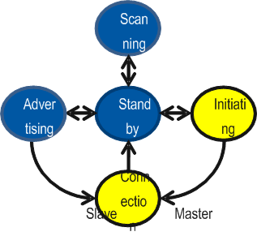
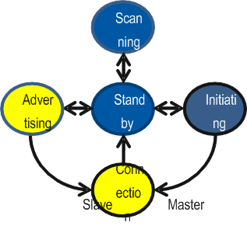
GATT Set-up a LE connection
Notes:
The messages in red are those different to standard BT
ADV_IND connectable undirected advertising event
ADV_DIRECT_IND connectable directed advertising event
ADV_NONCONN_IND non-connectable undirected advertising event

Slide 18
GATT White list
Whitelists are applicable for scan and connect only
Notes:
CSR_BT_GATT_WHITELIST_CLEAR_REQ
CSR_BT_GATT_WHITELIST_READ_REQ
CSR_BT_GATT_WHITELIST_ADD_REQ
The ADV_IND has connectable flag set
LE controller will be in state
Because advertising channels will be “busy” sometimes useful to filter out devices you don’t care about
White List set of devices in advertising packets that will be processed consist of an array of device addresses of a known size

Slide 19
CSR Synergy BT – GATT connection estabilshment - summary
Radio capability of peer devices is present in search results from CSR_BT_SD
Profile/use-case determins if connection shall be set-up on LE or BR/EDR. If BR/EDR is available it should be selected over LE
Simulataneous BR/EDR and LE connection can not present to same device
GATT provides APIs for setting up both LE and BR/EDR connections
When connected, the radio technology is completely transparent to both application and the user
Whitelists are applicable for scan and connect only
Notes:
This a good spot for break
Ex.
Proximity can run on either BT or LE radio
Thermometer is LE only

Slide 20
CSR Synergy BT – GATT server/client
ATT protocol communication
GATT server
Database structure
Example with proximity
Order of steps
What is an ”IRQ” from the database
GATT Client
Work order for initial connect and re-connect
Build local view of remote database
Write client configuration
Service changed

Slide 21
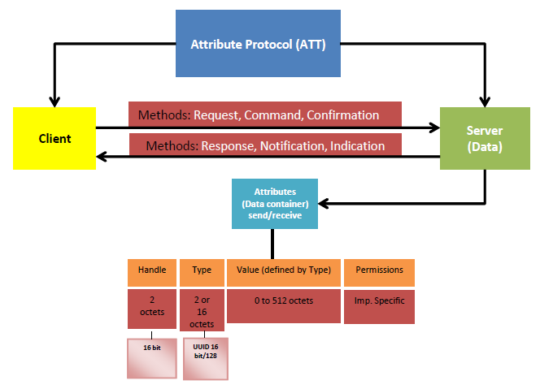
ATT – what protocol is running on this level

Slide 22
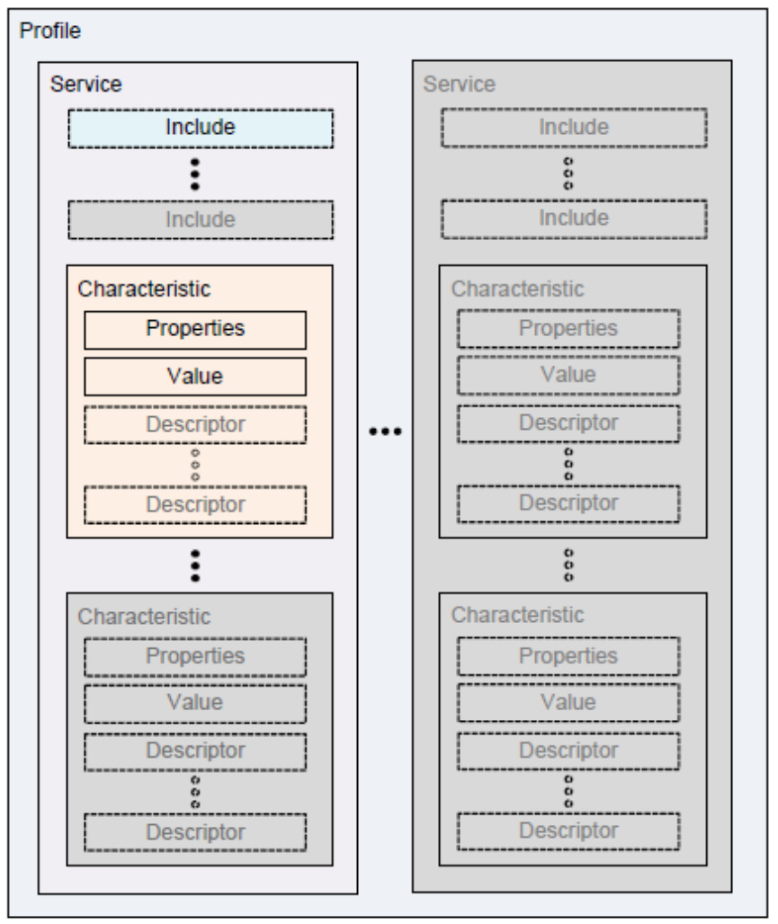
GATT server – Database Structure
GATT specifies the structure in which profile data is exchanged
Profile: Exposes one or more services necessary to fulfil a use case
Service: A collection of one or more data entries – known as characteristics
Characteristics
Declaration
Value
Descriptors
Configuration, description, format, etc.
Notes:
Ex: Proximity profile consist of services: Link Loss, Immediate Alert and Tx Power

Slide 23
GATT server – Database Structure – ex. proximity
Proximity server consists of 3 services
Tx Power Service is exposed in Characteristic Tx Power Level
How to interpret “Tx Power Level” characteristic
 | Proximity Reporter | Proximity Monitor
Link Loss service | M | N/A
Immediate Alert service | C1 | N/A
Tx Power service | C1 | N/A
Characteristic | Optional or Mandatory | Properties | Permissions
Tx Power Level | Mandatory | Read | Authentication
Tx Power Level
The Tx Power Level characteristic represents the current transmit power level in dBm. The level should be in the range from -30 to +20 to a resolution of 1 dBm.
Notes:
Ex: Proximity profile consist of services: Link Loss, Immediate Alert and Tx Power
Services are specified by BT Sig

Slide 24
GATT server – Database Structure – ex. proximity con’t
/********* Tx Power Level Service *********
* Structure:
* Handle | UUID | Value | Permission
* ------------------------------------------------------------------------------------------------------
* 0x0020 | 0x2800 | Primary Service, UUID=0x1804 (Tx Power Level Service) | Read
* 0x0021 | 0x2803 | Charac Descriptor, R, Handle:0x0022, UUID:0xB1E2 | Read
* 0x0022 | 0xB1E2 | 0x12 | Read
*/
value = CsrPmemAlloc(1);
*value = (CsrUint8) 0x12;
attrHandle = CSR_BT_GATT_APP_PROXS_TX_POWER_HANDLE;
head = CsrBtGattUtilCreatePrimaryServiceWith16BitUuid(head,
&attrHandle,
CSR_BT_GATT_APP_TX_POWER_UUID,
FALSE, /* create SDP record */
&tail);
head = CsrBtGattUtilCreateCharacDefinitionWith16BitUuid(head,
&attrHandle,
CSR_BT_GATT_CHARAC_PROPERTIES_READ,
CSR_BT_GATT_APP_TX_POWER_CHARAC_UUID,
CSR_BT_GATT_ATTR_FLAGS_IRQ_READ,
1, /*value size*/
value,
&tail);
Notes:
The attribute flag IRQ_READ mean the value is handled by application. The actual ”Tx Power Level” is only known by controller so application must obtain value from that before replying back to requester.

Slide 25
GATT Server – Work order
Allocate database range
Populate database
Add database
Start peripheral mode to become connectable
When connected, handle your service
IRQ caused by access to elements in DB
Notification/indication
When disconnected
Keep track of characteristic value that bondend devices have set flags for notification or indication. On reconnection they must be notified/indicated with lastest value.
Keep track of changes in DB layout as bonded devices shall be notified with ”Service Changed” on reconnect
On disconnect, goto 4

Slide 26
GATT Client – Work order
Initial connect
Connect
Discover all primary services (by UUID)
For each service of interest do:
Find included service
Discover All Characteristic Descriptors
If service is ok for you
Store layout of remote DB (handles, values) in persistent memory
To avoid use of poll then configure notification/indication in charcteristic if possible
Reconnect – use of notification/indication
Connect
Wait for indication – it is either:
Data in characteristic with notification or indication has changed
Service changed
Indicates that layout of handle range has changed in DB. Re-read DB layout and configure notification/indication accordingly

Slide 27
CSR Synergy BT – GATT server/client - summary
GATT server
Database structure
Example with proximity
Order of steps
Application owns value of DB entries with ”IRQ” flag set
GATT Client
Work order for initial connect and re-connect
Build local view of remote database
Write client configuration
Service changed

Slide 28
Pitfalls
SDP records
Configure value for broadcast
Combination of server and client
Avoid multiple servers
Limitations on simultaneous clients and servers – is it possible to connect while connectable
Client configuration creation and usage. Pitfalls in how to act after power-off
Both clients and servers need persistence storage
What happens when a client disconnect/reconnect, and application has changed DB
Whitelist – connection blocks for other connections
Host power consumption while receiving advertisements

