Slide 1

High Resolution
Digital Weather Forecasts
Glenn Austin & Chris Alex
National Weather Service
Office of Climate, Water, and Weather Services
ANNSTLF Users Meeting
Electric Power Research Institute
Washington D.C.
June 21, 2007

Slide 2
Outline
Need and Concept for Digital Forecasts
Forecast Process
National Digital Forecast Database
  Description
  Standards
  Elements
  Plans
Examples
Accuracy
Contacts for more information

Slide 3
Why Digital Forecasts?
More sophisticated customers
Greater demand for faster access to information
New formats requested
NRC recommendation – “Provide data and products in digital form.” (Fair Weather Report; June 2003)
Modern technologies provide new information exchange pathways
  Web Services
  XML
  GRIB2, html (with decoding to shapefiles, etc)
  Graphical

Slide 4
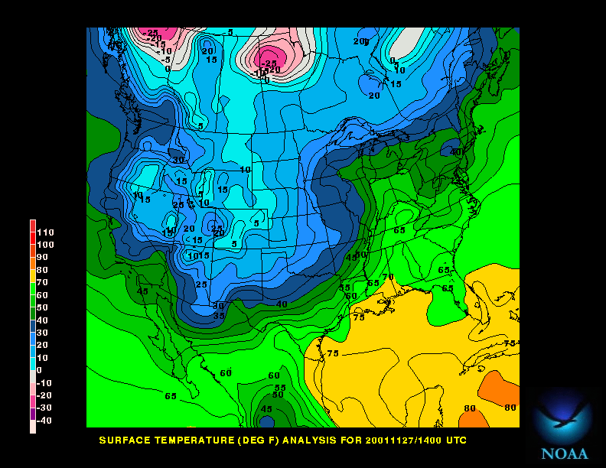
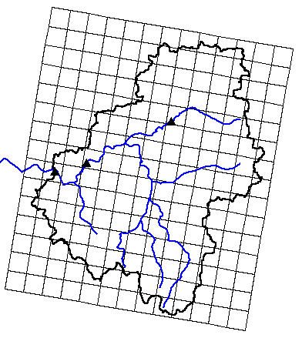
NWS Digital Services Gives Customers What They Want
The public, emergency managers and city planners use
WWW. graphic products for detailed forecasts
  More weather data
  Higher resolution forecasts
  Visual displays of probability
  User-defined products create business opportunities
Different Products for Different Customers
Commercial weather companies & emergency managers use grids to generate tailored products
TODAY...RAIN LIKELY. SNOW LIKELY ABOVE 2500 FEET. SNOW ACCUMULATION BY LATE AFTERNOON 1 TO 2 INCHES ABOVE 2500 FEET. COLDER WITH HIGHS 35 TO 40. SOUTHEAST WIND 5 TO 10 MPH SHIFTING TO THE SOUTHWESTEARLY THIS AFTERNOON. CHANCE OF PRECIPITATION 70%.
Radio stations & public read text forecasts
Notes:
This new process provides numerous benefits to our partners and customers. With a digital forecast database, the NWS can easily expand the range of product types to respond to evolving technological capabilities, from text to graphic to gridded information. Valuable data will be available on demand to satisfy diverse customer needs and provide new business opportunities for the private sector. Probability of occurrence information in visual and digital form supports informed, risk-based decisions for emergency managers, and allows citizens to take actions to mitigate the dangers posed by severe storms and floods.
By working together with our customers and partners through this new forecasting process we will collectively produce weather information that helps keep Americans safe and helps businesses prosper.

Slide 5
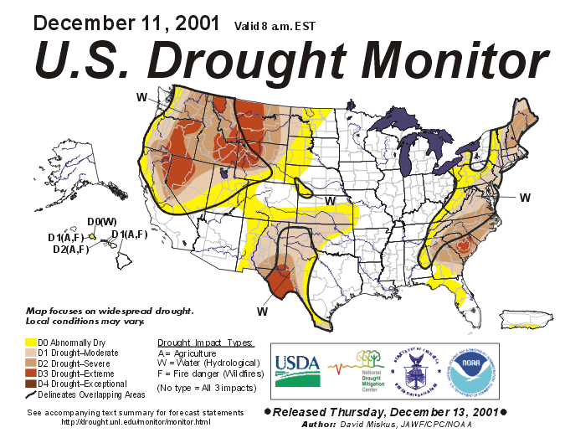
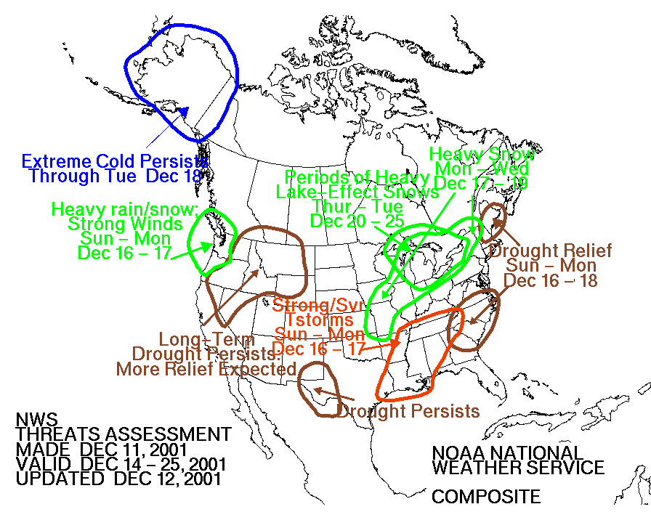
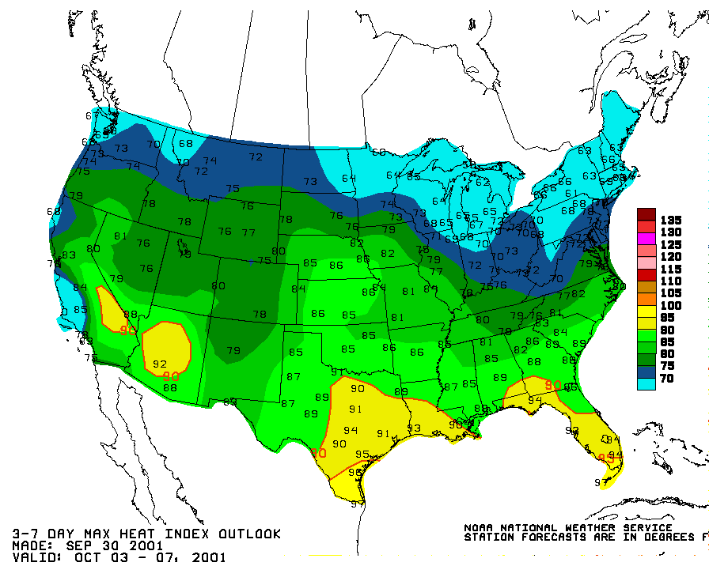
Traditional Forecasting Process
National Centers
Model Guidance
  Schedule Driven
  Product Oriented
  Labor Intensive
Field Offices
Type Text Products
National Centers
Generate Graphical Products
≈≈≈≈≈≈≈≈≈≈≈≈
TODAY...RAIN LIKELY. SNOW LIKELY ABOVE 2500 FEET. SNOW ACCUMULATION BY LATE AFTERNOON 1 TO 2 INCHES ABOVE 2500 FEET. COLDER WITH HIGHS 35 TO 40. SOUTHEAST WIND 5 TO 10 MPH SHIFTING TO THE SOUTHWESTEARLY THIS AFTERNOON. CHANCE OF PRECIPITATION 70%.
U.S. Drought Monitor
Threats Assessments
≈≈≈≈≈≈≈≈≈≈≈≈
≈≈≈≈≈≈≈≈≈≈≈≈
≈≈≈≈≈≈≈≈≈≈≈≈
≈≈≈≈≈≈≈≈≈≈≈≈
≈≈≈≈≈≈≈≈≈≈≈≈
≈≈≈≈≈≈≈≈≈≈≈≈
Excessive Heat Products
MARYLAND EASTERN SHORE
EASTON
PTCLDY CLOUDY PTCLDY PTCLDY SUNNY PTCLDY
60/52 63/54 65/47 55/40 55/37 50/33
POP 20 POP 20 POP 20 POP 20 POP 10 POP 10
Notes:
Here’s how we traditionally create forecasts. Weather models produce guidance for meteorologists at local offices and national centers. Forecasters at our national centers generate a variety of graphical products, and experts at each local office type text products and weather element forecasts for specific locations. With this process, the NWS and our partners and customers are wedded to fixed product formats and schedules. Also, even if our forecasters understand the details of a weather event at higher resolution (in space and time), they are unable to express the full content of this information to the public in words.

Slide 6
New Forecasting Process
National Centers Model Guidance
  Interactive
  Collaborative
  Information Oriented
High Resolution Grids
Local Digital
Forecast
Database
Field
Offices
National
Centers
Collaborate
Data and Science Focus
NWS Automated Products
User-Generated Products
TODAY...RAIN LIKELY. SNOW LIKELY ABOVE 2500 FEET. SNOW ACCUMULATION BY LATE AFTERNOON 1 TO 2 INCHES ABOVE 2500 FEET. COLDER WITH HIGHS 35 TO 40. SOUTHEAST WIND 5 TO 10 MPH SHIFTING TO THE SOUTHWESTEARLY THIS AFTERNOON. CHANCE OF PRECIPITATION 70%.
National Digital
Forecast
Database
Digital
Text
Graphic
Voice
Notes:
The new forecasting process addresses these previous shortcomings and limitations. With this new forecast process, they can produce text, high resolution gridded products and graphics.
Our forecasters will now focus on data and science, rather than product generation and formats. Weather models and data processing tools produce weather element forecasts, such as temperature, rainfall, wind, and clouds on high resolution grids.
We have a true collaborative activity between national centers and local weather offices. Forecasters at our national centers coordinate important changes to weather element grids with our local offices. Experts at each local NWS office fine tune weather grids to account for terrain, land use patterns, population density, and sources of moisture.
We maintain a consistent, high resolution, and easily accessible national digital forecast database updated on a frequent basis for use by both the public and private sectors.

Slide 7
National Digital Forecast Database
  NDFD has been operational since 2004
  Domains:
    CONUS
    Alaska, Hawaii, Guam, Puerto Rico, and the Virgin islands
    16 pre-defined sub-sectors
  Information available electronically:
    Pull via Electronic Dissemination Services over Internet
    Push via dedicated line (cost-recovery fee)
    XML Web Service and Web Feature Service
    Web-based Graphics
    GIS Compatible Formats
    Online Archive Access System
Notes:
NOAA’s NWS successfully met its strategic goal by making forecast information available in digital form beginning in 2004. With the addition of Alaska forecasts in 2006, NDFD now includes digital forecasts for the entire nation.

Slide 8
Database Standards
Local forecast updates are event-driven
Mandatory local update at 2200 UTC (6 pm EDT)
NDFD is updated hourly
Spatial resolution:
  5 km for the CONUS
  2.5 km for Hawaii, Guam, Puerto Rico & the Virgin Islands
  6 km for Alaska
Temporal resolution varies by element
UTC time convention followed
Notes:
Attributes for the local database include:

Slide 9
Elements in NDFD and Their Status
(as of June 2007)
Operational elements:
  Maximum Temperature
  Minimum Temperature
  Temperature
  Dew Point
  Probability of Precipitation
  Weather
  Wind Direction
  Wind Speed
  Apparent Temperature
  Relative Humidity
  Significant Wave Height
  Probabilistic Tropical Cyclone Surface Wind Speeds
Experimental elements:
  Quantitative Precipitation Forecast
  Snow Amount
  Sky Cover
  Wind Gust
  Convective Outlook Hazard Probabilities
    Convective Hazard Outlook
    Probability of Tornadoes
    Probability of Hail
    Probability of Damaging Thunderstorm Winds
    Probability of Extreme Tornadoes
    Probability of Extreme Hail
    Probability Extreme Thunderstorm Winds
    Total Probability of Severe Thunderstorms
    Total Probability of Extreme Severe Thunderstorms
Notes:
Note: Some variability exists in the status of forecast elements for particular regions of the country. The latest status of the elements is available online at www.weather.gov/ndfd/

Slide 10
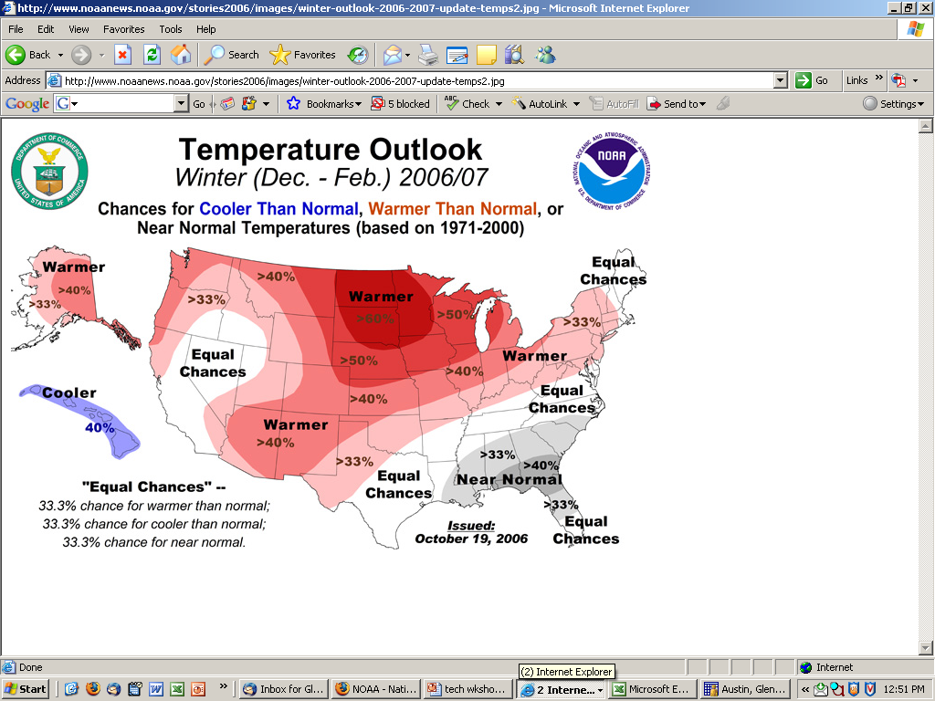
Products Under Development
Climate Outlooks:
  Probability of 8-14 Day Temperature and Precipitation Above/Below Normal
  Probability of 30 Day Temperature and Precipitation Above/Below Normal
  Probability of 90 Day Temperature and Precipitation Above/Below Normal
Notes:
... Climate Prediction Center.

Slide 11
NDFD Evolution:
Focus on High Impact Services
Add experimental WFO Hazardous Weather grids
Increase temporal resolution of many elements in NDFD to one hour
Increase grid-spacing resolution to 2.5 km for CONUS
Add experimental Fire Weather grids
Add experimental Aviation grids
Notes:
A 2005 survey of customers revealed a strong desire from the public for more information on hazardous weather. Thus, before the end of 2007, we will begin to implement the next phase of NDFD-based services. This next phase will focus on increasing the spatial and temporal resolution of the digital database as well as implement new information that will help first responders and others. These enhancements will be designed to compliment the NWS Service Evolution initiative.

Slide 12
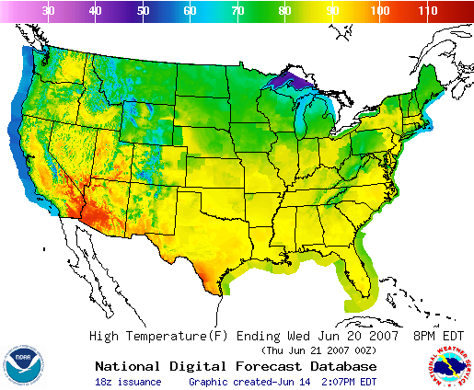
Sample NDFD National Data

Slide 13
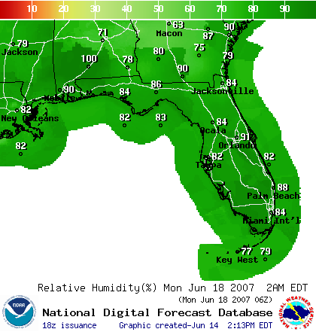
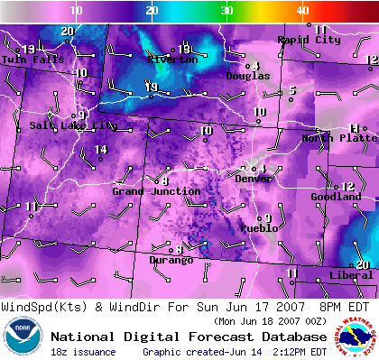
Sample NDFD Data

Slide 14
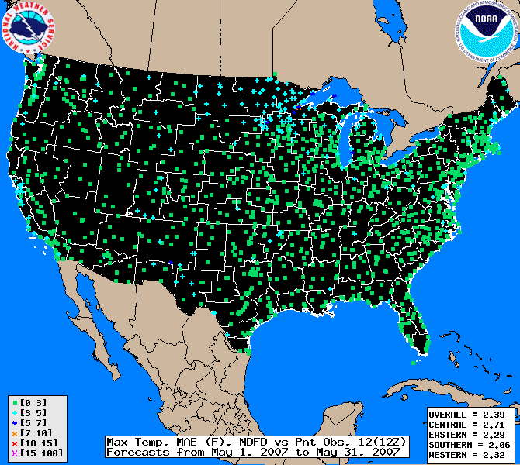
Accuracy http://www.weather.gov/ndfd/verification/

Slide 15
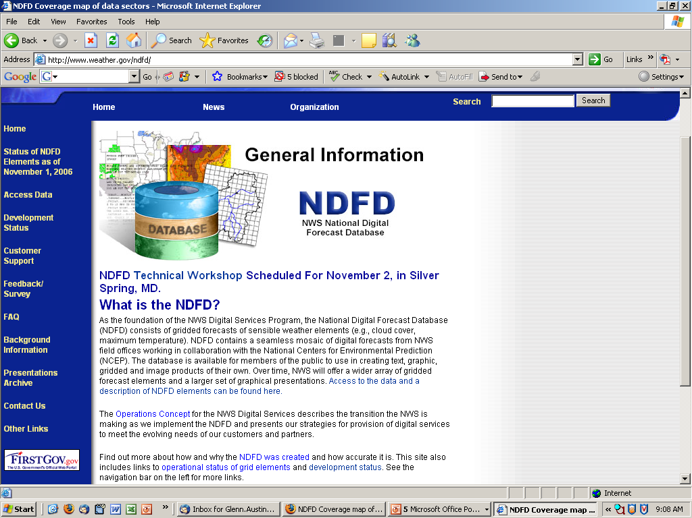
More Information
http://www.weather.gov/ndfd
  NDFD Elements and Associated Temporal Resolution
  NDFD Element Status Table
  How to Access the Data
    Free GRIB2 Decoder & Documentation
    Tutorials
    Using NDFD in GIS Environment
  Customer Information:
    Product Description Documents
    Notices of Changes (aka TINs)
    Links to customer surveys
    Real-time 24x7 customer support for data access
  Plans for Upcoming Changes
  Access to Archived NDFD Data

Slide 16
Contacts
Questions, comments, suggestions, or recommendations:
nws.ndfd@noaa.gov
Contacts:
glenn.austin@noaa.gov
301-713-1858 x 150
christine.alex@noaa.gov
301-713-1858 x 171

