Slide 1
TRACK 3D UNIFORM ELLIPSOID DISTRIBUTION
COMPARISON SC FIEDLS FROM TRACK , ASTRA AND ANALYTIC FORMULAS
J.-P. CARNEIRO FNAL 26-JULY-06
&TRAN
Win =2502.19d06, atp =1.00838D0
nqtot=1
qq= -1.
npat=200000
Qavr=1, Qdesign=1,Adesign=1.00838D0
Amass=1.00838D0
current=45.
db_b=0.000001,df_4D=180.
freqb =325D06, part = 0.995,
epsnx = 0.1, alphx = 0, betx = 15,
epsny = 0.1, alphy = 0, bety = 15,
epsnz = 25, alphz = 0, betz = 40,
phmax=90., dwwmax=0.05
dWWacc=0.05
&end
&INDEX
NRZ=1, igraph=1, iaccep=0, iflag_dis=52, iflag2D=0,iflag_qq=1,
iflag_rms=1, iint=100, nstep_cav=50
iflag_env=1, iflag_cav=0, iflag_ell=0, iflag_fenv=1
iflag_lev=1, isrf=100
iread_dis=0, iflag_corr=0
&end
&OTHER
a_axe=1. b_axe=1. c_axe=2.
&end
1 prmtr harm=1
1 prmtr zlhSC=16
1 prmtr gridSC=65 65 129
1 prmtr outSC=1 0. 0. 0. 1
1 drift .01 4.5 4.5
1 stop
TRACK inputfiles
for generation of a
3D uniform ellispoid
distribution

Slide 2
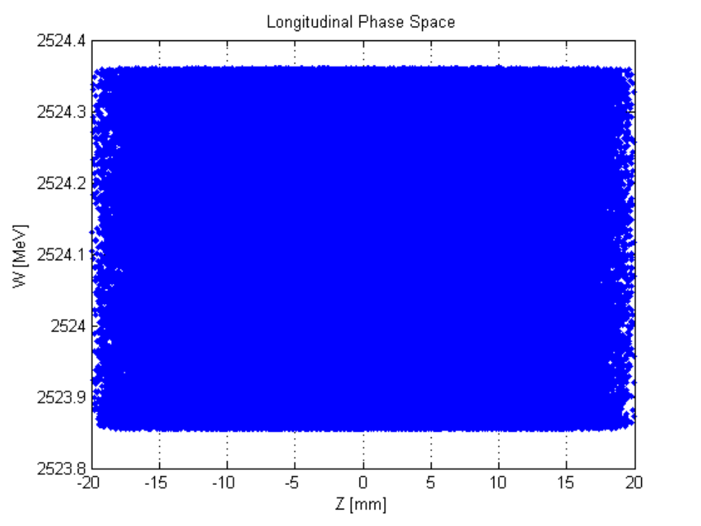
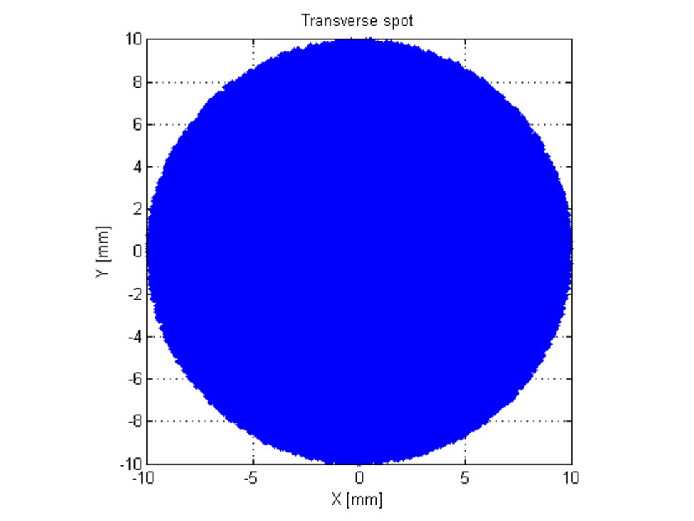
TRACK 3D UNIFORM ELLIPSOID DISTRIBUTION CONVERTED
INTO ASTRA INPUT DISTRIBUTION
longitudinal phase space
symmetric ellipsoid

Slide 3
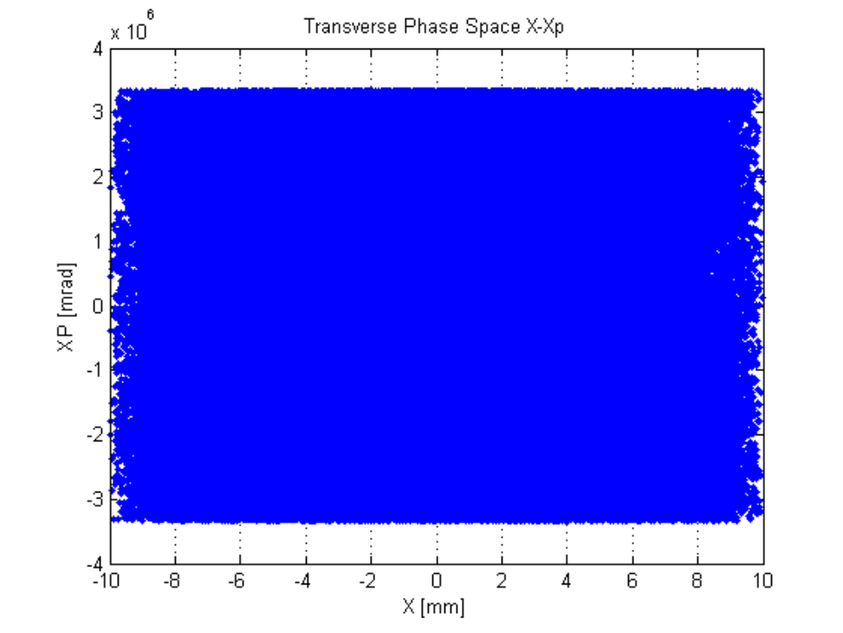
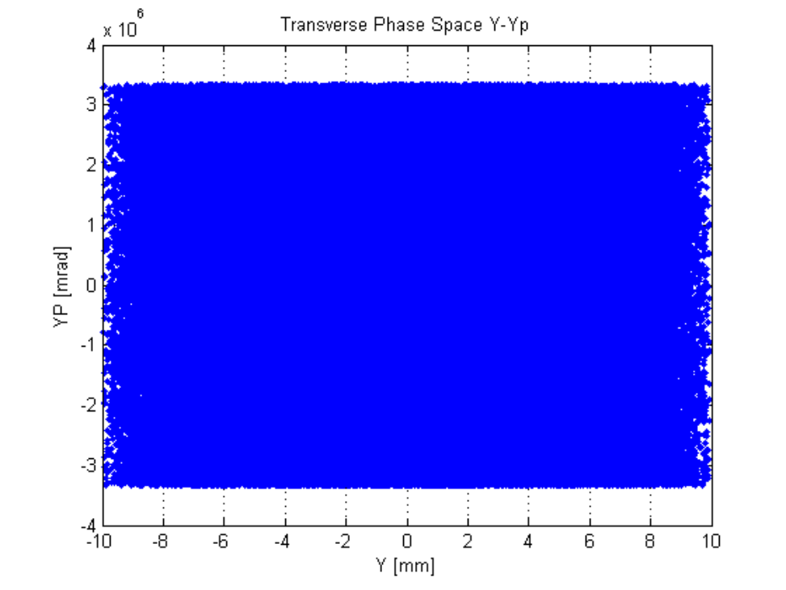
TRACK 3D UNIFORM ELLIPSOID DISTRIBUTION CONVERTED
INTO ASTRA INPUT DISTRIBUTION
transverse phase space

Slide 4
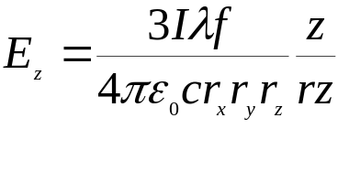
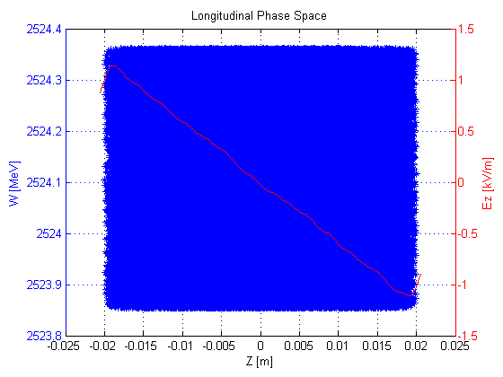
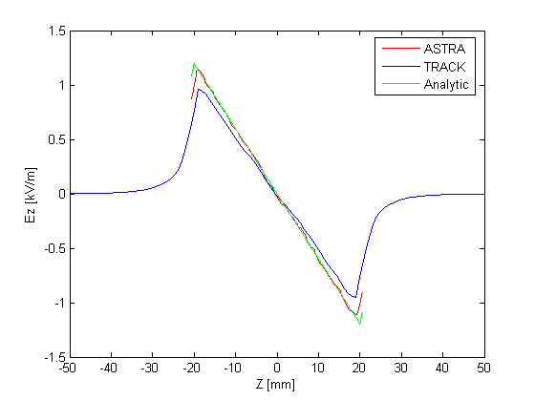
TRACK 3D UNIFORM ELLIPSOID DISTRIBUTION CONVERTED
INTO ASTRA INPUT DISTRIBUTION
longitudinal space charge field
generated by ASTRA
mesh 64×64×128
comparison with analytic formula :
Wangler
p. 277

Slide 5
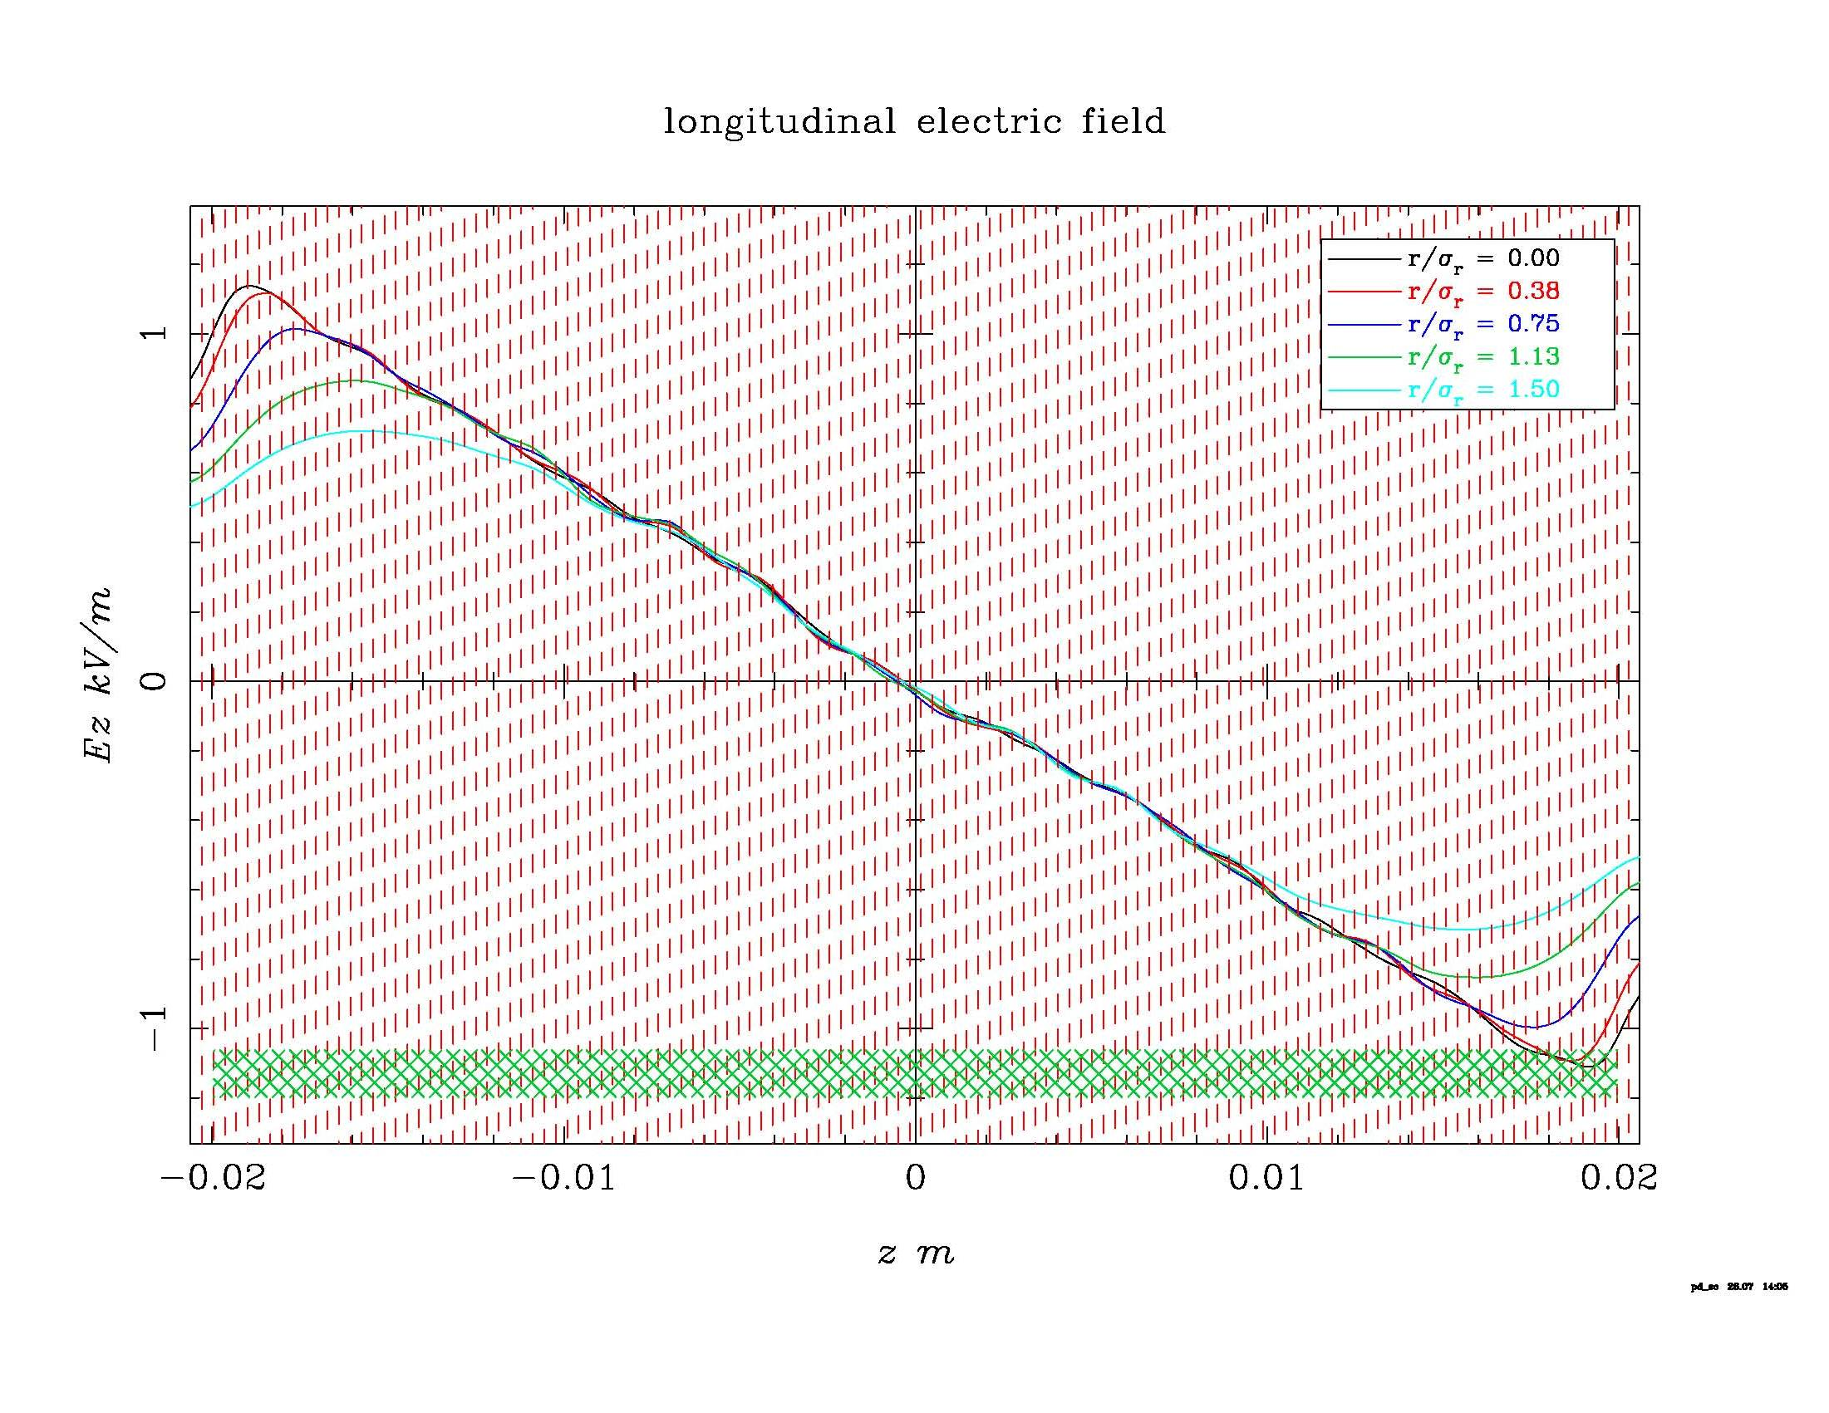
TRACK 3D UNIFORM ELLIPSOID DISTRIBUTION CONVERTED
INTO ASTRA INPUT DISTRIBUTION
ASTRA FIELDPLOT OUTPUT

