Slide 1
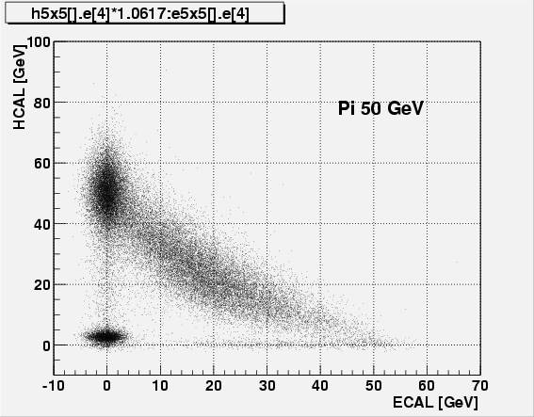
Run 3333

Slide 2
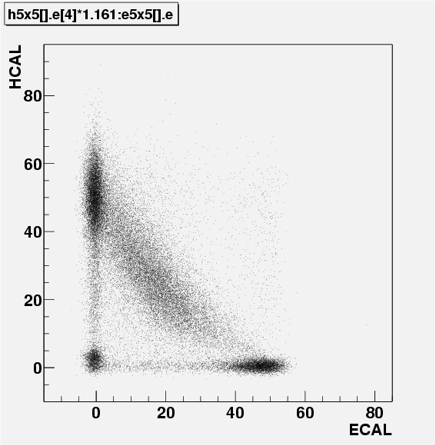
Pi 50 GeV (Run 2493)
phi 5 eta 11
events mismatch ?
electrons ?

Slide 3
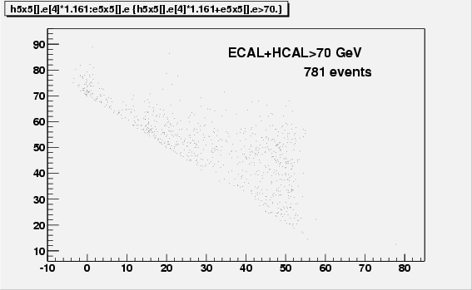
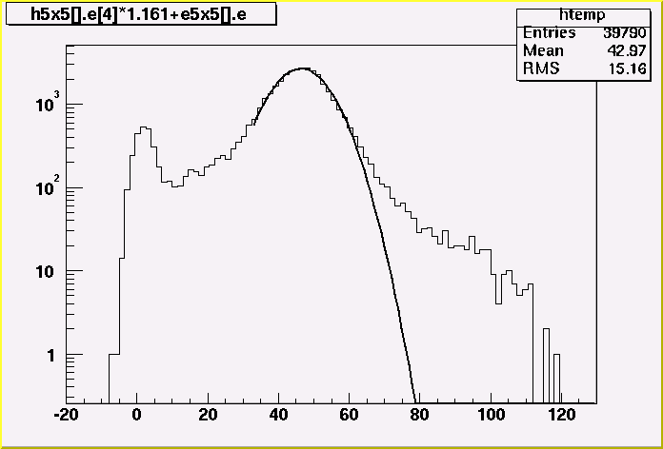
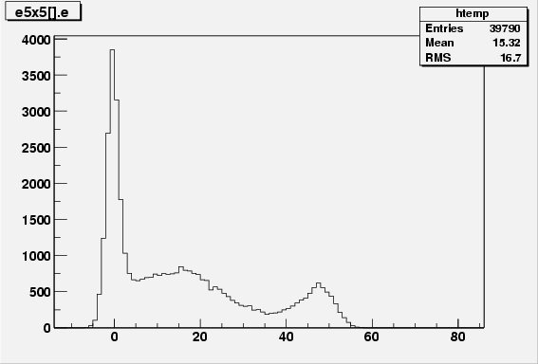
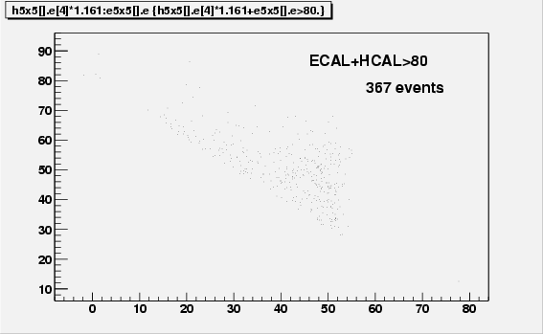
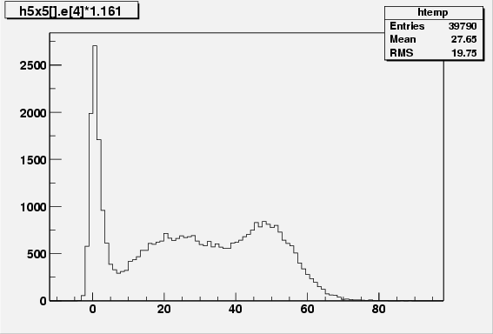
up to 120 GeV
ECAL
HCAL

Slide 4
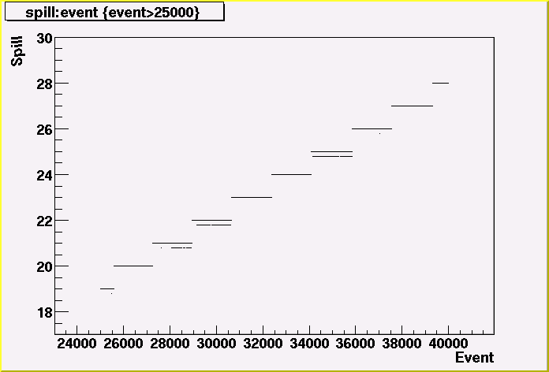
25
E > 80 GeV

Slide 5
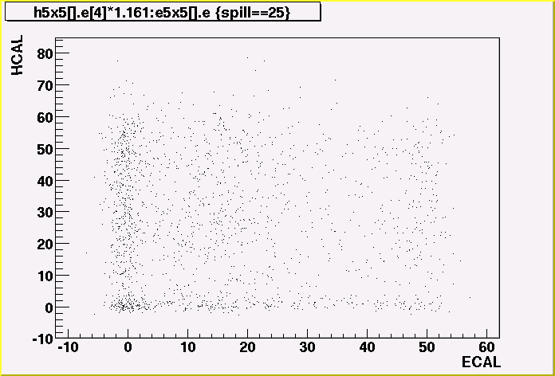
GeV
GeV

Slide 6
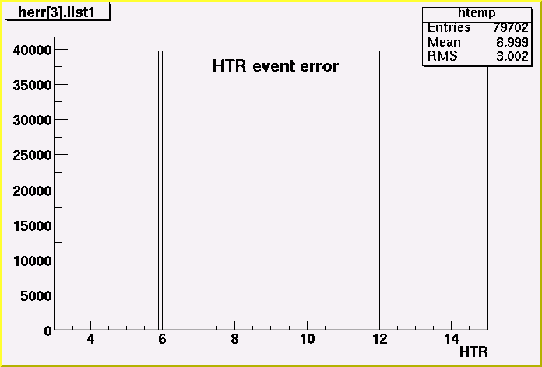
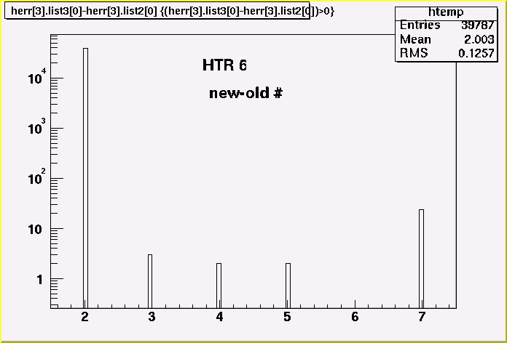
HTR 6&12 event error
for all events in the run !
6
12
Run 2493
phi 5 eta 11
pi 50 GeV

