Slide 1
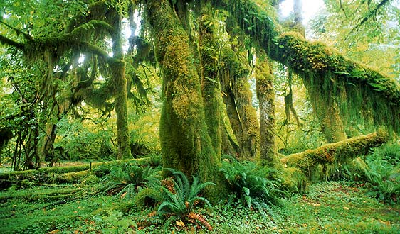
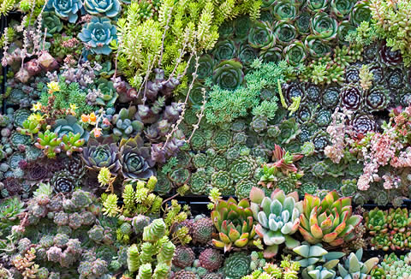
Biodiversity Assignment
Andrew Meade
A.Meade@Reading.ac.uk

Slide 2
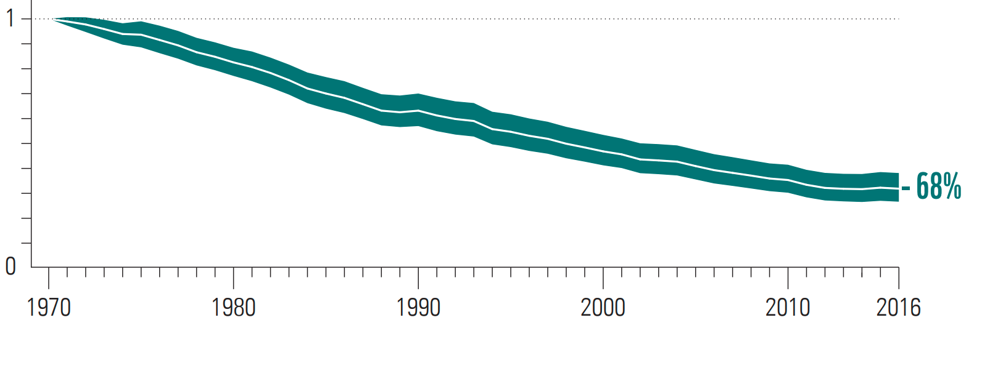
Living Planet Index (LPI) 1970 – 2018*
Living Planet Index (LPI)
Living Planet Index measure of the state of global biological diversity
*WWF - LIVING PLANET REPORT 2020
68% Global decline 1970 - 2016

Slide 3
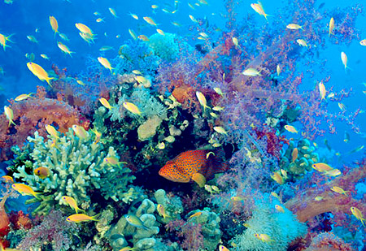
Assessing Biodiversity
Assess biodiversity using python
Part 1: Find the number of animas in a given location - 40%
Part 2: Use google maps / earth to visualise animals at a location - 30%
Part 3: Calculate species numbers at a location - 30%

Slide 4
Data
Global Biodiversity Information Facility (www.gbif.org)
Nearly 2 billion records
65,000 data sets
Assignment file
Mammal.txt 125,000 sightings of mammals (UK)
Birds.txt 250,000 sightings of birds (UK)
Each line of the file contains three pieces of information, separated by tab
Species name
Latitude
Longitude
Myotis nattereri 54.07663633 -1.006446707
Myotis daubentonii 52.52594618 -1.019690469
Dama dama 53.21942887 -1.624792548
Rattus rattus 55.94304686 -4.482137591
Cervus elaphus 52.34144062 0.716034267

Slide 5
CalculateDistance
A function CalculateDistance has been provided for you, it takes four variables, the latitude and longitude of the first location and the latitude and longitude of the second location. It returns the distance in km between the two locations.
For example, to calculate the distance between Exeter (50.7, -3.533333) and Newcastle (54.988056, -1.619444)
CalculateDistance (50.7, -3.533333, 54.988056, -1.619444)
Will return 493.92
NOTE the code supplied for the assignment is not commented to a sufficient level

Slide 6
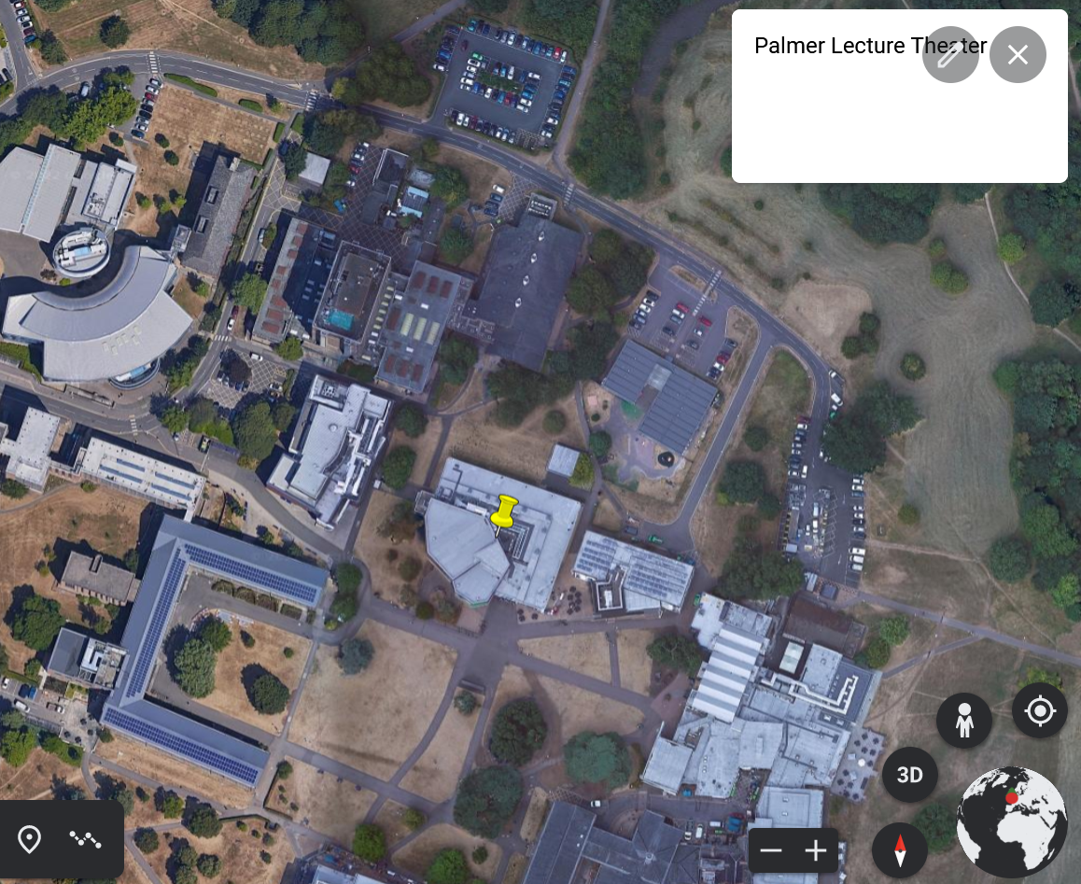
KML files
KML files contain text that describe locations on google earth
Chapter 8 of the handbook describes KML files in more detail
NOTE KML files are horribly and inconsistently case sensitive, be very careful
KML file content
KML file loaded into google earth
<Document>
<Placemark>
<description>Palmer Lecture Theater</description>
<Point>
<coordinates>-0.944283, 51.441378</coordinates>
</Point>
</Placemark>
</Document>
Notes:
display-kml.appspot.com

Slide 7
KML files can contain multiple place markers, the KML file below has three locations.
<Document>
<Placemark>
<description>Palmer Lecture Theatre</description>
<Point>
<coordinates>-0.944283, 51.441378</coordinates>
</Point>
</Placemark>
<Placemark>
<description>Teaching Office</description>
<Point>
<coordinates>-0.941968, 51.437728</coordinates>
</Point>
</Placemark>
<Placemark>
<description>Queens Head</description>
<Point>
<coordinates>-0.956619, 51.443092 </coordinates>
</Point>
</Placemark>
</Document>

Slide 8
Code commenting
Your code for the assignment needs to be commented.
Annotate a program
Quickly understand the purpose of a program
Documents the use of a program
Higher level information than the code
Comment start with #
They are ignored by python

Slide 9
How to comment in Python – Tips and best practices
https://www.androidauthority.com/how-to-comment-in-python-1138055/
When and how to comment in Python
Some common and useful captions to add to your code include:
A little bit about any new function and what it does
An explanation of what a variable or set of variables are for
Explaining why you have done something a certain way (if it is not obvious)
Highlighting key and important parts of your code
Providing warnings
Some useful tips for keeping comments helpful rather than distracting:
Keep comments succinct and no longer than necessary – be respectful of your reader’s time!
Avoid comments that state the obvious; don’t over comment
Don’t just explain what something does: explain why you put it there and why it’s important
Be polite and friendly! Absolutely do not use comments to shame other coders. That’s a quick way to become the least popular person on your team.

Slide 10
Before you start
Understand the key programming concepts
Variables, if, loops, lists, functions, files
Complete the worksheets
Understand the Assignment brief

Slide 11
Best of Luck!

