Slide 1
NEMDC
Tracability from Code to Design/WSDL/Swagger
v0.2
1

Slide 2
Tracability
Problem: NEM was recently were asked to find the corresponding WSDL for a service deployed to prod. This took longer that it should have.
Since the designs are only read by the developers and some components don’t need copies of the corresponding WSDLs + Swaggers the tracability between the deployed code and these artefacts is not consistently stored.

Slide 3
Solution
Create a “trace.txt” file in each project folder containing the below info, check into RTC.
Whenever swaggers or WSDL is taken from RTC for the build teams/ to embed in documents. The design team must create a snapshot to ensure the version can be recorded unambiguously
Applies to BPM processes, IIB services, ODM Rules, Datapower on ramp decorators
# Copy this file to trace.txt in the base folder of the project (same directory as ".project" file)
# Replace the <items> with the values for your component, remove those which do not apply
# Multiline entries can be made as follows.
# DesignChangesNotInDesign= This is a multiline \
# Entry for changes not in \
# Design
# Valid entries are
# DesignDocument=<sharepoint link to Design>
# DesignChangesNotInDesign=<Note any changes which are pending in design document at time of work>
# WSDLSnapshot=<RTC snapshot link to WSDL>
# SwaggerSnapshot=<RTC snapshot link to Swagger>
#
DesignDocument=<sharepoint link to Design>
DesignChangesNotInDesign=<Note any changes which are pending in design document at time of work>
WSDLSnapshot=<RTC snapshot link to WSDL>
SwaggerSnapshot=<RTC snapshot link to Swagger>

Slide 4
Process/Responsibilities
Design
Designer Adds Trace.txt details to design appendix
Development
Developer copies trace.txt details into RTC
DTF
Build scripts snapshots trace.txt alongside other source files during build
The design team would create the details in the trace.txt file and add to an appendix in the design document. There would be one per operation in ESB services, one per flow for BPM, one per rule for ODM . The same one would be used for datapower on ramp decorators if the ESB/BPM is exposed externally. The design team will need to snapshot the design stream and link to the WSDL/swagger file in the snapshot to ensure the exact same set of source files are found when following the link. Linking without snapshotting will mean the latest version is found which may not be the version desired.
The developer would copy the details from the design into a trace.txt file in the root directory of the project corresponding to the new/changed operation.
If the developer is making changes ahead of design changes, this can be noted in the trace.txt file
The DTF scripts snapshot the trace.txt file in RTC as part of the build
process. The UCD component creation scripts push the snapshot
name into UCD component versions.

Slide 5
Tracing mechanism
In UCD:
locate the component in the environment
Click the version
Click show details
Click Build Result
Click Snapshot
In RTC (build stream):
Choose the component and locate the project for the service
Download the artefact trace.txt
From the trace.txt:
Follow link to design (sharepoint)
Follow link to swagger/WSDL (RTC)
In RTC (design stream):
For the swagger/WSDL the file can be examined
in the RTC web client or downloaded.

Slide 6
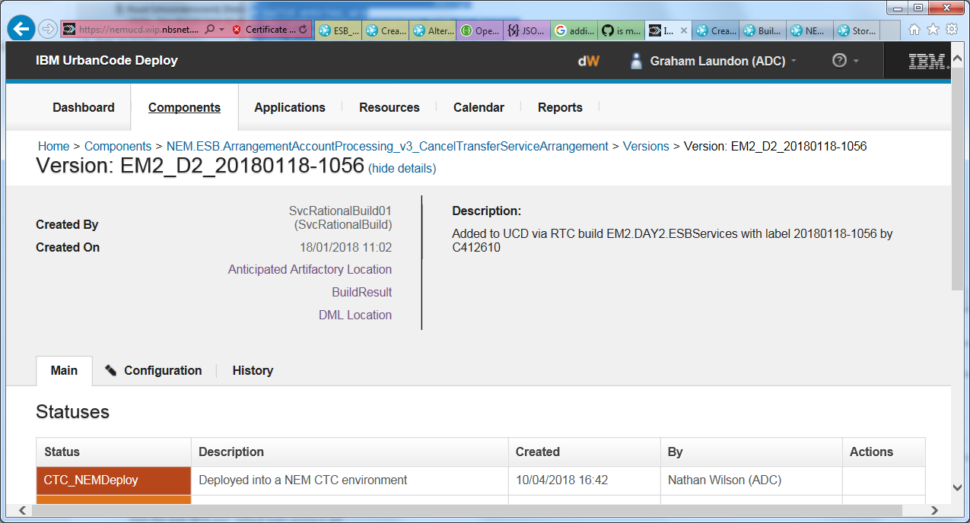
Extending the solution
When the components are imported into UCD the links/info from the “trace.txt” can be added as “links” to the component version. This way whenever anyone logs into UCD and looks at an environment they can go from the component version to the Design/Swagger with a click. This would make the traceability simpler at a cost of complicating the component creation scripts. The format of the trace.txt file is that of a java properties file, to make this extension as simple as possible if adopted in the future.
UCD:
Locate the component in the environment
Click the version
Click show details
Click <design document/swagger/WSDL link>

Slide 7
Limitations + Potential further extension
Limitations
Solution requires the designer to create and correctly update the ‘trace.txt’ file in the design document, then the developers to update it. This should be checked as part of design/code review, but is subject to human error
The sharepoint links are fragile, and will break if objects move in sharepoint.
Rigorously consistency in the trace.txt file text and location is needed in the project file to allow automated handling
For services deployed in the legacy manner to the ESB with one .bar file for several operations this will not be possible. This will make tracing only possible if the execution group where the component is deployed is already know. Currently this varies environment to environment.
Further extension
Could also link to centrasite service definitions
Some validation of the trace.txt links could occur during the build or RTC check in phase.

Slide 8
Recommendation: KISS
Initially do the minimum to make tracability possible. Consider the extension options at a later date if tracing is frequently required or proves useful.
Recommendation:
Designers create trace.txt in design appendixes. This will be validated as part of design review.
Developers add trace.txt in project folders, this will be validated in code review.
Action
Pick a service prove this works and document process
Communicate change to developers and design team
Add to design template
Design review checklist
Code review checklist

