Slide 1
NEMDC
REST Types Guidance
Graham Laundon, Denis Baltor
v0.3
1

Slide 2
Common Patterns
Currency Amounts
Define a CurrencyAmount object with 2 string elements: amount and currency. Never use a float/double (because of potential rounding issues). Always have a fixed number of decimal places, so £100 appears as £100.00. Never include thousands separators like “,” comma in the pattern. Never include the currency symbol like £ in the pattern. The description of the field should clearly specify the currency. Example: up to 22 digit integer currency amount with up to 6 decimal places ‘^\d{1,22}\.\d{1,6}$’
Examples of this pattern (string with base units) :
Google Wallet
Paypal
Amazon Payments
The Currency Cloud
Braintree
2checkout
GoCardless
Paynova

Slide 3
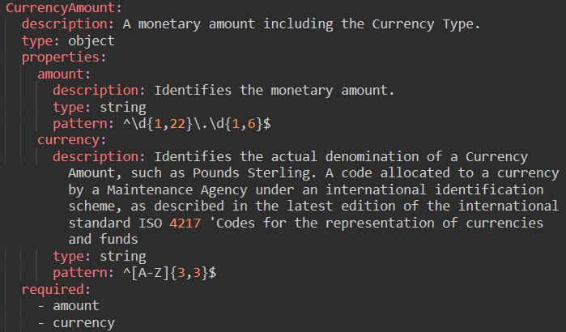
Common Patterns
Currency Amounts (string with base units)

Slide 4
Common Patterns
Numbers
IDs (e.g. customer number) : Use a string with a pattern format, not a number. This avoids ambiguity when the first digit is 0. Example: Involved Party ID - fixed 10 digit ID ‘^\d{10}$’ matches 0123456789
Actual integer numbers (e.g. count of monthly direct debits) on which the consumer may perform maths, use integer (int32, int64 formats), do not use strings with patterns for these.
Float & doubles should rarely be needed and should be avoided. Currency amounts should never be held in these fields.
Strings
When using a pattern to constrain use maxLength, and minLength to limit the size. This is easier to interpret than lengths encoded in regExs in the pattern.
Others (date, dateTime, boolean, byte, binary)
Follow the Swagger guidance as per next slide.

Slide 5
REST base types guidance
Common Name | type | format | Comments | Guidance
integer | integer | int32 | signed 32 bits | can be + or -, max is 2,147,483,647
long | integer | int64 | signed 64 bits | cab be + or -, max is 9,223,372,036,854,775,807
float | number | float |  | Not for normal use. Use by exception only
double | number | double |  | Not for normal use. Use by exception only
string | string
byte | string | byte | base64 encoded characters | Preferred choice for binary data
binary | string | binary | any sequence of octets
boolean | boolean
date | string | date | As defined by full-date - RFC3339 | e.g. 2018-06-18
dateTime | string | date-time | As defined by date-time - RFC3339 | e.g. 2018-06-18T11:30:20Z
Password | string | password | Used to hint UIs the input needs to be obscured. | Not for normal use. Use by exception only

