Slide 1

Access Specifiers
Integrative Programming
AY 2024 - 2025 2nd Semester

Slide 2

Outline:
Base Class
Derived Class
Public Specifiers
Private Specifiers
Protected Specifiers

Slide 3
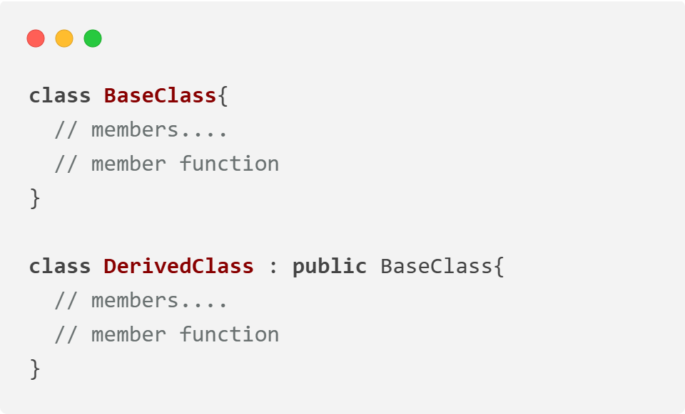
Base Class vs Derived Class
Base Class: A base class is a class in Object-Oriented Programming language, from which other classes are derived. The class which inherits the base class has all members of a base class as well as can also have some additional properties. The Base class members and member functions are inherited to Object of the derived class. A base class is also called parent class or superclass.
Derived Class: A class that is created from an existing class. The derived class inherits all members and member functions of a base class. The derived class can have more functionality with respect to the Base class and can easily access the Base class. A Derived class is also called a child class or subclass.

Slide 4
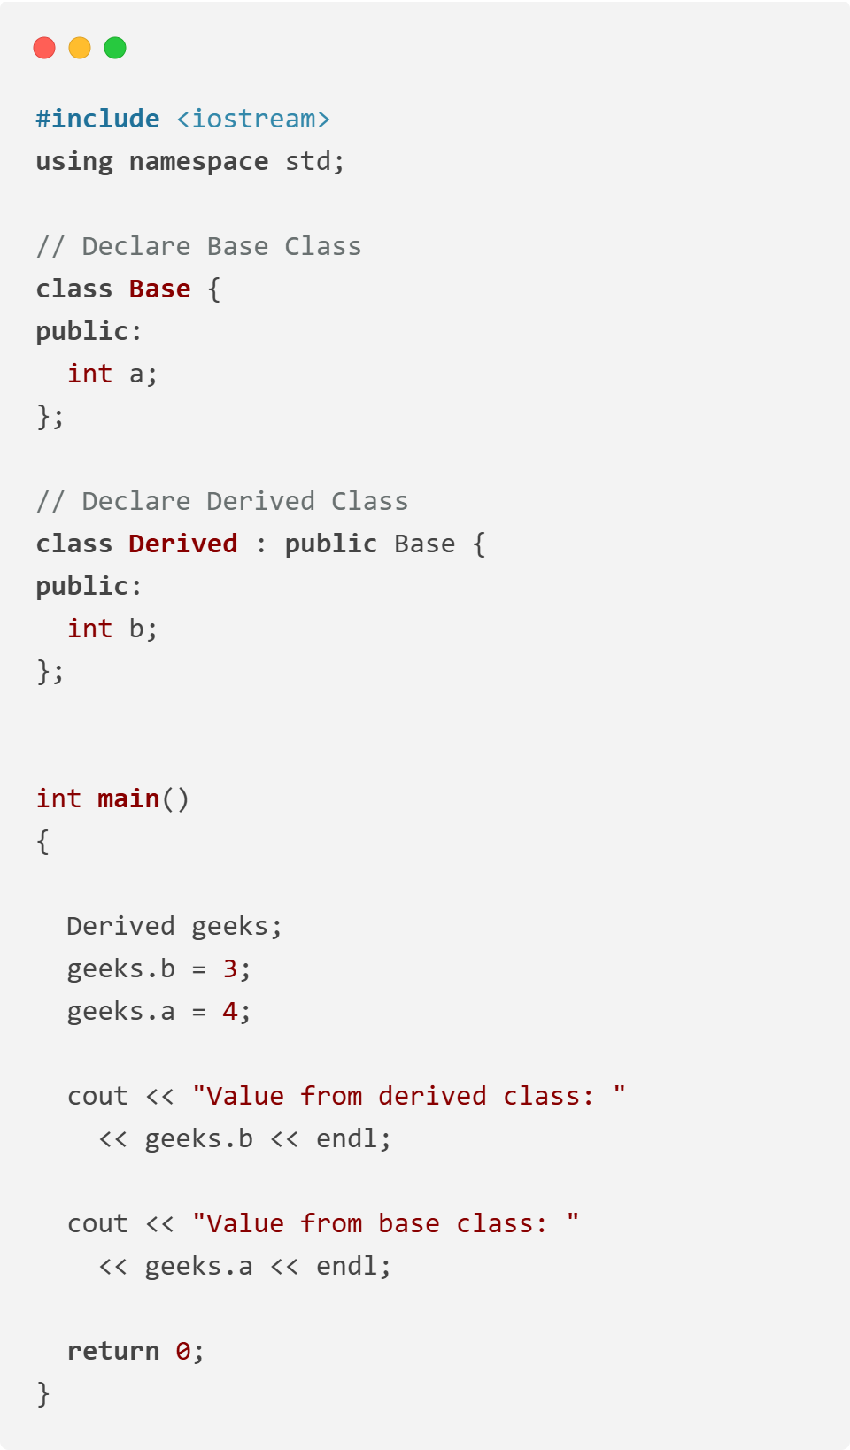
Base Class vs Derived Class

Slide 5
Access Specifiers
Access modifiers are used to implement an important aspect of Object-Oriented Programming known as Data Hiding.
Why do we need access specifiers in C++?
Access specifiers help control data access and ensure encapsulation, preventing unintended modifications and enforcing security.
Imagine a BankAccount class where all data members are public. This allows direct access to sensitive information, leading to potential security risks. Now, let's use private members and provide public methods (getters & setters) to protect sensitive data.
There are 3 types of access modifiers available in C++:
Public
Private
Protected

Slide 6
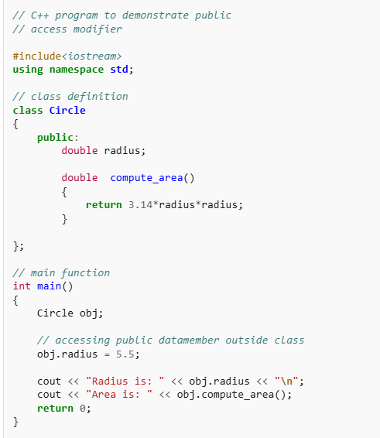
Public Specifiers
Public: All the class members declared under the public specifier will be available to everyone. The data members and member functions declared as public can be accessed by other classes and functions too. The public members of a class can be accessed from anywhere in the program using the direct member access operator (.) with the object of that class.

Slide 7
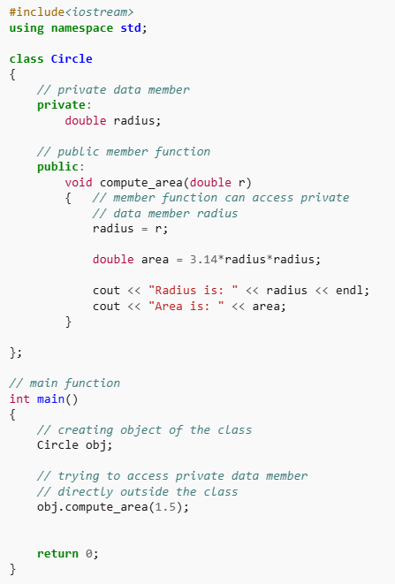
Private Specifiers
2. Private: The class members declared as private can be accessed only by the member functions inside the class. They are not allowed to be accessed directly by any object or function outside the class. Only the member functions or the friend functions/ friend class are allowed to access the private data members of the class.

Slide 8
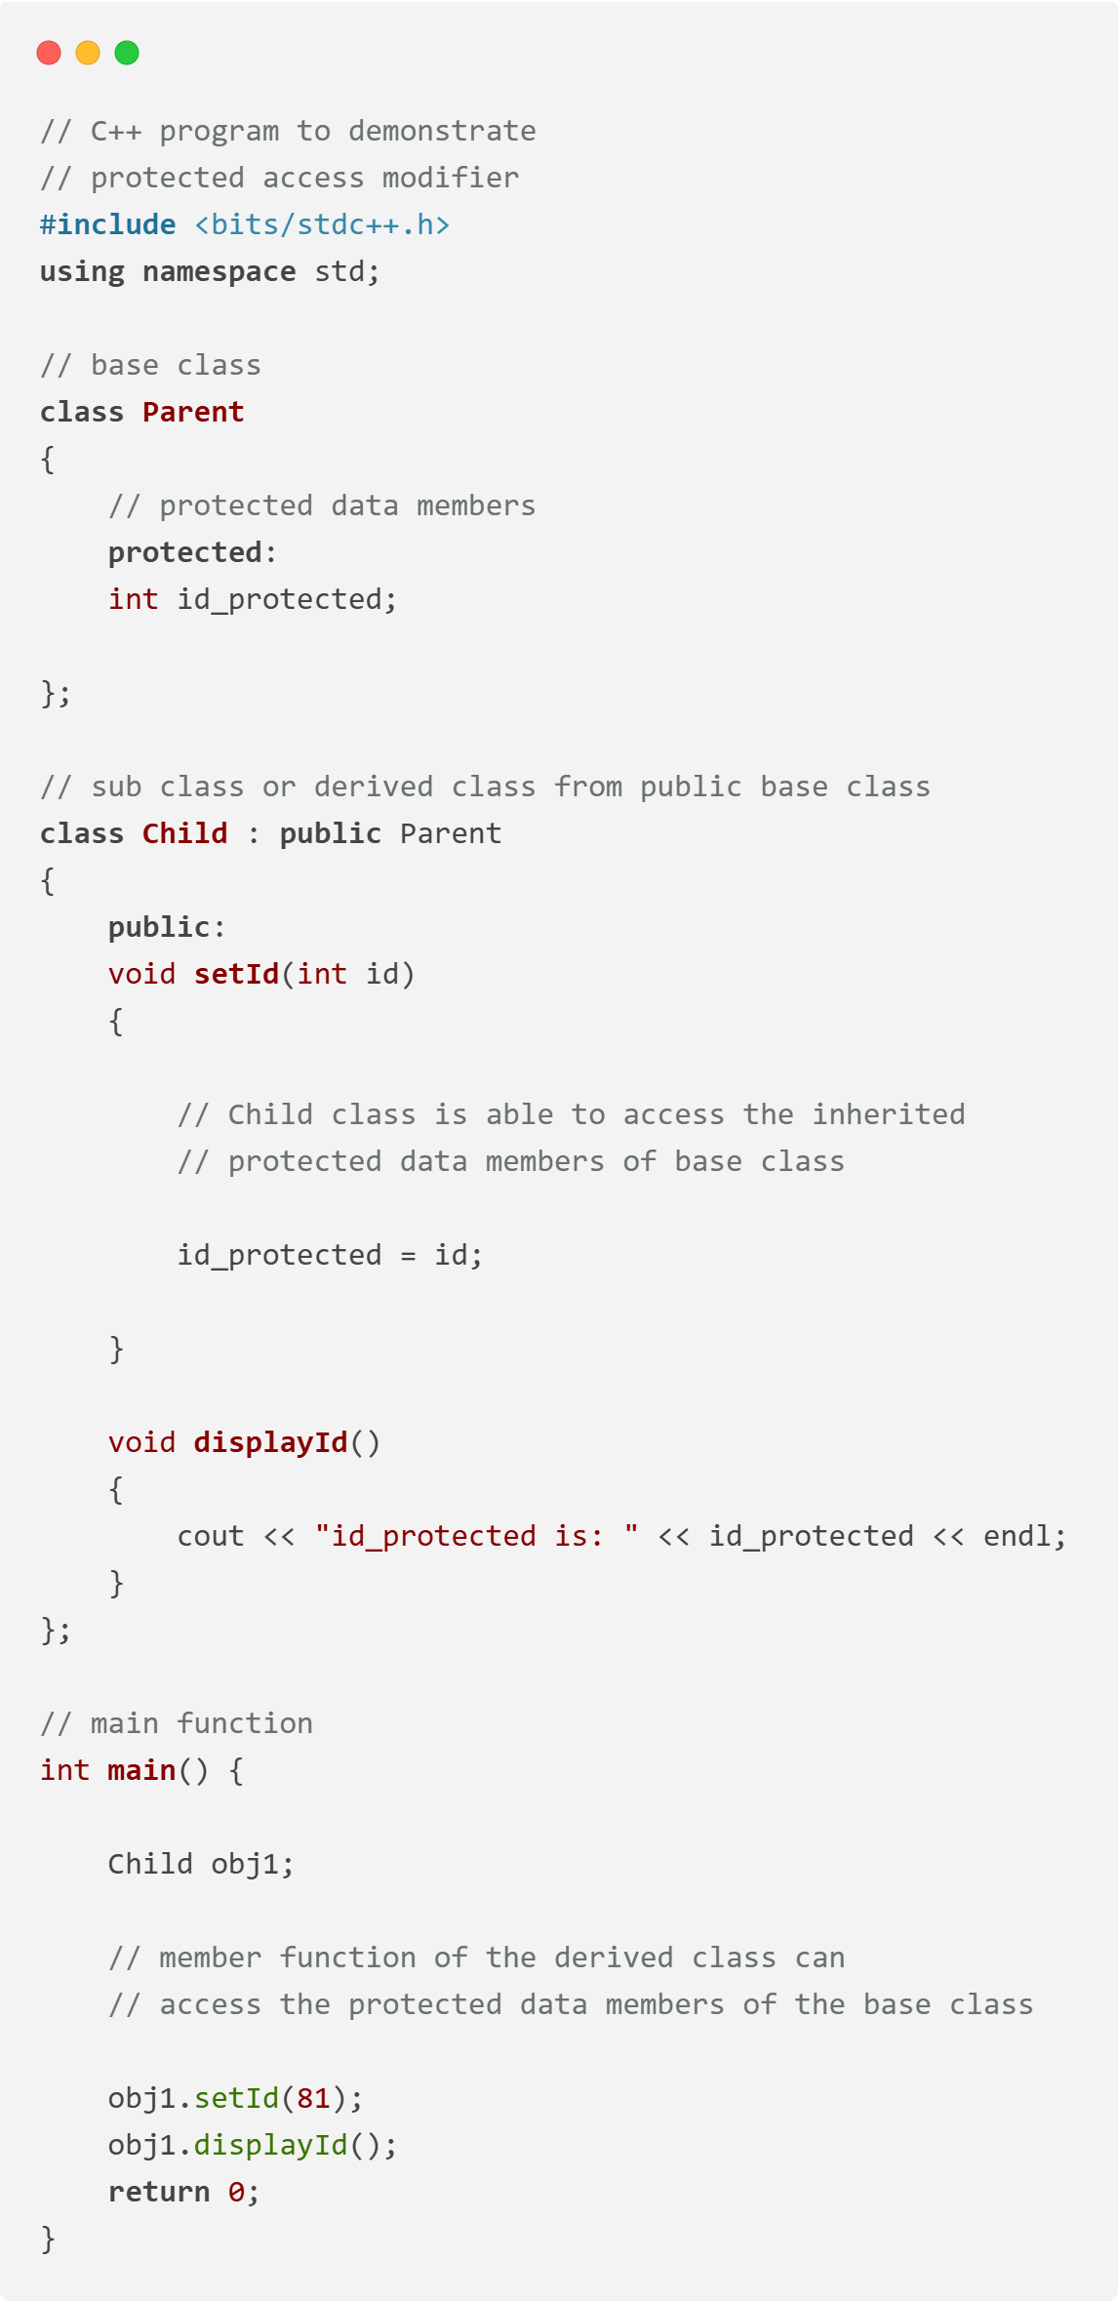
Protected Specifiers
3. Protected: The protected access modifier is similar to the private access modifier in the sense that it can’t be accessed outside of its class unless with the help of a friend class. The difference is that the class members declared as Protected can be accessed by any subclass (derived class) of that class as well.

Slide 9
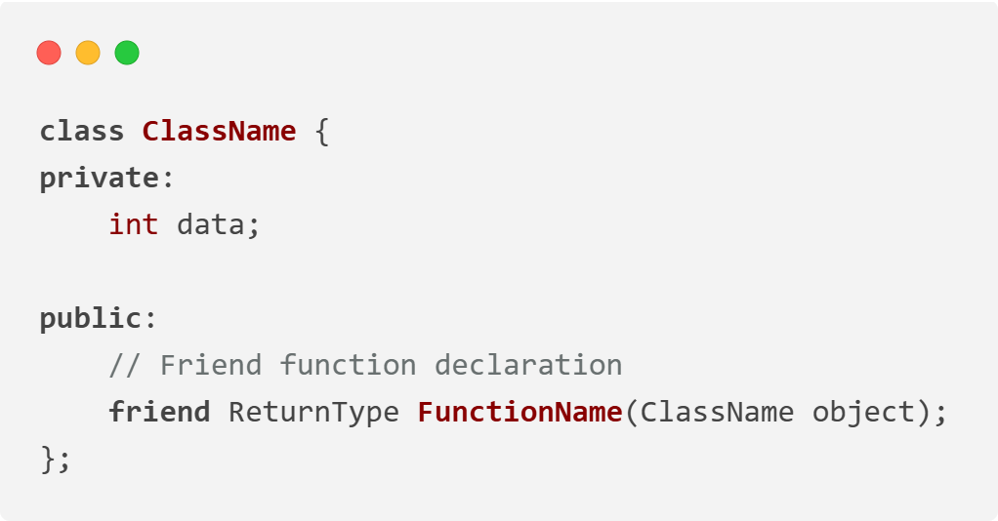
Friend Functions
A friend function can be granted special access to private and protected members of a class in C++. They are not the member functions of the class but can access and manipulate the private and protected members of that class for they are declared as friends.
It is declared using the friend keyword inside the class.
It can be a global function or a member function of another class.
General Syntax

Slide 10
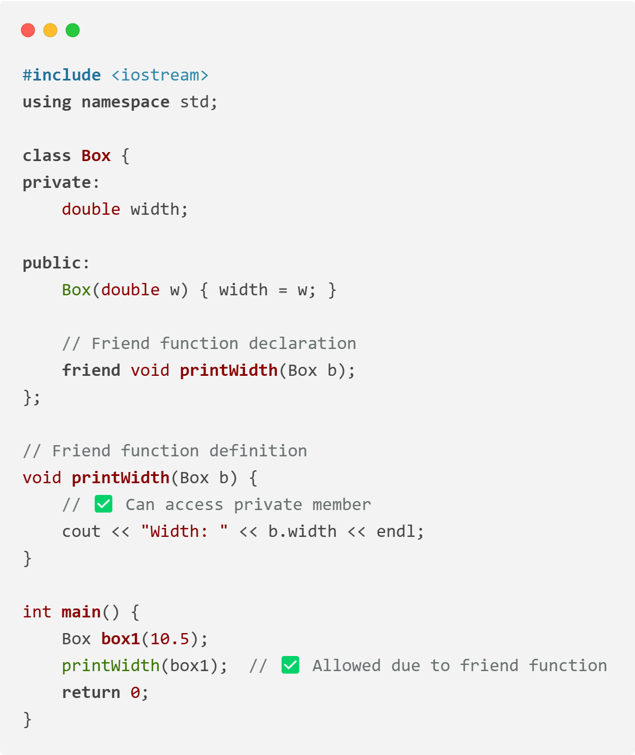
Friend Functions

Slide 11


