Slide 1

INTEGPROG
Integrative Programming
AY 2024 - 2025 2nd Semester

Slide 2

Outline:
Constructor
Destructor

Slide 3
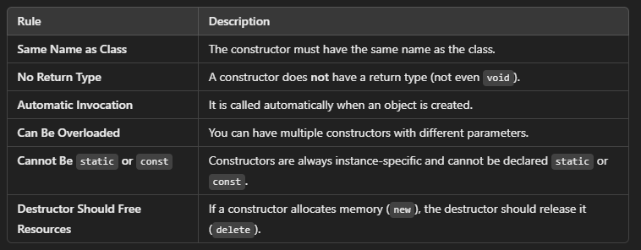
Constructor
Constructor in C++ is a special method that is invoked automatically at the time an object of a class is created. It is used to initialize the data members of new objects generally. The constructor in C++ has the same name as the class or structure. It constructs the values i.e. provides data for the object which is why it is known as a constructor.
Rules in declaring constructor:

Slide 4
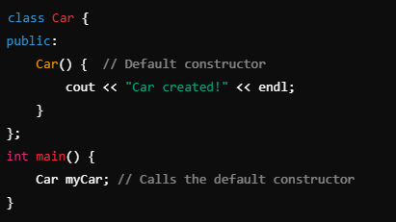
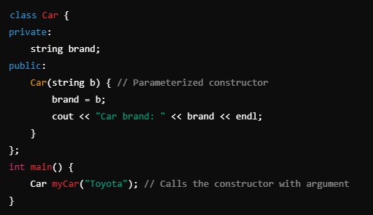
Types of Constructor
1. Default Constructor (No Arguments) A constructor that takes no parameters and initializes default values.
2. Parameterized Constructor. A constructor that accepts parameters for object initialization.

Slide 5
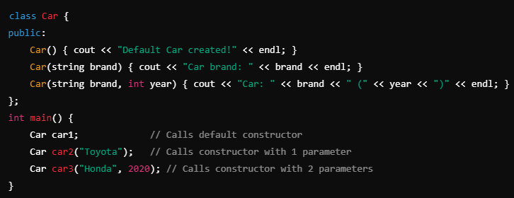
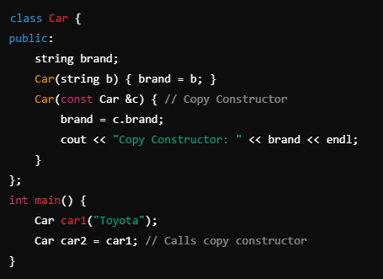
Types of Constructor
3. Constructor Overloading. Multiple constructors with different parameters.
4. Copy Constructor. Creates a new object as a copy of an existing object.

Slide 6
Destructors
A destructor is a special member function in C++ that is automatically called when an object goes out of scope. It is primarily used for cleaning up resources such as dynamically allocated memory, file handles, or network connections.
Rule | Description
Same Name as Class | The destructor must have the same name as the class, prefixed with a ~ (tilde).
No Parameters | A destructor cannot take any arguments.
No Return Type | A destructor does not return a value (not even void).
One Per Class | You can have only one destructor per class (cannot be overloaded).
Called Automatically | The destructor is automatically invoked when an object goes out of scope.
Runs in Reverse Order | If multiple objects are created, destructors are called in reverse order of their creation (Last-In, First-Out).
Cannot Be const, volatile, or static | Destructors cannot have these modifiers.

Slide 7
Destructors
A destructor is automatically called when:
A local object goes out of scope (at the end of a function).
A dynamically allocated object is deleted (delete obj;).
A container object (like vector<Car>) is destroyed, calling destructors of its elements.
Program execution ends, cleaning up global/static objects.

Slide 8
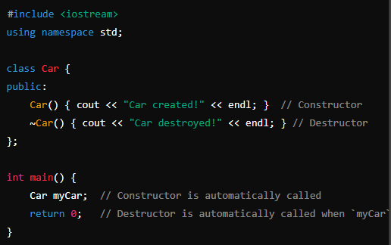
Destructors

Slide 9
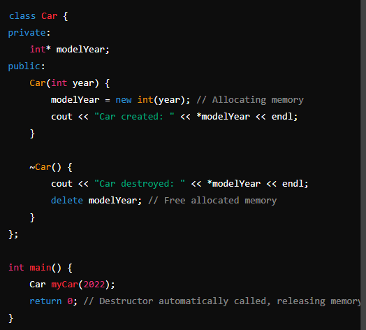
Destructors
Destructor with Dynamic Memory Allocation

Slide 10


