Slide 1

Encapsulation
Integrative Programming
AY 2024 - 2025 2nd Semester

Slide 2

Outline:
Encapsulation
Implementation of Encapsulation

Slide 3
Encapsulation
Encapsulation is the process of hiding data and only allowing controlled access through methods (getters and setters). It ensures that the internal representation of an object is hidden from outside interference.
Two Important property of Encapsulation
Data Protection: Encapsulation protects the internal state of an object by keeping its data members private. Access to and modification of these data members is restricted to the class’s public methods, ensuring controlled and secure data manipulation.
Information Hiding: Encapsulation hides the internal implementation details of a class from external code. Only the public interface of the class is accessible, providing abstraction and simplifying the usage of the class while allowing the internal implementation to be modified without impacting external code.

Slide 4
Implementation of Encapsulation
Encapsulation is achieved using access specifiers (private, protected, public) and getter and setter functions.
Steps to Implement Encapsulation
Declare data members as private to restrict direct access.
Provide getter functions to retrieve private data.
Provide setter functions to modify private data with validation.
Use public methods to expose functionality safely.

Slide 5
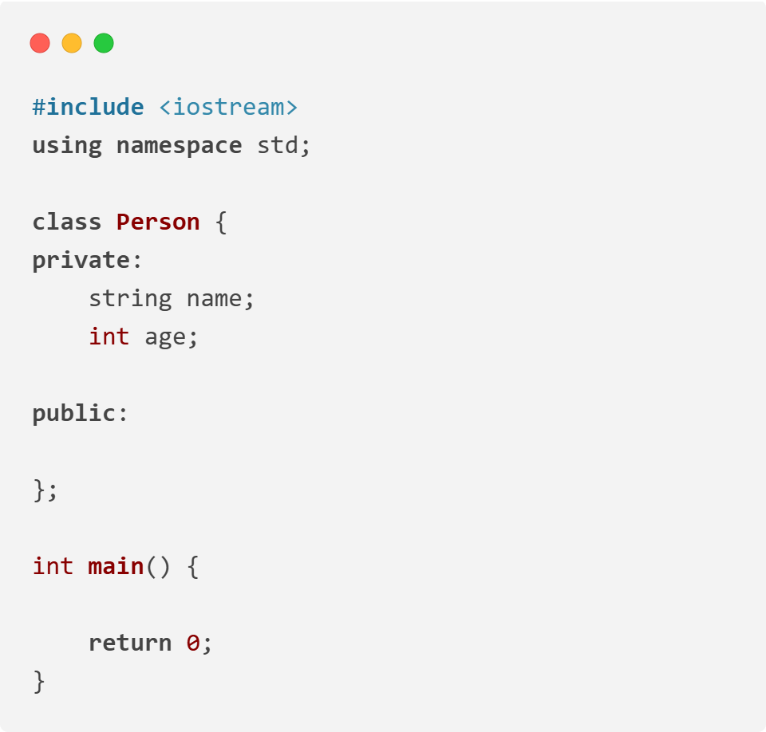
Implementation of Encapsulation
// Program that get person name and person age
1. Declare data members as private to restrict direct access.

Slide 6
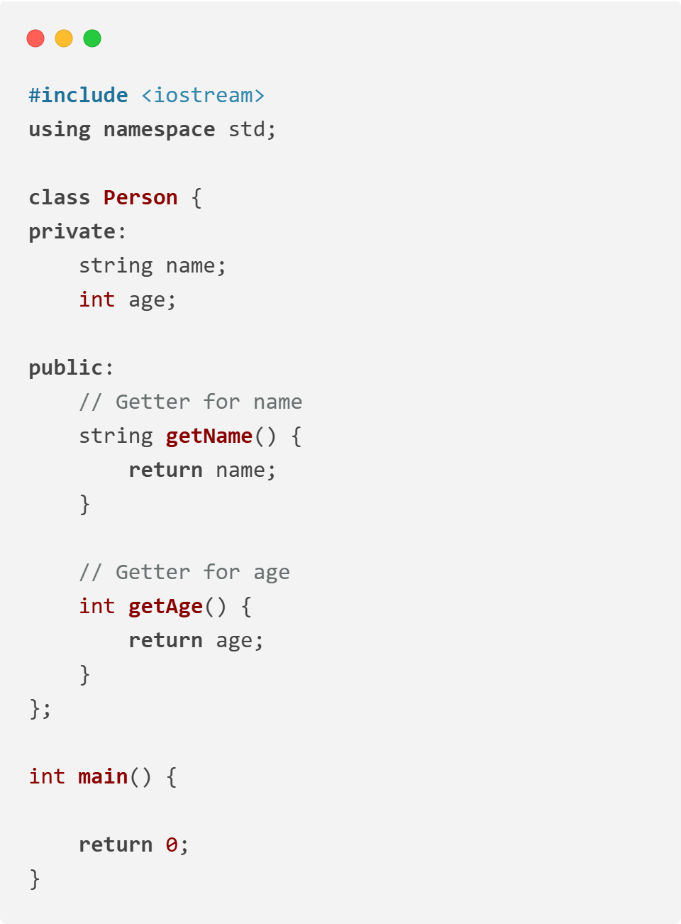
Implementation of Encapsulation
// Program that get person name and person age
2. Provide getter functions to retrieve private data.

Slide 7
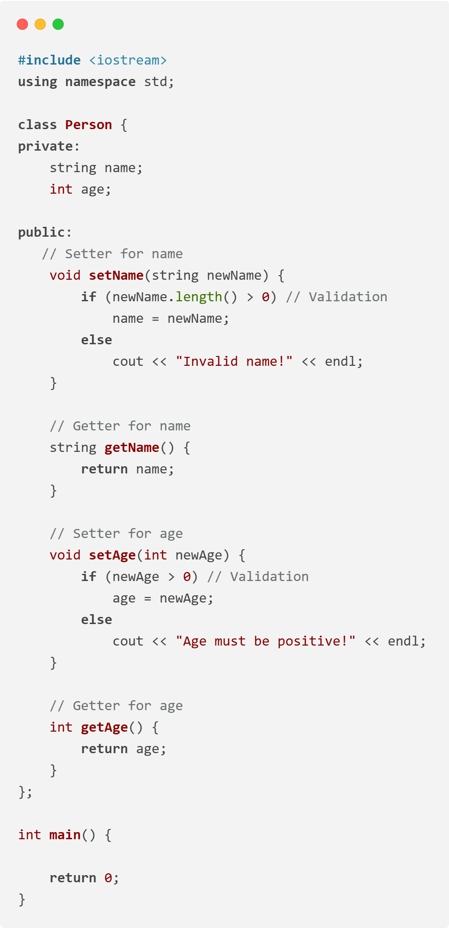
Implementation of Encapsulation
// Program that get person name and person age
3. Provide setter functions to modify private data with validation.

Slide 8
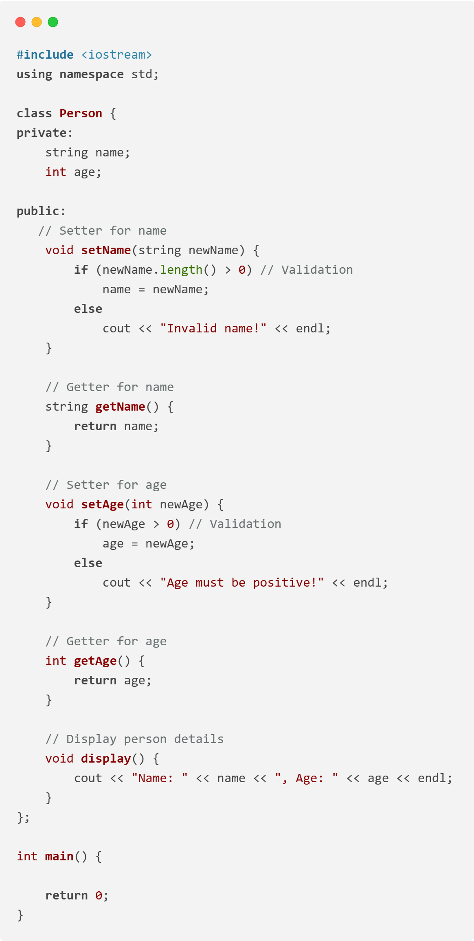
Implementation of Encapsulation
// Program that get person name and person age
4. Use public methods to expose functionality safely.

Slide 9
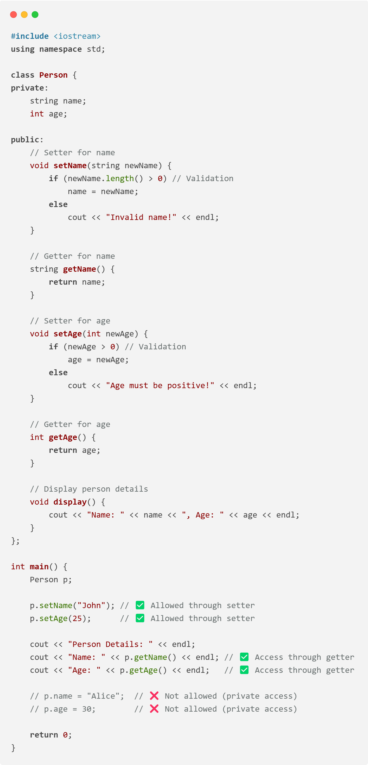
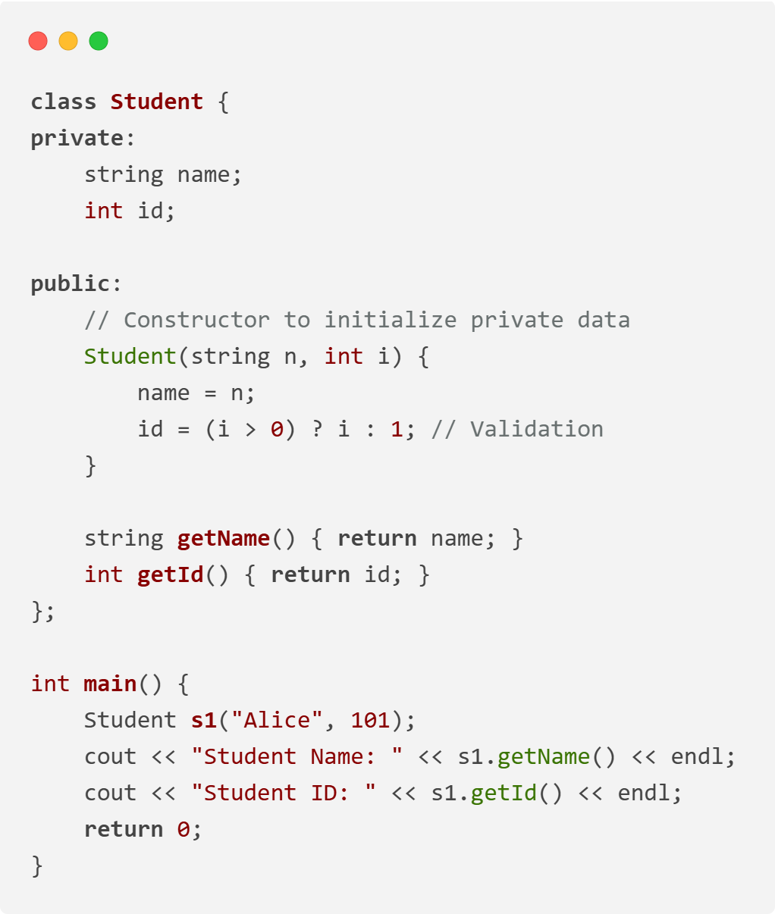
Implementation of Encapsulation
Encapsulation with Constructor

Slide 10


