Slide 1
Temešvár 2015
Team presentation

Slide 2
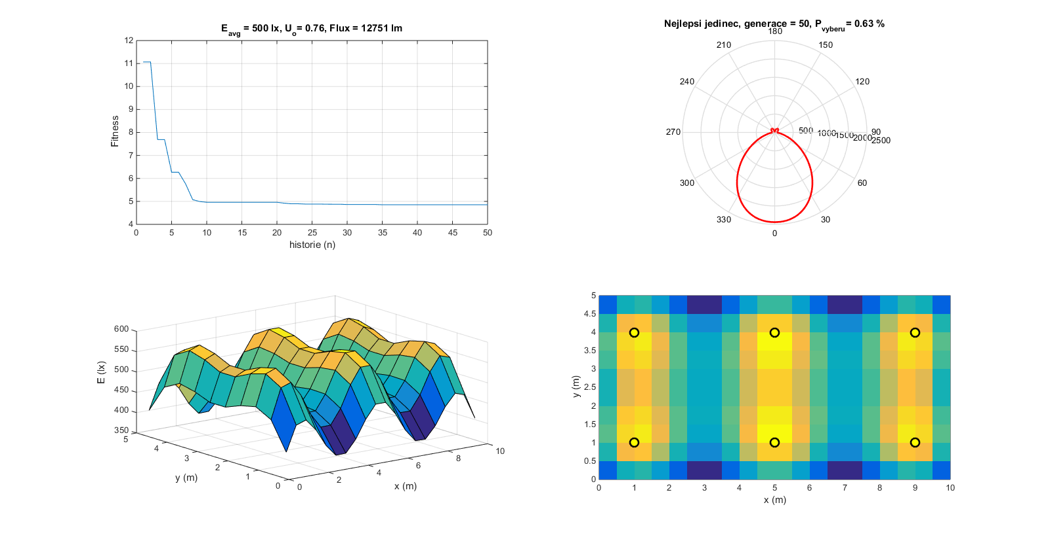
Lighting design by GA
Cooperation with K13115
Rudolf Bayer
Michal Brejcha
Zuzana Pelánová
Jan Zálešák
Conference:
EPE 2015
Světlo/ Light 2015
Magazines:
Lighting Research & Technology

