Slide 1
CAPACITORS
Basic parameter: capacity
Other important parameters: max. applied voltage, dissipation factor D (quality factor), equivalent series resistance, isolation resistivity, leakage current, temperature and voltage dependence (TCC), frequency dependence, ageing.
DESIGN
- rolled cap.: paper or plastic dielectric, inductive or inductive-less design,
with or without metalized foil
- ceramic cap.: simple or monolithic structure, linear or nonlinear
dielectric (temperature sensitive), made from re-oxidized ceramic
- electrolytic cap.: aluminum or tantalum dielectric, liquid or solid
electrolyte
- mica-foil and air (vacuum, oil) cap.: special design
- charge accumulators: not capacitor!

Slide 2
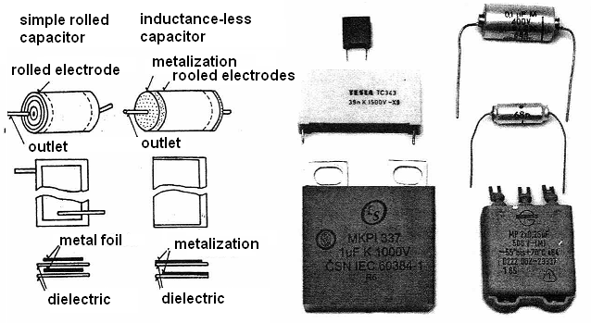

ROLLED CAPACITORS - design

Slide 3
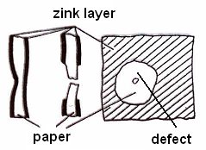
Rolled capacitors
Scrolled electrodes are separated by strips of rolled dielectric. Rolling is done automatically – required number of turns, then fixing.
- dielectric: dry paper for capacitors (natron-celluloze) from 6 to 20 μm
thickness, typically 2 layers.
- foil of plastics: polystyrene, polyethylentherepthalath (PETP),
polycarbonate, polyimide, polypropylene.
- electrodes: aluminum foil, thickness – units of μm.
- outlets (terminals): copper pads bonded directly on electrodes, copper
wires rolled into bulk of capacitor.
- inductance-less design: metallization on both front sides of rolled
electrodes.
Metalized electrodes (MP type)
Electrodes are made as Zn or Al layer (0.05 up
to 1 μm) placed on dielectric basis (paper).
Preparation of paper: paper is sprayed with
nitrocellulose varnish (1 μm), dried (105°C),
covered with Zn layer in vacuum (10⁻¹ Pa) by vapor deposition.

Slide 4
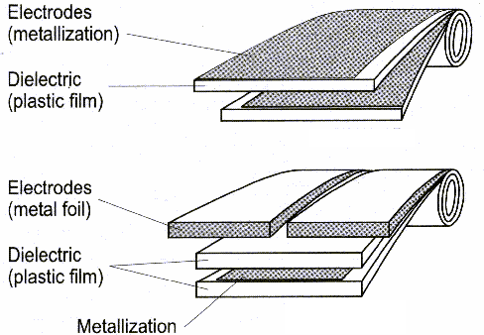
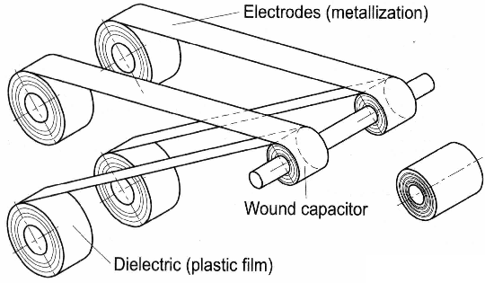
Principle of
rolling

Slide 5
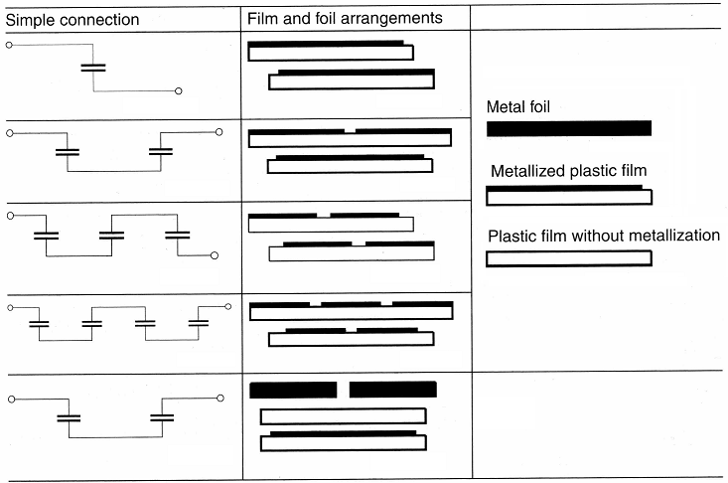
Possible arrangement

Slide 6
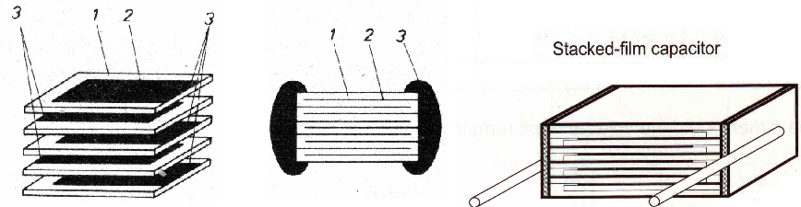
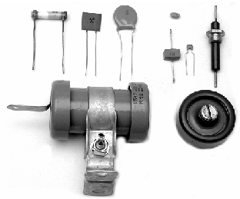
Monolithic capacitors: dielectric foil and electrodes are not rolled, they are assembled into blocks and fixed (laminated) at high temperature and pressure. Laminated blocks are then cut into individual capacitors.
Ceramic capacitors
Ceramic material with relative permittivity
changing from 1 (linear) up to 10⁴
(ferroelectric) is used for dielectric layer.
Conductive surface of electrodes is made
from silver. Silver is evaporated.

Slide 7
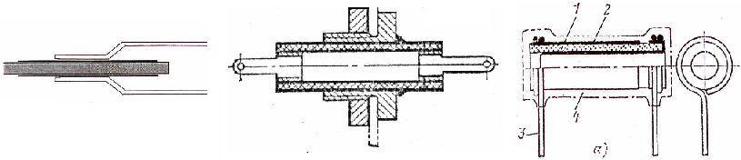
Basic properties of capacitors are determine by used ceramic material:
- the oldest ceramics (1930): were based on oxides of titan and manganum (ε_{r} ~ 10 - 100, TCC from -750 to +100x10⁻⁶ /°C).
- titan based ceramics: BaTiO₃, CaTiO₃, SrTiO₃, MgTiO₃) have ε_{r} in range 1000 – 20000 but they are ferroelectric – exhibit Curie’s temperature, dielectric hysteresis and they are voltage dependent.
- capacitor called „class 1“: stabile and linear ε_{r}, low power loss: tg δ (D factor) at maximum 2x10⁻³, TCC from -680 to +200x10⁻⁶/°C, voltage independent. Commercial names: STEALIT (similar to porcelain), STABILIT, TEMPA, RUTILIT, KONDENSA, NEGALIT. Typically contain TiO₂, MgO, ZrO₂. Such capacitors are good for high frequency and high voltage applications.

Slide 8
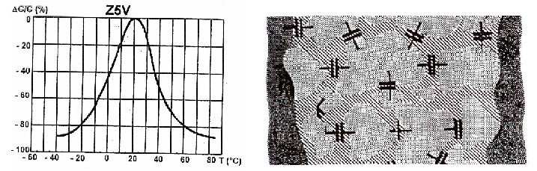
- capacitors „class 2“: dielectric with high ε_{r}, ferroelectric features, very temperature sensitive. Peak of maximum ε_{r} can be shifted by additional oxides (SrTiO₃, PbTiO₃, BaSnO₃, CaSnO₃) or flatten (CaTiO₃, Bi₂SnO₃). Commercial names: PERMITIT (BaTiO₃, tg δ max. 3x10⁻², tolerance ± 50 %). Suitable for coupling and filtering capacitors.
- capacitors „class 3“: similar ceramic as for „class 2“ but different burning process (re-oxide ceramic). Material has a domain structure – ferroelectric properties again. Burning first in atmosphere of H₂ (1200°C), then burning in O₂ atmosphere. Grain domains are about 1 μm length. Commercial names are SUPERMIT, SIBATIT (ε_{r} circa 5x10⁴).

Slide 9
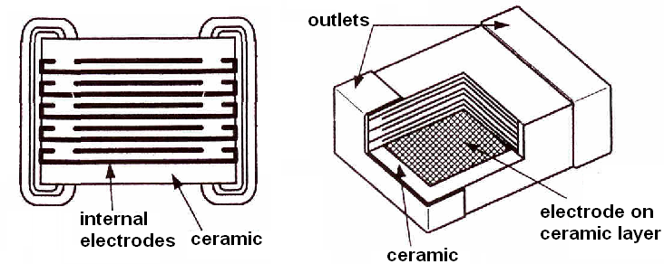
Disadvantage of „class 3“ capacitor is relatively large power loss. Thanks to high electrical strength in ferroelectric, ceramic exhibit some „semiconductor“ behavior. Dissipation factor is then about 10 %. These capacitors are not high-quality devices; ideal for low-cost application.
Mechanical design of ceramic capacitors
- outlets: without or wired outlets,
- shapes: pipe/tube (oldest), today tablet, disc, multi-chip module, plate,
- electrodes: sprayed emulsion of Ag paste, then burning at 850°C,
- surface protection: synthetically glazed or phenol cement with wax.

Slide 10
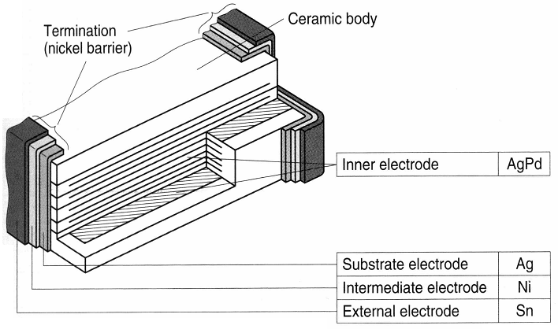
Ceramic capacitors for SMD: cross-section

Slide 11
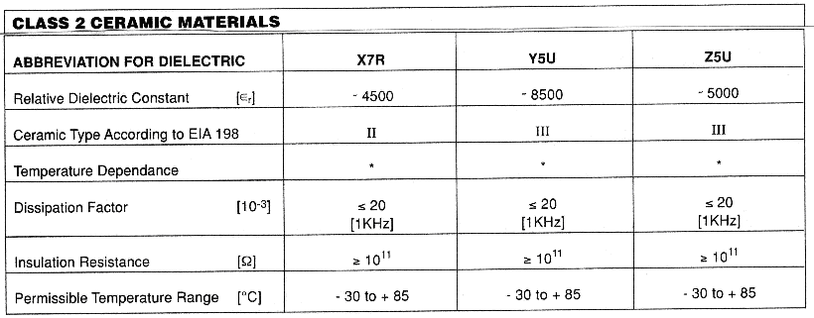
Typical properties of class 2 capacitor
Ceramics with names: X7R, Y5U, Z5U, etc.

Slide 12
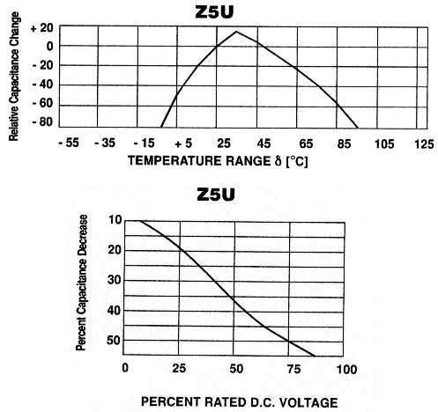
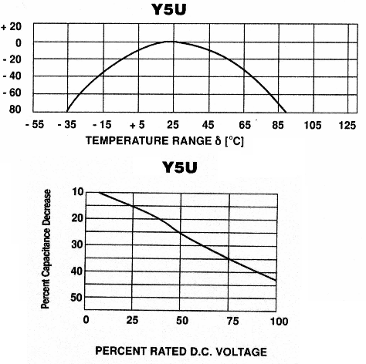
Temperature dependence of class 2 capacitor

Slide 13
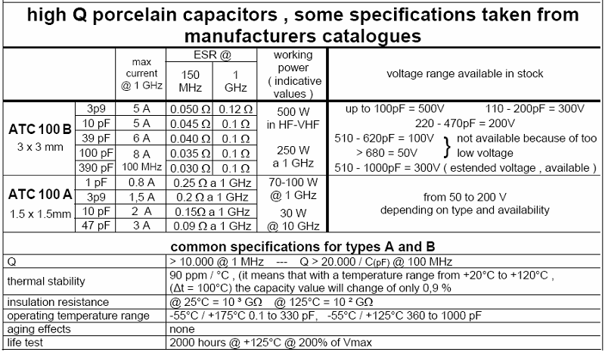
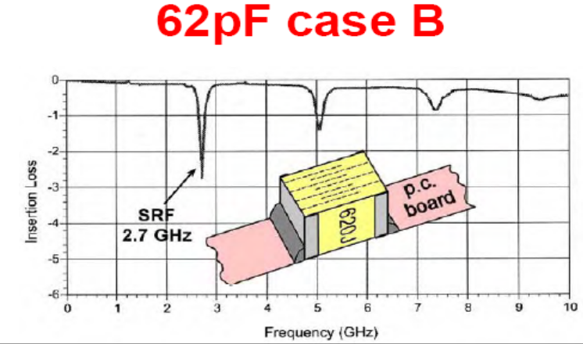
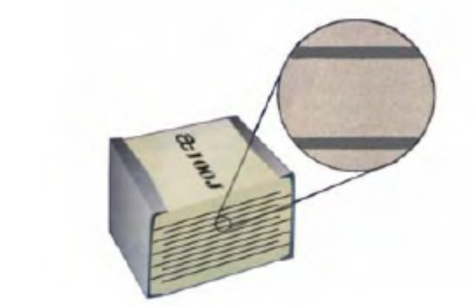

Slide 14
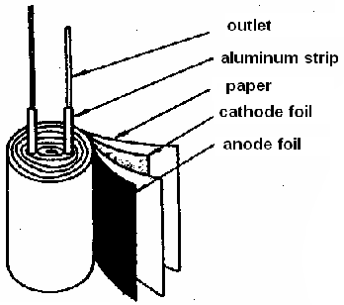
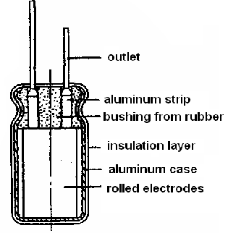
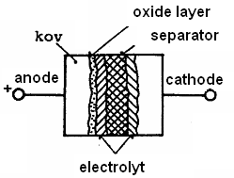
Electrolytic capacitors
- dielectric: created by a very thin oxide layer placed on one side of electrode. Thickness allows to achieve large capacity in a small volume. Disadvantageous is a polarization of oxide layer.
- design: aluminum electrolytic capacitors are similar to rolled capacitors. Rolled electrodes are made of aluminum strip. Surface is enlarged by brushing and finally is etched. Dielectric layer is formed by anodic oxidation process. Rolled strips are impregnated by electrolyte.

Slide 15
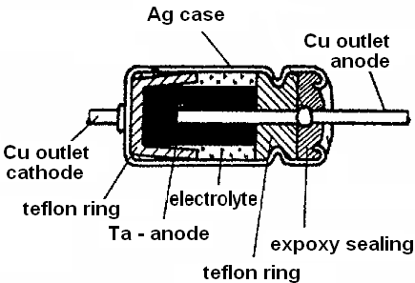
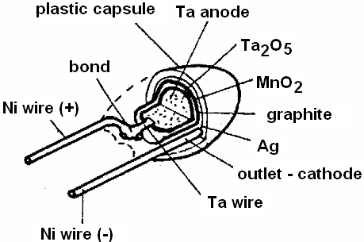
Tantalum electrolytic capacitors
Anode: Made from burned Ta powder, then oxidized in H₃PO₄
Cathode:
- capacitors with liquid electrolyte have hermetic Ag capsules (cathode), acid H₂SO₄ is used as electrolyte. (left picture)
- capacitors with solid electrolyte don't have hermetical capsule, MnO₂ is used as electrolyte, cathode is made from colloidal graphite and silver. (right picture)

Slide 16
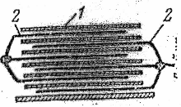
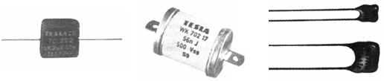
Mica foil capacitors
Mica (isinglass) is the only inorganic dielectric, that can be used in layers with thickness about 10 μm. Mica has excellent electrical and mechanical features, it is suitable for high frequency and high voltage applications.
- MUSKOVIT (Al-K-SiO₂), permittivity ε_{r} from 6.5 to 7, tg δ circa 10⁻⁴,
insulation ability up to 130 kV/mm, specific resistivity 10¹⁶ Ωcm.
- FLOGOPIT (Al-Mn-K-F-SiO₂), little bit worse electrical parameters,
tg δ circa 10⁻³ or 10⁻².
design: just plates of mica, no rolled structure!
electrodes: plates from Ag, Cu or another metal.

Slide 17
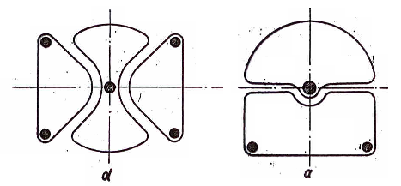
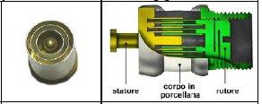
Today's mica-foil capacitors are capsulated into phenol cement. Older types were capsulated into epoxy plastic. The most reliable capsulation is metal-ceramic – they are water-proof and hermetic. Sometimes are filed with impregnation oil. Mica-foil capacitors are used for units of kV and for conduction of units of Ampere at high frequency (GHz)
Air capacitors
They are created with a set of metal plates separated with an air dielectric. Power losses are negligible. Maximum applied voltage is given just with the air-isolation capability. Design is exclusively based on rotation metal parts. They are used as tuning and variable capacitors.

Slide 18
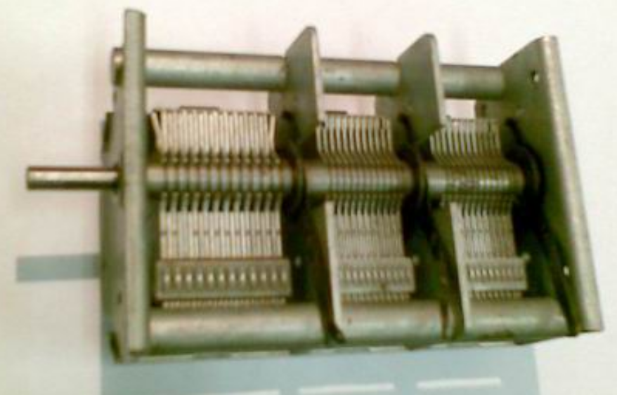
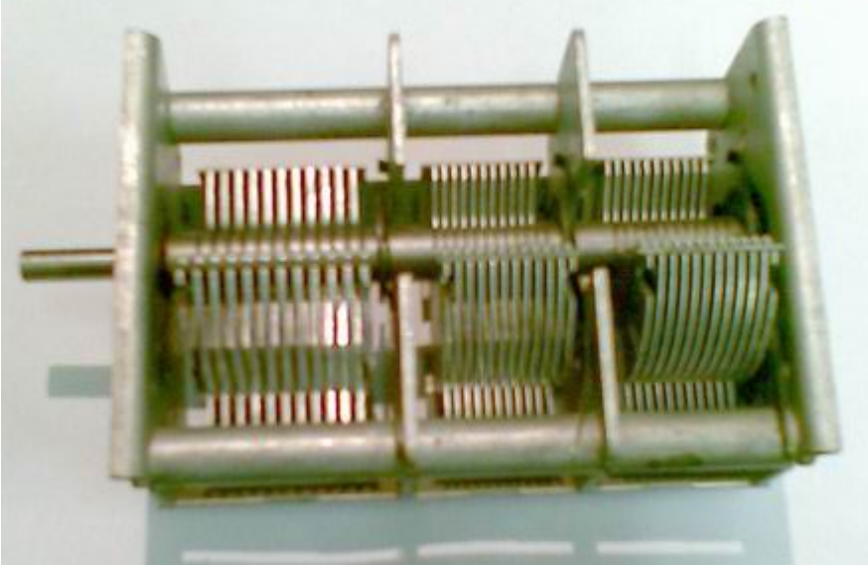
Classis design of air-variable capacitor
set of metal plates (electrodes) create stator and rotor
metal chassis
shaft with knob/button for manual setting
insulation system between stator and rotor parts
collector on rotor part

Slide 19
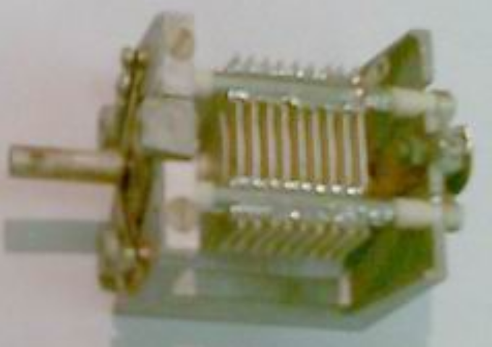
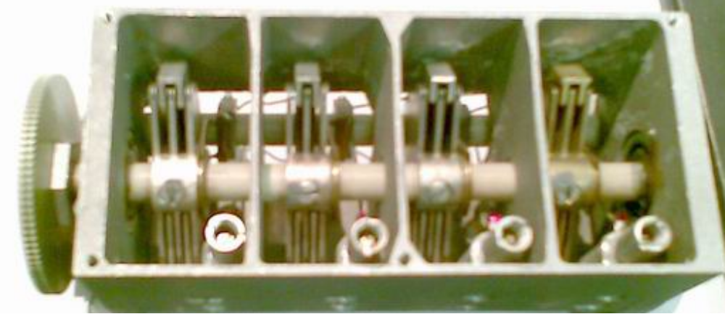
- metal plates: made from Al, Cu, bronze, brass, cover with a thin layer of
Ag, Au.
- connection of plates: soldering, bonding, labored parts are not reliable
(not stabile dimension and capacity)
- high quality parts: bronze, brass
- metal chassis: Sometimes made as a precise milled and cut metal bulk (AL, bronze, etc.), more often assembled as a structure of metal and ceramic parts (low-cost).

Slide 20
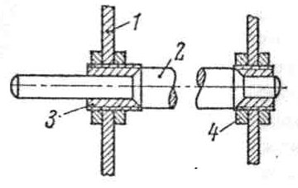
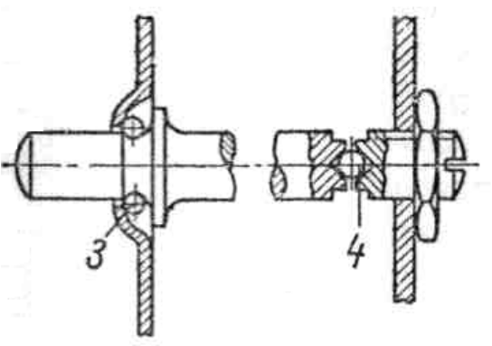
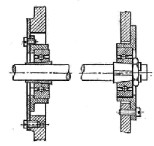
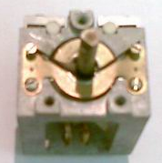
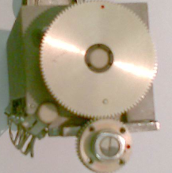
- shaft: metal or ceramic part (precise), sometimes plastics (low-cost).
Required is a fixing in bearings without clearance (tolerance)
bearings: ideal are precise ball-bearings, not sliding bearing
Some variable capacitors are
equipped with gearbox for
precise tuning.

Slide 21
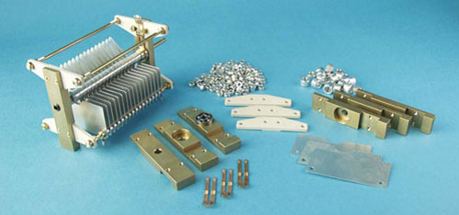
- insulation system: between stator and rotor, important are low power losses and large insulation capability. Ideal materials are ceramic and glass, not convenient are plastic (higher power losses, not mechanically reliable).

Slide 22
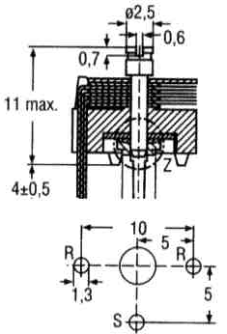
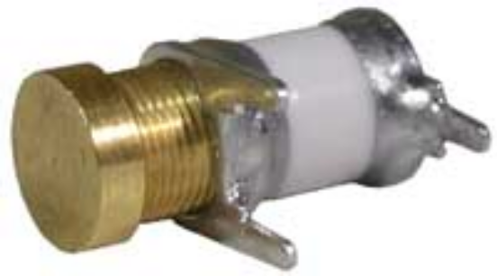
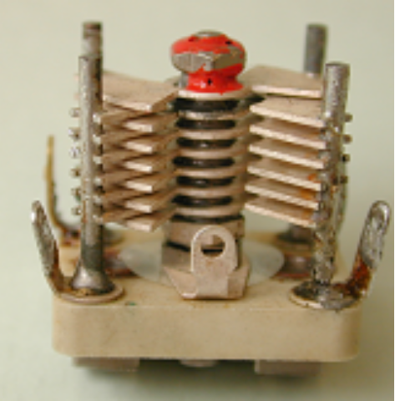
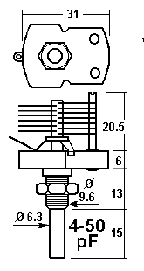
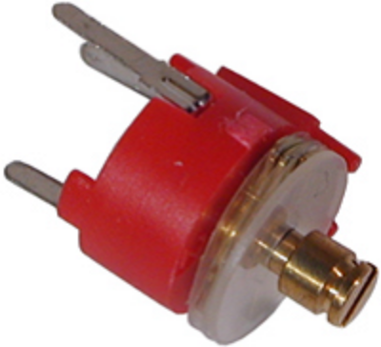
Trimmers
Simplified air capacitor, just stator and rotor parts, settings is done only by some tool (e.g. screwdriver), required is lock of current setting.
Between electrodes can be solid dielectric layer based on polystyrene, styroflex, etc.

Slide 23
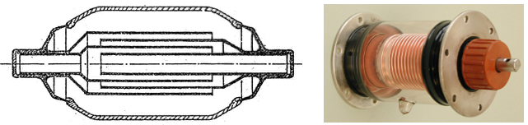
Vacuum capacitors
Electrodes (stator and rotor) are very similar to air capacitors. Structure can operate also in compressed air, oil or in vacuum. Advantageous is higher insulation capability. Most widespread design is vacuum tube similar to electron tubes. Maximum applied voltage is given just by auto-emission of electrons between stator and rotor parts. Most critical is hermetic sealing (glass tubes).

Slide 24
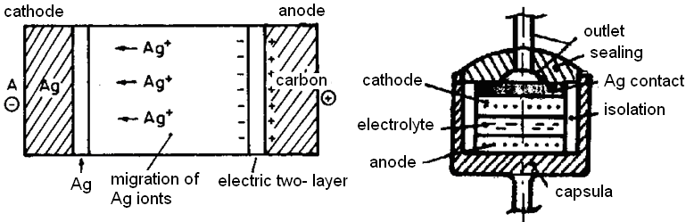
Charge accumulators (ESD – energy storage device)
Charge accumulators are special type of capacitors with a large volume capacity. Principally they are similar to electrolytic capacitor with solid electrolyte. Capacity is managed by ion double-layer on the interface between graphite electrode and electrolyte. Capacity is in the range 10 F/cm². Accumulator is created from silver anode that is separated from carbon cathode by electrolyte of RbAg₄J5 (Rubidium-silver-iodum).
When charging, Ag ions migrate through electrolyte from anode to cathode. When discharging, ions migrate back. Maximum applied voltage is about 0,66 V. Cells of such ESD are connected in series.

Slide 25
Properties of capacitors
Main: Electric capacity
Q = C.V (Coulomb; Farad; Volt)
Other: temperature and voltage dependence of capacity, isolation resistance, isolation (leakage) current, frequency dependence of capacity, maximum applied voltage and current, ageing (time-dependence of capacity).
Conditions:
Capacity and its tolerance is the main parameter. Capacity are produced from 1 pF up to 0,1 F, special ESD can achieve 10 F. Nominal capacity is typically measured at 50 Hz or 1 kHz, for ceramic capacitors sometimes at 1 MHz. Polarization is about units of volts, not higher. Electrolytic capacitors are measured under DC bias, measured signal has low AC ripple signal.

Slide 26

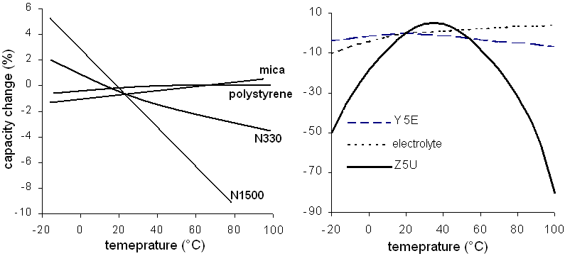
Temperature dependence: critical parameter for applications as resonance and frequency selective equipments. Linear dependence can be characterized by temperature coefficient of capacity (TCC):
Voltage dependence: This dependence can be observed when polarized dielectric is used. It is typical for ferroelectric ceramic. Permittivity is depending on applied voltage. This dependence is nonlinear and can cause distortion of harmonic signals.

Slide 27
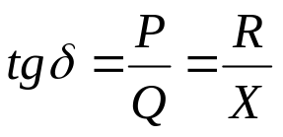
Isolation resistivity (leakage current/time constant)
This parameter describes isolation capability of used dielectric under DC bias. It can be also used for evaluating of influence of ambient humidity. Typical isolation resistivity of rolled (paper and plastic) capacitors is from 10⁹ up to 10¹¹Ω.
Quality of isolation layer of electrolytic capacitors is evaluated by leakage current. Leakage current is defined as a current flowing through capacitor after 5 or 10 minutes after DC polarization. Leakage current is very temperature sensitive, the higher the temperature is, the higher is the leakage current (and isolation resistivity is lower).
Power loss factor (dissipation factor, tg δ) described the total power losses in dielectric with AC bias. Dissipation factor is defined a ration of active power P and reactive power Q. The same definition can be: “ratio of real and imaginary part of impedance”. Dissipation factor connect all the losses together, including ohmic losses in wire outlets and electrodes.

Slide 28
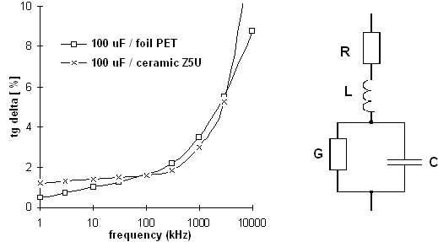
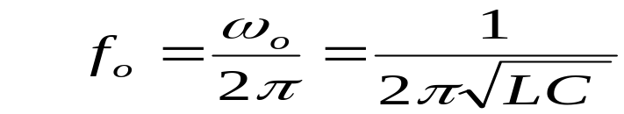
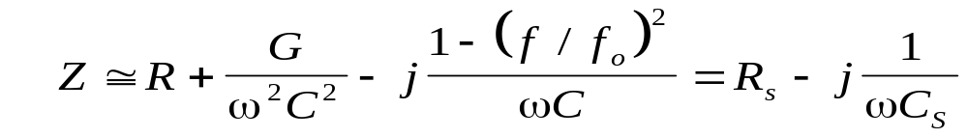
Frequency dependence can be caused by:
- frequency dependence of used dielectric (ferroelectric),
- apparent dependence thanks to parasitic features.
Typical capacitor exhibits capacity just in frequency band lower then self-resonance frequency. With increasing frequency is increasing D factor and also apparent capacity. At self resonance (f₀) the impedance is at its minimum (just real part). At frequency higher then self resonance capacitor exhibits inductance behavior.

Slide 29
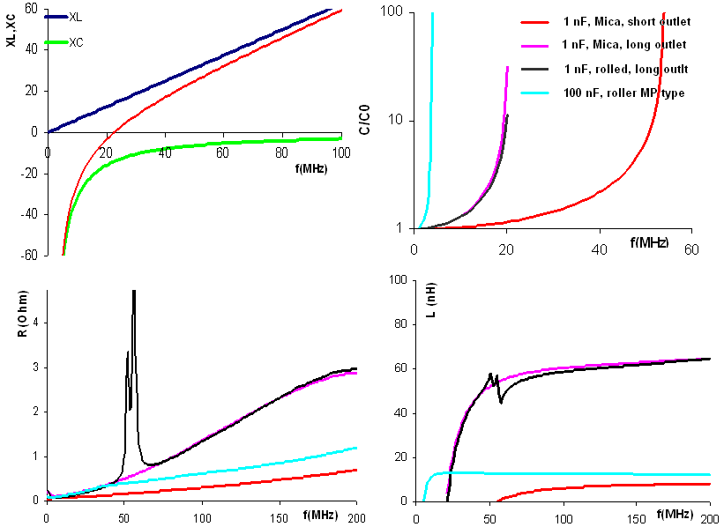
Possible influence of parasitic features on frequency dependence

Slide 30
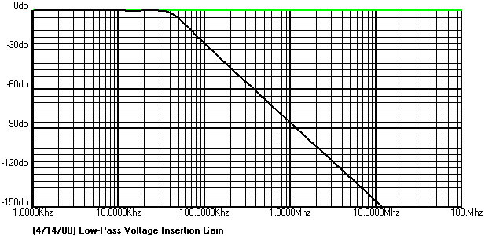



Influence of parasitic on LC reactive filters
Idealized LC filter:
L = 300 uH,
C = 0,1uF
LC filter with parasitic:
L=300uH, Cp=20 pF, C=0,1 uF, Ls=100nH

Slide 31



Electrolytic capacitors
Frequency dependence for electrolytic capacitors differs from simple (rolled) capacitors. Dependence is influenced both by oxide layer on electrodes and by capacity of electrolyte. Capacity and resistivity of oxide layer is represented by C₀, R₀. Electrolyte is characterized by C_{E}, R_{E}. Parasitic R_{S}, L_{S} stand for outlets (terminals).

Slide 32

Frequency dependence of impedance for electrolytic capacitor

Slide 33
Maximum ratings
- maximum voltage is often presented as a maximum of DC voltage, that can be permanently applied on the terminals of capacitor.
Sometimes, for capacitors in AC applications, maximum voltage is presented as maximum AC signal with 50 Hz. In other cases, maximum of AC voltage used to be just 20-30% of maximum DC voltage. At high frequency maximum AC voltage is limited also thanks to power losses and dielectric heat. In case of applying both AC and DC signals on capacitor, their peak sum can not exceed maximum voltage.
- maximum operational current is defined as a maximum AC current which does not cause any damage of capacitor. (over heating, etc.) At high frequency this maximum current is limited by dielectric losses and ohmic losses in the terminal (outlets).

Slide 34
Maximum power is defined as a maximum of reactive power Q (not active power P!) that can be dissipated in a volume of capacitor without any thermal damage. Both powers (P and Q) are in mutual relation thanks to dissipation factor (D). The maximum reactive power P is (at high frequency) limiting also by maximum applied voltage. Maximum voltage is therefore indirectly proportional to frequency, sometimes the relations is equal to f ⁻². Maximum total power losses are affected by cooling, design of capsulation and also by ambient temperature.
Ageing of capacitor is characterized as a irreversible changes of electric properties. Critical parameters are capacity, D factor, isolation resistivity. The rate of ageing is mostly affected by operational temperature. The higher is the temperature, the faster is this degradation. Also voltage stress has negative effect on ageing. Capacitors with the fastest ageing process are electrolytic capacitors. It is caused by drying of electrolyte.

