Slide 1
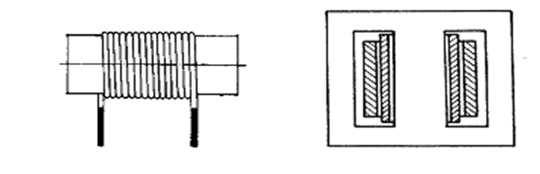
INDUCTANCES, COILS, TRANSOFMERS
Devices with the lowest portfolio on the market, very pure mass-production. Often must be inductances designed “on-demand” during designing process. According design we recognize:
  - coils without magnetic core (air-wounded)
  - coils with ferromagnetic core:
    - polycrystalline – printed cores, powder cores,
    amorphous cores – magnetic glasses, oxides (ferrites – Manganum + Zinc, Nickel + Zinc)

Slide 2
Basic parameter:
value of inductance L (H)
Other parameters:
temperature dependence, current and voltage dependence, frequency dependence of inductance (or impedance), quality factor, maximum current, maximum applied voltage and power, ageing.
Other parameters for transformers:
transfer parameters, leakage (dispersion) inductance, mutual inductance.

Slide 3
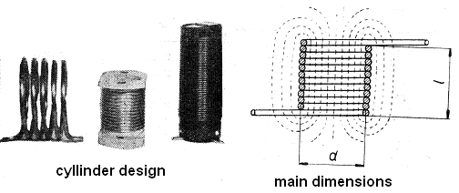
Coils without core (air)
- coils with relatively low inductance (in order of 100 nH up
to 1 mH), stabile and linear parameters,
- ideal for low-power and high frequency applications,
design is influenced with requirements on quality factor.
possible application in power circuits, when linearity of
parameters is required.
Not often used for transformers, just for high frequency circuits, typically in resonance circuits.

Slide 4
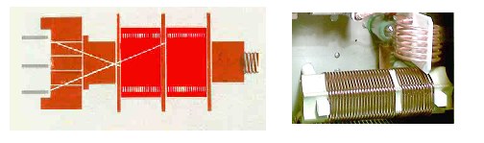
Design of coils – winding
Single or multi-layer winding made from a wire with rounded or square cross-section; placed on insulation bases (skeleton, frame)
Sometimes can be winding self-supporting (without skeleton).
Winding are sometimes separated into chambers, especially for minimizing self-capacity and maximizing inductance.

Slide 5
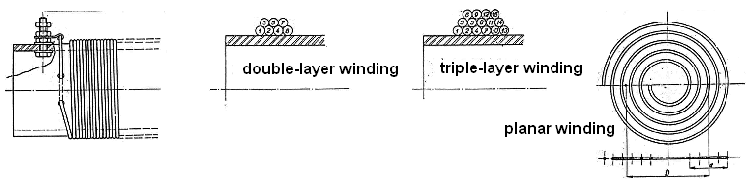
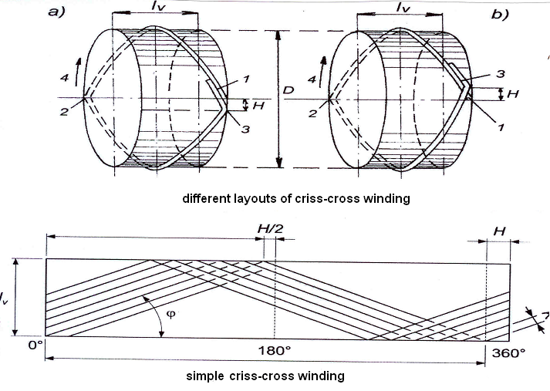

Slide 6
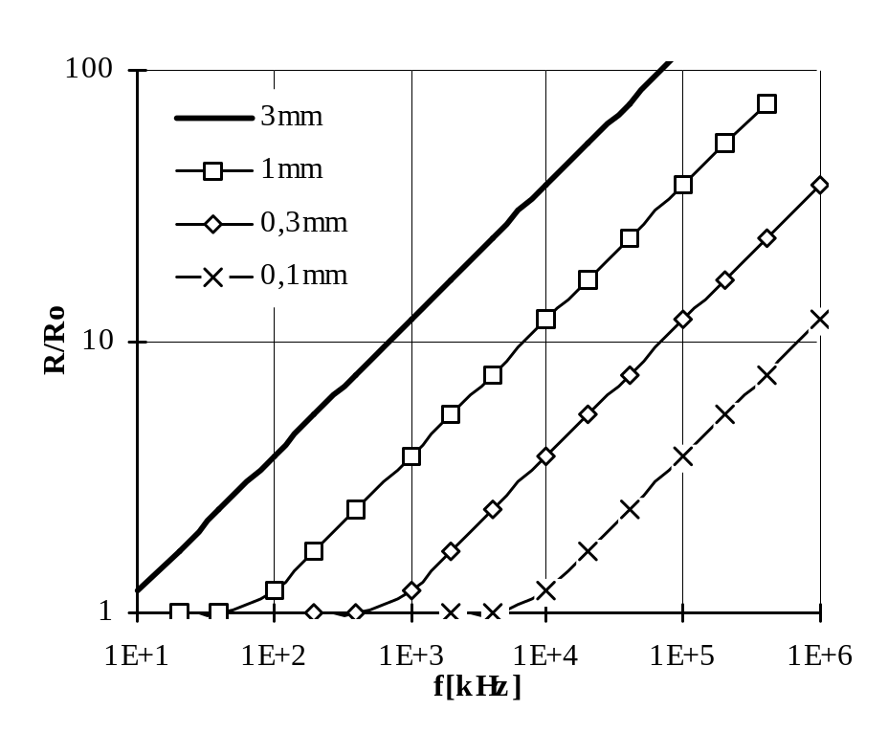
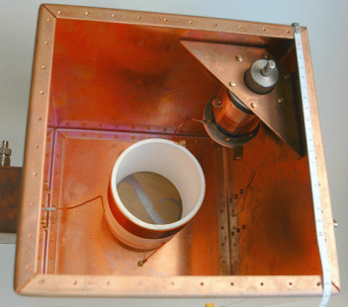
Typical design
Dimensions, number of turns, wires for windings, dimensions of cover are given typically by approximation or empiric equations. For high quality factor, inductance must have very low resistance. Quality factor is nearly proportional to dimensions (volume) of inductance. Optimum of coil length is in range 0,5D up to D (D is the diameter of winding). Resistivity on high frequency is always influenced by skin effect and proximity effect.

Slide 7


Resistivity on high frequency
For HF application are often used cables (cords) made from a set of single copper wires. There are small air-chambers between individual wires. Surface of such cable is then much bigger than the surface of single-wire cable. Cables are convenient in a narrow frequency range given with following formula
where:
d - is a diameter of single wire in a cable (cm)
s - is a length of twisted element of cable
N - is the number of wires in a cable
ρ - is a specific resistivity (Cu ~ 0.0173 Ωmm²/m)
Equivalent depth of current density - α
It describes the utilization of conductor at high frequency
σ - is a specific conductivity for DC current (Cu ~ 5.6x107 S/m)
ω - is a circular frequency
μ - is a permeability of conductor. For non-ferromagnetic materials it equals to 4π 10⁻⁷ H/m

Slide 8

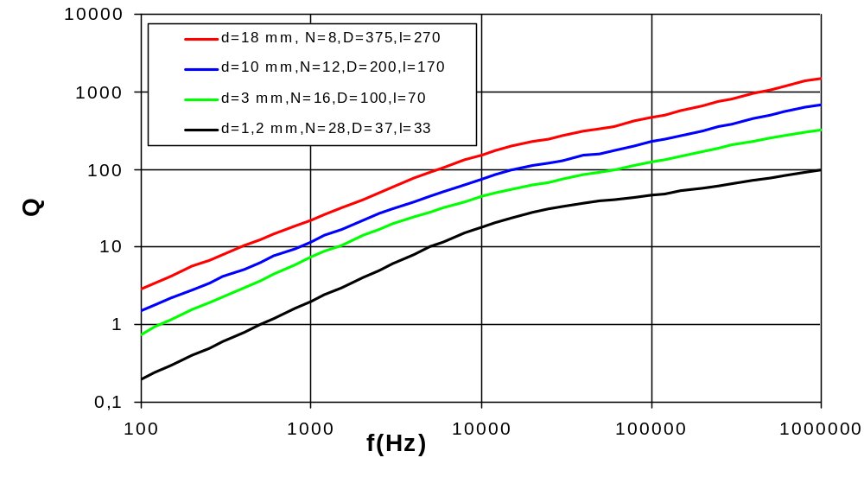
Quality factor (Q)
Ration between real and imaginary part of inductance

Slide 9
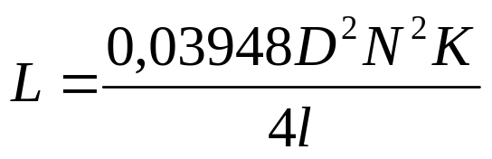
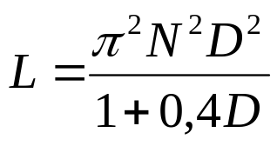
Inductance of coils
Inductance is primary given by a geometric shape and dimensions of coil and by the number of turns (N). For design and computing are often used empiric formulas, e.g. Nagaoko’s formula. There is important ration between diameter and length of coil/winding (D/l). Values of coefficient K are in table bellow.
L is inductance (μH), D (cm) is a diameter of coil, l (cm) is the length of coil and K is a ration coefficient from table. For preliminary estimation of inductance can be used another simplified formula: (nH; cm)
D/L | 0,00 | 0,25 | 0,50 | 0,75 | 1,00 | 1,25 | 1,50 | 2,00 | 2,50 | 3,00 | 3,50 | 4,00
K | 1,000 | 0,902 | 0,818 | 0,748 | 0,688 | 0,638 | 0,595 | 0,525 | 0,472 | 0,429 | 0,394 | 0,365

Slide 10
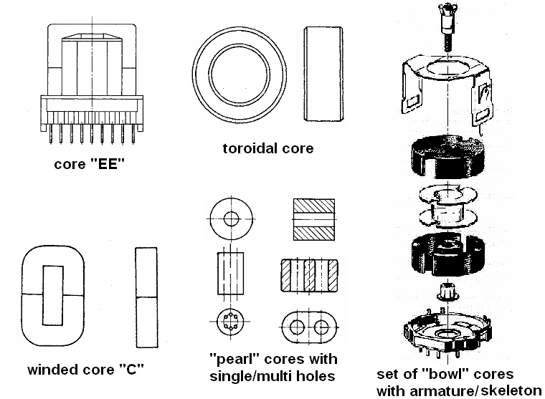
Coils with ferromagnetic cores

Slide 11
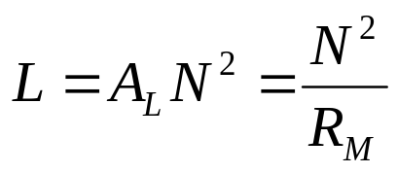
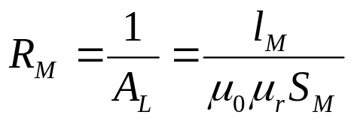
Inductance of coils with ferromagnetic cores
Typical for inductances in range from 50 μH up to ten of H. Inductance is very often computed with using of core constant „A_{L}“
A_{L} constant used to be in catalogues for mass-produced cores and their armatures.
Constant A_{L} is inverted magnetic resistance R_{M}. A_{L} or R_{M} can be computed based on dimension of core by means of following formula:
Where
l_{M} – is the average length of magnetic circuit (or its element)
S_{M} – is the cross-section of magnetic circuit (or its element)
μ₀, μ_{r} – is the permeability of vacuum and magnetic material of core

Slide 12


CORE
- used for maximizing of magnetic induction B, when magnetic intensity H is low/acceptable
- disadvantages:
  non-linearity
  frequency dependence
  power-losses
Power losses
losses from whirling currents
(d is the thickness of metal sheets)
losses in dynamic magnetizing (hysteresses)
(k_{h} ~ 100; α ~ 2)
Optimization
- core is made from a thin metal sheets,
- air-gap in magnetic circuit helps to reduction of intensity H (B), power losses, reduction of dependence between μ and inductance L.

Slide 13
Metal magnetic materials
Metal sheets (plates)
- the most common type – rolled when hot, without any orientation of domains
- oriented texture – rolled sheets when cold (better properties)
- surface protection – insulation layer from oxide, varnish, phosphate
Production of cores
- small cores are cut directly from sheets (types „EI, M, UI, L, EB“)
- winded cores made from sheets with oriented domains
Metal glasses
- materials without crystalline structure
- production: very fast cooling of hot liquid alloy (melt), rolling into tin foils
- properties: better than sheets, low power losses, maximum of magnetic
induction B higher than 2 T

Slide 14
Powder cores
grains: 1 μm to 10 μm pressed together with non-conductive binder, low whirling currents up to HF but also low permeability (max. 100 or 200) .
- binder: polystyrene, bakelite or similar plastics
- ferromagnetic grains: silit, mumetal, AlSiFer, sendast, permalloy, the oldest materials based on iron+carbon
- manufacturers: AMIDON, MICROMETAL
Properties are influenced with pressing process.
Materials – general overview
Hot-rolled silicon steel
- volume of Si 0,5 % to 5 %, higher resistivity ρ, max. induction B cca 2T, power losses 0,5 to 5 W/kg (50 Hz), sheets thickness 0,35/0,5 mm
- typical rel. permeability 5000 to 30 000
- application: line transformers, low-cost audio transducers
Cold-rolled silicon steel
without Si, max. B cca 2 T, power losses 0,5 to 2,5 W/kg (50 Hz), sheet thickness less than 0,35 mm
μ max. 60 000, suitable for line transformers up to 400 Hz

Slide 15
Alloyed materials
- alloys of Fe, Ni, Cu, Cr, Mo, Mn
- low power losses at high frequency
- lower maximum inductivity B (0,5 T to 1 T)
PERMALLOY (classic): 78Ni 4Mo, μ.ρ ~ 6000; μ_{max} ~ 7x10⁴
SUPERMALLOY: 79Ni 5Mo 0,5Mn, μ.ρ ~ 10⁵; μ_{max} ~ 10⁶
MUMETAL: 76Ni, 5Cu, 2Cr, μ.ρ ~ 20000; μ_{max} ~ 10⁵

Slide 16
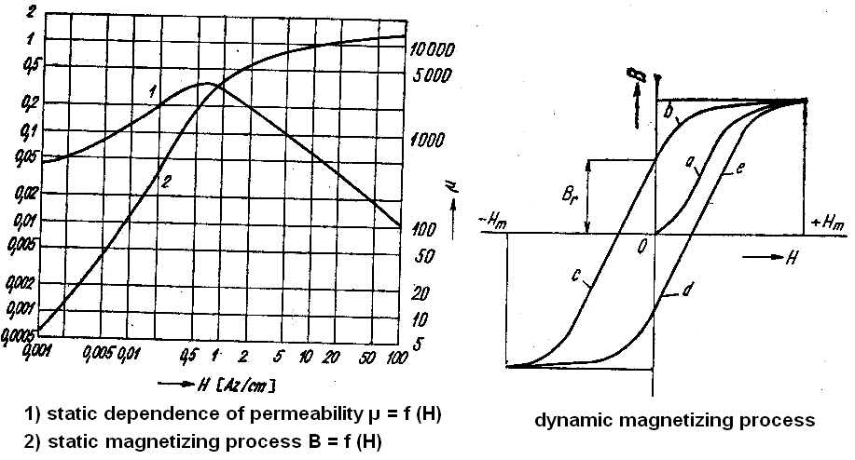
Static and dynamic magnetizing processes

Slide 17
Ferrites
Sintered ceramic materials, mixture of metal oxides (MeO + Fe₂O₃) where “Me” is: Mn, Co, Cu, Zn, Ni
Ferrites are not-conductive insulators (semiconductors), there are no whirling currents.
B_{max} is very low, cca 0,3 T to 0,4 T; μ_{max} depends on composition, varies from 10 to 10 000, power losses (tg δ) very low 0,1% -1 %.
Processing of ferrites
Similar to common ceramics: mixing of oxides, pressing, drying, burning (co-firing), final sharpen into required shape.
- shapes of cores: enclosed cores: bowls, „EE“, „UI“, toroid, pearls; open shapes: bars, tubes (pipes).
- properties: very fragile and hard materials, low thermal transfer. Overheating and not proper assembly can cause mechanical damage.
- marking of ferrites: „N“ – Ni and Zn ferrites; „H“ – Mn and Zn ferrites

Slide 18
Ni + Zn ferrites (“N”)
Lower μ in the range 10 up to 300, power losses (tg δ) in range 1 % (for low frequency up to 1 MHz)
- application: precise inductors and transformers in range 1 to 200 MHz, wide-banded (not tuned) coils up to 1 GHz.
Mn + Zn ferrites (“H”)
Higher μ (typically 600 up to 10000), power losses (tg δ) cca 0,1 % at low frequency (kHz), in the band of MHz little bit higher (1 %). Above 1 MHz real part of μ is decreasing.
Maximum saturation of magnetic induction (B_{max}) about 0,4 T is limiting factor for power inductors (high-current applications).
Typical applications: medium frequency transformers for SMPS (switch mode power sources).
Ferrites are very sensitive on DC or low frequency magnetization (50 Hz).

Slide 19
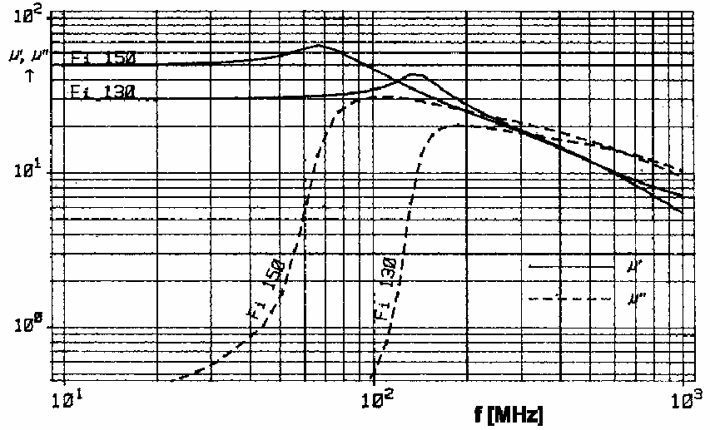

Complex permeability of nickel-ferrites
(Vogt Fi 130 and Fi 150)

Slide 20
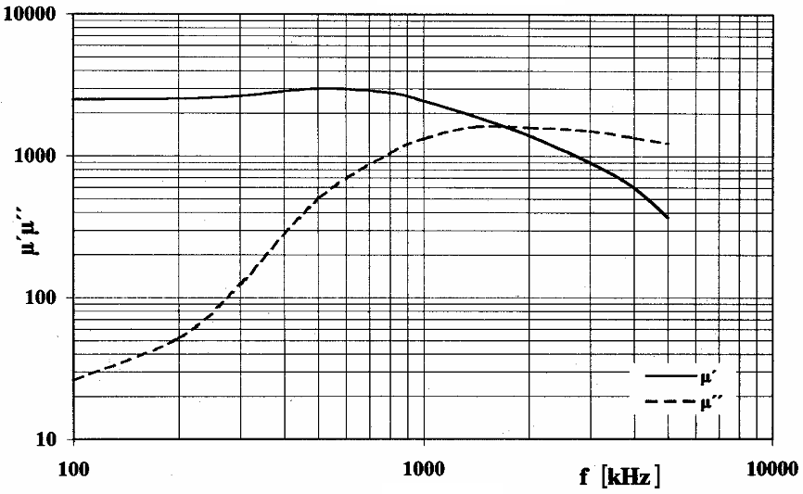
Complex permeability of manganum-ferrites
(Vogt Fi 323)

Slide 21
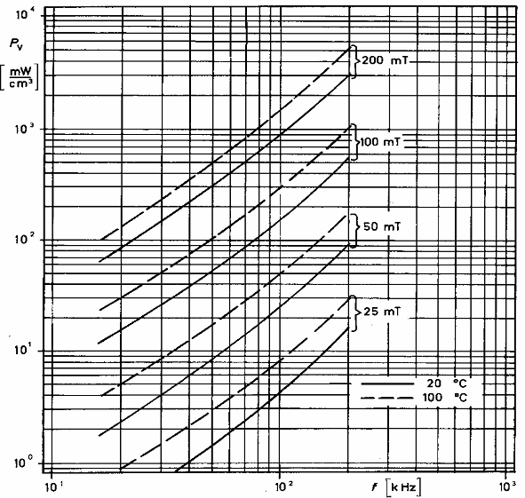
Specific power losses of ferrite Vogt Fi 323
dependence of magnetic induction

Slide 22
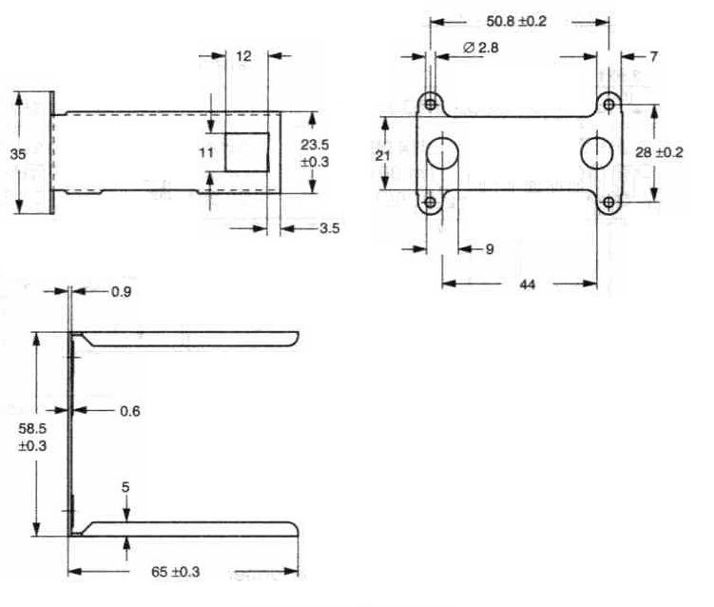
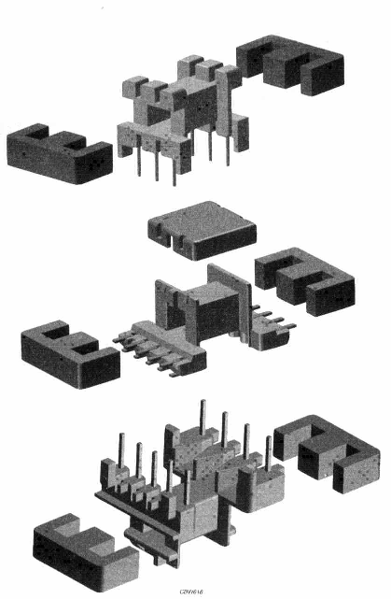
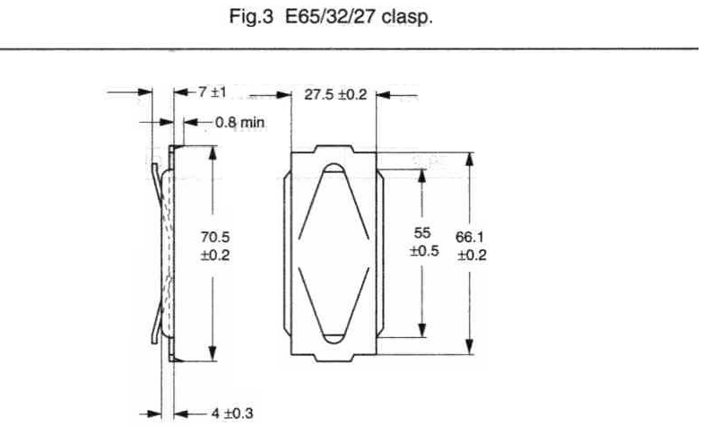
Core „EE“

Slide 23
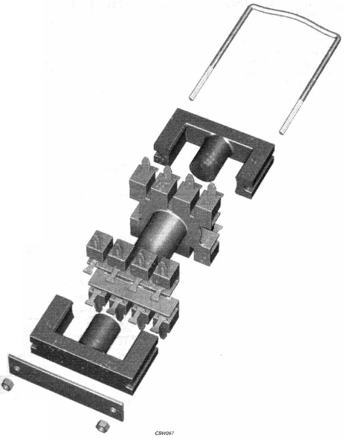
Core „ETD“

Slide 24
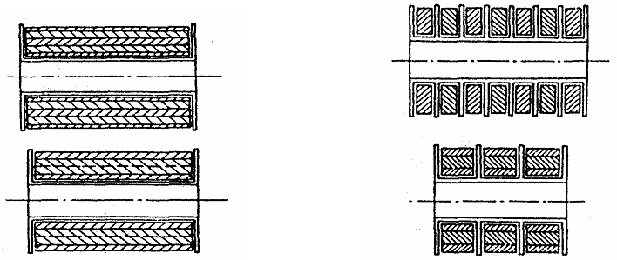
Winding
Processing, design:
Winding of coils and transformers with ferromagnetic cores is typically multi-layer. Layers and sections of winding are often separated into independent chambers by means of paper or plastic prepregs/separators. Prepregs should be bigger than the winding (at least 2 mm). Prepregs also protect winding to move to upper/lower layer. Wire outlets are usually covered with isolation pipe (silicon, PVC etc.) Leakage inductance can be reduced by dividing windings into more sections.

Slide 25
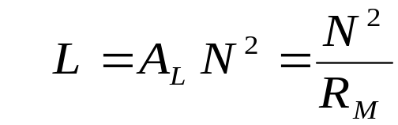
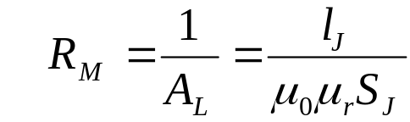



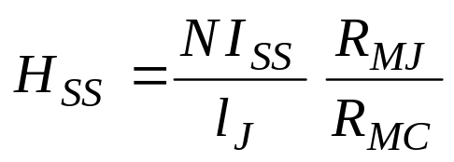
Number of turns
- computation based on required inductance:
- computation based on magnetic induction:
for harmonic (sinus) signals
for AC square signal
for square signal with one polarity
where:
V_{ef} – is the effective voltage on coil
f – is the operating frequency
- computation based on DC magnetization:
Where I_{DC} is DC current flowing through the inductor, R_{MC}, R_{MT} are the reluctances of ferromagnetic core (R_{MC}) and total reluctance of magnetic circuit (R_{MT}). Both are defined for given static permeability of used ferromagnetic material.

Slide 26

Parameters of coils
Main parameter of coils is the inductance. Commercially produced coils are matched to the sets E3, E6, E12 in the range 100 nH to 0,1 H.
Tolerance is depending of assumed application. For filtering and power devices can be tolerance 10-20 % acceptable. For tuned RF applications are sometimes tolerances 0,1 % critical.
It is very difficult (and not reasonable) to produce inductors and transformers with a very high accuracy. Therefore, these devices are often produced as a variable inductors. Setting in the range 10-20% is always done by moving ferrite core. Such devices can be also simply matched to the resonance circuits and tuned on required resonance frequency.
Temperature dependence of inductance is typically linear and is described by following formula:
where α_{L} is the temperature coefficient of inductance

Slide 27
Temperature non-linearity
Air inductors are quite linear, non-linearity is in the order 10⁻⁵ K⁻¹ when ceramics and glass is used for chassis and armatures.
Inductors with ferromagnetic cores are temperature sensitive and often non-linear. Inductors without air-gap can exhibit non-linearity in the order of 10⁻² K⁻¹. Air gap can reduced this dependence to the order 10⁻⁴ K⁻¹.
Frequency dependence
This dependence can be observed nearly for all inductors and transformers. Frequency dependence is first caused by inherent frequency dependence of permeability. Also the distribution of current in winding is changing with the frequency. Last cause of (apparent) frequency dependence are the parasitic parameters.
Parasitic parameters apparently influence the real (own) inductance L, so that the measured inductance L_{M} seems to be frequency depending.

Slide 28
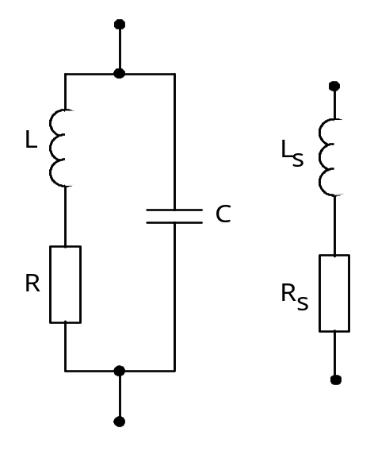
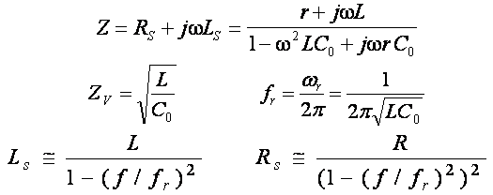
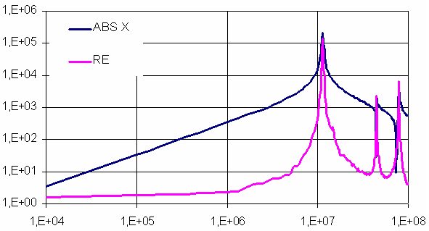
Frequency dependence of inductance
Above the self-resonance
frequency f_{r}, the imagina-
ry part of impedance
seems to be CAPACITY!
Other resonances are
caused by reflection of
standing waves.

Slide 29
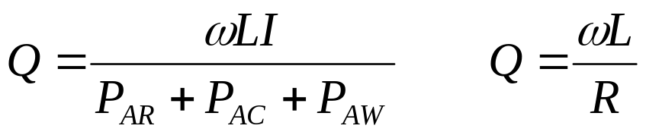
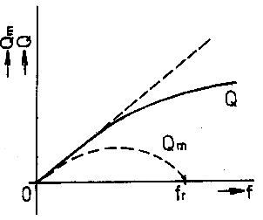
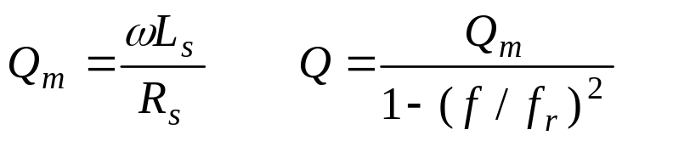
Činitel jakosti
Quality factor
Quality factor can be expressed as a ration between reactive power P_{r} and total active power P_{A}, which is dissipated in the inductor. Other possibility is using of substituting circuits and its equivalent elements R, L.
P_{AR} - is an active power lost in a copper winding
P_{AC} is an active power lost in a ferromagnetic core
P_{AW} is an active power lost in a metal shielding (whirling currents)
When using a Q-meter, we receive Q_{m} factor
and impedance corresponding with L_{s}, R_{s}.
Q_{m} (over-loading factor) is very similar to
Q factor, but not the same variable!

Slide 30
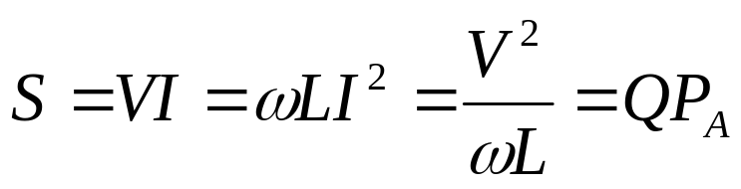
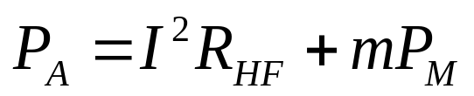
Maximum operating parameters
Maximum operating current, voltage and power are in mutual relation with the complex impedance of inductor. Maximum of reactive power is limited by:
cooling process (both of wires and core),
maximum of intensity (H) or induction (B) in the magnetic core,
voltage breakdown on wires insulation system.
Total reactive power is limited, when one of these three variables is at the limit value at current frequency. Total active power P_{A} (power losses) can be than expressed by means of flowing current and specific losses in ferromagnetic material:
I is the flowing current through the winding
R_{HF} is the HF resistivity of winding
m is the mass of ferromagnetic core
P_{M} is the specific losses in magnetic core

