Slide 1
Devices:
- passive – R, L, C; can only dissipate power (power loss)
- active – can amplify signals (supply needed)
Active/passive circuits and devices differs from power balance point of view (relation between input and output power):
PASSIVE P_{out} <=P_{in}
ACTIVE P_{out} > P_{in}
Notice:
From total power balance (including supply) all the circuits seem to be passive. Active circuits need to be supplied/powered. Part of this power is transferred into output signals, remaining part is dissipated into power losses.

Slide 2
Semiconductor devices
Their principle is based on effects in monocrystal semiconductor materials (Si, GaAs, etc.), they can be both passive and active.
Linear circuits
Effects and behavior can be described by means of simple linear equations (and their combinations) and by mutual proportional dependences.
Nonlinear circuits
Effects and behavior is described by nonlinear equations (power, exponential), such circuits can generate harmonic and intermodulation signals (combination of more harmonic signals).

Slide 3
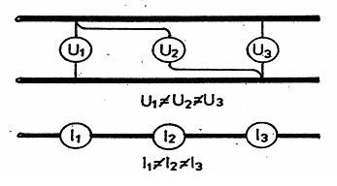
Circuits with spread parameters/elements
Circuits with concentrated elements can be described by final (limited) number of devices (R, L, C) which are connected by ideal conductors. Changes in such circuits are so slow, that the speed of propagation of changes is not critical. Equations contains just one independent variable – time. Only simple differential equation must be used.
Circuits with spread elements are described with more difficult differential equations, where are two variables: time and coordinates. Maxwell equations must be used for
describing such circuits.

Slide 4
RESISTORS
Basic parameter – electric rezistivity (R), dissipated power (P_{max})
Important parameters:
- temperature dependence of rezistivity (TCR),
- maximum applied voltage (V_{max}),
- voltage dependence of rezistivity (THI),
- frequency dependence,
- noise, nonlinearity (THI), ageing.
DESIGN
layered: carbon, metal, metal-oxide resistors
varnished resistor: varnished-carbon foil, just for high voltage appl.
wire resistors: power dumping resistor, variable resistors
non-linear resistors: thermistors (NTC, PTC), varistors (VDR – voltage depending resistors)

Slide 5
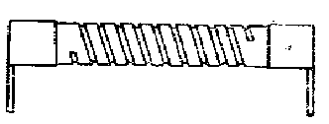
Carbon resistors
Device is made of ceramic cylinder body (e.g. alkalic ceramic) and covered with carbon layer. Layer of carbon is made by heat decompositions of some hydrocarbon (e.g. CH₂-CH₂).
Metal resistors
Design is similar to carbon resistors. Layer with required rezistivity is made from some metal – typically from chrome-nickel alloy (Cr-Ni) or Si-Fe-Cr.
Metal-oxide resistors (MOX)
Design is similar to metal and carbon resistors. Layer with rezistivity is made from Sn0₂ by using of reactive (jet) vapor deposition.
Varnished (lacquered) resistors
Resistive layer is sprayed on a ceramic body. Layer consist from polymer binder (varnish – terephthalate), rezistivity is managed by graphite filler (soot). Layer have a huge specific rezistivity!

Slide 6
Power wire resistors
Coiled ceramic body with resistive wire. For applications at high temperature (e.g. 350°C) coiling is one-layer made from chrome-nickel wire (TCR ~ 10⁻⁴ K⁻¹). Isolation is managed by oxide layer on wires. Undesirable feature is a quite big parasitic inductance.
Precise resistors
They are not dedicated and used for power application nor for high temperature operation. Resistors consist from ceramic or plastic body and from multi-layer winding. Winding is made from isolated Manganin, Kanthal or Constantan wire. Low TCR is required!
Manganin – 86 % Cu, 12 % Mn, 2 % Ni, TCR ~ 10⁻⁵ K⁻¹
Constantan – 54 % Cu, 45 % Ni, 1 % Mn, TCR ~ -3x10⁻⁵ K⁻¹
Bulk resistors
Bulk („mass“) resistors are made as a bulk of material with high specific rezistivity. Often are used ceramic materials contaminated with metal-oxide flakes, graphite or silit (SiC). Ceramics is then pressed and fired (burned) into required shape. Copper outlets (wires) are soldered.

Slide 7
Thick-layer resistors
In the past these resistors were used in hybrid devices (printed circuit board on ceramic plate with integrated semiconductor part. Today's some of thick layer resistors are made and used for surface mounted technology (SMT). Features are similar to layer metal and metal-oxide resistors.
Thin-layer resistors
Big specific rezistivity on square of thin layer is suitable for thin-layer resistors. Also such layer can exhibit low TCR (lower than 10⁻⁴ K⁻¹) The layer is made by vapor deposition on smooth and flat basis – glass, ceramic. Typical shape of such resistor is a meander or strip.
Foil resistors
Resistors are made as a thin layer (5 μm) of some metal (N, Cr, Cu). They are linear, stabile, low-inductance a low-capacity.

Slide 8
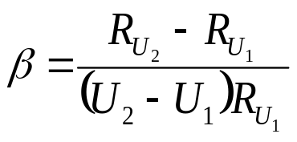
Temperature dependence of rezistivity
TCR – temperature coefficient of rezistivity, required minimal value
clean metals (not contaminated): 2÷10x10⁻³ K⁻¹ (Fe ~ 10; W, Mo ~ 5.5;
Cu ~ 4; Pt ~ 3.8)
alloys exhibit lower TCR: brass (Cu + Zn) ~ 1,5x10⁻³ K⁻¹
resistive alloys have the lowest TCR: 1÷3x10⁻⁵K⁻¹(Manganin, Constantan)
Voltage dependence of rezistivity (nonlinearity)
Under voltage stress (voltage loading) can be at maximum up to 10 % of nominal rezistivity (bulk, varnished resistors). Linear resistors (metal, metal-oxide) – low dependence (β < 10⁻⁶).
For AC signals is voltage dependence often indicated and measured as a non-linearity. This is given as a ration between supplied 1st. harmonic signal (V₁) and generated (undesirable) 3rd. harmonic signal (V₃). The ration called „Third Harmonics Index“ (THI) is often given in a dB unit.

Slide 9
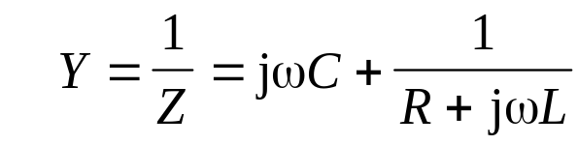
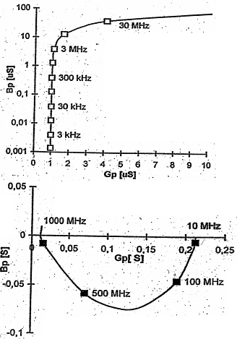

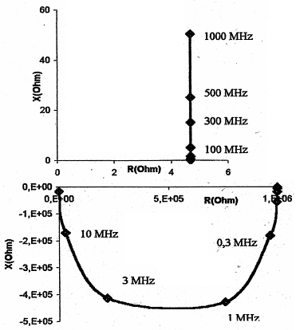

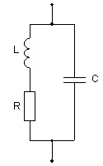
Frequency dependence of impedance:
For the majority of commonly used resistors the diagram shown on the left can be used. It can describe behavior in a wide frequency band. „R“ is a main rezistivity, „L“ is a parasitic series inductance and „C“ is a parasitic parallel capacity.

Slide 10
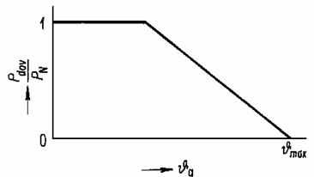

Maximum total power
Up to some ambient temperature (typically 80°C) the loading can by 100 % of nominal.
Thermal noise
Thermal noise is a non-periodic, non-harmonic random signal with natural origin. It is frequency independent. U_{n} is an average noise voltage; k is a Boltzmann’s const. 1.38x10⁻²³ J/K; T is absolute temperature; B is equivalent frequency bandwidth; R is a rezistivity. Thermal noise is not a quality marker.

Slide 11

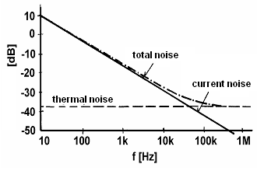
Current noise (flicker noise)
u_{n}² is a square of noise voltage measured in 1Hz band, A is a quality marker of used resistor, I is a loading current, f is a frequency, α, β are parameters depending on the type of resistor (typically α = β = 2).
The level of current noise is critical mainly in low-frequency audio and video HiFi equipments. Current noise is a quality marker and can be used for predictions of reliability and life-time of devices. Current noise is frequency dependent.

Slide 12
Comparison of different types of resistors
type | carbon | Thin-layer | MOX-layer | Thick-layer | Wire wounded
Layer thickness (nm) | 10 up to 3000 | 10 up to 1000 | 10 up to 1000 | 10 up to 30 um | -
specific rezistivity per square (Ω) | 1 up to 5000 | 20 up to 1000 | 20 up to 1000 | 10 up to 1000 | -
TCR (ppm/K) | -800 up to -200 | ± 100 | ± 300 | ± 300 | ± 30
max. operational temperature (°C) | 125 | 175 | 250 | 50 | 350
drift (%) | 1 | 0.5 | 2 | 1 | 0.01 – 0.1
current noise | medium | very low | low | low | negligible
nonlinearity | medium | very low | low | low | negligible

Slide 13

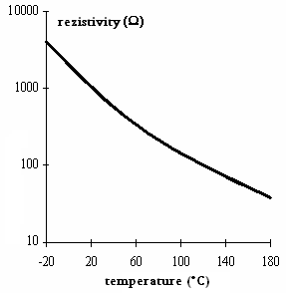
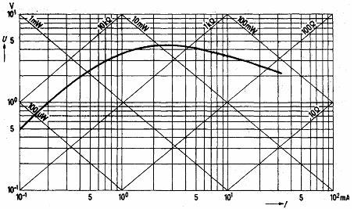
Nonlinear resistors
- thermistors (NTC, PTC)
- voltage depended resistors (VDR) – varistors
- photoresistors
NTC thermistors – negative dependence, rezistivity is unproportional to the ambient temperature, C is close to zero, B is in the range 10³ up to 10⁴.

Slide 14
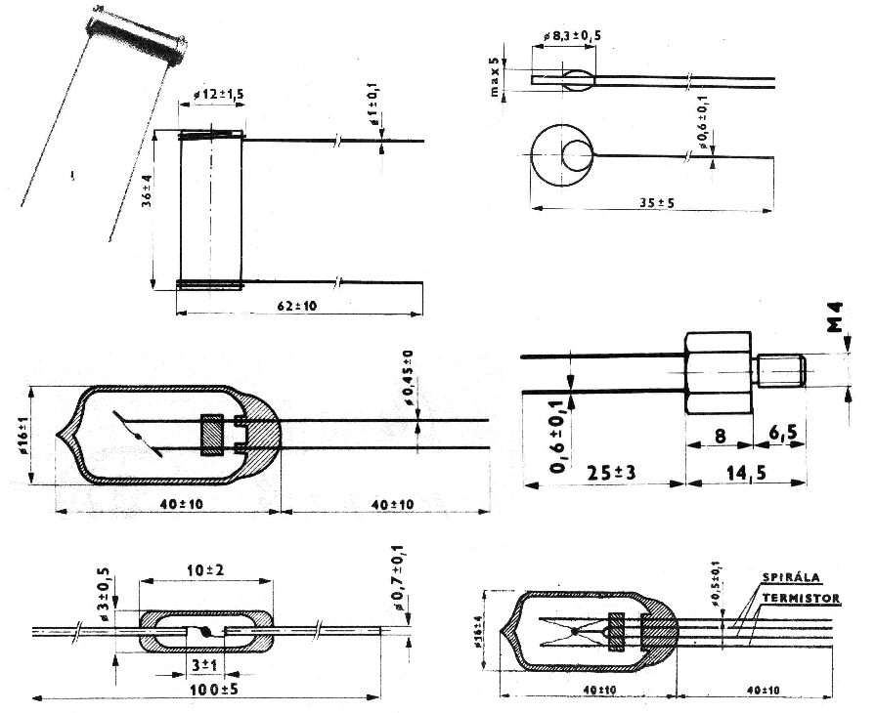
Examples of thermometers based on thermistors

Slide 15
Design of NTC thermistors
- shapes similar to: pales, tablets, small pearls,
- materials: polycrystalline semiconductors plus oxides of Mn, Ni, Cu,
Co, V, Cr, Ti, W, (in the past often used UO₂, TiO₂, CuO). Minced
mixture of oxides must be homogenous and well mixed.
Pales and tablets:
- pressed under big stress (600 kg/cm²) into required shapes,
- burning at temperature 1000°C (up to 1400°C) in oxidation
atmosphere,
soldering of Cu outlets by Ag paste.
Small pearls
- between two wires of Pt-alloy (with diameter 25 – 100 μm) is putted
a drop of minced mixture,
burning at the same temperature as above,
capsulation into glass (thermometers) or vacuum capsule,
important is artificial ageing to stabilizing electric features!

Slide 16
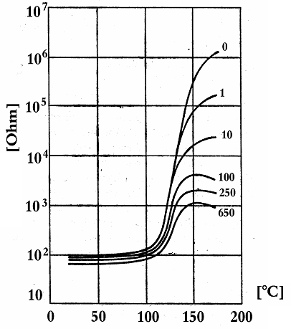
PTC thermistors – positive dependence, at cold-state low impedance, at hot-state high impedance. This effect is caused by ferroelectric material and changes of its permittivity.
- low temperature = ferroelectric
domains exhibit high electrical
strength – conductive low impedance
state,
high temperature = ferroelectric
domains exhibit lower permittivity and
lower electric strength – high
impedance state.
- PCT are both voltage and
frequency dependent devices.

Slide 17
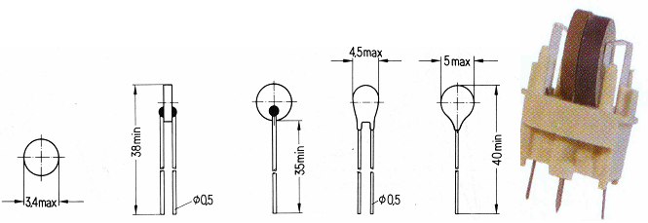
Design of PTC thermistors
used shapes: pales and tables again,
materials: burned mixture of BaCO₃, SrCO₃, La₂O₃, TiO₂, SiO₂,
processing: minced mixture is formed under a big stress; burning at
the temperature 1100°C starts calcinations process; than second
mincing and final burning/annealing at 1400°C for 2 hours; soldering
of Cu outlets (wires).

Slide 18
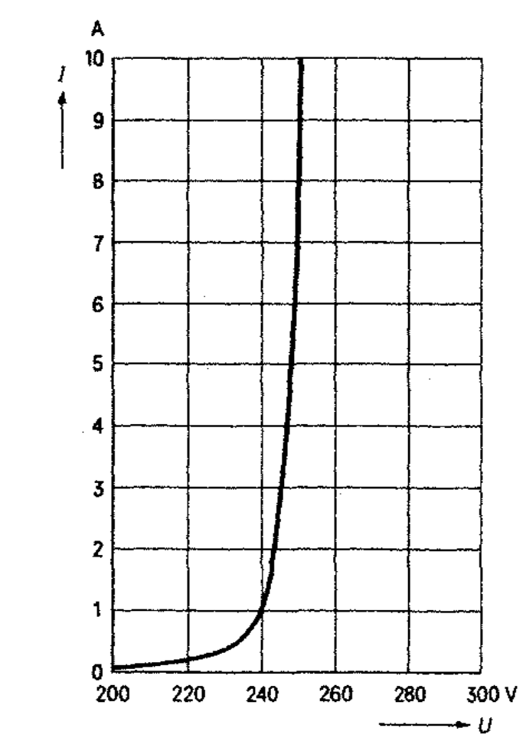

Varistor (VDR)
- resistor made from polycrystalline
semiconductor, I-V characteristics as follows:
- fast increase of flowing current after achieving
of breakdown voltage,
- decrease of impedance is caused by increase
of electrical strength between domains of
semiconductor,
- I-V characteristic are symmetric for negative
and positive polarity,
- fast response in the order of 50 ns,
- at higher frequencies VDR seems to be a
capacitor with big power loss.

Slide 19
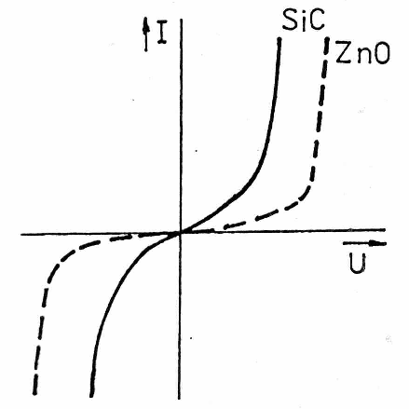
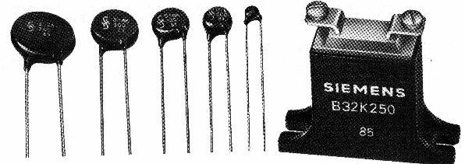
Design of varistors
- shape: typically tablets, pressed from a
mixture of polycrystalline semiconductor,
- material: SiC (old), now ZnO with MnO,
Sb₂O, MgO, Bi₂O₃ and fixed with a
glass fibers,
- outlets: burned AgPd pads and soldered
Cu wires outlets,
- covering: synthetic or epoxy resin

Slide 20
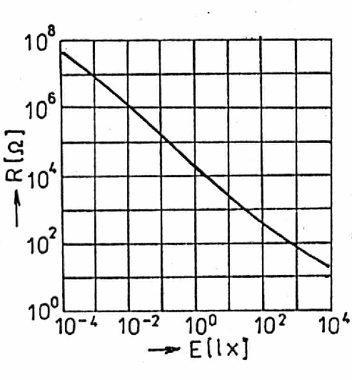

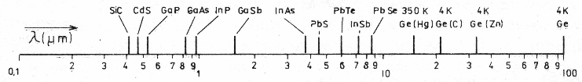
Photo resistors
- I-V characteristics is nearly linear, rezistivity is
depending on illumination,
- based on semiconductor material without pn
junction, rezistivity is influenced just by internal
photo effect,
- influence of light is determine by a spectrum
function of sensitivity,
- typical materials: CdS (similar to human eye),
then PbS, PbTe, CdSe, InAs, InSb etc.
dynamic response not fast (CdS very slow ~
1000 s, InSb faster ~ 10 μs).
(E – illumination, γ – conversion factor)

Slide 21
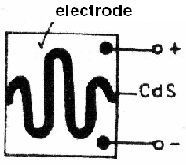
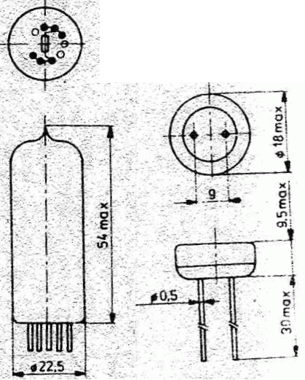
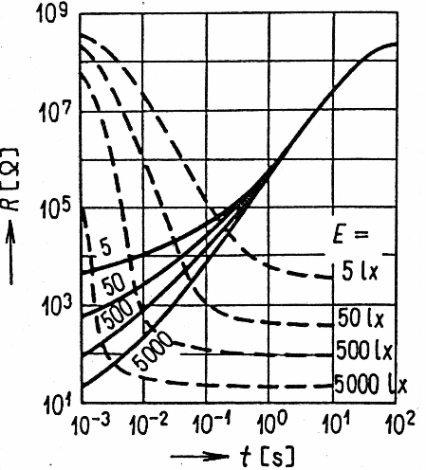
Design of photo resistors
- active layer is applied on basis pad (ceramic, glass etc.)
- layer is sensitive on humidity – hermetical capsulation is
important (glass is the best, plastics and epoxy for
low-cost applications)
- purpose: contact-less switches and sensors

Slide 22
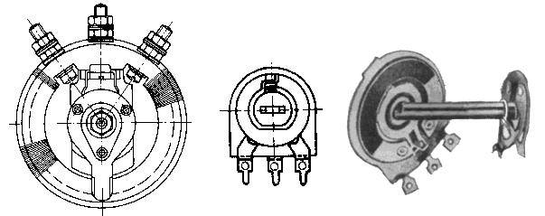
Variable resistors: potentiometers, trimmers
Design of variable resistors is based on movable collector moving/rotating above a resistive track. Mostly used design is shown bellow.
- layer resistors: resistive track is created from varnished
ceramic, cermets or conductive plastics (cermets = ceramics +
metal; it is composite),
- wire resistors: resistive track is made from wire coiling wounded
on some isolation,
- movement of collector: linear, rotation, helix, etc.
- potentiometers: longer lifetime and more cycles,
- trimmers: just for settings and few cycles.

Slide 23
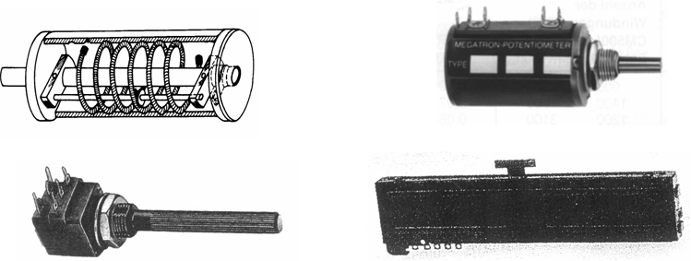
collector: moving above the resistive layer, important is small transient rezistivity between collector and track, typically made from carbon,
profile of track: dependence between movement (angle, position, etc.) of collector and rezistivity,
Helix wired potentiometers: They have typically very long resistive track, collector can make a lot of turns, used for precise settings and adjustment.

Slide 24
Basic features
- similar to features of fixed resistors,
- typical values of resistivity from the sets E6 or E12,
- resistivity of layer tracks between 100 Ω and 5 MΩ,
- resistivity of wired tracks between 1 Ω and 100 kΩ,
- tolerance (accuracy) 20 %, just for special usage 0.3 %,
- possible profiles of tracks (inc. marking):
  - linear N, A,
  - linear special Ns,
  - logarithmic G 50 dB, G 60dB,
  - logarithmic with diversion Y,
  - linear with diversion F,
  - exponential E 50 dB, E 60 dB, C (complement to logarithmic),
- tolerance of resistive track: sometimes 0.3 %, for doubled
potentiometers (audio-video) 1 or 3 dB

Slide 25

Features – follow-up
- maximum total power – the same issue as for fixed resistors,
- maximum applied voltage – given with isolation between track and
fixing armature,
- maximum current – restricted due to possible damage of collector,
- noise – given by thermal noise of resistive layer,
- whisper/rustle signals – disturbance given by movement of collector,
not substitute with noise!
Typical levels of whisper signals are from 1 μV/V_{DC} up to 10 μV/V_{DC}.
Mechanical properties
- angle of rotation: single-turn potentiometers use a track shorter than
360°
multi-turn potentiometers can use 2, 5, 10, 20 turn (higher accuracy).

Slide 26
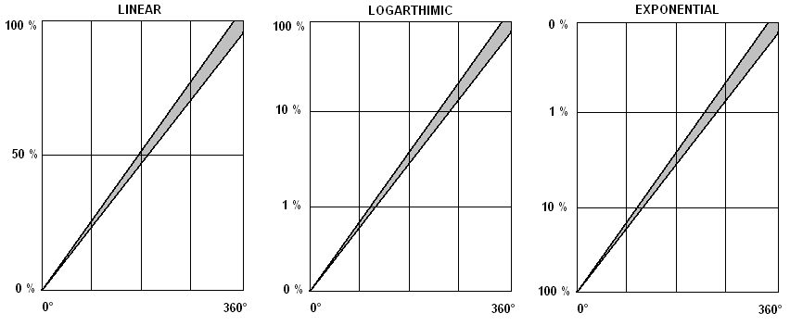
Typical profiles of tracks gray area – tolerance field

Slide 27
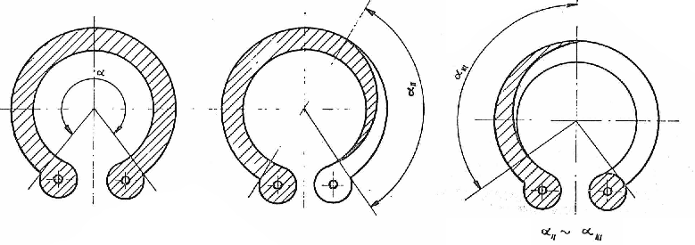
Design of layer variable resistors
- resistive track: rounded on an isolation basis (paper, ceramics,
plastics, cermets, etc.),
- varnished tracks: layer is sprayed from a mixture of varnish and
carbon filler,
- nonlinear tracks: multilayer structure, bottom layer has the higher
resistivity, top layer has the lowest resistivity.

Slide 28
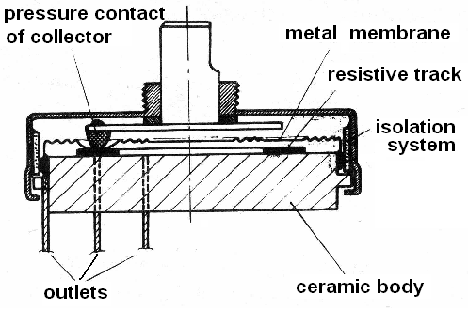
Cermets tracks: resistive layer is made from burned paste on a ceramic basis. Layers are made by thick-printing technology (silk-screen printing). Only linear profile can be made.
Tracks from conductive plastics: tracks have a big cross-section, are abrasion-proof, also tracks with non-linear profile can be made.
Collectors: typical made from bronze with phosphorus and carbon contact. Convenient is a design with a metal membrane between contact and track – abrasive-proof solution with longer life-time.

Slide 29
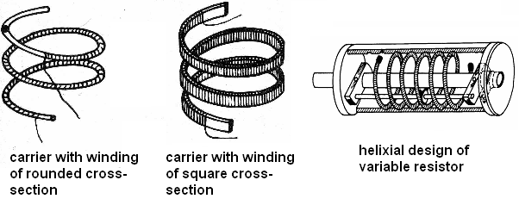
Wire helix resistors
Collectors are moving along helix winding. Such types are commercially known as „ARIPOT“ or „HELIPOT“ design. Resistive track is quite long and wounded on a carrier (isolated metal or ceramic chassis).
Collectors are moving just in axial direction. All the mechanical parts must be precise and adjusted together. Shafts are honed (sharpened) and holed in a bear rings. Some types of HELIPOTs are covered into hermetic capsules and filled with a mineral oil.

Slide 30
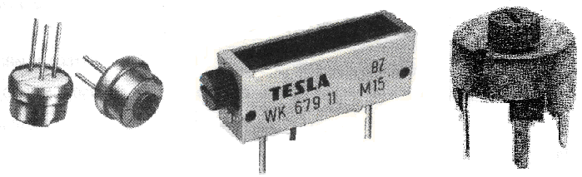
Trimmers – tuning resistors
Basic principle is the same for potentiometers as for trimmers. Trimmers usually don't have shaft and knob, setting in done manually by some tool (e.g. screwdriver). Design is simplified – without cover, trimmers used to be fixed by outlets (missing armature/chassis). Long-life operation is not expected, trimmers are used just for settings. Only ability to lock the collector is required.

Slide 31

Comparison of different types of variable resistors
 | carbon layer | cermets layer | wired | wired, helix | plastic track | cermets trimmer
accuracy of track | 10%, 3dB | 1 % | max. 1 % | 0.1 % | 10 % | 1 %
whisper signals | 1 μV/V | 10 μV/V | none | none | 100 μV/V | 100 μV/V
max. power | 1 W | 1 W | 1 kW | 1 W | 1 W | 2-3 W
life-time (cycles) | 10⁴ - 10⁵ | 10⁴ - 10⁵ | 10⁴ - 10⁵ | 10⁷ | 10⁸ | 100
stability | 10 % | 1 % | max. 1 % | 0.1 % | 0.5 % | 1 %
cost (a.u.) | 20 | 30 | 30 | 500 | 500 | 10

