Slide 1
Cooling of power semiconductor devices

Slide 2
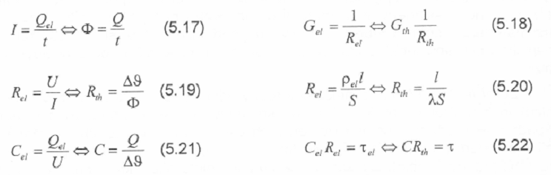
Analogy between thermal end electrical field
electrical variable | voltage | charge | Current | Resistivity | Conductivity | Capacity
 | V | Q | I | R | G | C
Units | V | C | A | Ω | S | F
thermal variable | Difference of temper. | heat | heat density | Thermal resistivity | Thermal conductivity | Thermal capacity
 | Δ υ | Q | Φ | R_{th} | G_{th} | C_{th}
units | K | J | W | KW-1 | WK-1 | JK-1
Conclusion: Thermal tasks can be (after some adaptation) solved and simulated
as electrical circuits.

Slide 3
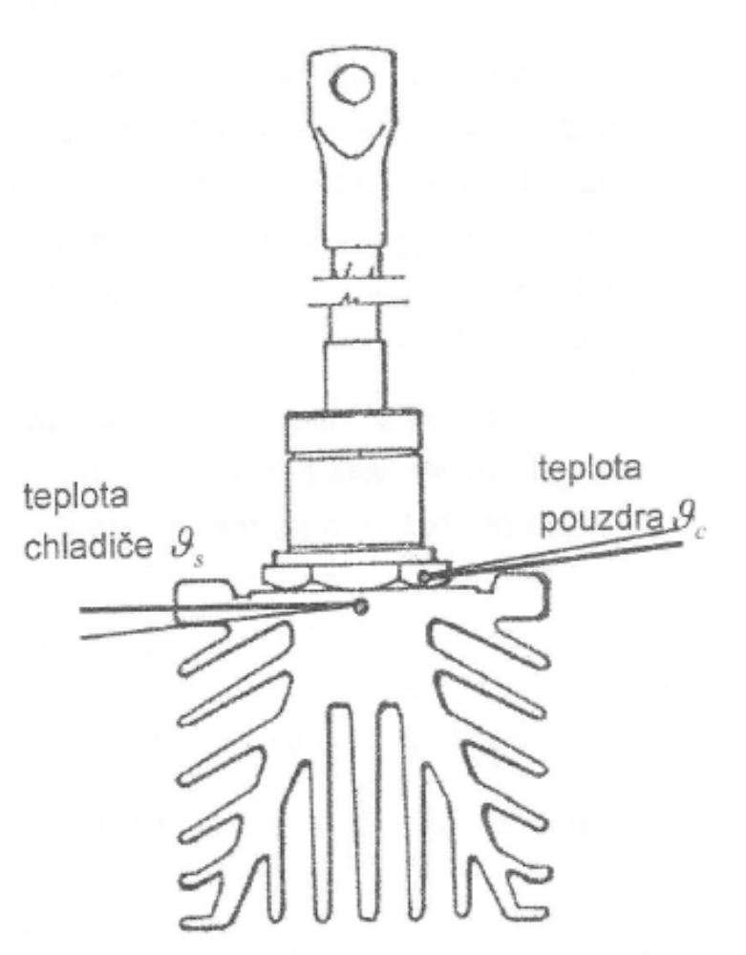
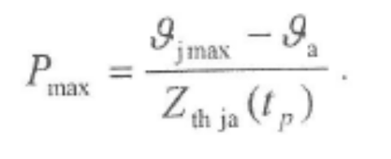
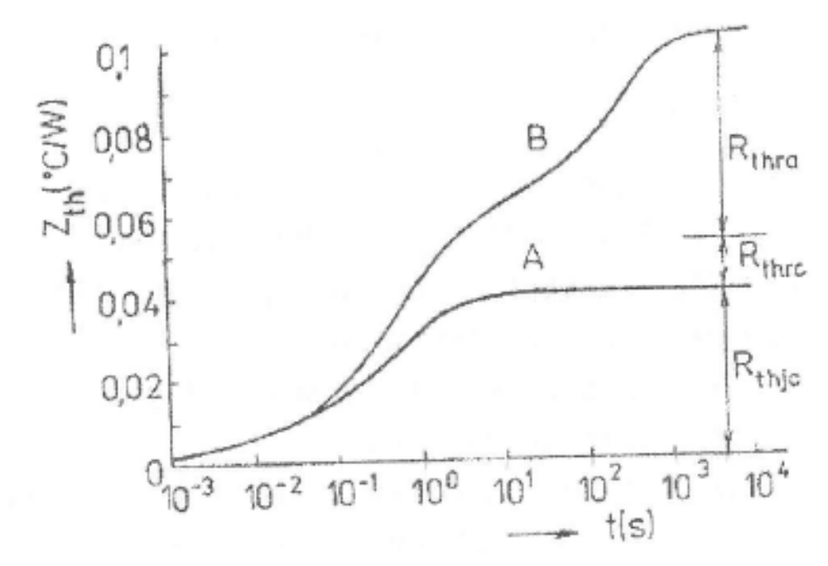
Thermal resistance
Following expression defines the highest acceptable power losses with respect to the maximum operation temperature (T_{jmax}). This T_{jmax} can influence the reliability and life-time of devices:
Time dependent thermal resistance is called „Transient Thermal Impedance“ (it includes also thermal capacity)
Temperature of heat sink
Temperature of case (housing)

Slide 4
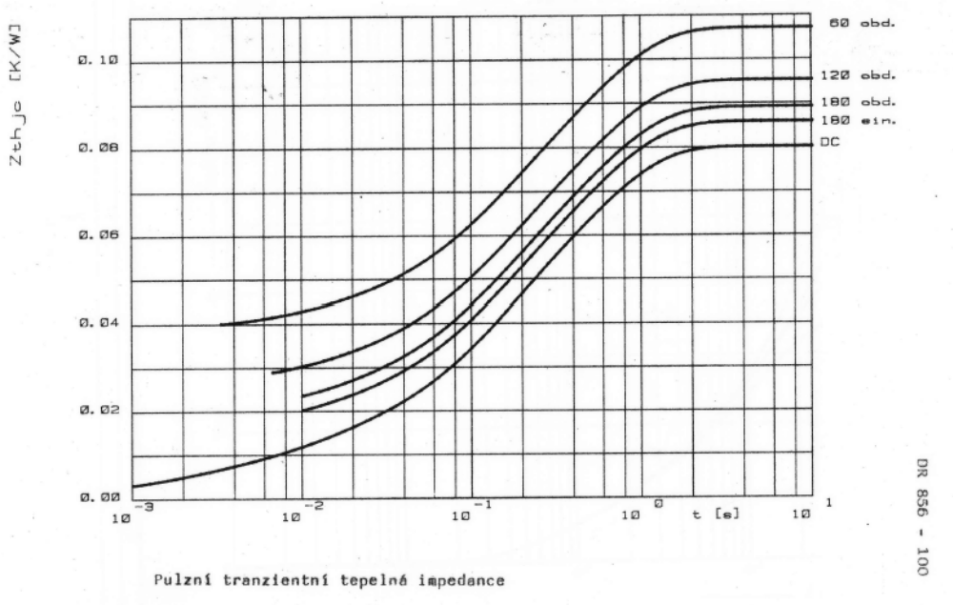
Transient Thermal Impedance Z_{th}/R_{th}
After disappearing of dynamic (transient) process: Thermal impedance Z_{th} (variable) changes into constant thermal resistance R_{th}.

Slide 5
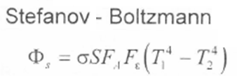
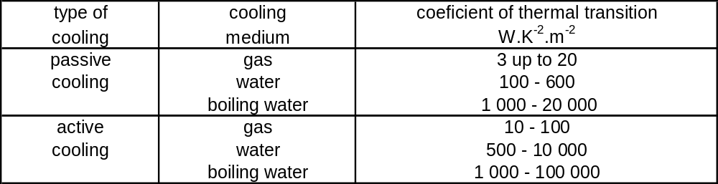
Radiation and convection of heat
Passive cooling: small efficiency; thermal transport is proportional to T⁴; for common temperature range (up to „F“ class - 190°C) is nearly negligible:
Radiation of heat is always influenced by properties of surfaces. Especially, emission coefficient Fε (sometimes called just ε) is very important. Active cooling (movement of cooling fluid – gas or liquid) is much more efficient, see table with the coefficient of thermal transition:

Slide 6
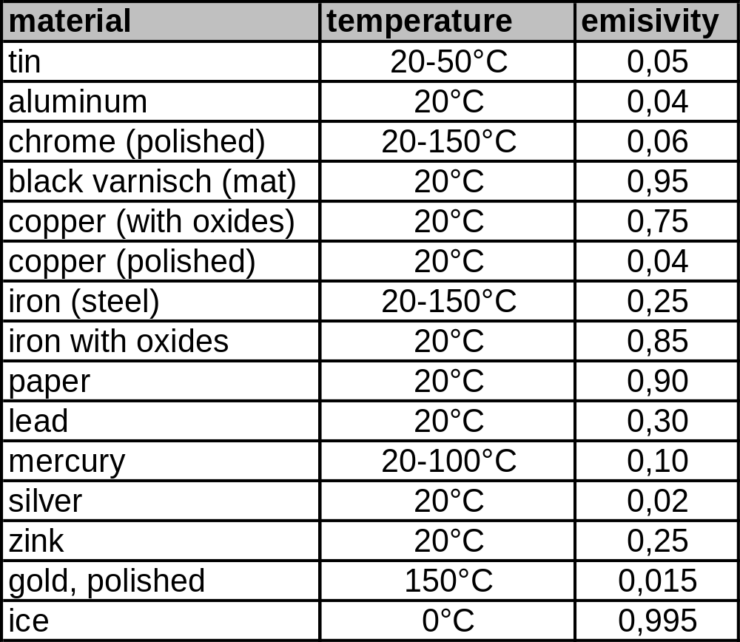
Emission factor Fε of important surfaces

Slide 7
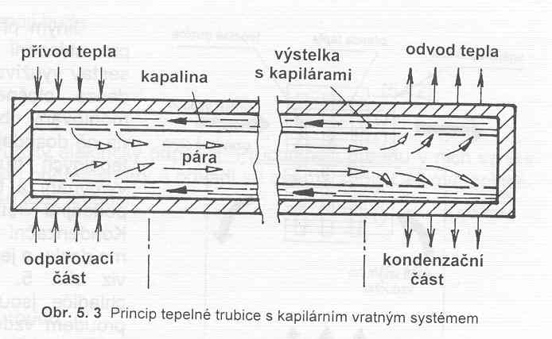
Heat pipes – the most effective cooling
Incoming heat
capillary system reverse transport
Heat transfer
liquid
Vapor area
Boiling area
Condensation area
Heat pipes exhibits the highest efficiency of heat transport. They are based on phase-changing between liquid and vapor. This changing is repeatable. Composition of used liquid can change a boiling temperature. Water is used for 100°C (standard 101 kPa); alcohol-based liquids for range 60-80°C; liquefied gas (N₂, etc) for cryogenic range.

Slide 8
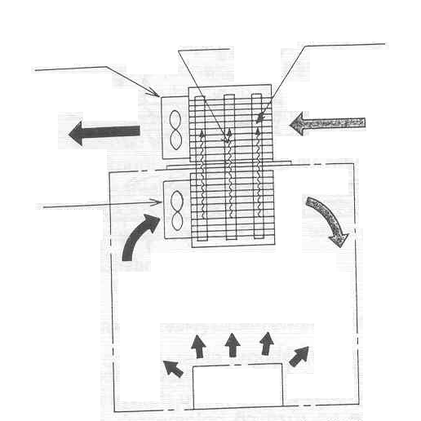
Advantages of heat-pipes
The biggest advantages of heat-pipes are small dimensions and low weight. They also enable to transmit the heat for a long distance (units of meters).
E.g.: power converter in locomotive (source of heat) and heat exchangers at the roof of locomotive are separated by 3-8 meters of pipes.
Heat transport
Heat pipes
External fan
External air-flow
Closed box
Internal fan
Internal circulation of air flow
Heat generator

Slide 9
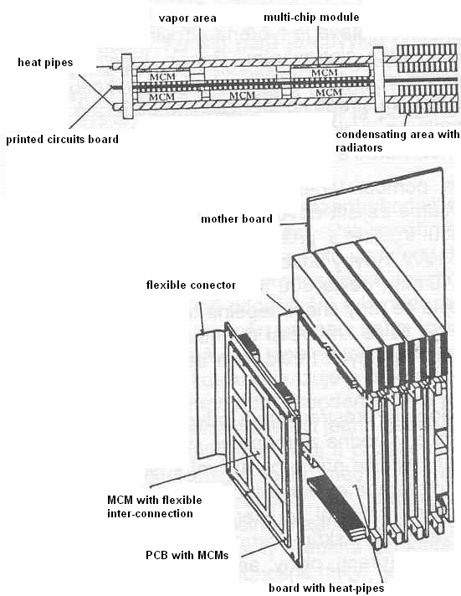
Heat pipes for printed circuits boards and multi-chip modules:
Thanks to the different filling, it is possible to make the cooling also in the range of 60-80°C. This is advantageous for electronic circuits (PC, notebooks, etc.)
Filling can be based on ethanol or glycerol liquids.

Slide 10
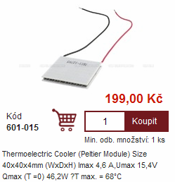
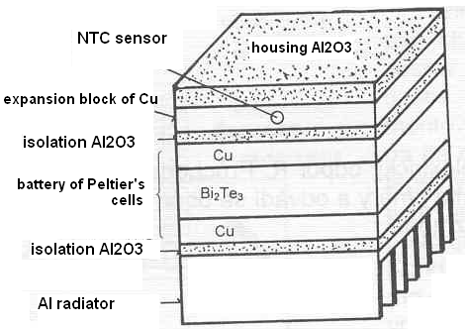
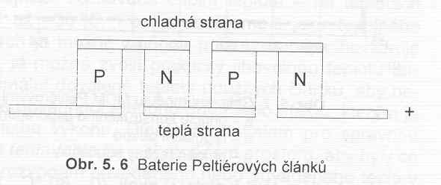
Peltiére’s cells
Example from e-shop www.gme.cz
It is based on a reversed Siebeck’s effect. Temperature changes (cooling effects) are caused by current flowing through a contact between two different metals. This is not a typical „cooling system“, because one side of cells is cool, but the second one is hot! It is just a „moving the temperature“ to another place. Also, Peltiére’s cells need some feeding / supply voltage!!!
Typical application of Peltiérs cells: cooling of notebooks, cooling boxes in cars (12V/ 4A) etc.
Cool side
Hot side
Battery of Peltieres cells

Slide 11
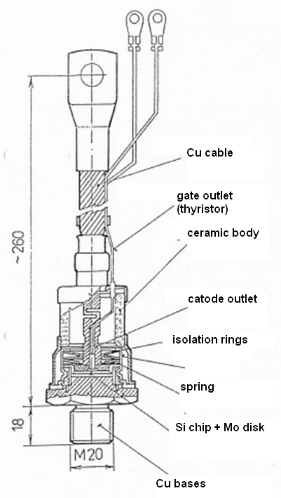
1. Generation – thread devices
Oldest design, from the 50th/60th of the 20th cent.
Simple connection via thread and cable (twisted rope),
Single-side cooling, not efficient, max. loading 200-300 A permanently,
Unsuitable relation between total mass and current density,
Today obsolete, just as a spare parts for traction systems (trains, tramway, etc)

Slide 12
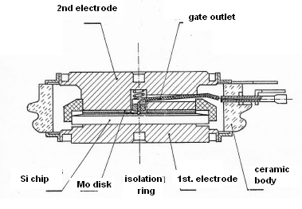
2. generation of devices (puck design)
puck or disk design
double-side cooling, much more efficient
difficult assembly, does not have „outlets“, clamping system is necessary
today trend – housing-less
design up to 190°C, for
minimizing of thermal resistance
loading up to 103 A
for high power appliances (MW)
diameter up to 6“ (15 cm)
very expensive

Slide 13
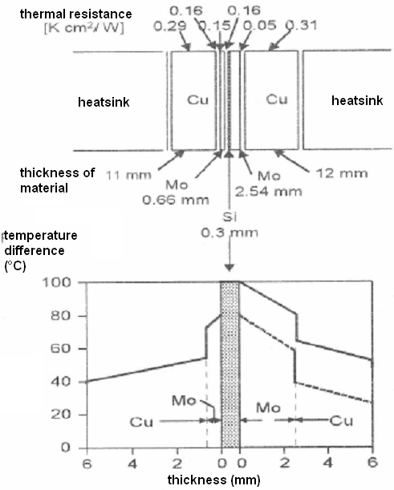
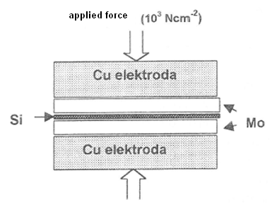
Thermal dilatation issue
Thermal dilatations and their matching is very important for reliable operation. Each device must be symmetric for thermal dilatation point of view. It can not be like a „bimetal“. Unfortunately, the most often used material Si + Cu are quite a problem. Therefore, Mo or W disk are inserted between Si and Cu parts. (W is today very expensive)

Slide 14
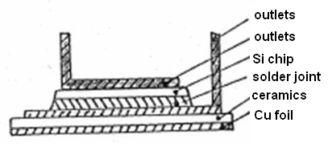
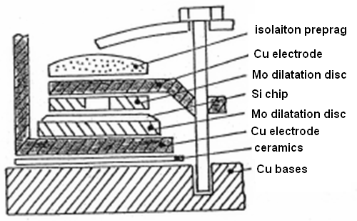
3. Type - power integrated modules
A few of discrete devices are capsulated in one isolated package. Also, they can be connected into a bridge or another circuit. Advantageous are small dimensions and inductance-less connection. Chips are placed at isolated cooling copper bases. Disadvantageous are worse cooling properties thanks to isolation by ceramics.
Isolation between chips and Cu base – typical be means of ceramics (Al₂O₃, AlN, Be₂O, Etc.)
Examples of „screwed“ modules – chips and electrodes are fixed by screws and bolts (not soldered)

Slide 15
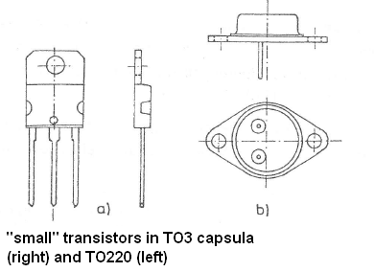
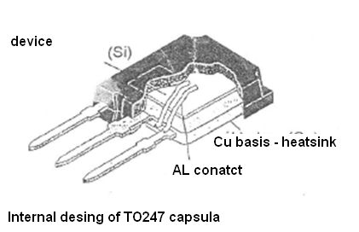
Packaging of „small“ devices especially for SMD technology and PCBs
Thanks to small dimension (units of cm), there are no troubles with different thermal dilatation of Si/Cu. Devices does not have symmetrical housings.

Slide 16
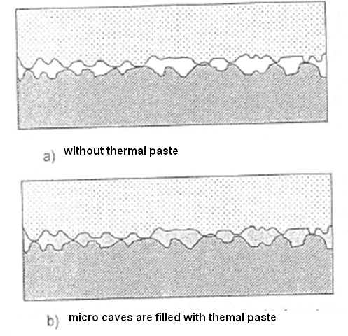
Impact of the surfaces on R_{th}
For achieving good cooling properties, it is necessary to keep required applied forces and torques. Proper metal contact between housing and heat sink is also important!
Inequalities, scratches and mechanical damages will deeply increase R_{th}.
For minimizing of R_{th} can be used thermal pasta, that is applied in a thin film. Either, it will stand for an additional Rth. Small devices for PCB sometimes are equipped with textile pads.

Slide 17
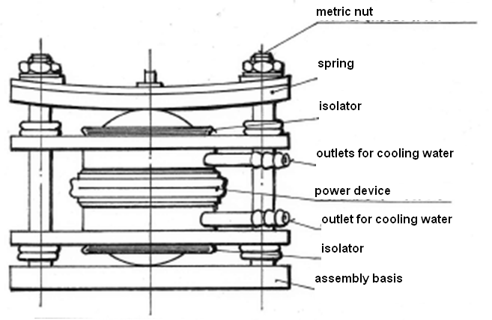
Assembly for water cooling system
Disc devices must be mounted into proper chassis. Important is a big applied force, that is concentrated in the middle of the housing (housing have a central hole). Chassis must be isolated from all HV parts.

