Slide 1
Organization, planning and management of production

Slide 2
Basic sorts of production
According SIZE (or detailed description of technology)
  MASS production: important detailed description of technology process, not qualified staff necessary
  PIECE production: important high qualified staff, often are given just brief instruction and documentation
According CONTINUOS of production flow
  Continual prod. (iron and steel works, cables)
  Batch prod. (electrotechnical industry, assembly factories)
According CHARACTER of production cycle
  Complete production („from pinhead to car“)
  Semi-finished product (work-in progress)
  Assembly cycle (today very popular)

Slide 3
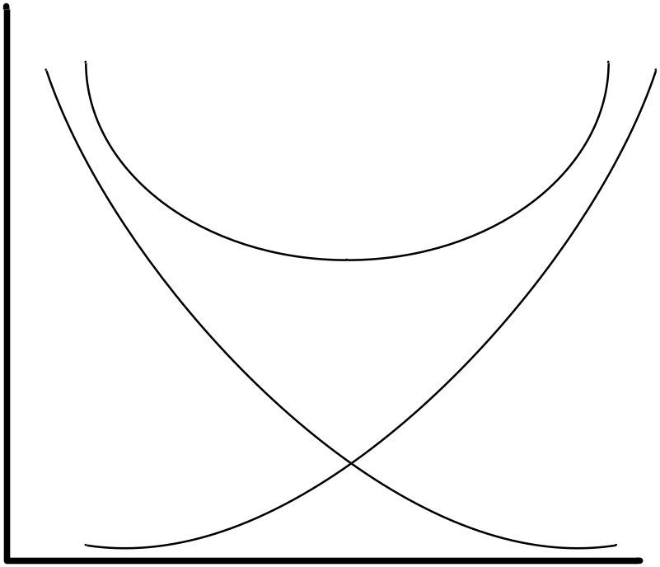
Optimization
Question of mass-production: How big shall be batches, how to select proper mechanical turning, etc.
  Big series (mass production) = more expensive preparation of production, but cheaper price for one piece
  There is an optimum for selected technology and number of produced pieces
Total price
optimum
Cost of press (machine)
Costs for
piece
pieces

Slide 4
Layout of productions
LINES – automatic lines, assembly industry. Layout is strongly copying production flow and operations.
CIRCULAR – so called „turning centers“, used by Volvo during 70th/80th, convenient just for automation turning and machining. It can minimize clamping = high accuracy of mechanical processing.
TECHNOLOGIC – e.g. production of semiconductors, PCBs, microelectronic etc. Layout is designed with respect to requirements on clean areas.
Main issue: How to solve flow of materials and staff; logistic. Layout shall copy the production flow, but many times it is impossible!!!

Slide 5
Main departments of typical factory
Purchasing – ensures „everything from pencil to steel sheets for transformers“.
Quality (control no.1) – „Input quality gate, e.g. quality statistic inspection of incoming materials (sheets for magnetic circuits)
Production – own process of creating products
Quality (control no. 2) – inspection of final product, focused on our staff – inspection of Production department.
Expedition – also called dispatching, or Orders-handling.
Other departments: facility (care of building, halls), service (care about machines), IT, HR, research + development, management, etc.

Slide 6
Marketing (behavior) of factory
Product based factory – exclusive product (Rolls & Royce), does not need advertising, limited production.
Production based factory – common trade marks (VW, SONY), house-hold goods, needs advertising, maximum of production.
Sale strategy – focused on current group of customers (e.g. young people – Apple), often used social engineering.
According marketing – structure of factory can vary! Product based factories don’t need PR department etc.
According advertising you can recognize type of marketing. Many companies just inform you about a new product without any other information (advantages) This is typical for car industry (slogan: „Das AUTO“, „Wir Leben Autos“ Etc.) It is just for you information, it does not have any special meaning.

Slide 7
Main parts of factory
Production – ensures the main function and profit of the company, typically at least staff, but the most cost-savings.
Purchasing – supplying of all other departments, incoming of materials (from „pencil to steel“)
Planning – control of purchasing and production, prediction of future orders, estimation of market place.
Graphical timetables (flow charts) – graphic representation of production flow including times, deadlines, etc. For the first time used in public transport systems!

Slide 8
Minor parts of factory
Quality (QC) – check-in of all internal process, including Environmental Management System (EMS) and OHSAS (Occupational Health and Safety Assessment Specification).
Research & Development – technical support for production, solving issues, project oriented work and budget, releasing new technologies and methods.
Facility – care about buildings, machines, cleaning service, etc. Big impact on quality, often undervalued!

Slide 9
Other departments of factory
Human resources (HR) – ensures new staff (today in Europe very undervalued), solves issues between management and trade unions, etc.
Management – strategic control, makes prognoses to the future, estimation of market places, creates company culture. Often difficult structure and not clear responsibility (typical for „big company). Sometimes various parts of management compete between each other.
Controlling (accounting dep.) – control of all financial flowing, responsibility for business results, strict rules for company operating at stock market (SOX rules, etc).

Slide 10
What is important during production (1 part)
Quality – today natural thing („customer comes back, not the product“)
OTD – On Time Delivery. Toady very important for good planning and logistic. Based on measurable parameter TPT – through-put time. This gives an information, how long does some production procedure take.
OHSAS (ISO 18000-1) – management for safety and healthy care during work. It covers safety controls, medical care, test fro alcohol on work-place, etc.
Productivity of the staff – It can be measured as a parameter „standard hour“ (since 19th century): „How many pieces can I do in one hour?“. Today are more popular „cost-drivers“. It is a more complicated information „How much (in TOTAL!) cost some operation? E.g. How much money cost impregnation of HV winding in Czech or in Germany, etc. According this information company decide, where it will be manufactured.

Slide 11
What is important during production (2 part)
Production cost – everything that comes into the production flow must be putted into information system (SAP, K2 etc). Each product is described by:
  list of components – numbered and sorted list of all components coming into final product, all items have its costs
  Work-flow – a list of all processes and labor (including price) necessary for manufacturing final product.
LEAN management – minimizing consumption of materials, costs, energy, etc. Production is focused only on real orders, no products are stored „in the stock“.

Slide 12
Tools for increasing quality
ISO – today considered as „out of fashion“, „nearly everyone can have ISO 9001“. Ownership of the ISO certificate does not give you any special advantage on the market.
TQM (Total Quality Management) – today popular in USA, Japan. Basic motto: „all the staff is responsible for everything“.
KAIZEN – „improvement ideas“. Translation of kai-zen from Japanese to English means „good things“. Staff is encouraged and evaluated to make a new improvements.
5S – five rules „how to keep order at work-place“. It comes from Japan in 60th, all rules begins at „S“, see next slides.
KANBAN – production flow is controlled by „cards“, each production lot/batch needs it own card. Without card can not be material processed. It helps to planning department.

Slide 13
KANBAN – What does it mean?
method for control production flow, each lot/batch is equipped by kanban „cards“ (something like a ticket in public transport sys.)
it can accelerate production and minimize TPT
it help us to reduced Work In Process (WIP)
it prevent us against „slow-movers“ or „slow-sellers products“
introduced by Toyota during 70th
KANBAN is driven by planning dep. By number of cards can be production flow controlled

Slide 14
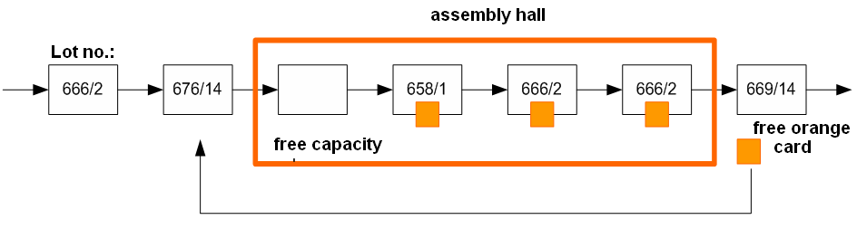
KANBAN – How does it work?
Each lot/batch has it own card („tickets“) for current production operation. E.g. Testing room has „orange“ cards, assembly hall has „blue“ cards, etc.
Number of card is equal to the number of lots/batches, that can be simultaneously in production flow.
It is forbidden to work and processed next lot/batch WITHOUT(!) kanban card with appropriate color.

Slide 15
5S – What does it mean?
It is a way, how to keep an order at workplace
Seiri = organizing of workplace. I am using only tools, that I really need. Everything other thing must be away.
Seiton = sorting – on the left is incoming materials, on the right are my tools, in front of me are slides with documentations, manuals, etc. Even a dustbin (rubbishing) has its own place marked with color strip!
Seiso = cleanest – on my desk there are no „broken pencils“, old newspaper, on my desk are only my things, that I am daily using for my job!
Seikutsu = standardization – all my tolls has its own name and place, everything is stored in boxes/boards
Shitsuke = training. New colleagues are trained, old staff is periodically trained also.

Slide 16
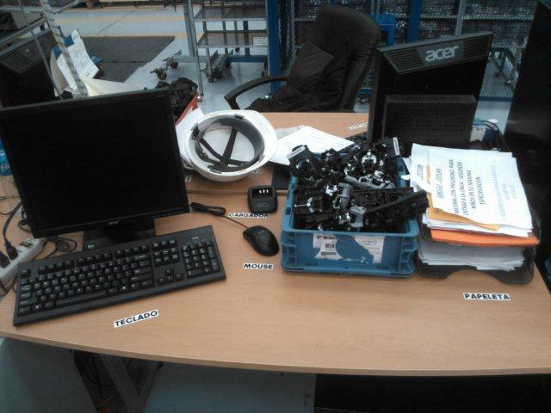
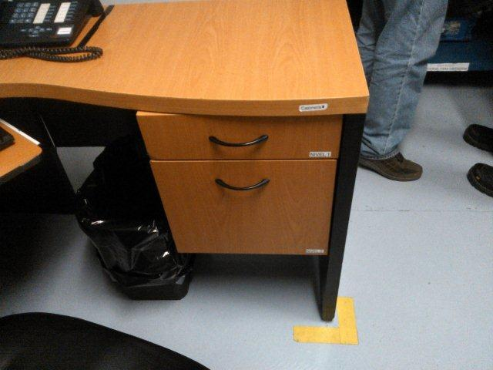
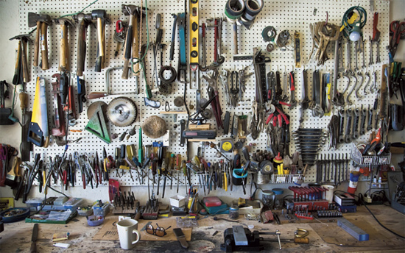
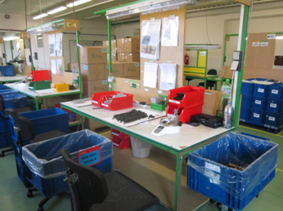
5S – examples from office and assembly hall
NO YES

