Slide 1
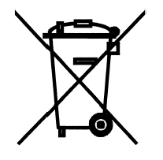
Wasted Electronic and electrical equipment – origin and processing
Hazardous substances in production - RoHS

Slide 2
Basic terms
Basic Czech law about wasted materials no.185/2001 Sb.
Wasted E&E Equipment /WEEE/:
  „product, which functionality depends on electrical current or on electromagnetic filed, or which is determinate for production, transport, measuring of electrical current or electromagnetic filed. It is dedicated for all equipments supplied from 1000 VAC up to 1500 VDC.“
WEEE – all household products are considered as WEEE after finishing its life-time.
!

Slide 3
Legislation
CZ Law no. 181/2001 Sb. About wasted materials
Directives EU:
  COUNCIL DIRECTIVE of EU PARLIMENT no. 2002/96/ES from the 27th. January 2003 about WEEE
  COUNCIL DIRECTIVE of EU PARLIMENT no. 2002/95/ES from the 27.th January 2003 About Restriction of using of hazardous substances (RoHS)
CZ Law no. 7/2005 – translation of 2002/96/ES and
Ordinance no. 352/2005 – Detailed description of handling with WEEE
!

Slide 4
Why to solve WEEE?
Material reasons:
  A lot of small equipments are containing very expensive (heavy/precious) metals (Au, Ag, Pb, Ta, Ni, Co, Cd, Pd…).
Ecological reasons:
  Using of hazardous substance during production flow
  Presence of some toxic substances in WEEE (batteries, accumulators, soldering, SMD components etc.)
Human reasons:
  South-east Asia – WEEE from USA, Japan, Europe, etc…

Slide 5
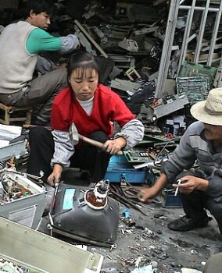
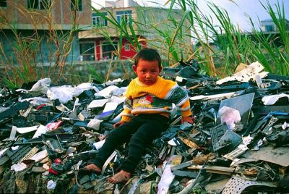
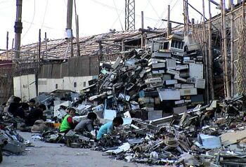
Why to solve WEEE
disassembly using simple tools – hammer, screwdriver, hands
manual separation of plastic materials, Fe/Cu/Al wires and parts
manual crushing of integrated circuits (sorting of Au, Ag, Pd etc. parts)

Slide 6
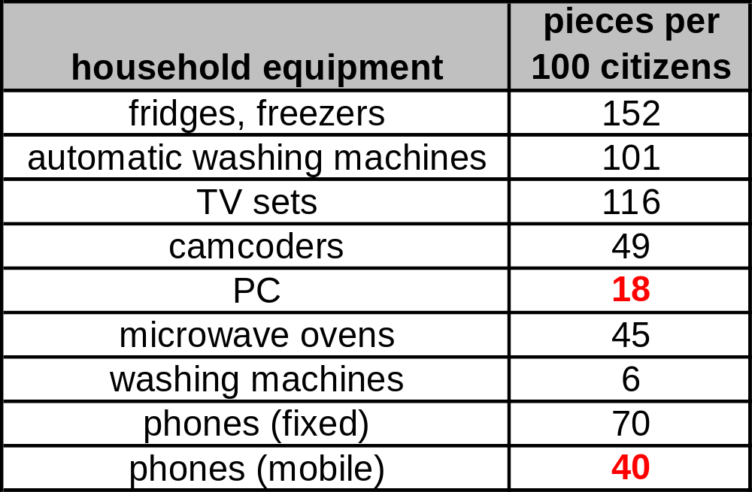
Facilities in household – production of WEEE
continual increase of no. of mobile phones, PC,
increasing complexity and sophistication of equipments
Number of current appliances in Czech households
old data!!!
Notes:
Statistika z r. 2002

Slide 7
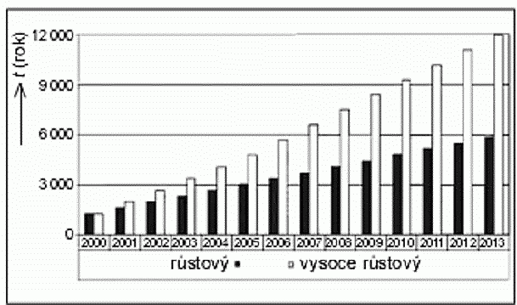
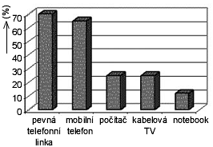
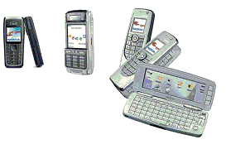
Prognosis of WEEE
Trend of WEEE per 1000 people in Czech
Today: about 4,0 – 4,5 kg of WEEE produced in Czech per one citizen.

Slide 8
Impact of WEEE on environment
Consumption of non-renewable sources – using of expensive (poisoned/heavy) metals – Hg, Pb, etc, and a lot of not-recycled materials
Consumption of energy – necessary for recycling of WEEE
Using of hazardous chemical materials in WEEE – Cd, Ta, Co, Cr, Pd, Pb, Hg
Necessity of a new places for rubbishing/junk

Slide 9
Responsibility and obligations in Czech
Directives of EU:
EU sets the obligation for all member states of retrograde purchasing (takeoff). Also recycling of WEEE is mandatory.
Basic aims:
prevention in WEEE branch
increase of volume of recycled equipments
minimizing of WEEE as a municipal waste
responsibility is on the producer!!! (basic principle) during the whole life-time of EEE (LCA = Life Cycle Assessment)
!

Slide 10
What belongs to WEEE?
    Big household appliances (freezers, washing machine, cookers, etc.)
    Small household appliances (fan, kettle, elec. shavers)
    Equipment of ITC, printers, photocopiers
    Consumer equipment (TV, Hi-Fi, DVD player…)
    Lighting systems
    Hand-held electrical tools (screwdrivers, grinders, drills...)
    toys, sports accessories
    Medical equipments (exception for implanted equipments – pacemakers)
    Regulating apparatus, sensors (e.g. for heating),
    Automatic machines for coins, coffee, etc.

Slide 11
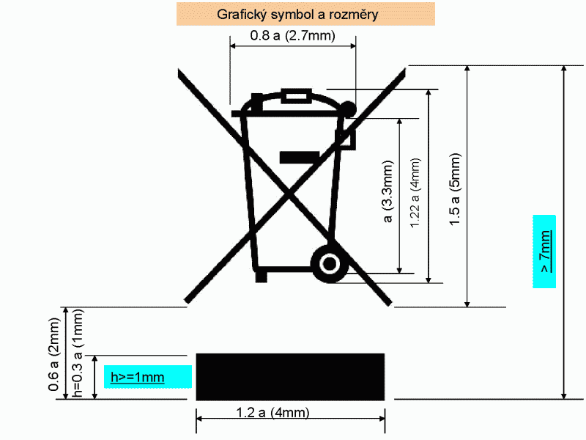
Obligations for producers
to be registered on the Ministry of the Environment of the Czech Department
provide marking of products as follows:
- date of introducing on market place
- symbol (name) of producer
- symbol of WEEE:
!
For all products after 13. 8. 2005 !
Notes:
Starý symbol !!!

Slide 12
Obligations for customers
Provide retrograde takeoff on the same place as purchasing
To be informed about the nearest place for takeoff
Retrograded (reverse) take-off
  Collecting of used WEEE from household
Selecting takeoff
  Collection of used WEE not from household, but from companies, from production lines, etc.
Repeated usage
  Using once again without any other processing – good idea, but it does not work at all !
Recycling
  Separation of basic materials and elements for second usage (energy and processing necessary)

Slide 13
Obligations for companies
Takeoff WEEE only at places dedicated for WEEE !!!
!
Obligations for manufacturers (processors) of WEEE
ensure storing
ensure repeated (second) usage of WEEE
register WEEE
handle with WEEE according Directives of EU (international transport, etc.)

Slide 14
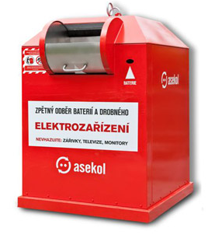

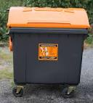


Companies recycling WEEE
ASEKOL
REMA
RETELA
SAFINA a.s.
Kovohutě Příbram a.s.
MHM eko s.r.o.
PAPER PLASTICS GLASS PAPER +Al

Slide 15
Directive RoHS
!
Based on Directive no. 2002/95 ES
Restriction of the use of Hazardous Substances
Beginning the 1st of July 2006 for newly introduced products are forbidden:
    Lead (Pb)
    Mercury (Hg)
    Chrome (Cr VI)
    Cadmium (Cd)
    Polybromme-bifenyle (PBB)
    Polybromme-difenylether (PBDE)
There is a lot of exceptions (batteries, varnishes. Etc.). Soldering – just without Pb - Pd-free !!! (higher temperature, lower reliability, not advantageous)

