Slide 1
Stress Enhanced Fear Learning (SEFL) Analysis
Brenna Williams
(will also upload recording)

Slide 2
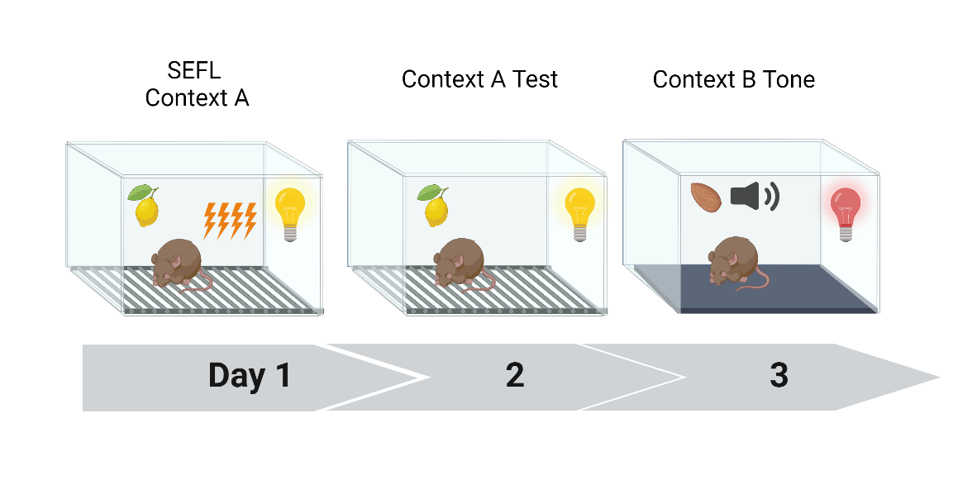
Stress Enhanced Fear Learning (SEFL)
Pavlovian behavioral paradigm used to model pathological anxiety and fear overgeneralization and is meant to capture features of PTSD.
How does Early Life Stress (ELS) impact the development of fear overgeneralization in adulthood?
Animals reared under ELS or control (Ctrl) conditions will be assessed for their freezing during Context A training and testing as well as in Context B to a mild stressor.

Slide 3
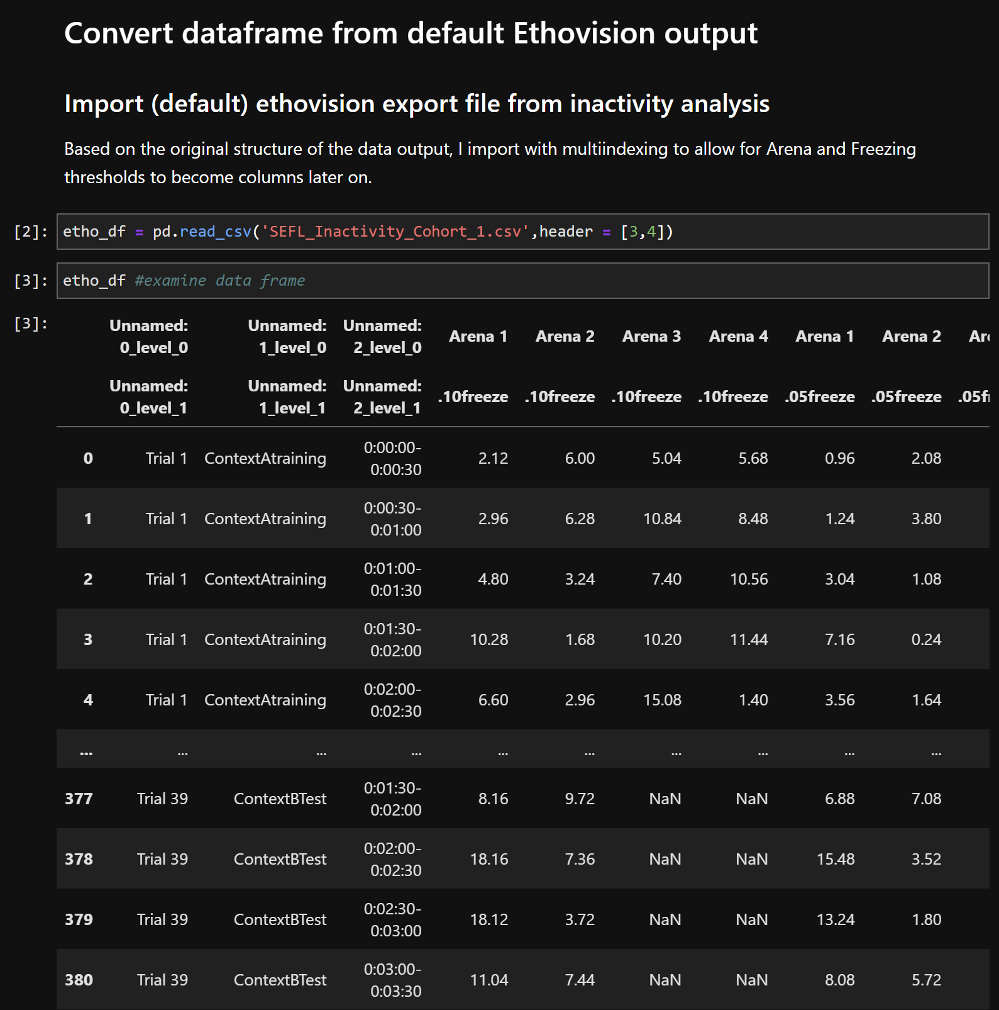
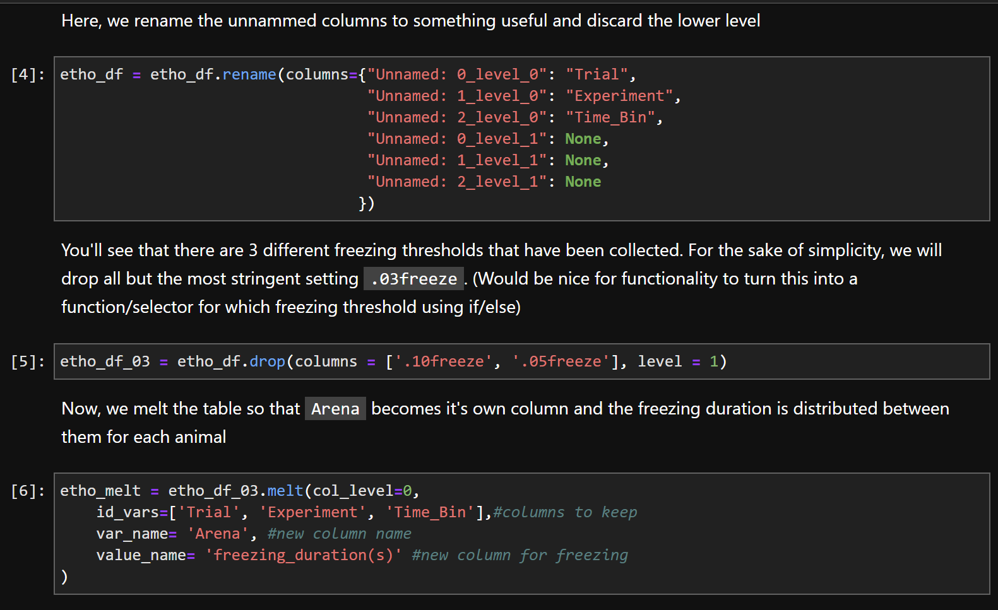
Notes:
Discard original header names and make the first two rows (arena and freezing threshold) into headers

Slide 4
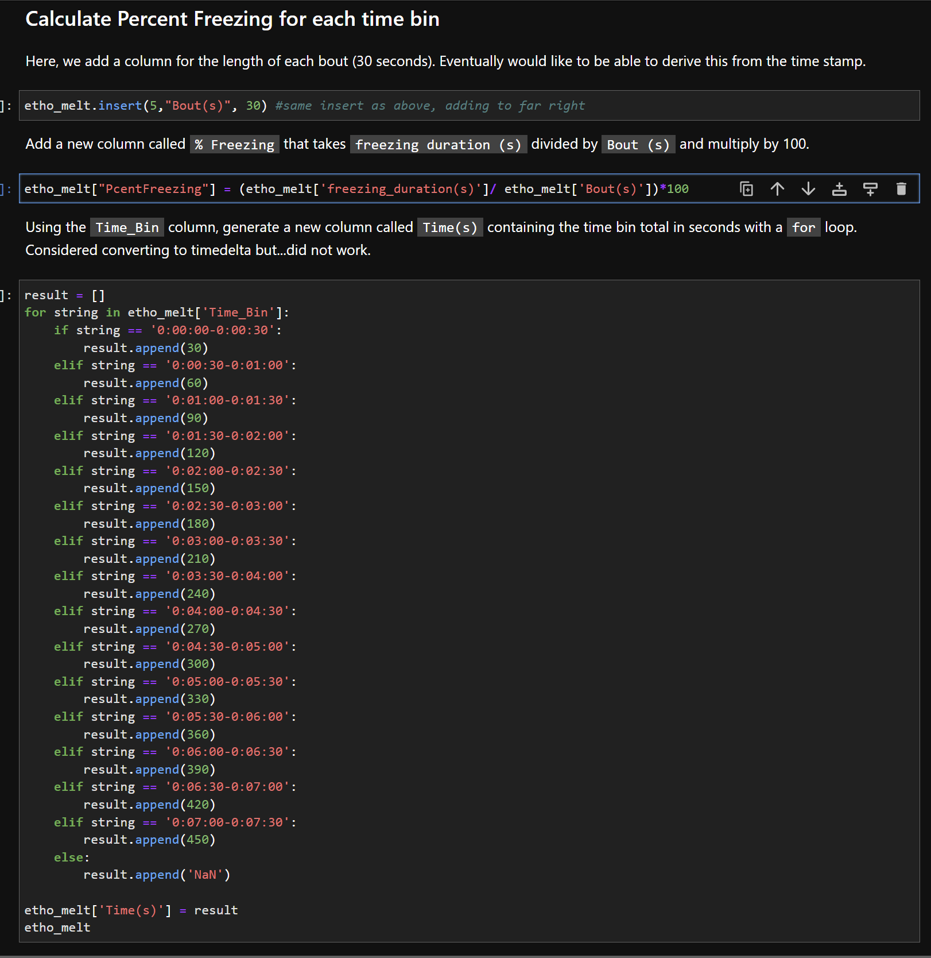
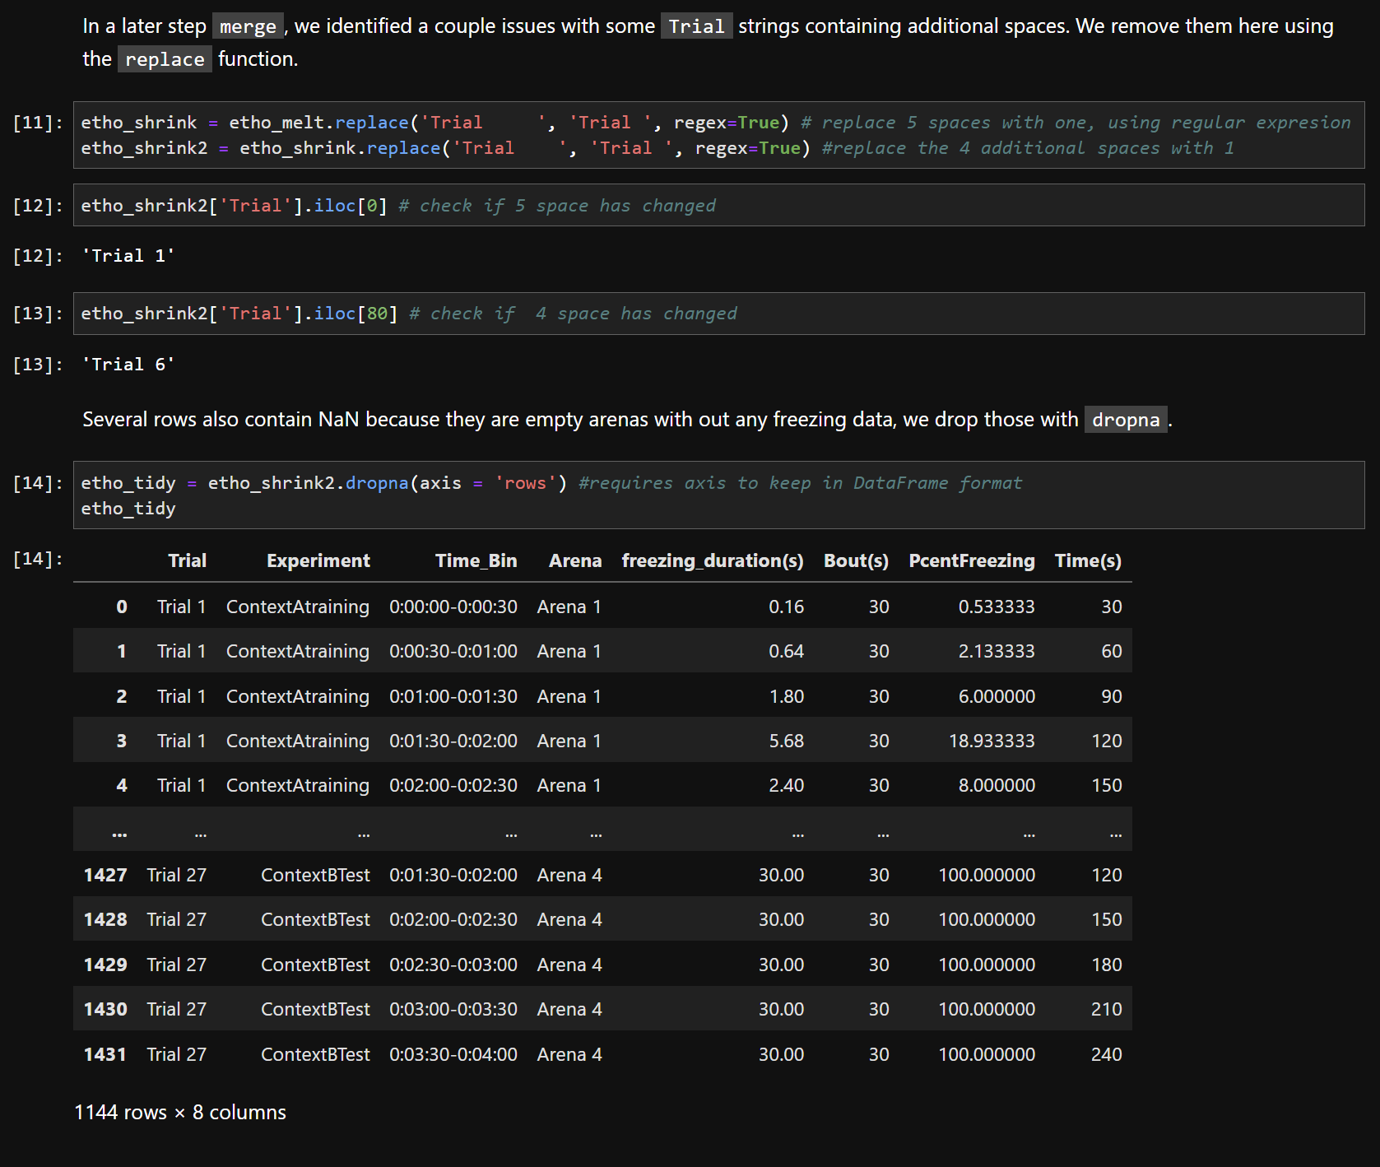
Notes:
Add a column that has a bout length of 30 sec
And create a new column that is freezing duration divided by bout
Create a new column called time bin that converts the pretty much useless time format into seconds
Found some issues with strings in the Trial column and fixed those and dropped Nas

Slide 5
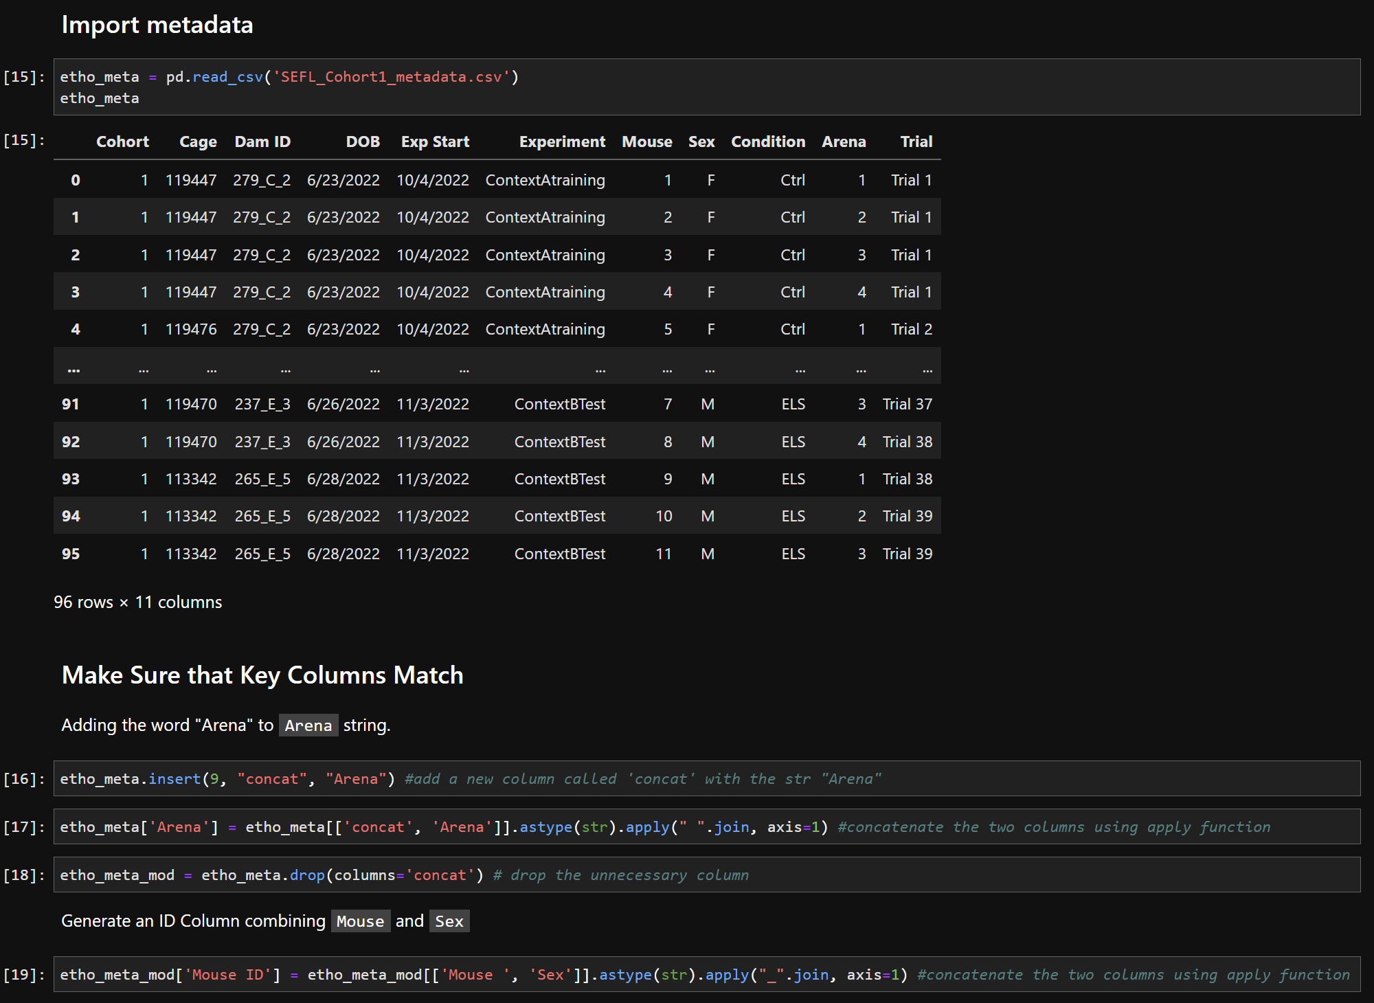
Notes:
Our metadata just has an integer so we add the word Arena to each instance by creating an “Arena” column and joining them.
We also create a new ID column that combines mouse and sex to make (1F, 1M, etc)

Slide 6
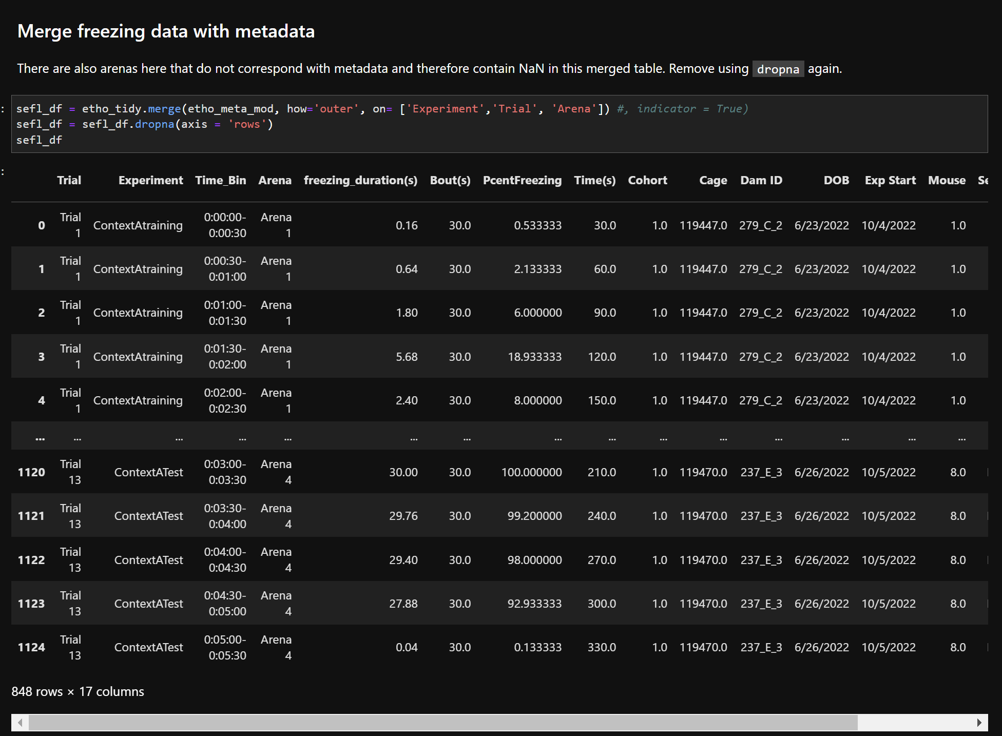
Notes:
Now that everything is matching, were able to perform an outer merge using the rows Experiment, Trial, and Arena as the key values (this actually took a ton of work to get to this point where it would actually merge)
We then drop NAs for arenas that didn’t actually have any animal data associated (empty arenas)

Slide 7
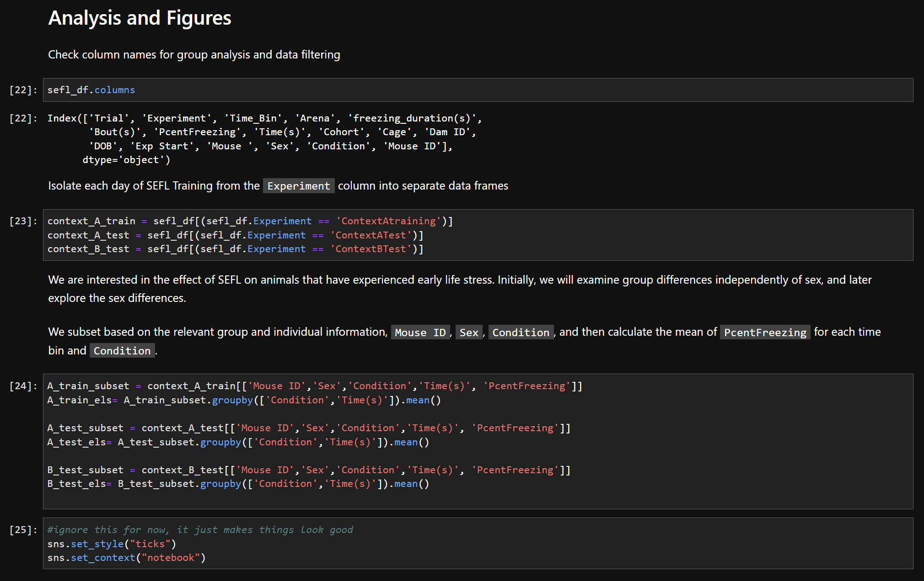
Notes:
Finally, we can group animals together and analyze their behavior.
We separate each experiment into different data frames
Then we subset based on the information we want to group by and analyze

Slide 8
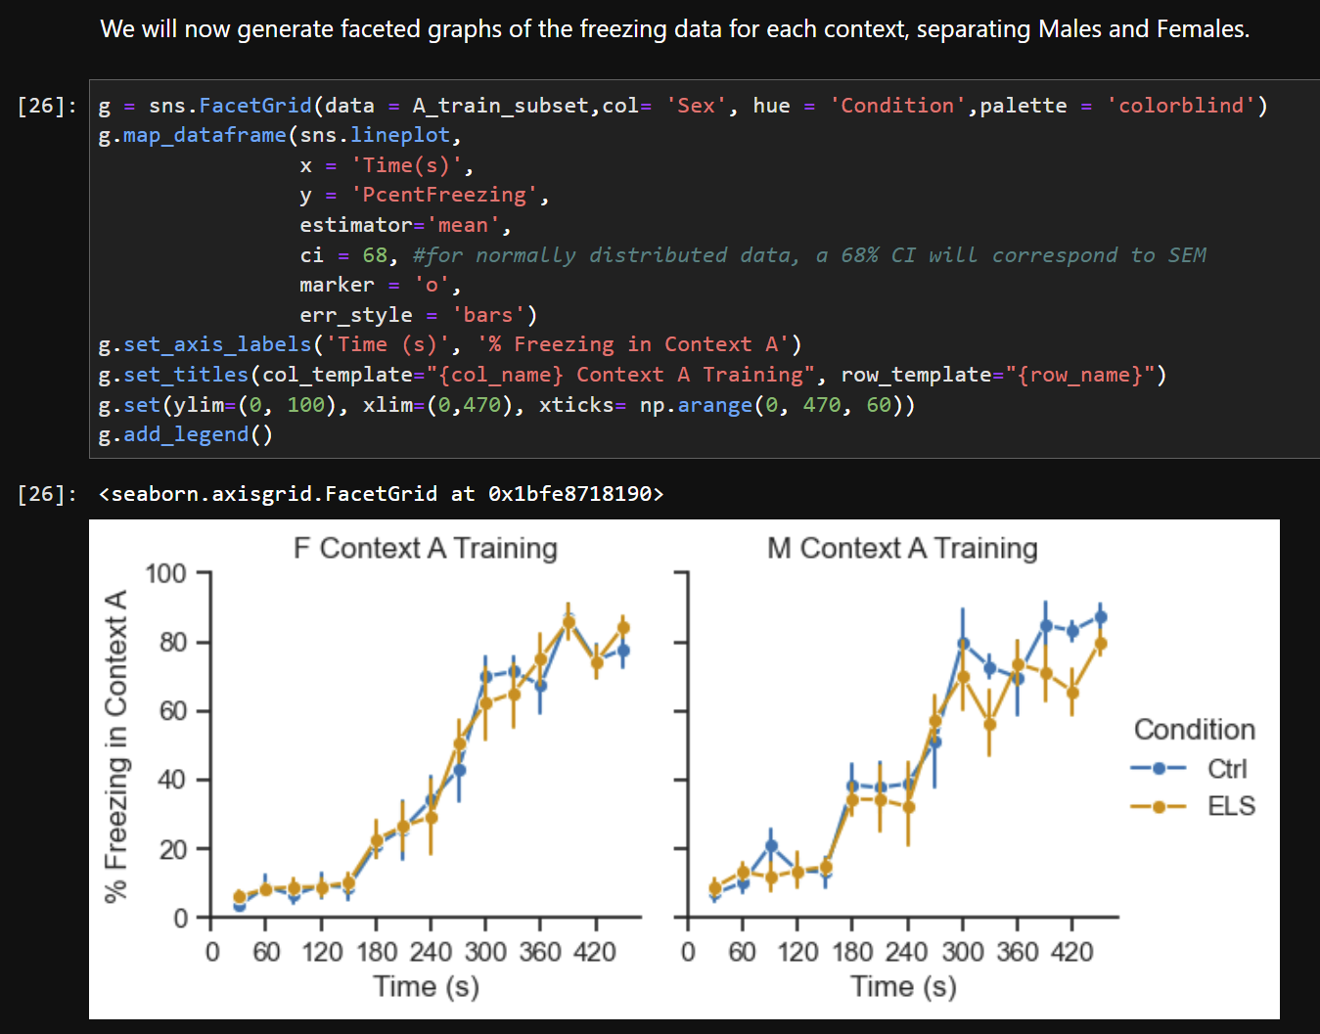
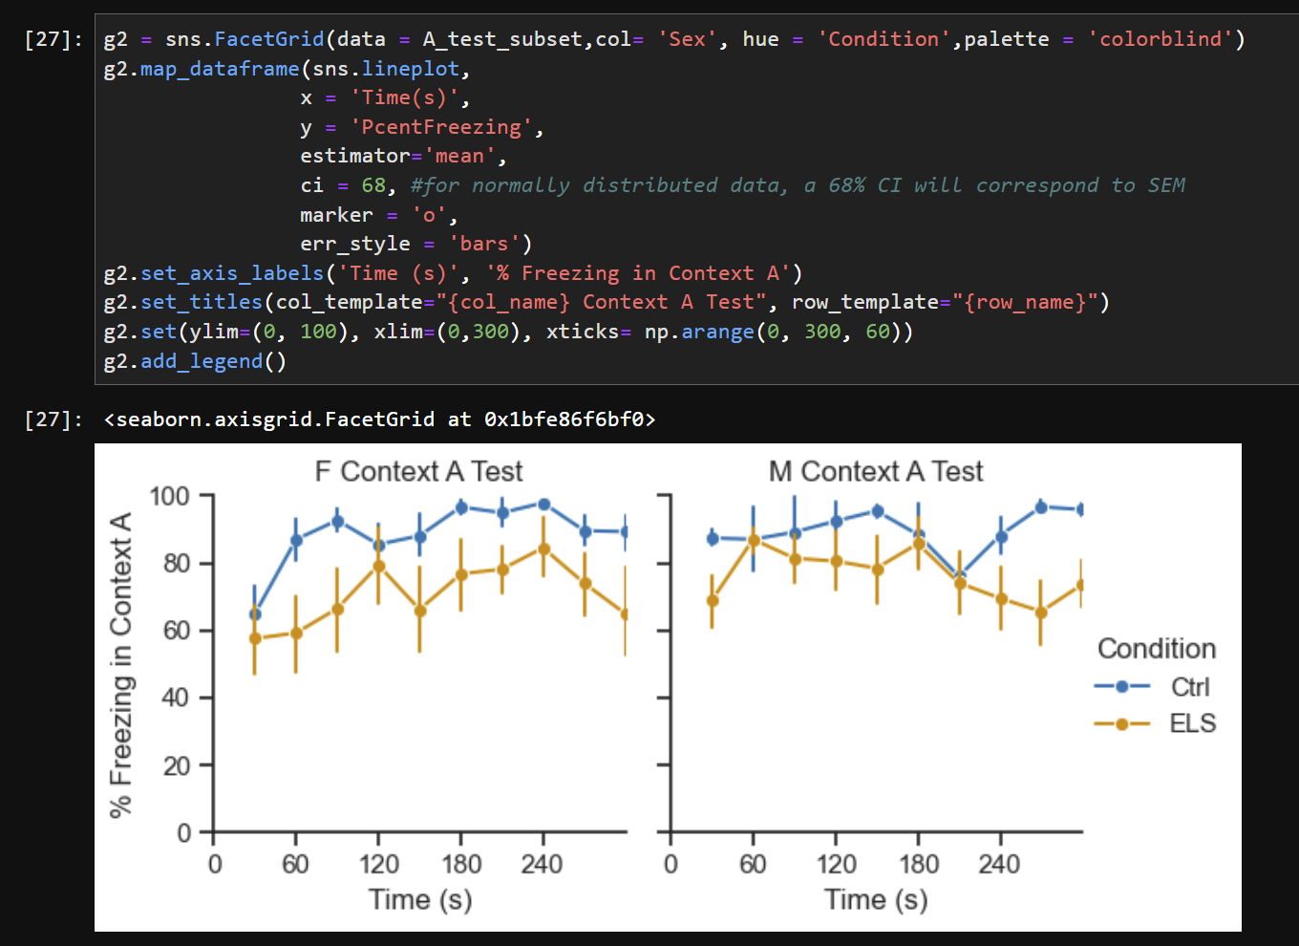
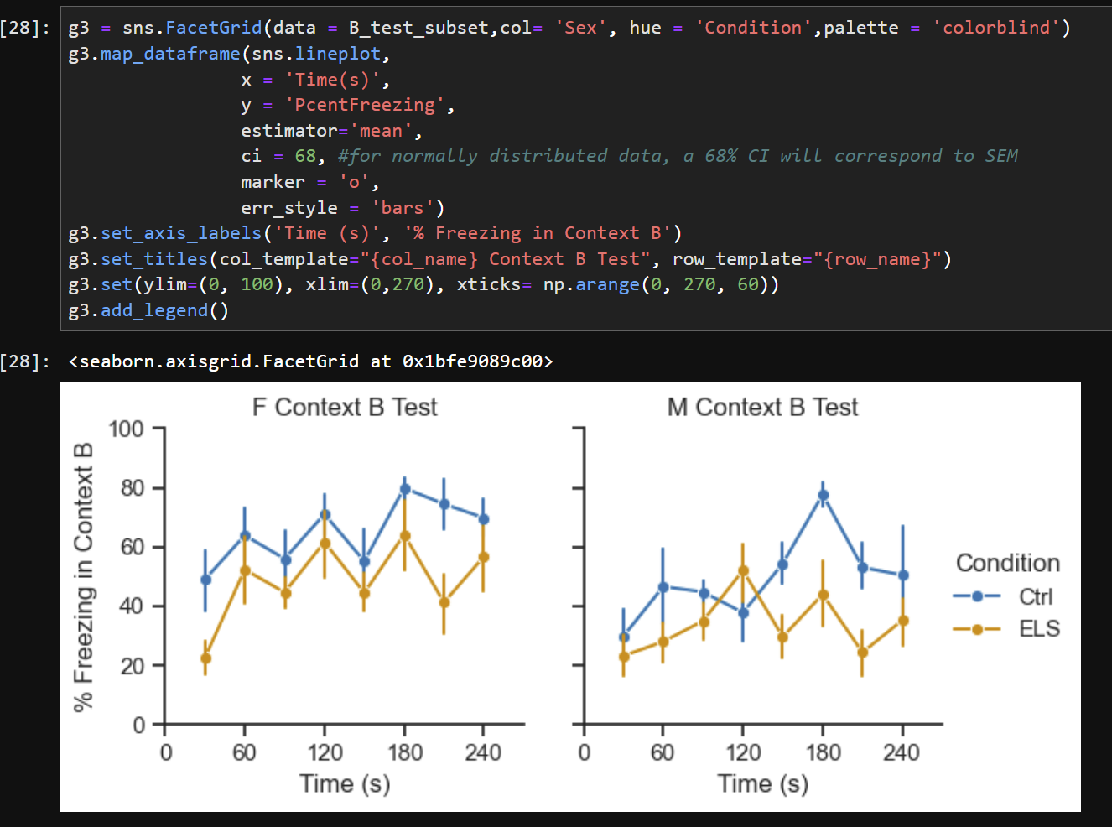
Graphs!
Thanks to Jasmine, Abhi, and Sam for all your hard work!
Notes:
And then we generate graphs!
I used the seaborn FacetGrid function with the lineplot mapping to create these
And we can see that, most interestingly, ELA animals seem to be freezing less than controls! Science!

