Slide 1
ANOVA!
Brenda Woodard
source: https://dasl.datadescription.com/datafile/hand-washing/

Slide 2
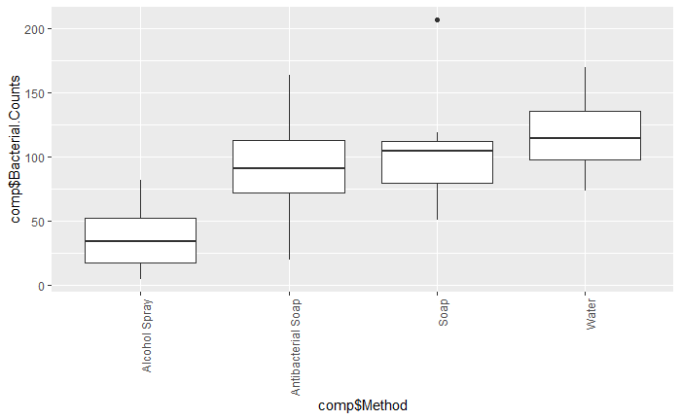
Soap- necessary, or not?
I found a dataset to analyze concerning handwashing.
Four different handwashing methods were tested eight times each to determine which, if any, has an affect on the bacterial count.
I plotted the data to do a visual analysis and determine what tests to run on the data.

Slide 3

After plotting the data it is clear that the Alcohol Spray method is the most effective method.
Summary of ANOVA
summary(model)
summary.aov(model)
Df Sum Sq Mean Sq F value Pr(>F) comp2$Method 3 29882 9961 7.064 0.00111 **
Residuals 28 39484 1410
---
Signif. codes: 0 ‘***’ 0.001 ‘**’ 0.01 ‘*’ 0.05 ‘.’ 0.1 ‘ ’ 1
Df Sum Sq Mean Sq F value Pr(>F) comp2$Method 3 29882 9961 7.064 0.00111 **
Residuals 28 39484 1410
---
Signif. codes: 0 ‘***’ 0.001 ‘**’ 0.01 ‘*’ 0.05 ‘.’ 0.1 ‘ ’ 1
After running an ANOVA on the data we confirm that we reject the null hypothesis that the means of all methods are equal.

Slide 4
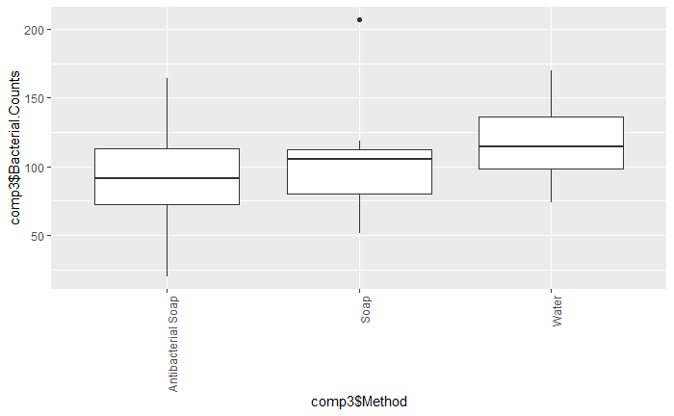
I plotted and ran an ANOVA on the three methods that seemed to have similar means.

Slide 5
Summary of ANOVA
summary(model)
summary.aov(model)
Df Sum Sq Mean Sq F value Pr(>F) comp2$Method 3 29882 9961 7.064 0.00111 **
Residuals 28 39484 1410
---
Signif. codes: 0 ‘***’ 0.001 ‘**’ 0.01 ‘*’ 0.05 ‘.’ 0.1 ‘ ’ 1
Df Sum Sq Mean Sq F value Pr(>F) comp2$Method 3 29882 9961 7.064 0.00111 **
Residuals 28 39484 1410
---
Signif. codes: 0 ‘***’ 0.001 ‘**’ 0.01 ‘*’ 0.05 ‘.’ 0.1 ‘ ’ 1
Here we except the null hypothesis that the means are equal.
We can conclude that if you do not have alcohol spray available you might as well just rinse your hands off with water.

