Slide 1
Predicting Employee Turnover
An HR Data Analysis of 14,999 Employee Records
Identifying the drivers of employee churn using Python, SQL & data visualization
Brenda Murillo & Lucinda Piña
California State University, Bakersfield | Data Analysis Project

Slide 2
Problem Statement & Overview
Why do employees leave — and who is at risk right now?
The Problem
Research Questions
• Employee turnover costs 50–200% of a departing employee's annual salary
1. What factors most strongly predict whether an employee will leave?
• Most organizations respond reactively — only after employees resign
• HR signals are collected but rarely analyzed jointly or proactively
• This project flags at-risk employees BEFORE they decide to leave
2. Do overworked or underpaid employees leave at higher rates?
3. Can we identify current employees who are at high risk of churning?
The Dataset
• Dataset: HR Employee Retention (Kaggle) — 14,999 simulated records
4. What actionable changes could reduce turnover in the most vulnerable groups?
• Features: satisfaction, evaluation, projects, hours, tenure, salary, promotion, accidents
• Target variable: left (1 = resigned, 0 = still employed)
• Overall turnover rate: 23.81%
Brenda Murillo & Lucinda Piña | CSUB | HR Employee Churn Analysis

Slide 3
Methodology & Tools
A reproducible, SQL-driven pipeline from raw CSV to actionable findings
1
2
3
4
5
Data Loading & Exploration
Data Cleaning
Database Design & SQL Queries
Visualization
Risk Profiling
→
→
→
→
Loaded 14,999 records Inspected types & distributions
Handled missing values Validated ranges & types
Normalized to 4 SQLite tables Ran targeted SQL aggregations
4 charts showing key factor relationships
Identified 615 at-risk employees still employed
Tools Used:
Python (pandas, matplotlib)
SQLite
Jupyter Notebook
Claude Code (AI-assisted)
Database Schema — 4 Normalized Tables:
salary_levels · employees · performance_records · employment_events
PK/FK integrity enforced · CHECK constraints on satisfaction & evaluation (0–1 range) · Boolean event typing
Brenda Murillo & Lucinda Piña | CSUB | HR Employee Churn Analysis

Slide 4
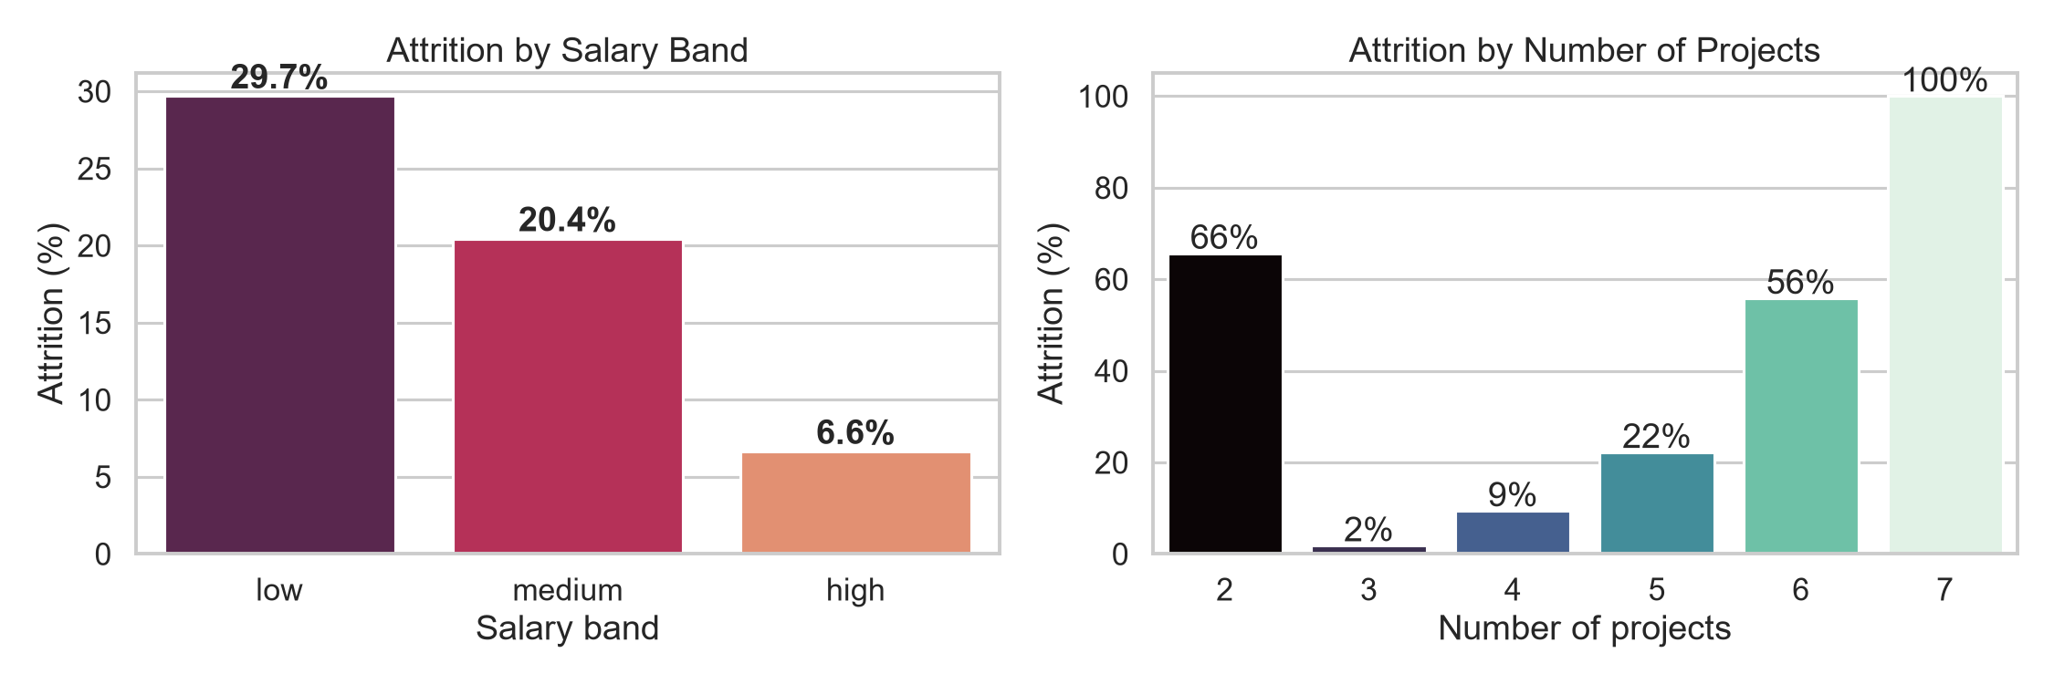
Key Finding 1: Turnover Rate & Salary Impact
Low-salary employees leave at nearly 4.5× the rate of high-salary employees
23.81%
3,571
14,999
6.6%
Overall Turnover Rate
Employees Who Left
Total Employees
High-Salary Turnover
Key Insight:
• Low-salary turnover ~30% — nearly 1 in 3 employees
• High-salary turnover 6.6% — pay clearly drives retention
• Salary adjustment offers the highest ROI for HR action
Brenda Murillo & Lucinda Piña | CSUB | HR Employee Churn Analysis

Slide 5
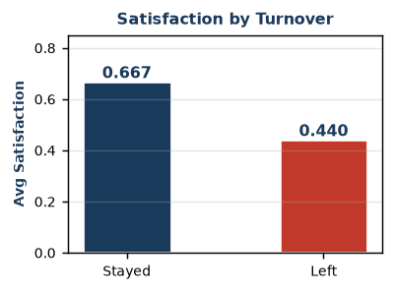
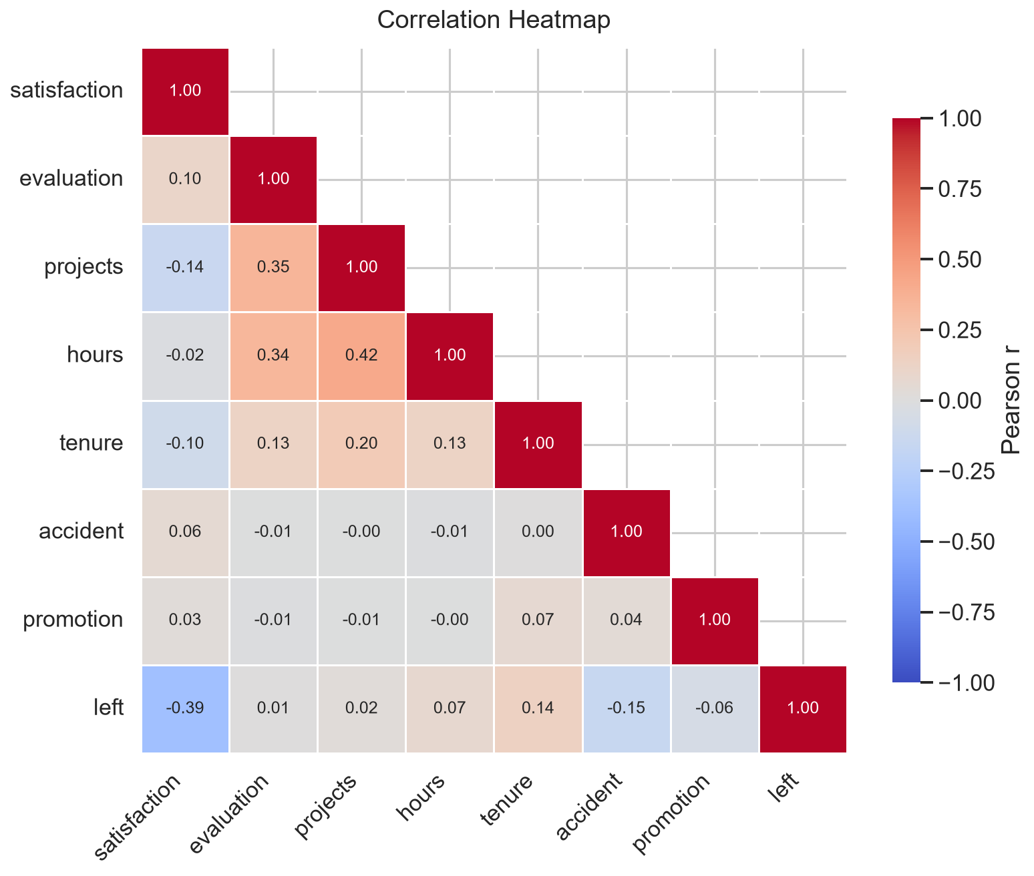
Key Finding 2: Satisfaction & Feature Correlations
Satisfaction is the single strongest predictor of turnover (r = −0.388)
Satisfaction Gap
Correlation Ranking
• Employees who LEFT averaged satisfaction of 0.44
• Satisfaction: r = −0.388 (strongest predictor of leaving)
• Employees who STAYED averaged satisfaction of 0.667
• Tenure: r = +0.145 | Avg Hours: r = +0.071
• Difference: −0.227 points — a 34% gap
• Evaluation score and project count: near-zero effect
Brenda Murillo & Lucinda Piña | CSUB | HR Employee Churn Analysis

Slide 6
High-Risk Profiling & Recommendations
615 current employees match the highest-risk profile — and can be supported before they leave
High-Risk Profile Criteria
615
~220 hrs
Satisfaction < 0.40 · Salary = Low · No promotion in last 5 years · Still employed
High-Risk Employees Still at the Company
Avg Monthly Hours (top risk employees)
Emp ID
Satisfaction
Avg Hrs/Mo
Tenure (yrs)
Recommendations
2087
0.12
244
5
• Conduct 1-on-1 check-ins with 615 flagged employees immediately
3129
0.12
257
6
• Review salary bands — low-salary employees leave at 4.5× the rate of high earners
4684
0.12
276
4
• Establish promotion reviews for employees with 3+ years and no advancement
8745
0.12
287
4
• Monitor workload — leavers worked ~8 more hours/month on average
13280
0.12
191
5
• Build an early-warning HR dashboard from the high-risk SQL query
† Showing top 5 of 615 high-risk employees
Brenda Murillo & Lucinda Piña | CSUB | HR Employee Churn Analysis

Slide 7
Conclusion & Next Steps
Three findings. 615 at-risk employees. A clear path forward.
Key Findings
Business Impact
Future Work
• Satisfaction (r = −0.39) is the single strongest predictor of turnover
• Turnover costs 50–200% of each departing employee's annual salary
• Train a Random Forest / Logistic Regression classifier for automated risk scoring
• Low-salary employees leave at 4.5× the rate of high earners
• 3,571 departures represent tens of millions in replacement costs
• Build a real-time HR dashboard powered by the risk-profiling SQL query
• 615 current employees match the highest-risk profile today
• Early outreach on 615 flagged employees could prevent the next wave
• Expand analysis to department-level and manager-level breakdowns
• Overworked staff (220+ hrs/month) show the highest departure rates
• Proactive, data-driven HR pays for itself in avoided rehiring costs
• Automate monthly at-risk employee reports for HR leadership
• HR signals exist — they just aren't being analyzed proactively
• SQL-based risk queries can scale to any HR dataset in hours
• Validate findings on real-world (non-simulated) HR datasets
Brenda Murillo & Lucinda Piña | CSUB | HR Employee Churn Analysis

