Slide 1
US Prosperity
Major Factors in the United States, are they improving?

Slide 2
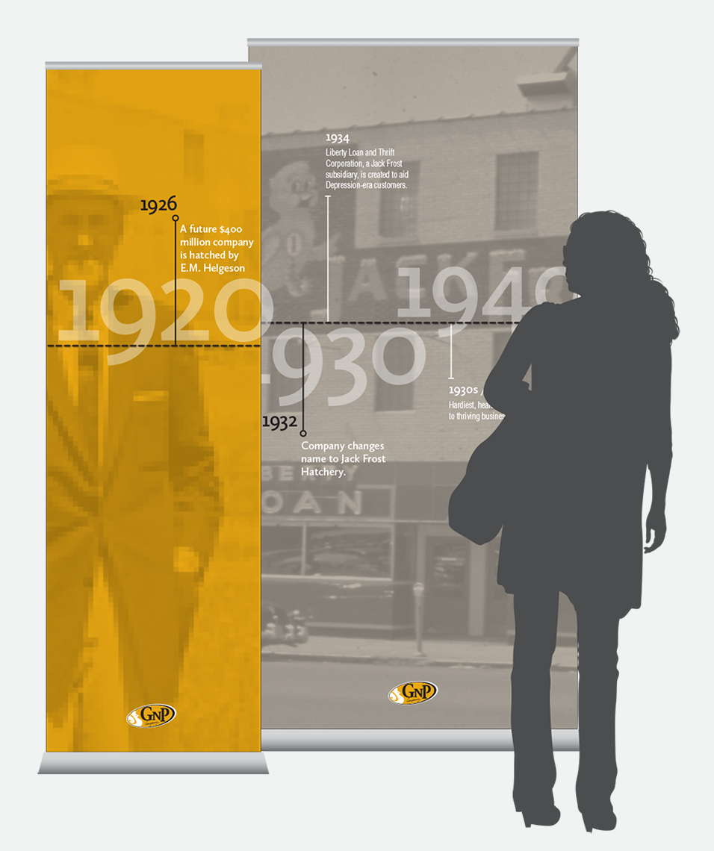
Inspiration
"If you had to choose one moment in history in which to be born, and you didn't know in advance whether you were going to be male or female, which country
you were going to be from, what your status was, you'd choose right now… [the world has never been] "healthier, or wealthier, or better educated, or in many ways more tolerant, or less violent, than it is today."
- Barack Obama
Notes:
Podcast
Quote (Howard University Commencement 2016)

Slide 3


Goals
Combat effects of ‘doom scrolling’ and better understand the country’s current level of growth by adding historical context.
Visualize the growth and decay of major world concerns to find insights about how these factors interact together over time.
Notes:
Touch on ‘Doom Scrolling’ and how it leads us to think.
Ask on dashboard… these are the things that were happening at the time. Try to think back to those times and make a hypothesis for what these trends might show.

Slide 4



Process
Our World in Data
Organization for Economic Co-operation and Development
Data Collection
Federal Bureau of Investigation

Slide 5

Process
Tool: Python
Packages: Pandas, Numpy, Matplotlib, Seaborn, Functools
Data Structures: DataFrames, Lists, Dictionaries
Clean and Transform Data
Abilities Exhibited: Data wrangling, Loops, Calculated fields, Concatenation, Heatmaps, Plots, Merging data, Integer location

Slide 6

Process
Tool: Power BI
Order of Operations:
Import the cleaned data
Choose the best visuals
Analyze the data
Create the Visualization
Notes:
‘I am the end user, these are the things I would want to know.’

Slide 7
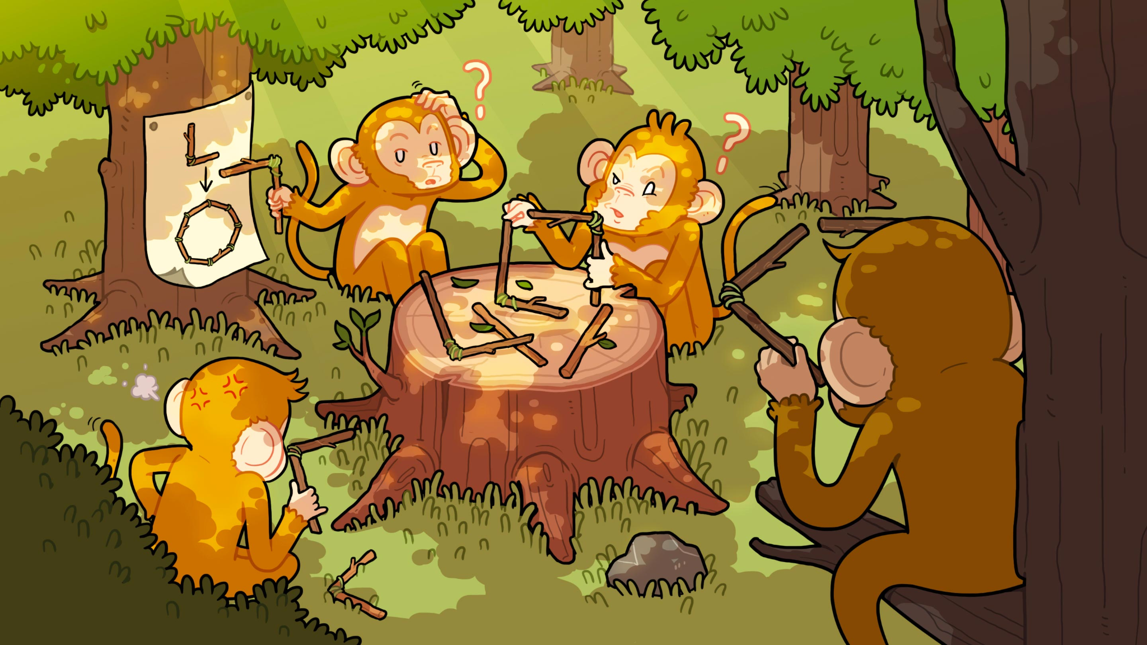
Obstacles
Link to Published Dashboard
Weighting the factors for importance
Varying abilities of visualization tools
Formatting the Python DataFrame to be visualized properly in Power BI
Notes:
Understanding that all factors are not equal, I wanted to find a way to add a weight to the scores.
First, I thought a survey asking for a ranking of the factors by importance would be perfect and reduce bias.
Because of time restrictions it was decided that this would not be the best way to go about this challenge. I would also be adding several bias’ with this strategy as well. Not having historical data for the survey over the selected time period.
Second, It was brought up that I should try a correlation factor. I should find a factor that best encompases a healthy america and find the correlation this factor has with the other factors. There were a few candidates, but as I saw the correlations and how they changed from factor to factor I realized that using the correlation as weights would only add inaccuracy to my project. Trying to decide which of the selected factors are more important than others was out of my reach as It changes at the individual level.
Tidy data

