Slide 1
Country Music hall of fame inductees
Analysis by Brenda Gutman

Slide 2
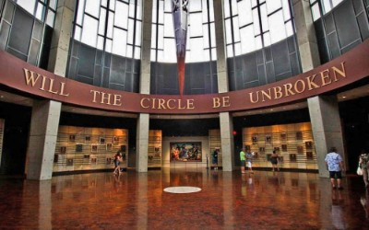
Country Music hall of fame - Facts
Launched in 1961, plaques located at the Tennessee State Museum
Moved to its own building on Music Row in 1967
Building was given a 37-million-dollar remodel in 2001
140 artists inducted since it first launched.
The first three inductees:
Jimmie Rodgers
Hank Williams
Fred Rose

Slide 3
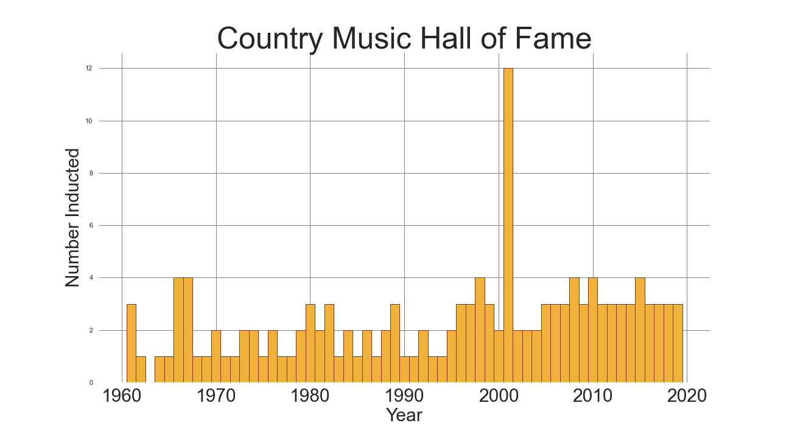
What happened in 1963 and 2001?
“It's not an automatic conclusion that someone will be inducted every year. In 1963, no one received sufficient votes, so no new members were added. But in other years, notably 2001, a dozen new members were inducted because they all received enough votes.”
-Robert Silva, liveabout.com

Slide 4
Resources
https://countrymusichalloffame.org/
https://www.liveabout.com/the-country-music-hall-of-fame-929348

