Slide 1

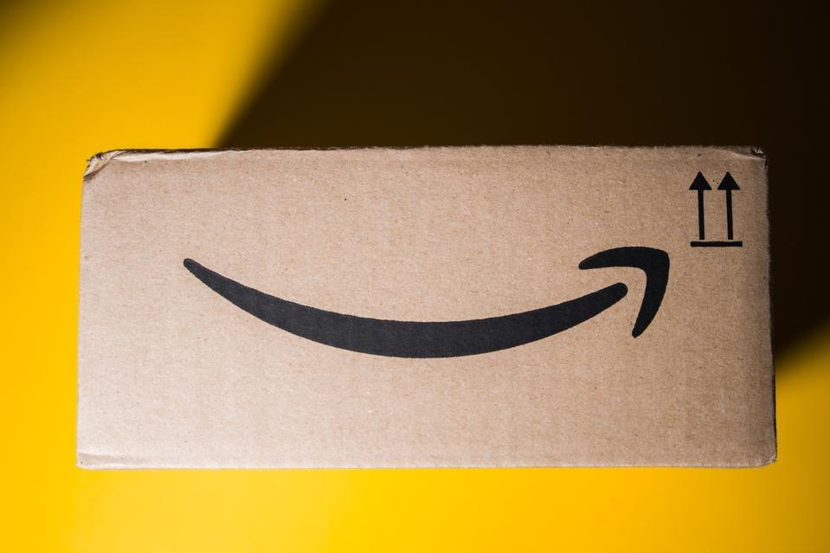
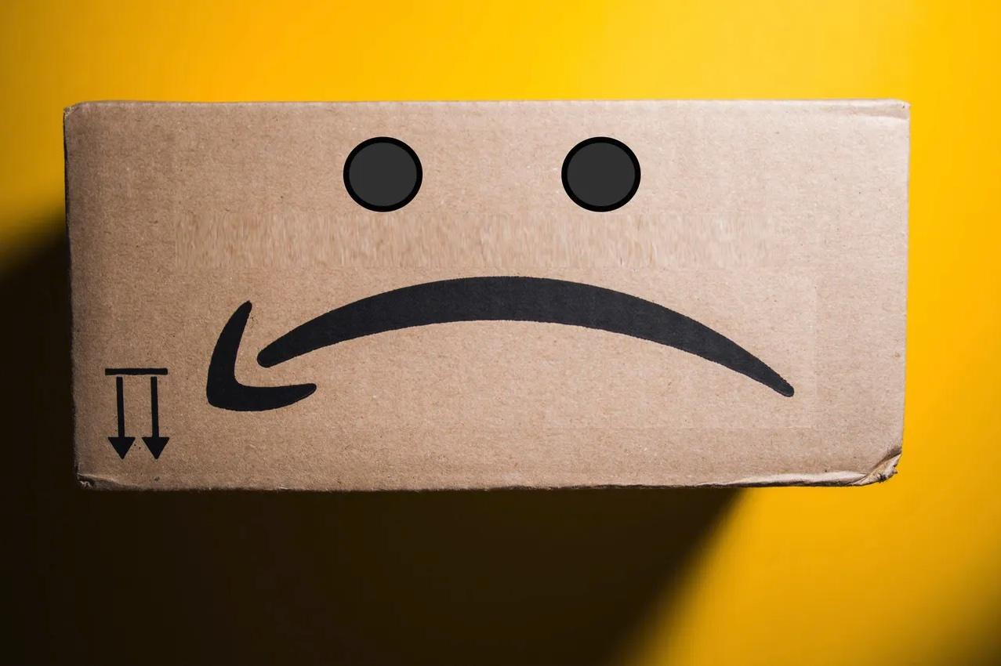
Recommender System
User’s review Amazon products

Slide 2


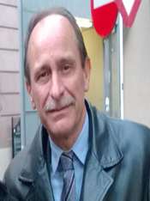
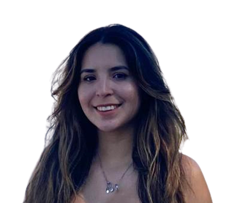
Recommender System - Our Team
“A” Team
Antonio
Brenda
Evaristo
Joan

Slide 3




Recommender System - 1. Motivation
Improve user experience: help users to discover new products and services based on their own interests.
User engagement: encourage users to engage with the content based on the recommendation of the products or services.
User loyalty: encourage customers to return.
Marketing campaigns: knowing the users preferences, is better to target marketing action.

Slide 4
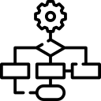







Recommender System - 2. Goals
More complex model
More complex data (context)
TBD: ethic recom, last seen …
Baseline

Slide 5
Recommender System - Dataset
Subset: Musical Instruments
Reviews
1,512,530
Products
112,222
Users
903,330
795,6
Mb
Notes:
ampliar un poco aqui a detalle de tipo de producto

Slide 6
Recommender System - 3. Implementation
ANALYSIS
Amazon reviews (Recommender Systems Datasets (ucsd.edu))
One dataset for every product category
Common format: userId, itemId, rating, timespan
Get a script to set up category datasets:
Reformat data types
Remove duplicates
Reduce size by parametrization of minimum ratings: per item and user

Slide 7
Recommender System - 3. Implementation
COMPUTATIONAL RESOURCES
GIT repository (recommender system project AIDL2023)
colab notebooks
Google cloud virtual machine
DEEP LEARNING MODELS
Factorization Machines (FM)
Graph Convolutional Embeddings
Random
Popularity-Based

Slide 8

Recommender System - 4. Milestones
18/01 - Project Definition
30/01 - Data Analysis
08/02 - Model v1
08/02 - Presentation: Project Critical Review
14/03 - Model v2
22/03 - Presentation: Project Defense

Slide 9
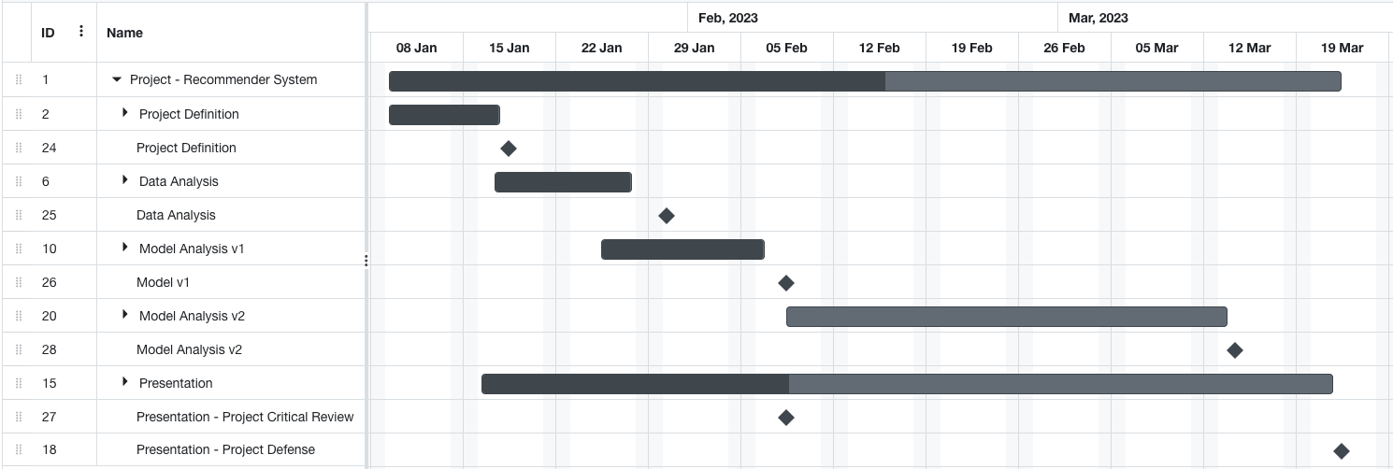
Recommender System - 5. Project plan
18/01
30/01
08/02
14/03
08/02
22/03

Slide 10
Recommender System - 6. Progress

Slide 11

Recommender System - 7. Our questions
Is it relevant to apply the model to other datasets?
Based on your experience, which metrics could we use for bias detection?

Slide 12
Recommender System
Thank you! Questions?

