Slide 1
Building for Google Glass
What You Need to Know
Brenda Jin @cyberneticlove
Developer, Macys.com

Slide 2
About Me
JavaScript developer since January 2013
Tablet prototyping at Macys.com
Interested in how technology can bring humans closer to our environment

Slide 3
Overview of Google Glass
Notifications
Cards
Directions
Photo/Video
Social

Slide 4
My Favorite Glass Features
Text/Email
Biking Directions
Google Now Search

Slide 5
Best Glass Experieces
Contextual
Relevant
Quick

Slide 6
Limitations
Battery power
Eye fatigue

Slide 7
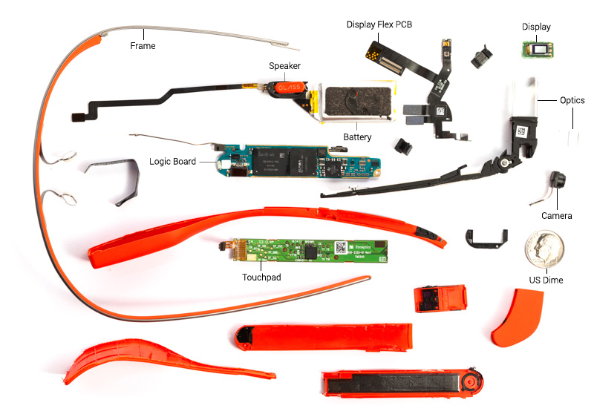
Source: http://www.catwig.com/google-glass-teardown/

Slide 8
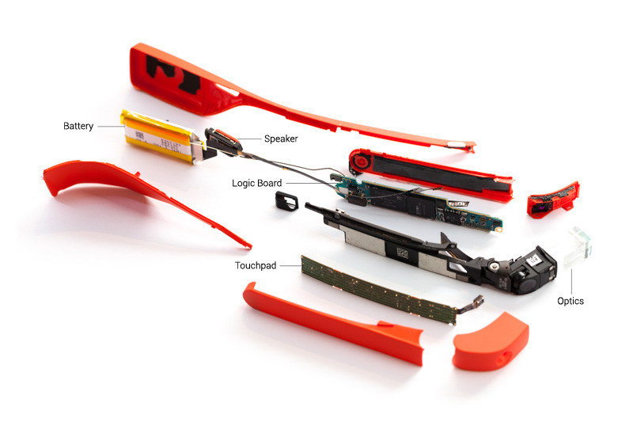
Source: http://www.catwig.com/google-glass-teardown/

Slide 9
Google Glass Development
No store or formal distribution method for Apps yet
GDK unveiled next week
.apk Android development or Mirror API
Frequent operating system and API updates, as well as forthcoming hardware updates

Slide 10
HTML5 Demo with PhoneGap
Google Glass
ADT Bundle or IDE with ADT Plugin http://developer.android.com/sdk/installing/bundle.html
adb $PATH variable setup http://developer.android.com/tools/help/adb.html
PhoneGap (2.7.0+) http://phonegap.com/

Slide 11
Q&A
Brenda Jin @cyberneticlove
Developer, Macys.com

