Slide 1
Building for Google Glass
What You Need to Know
Brenda Jin
@cyberneticlove
Tim Anglade
@timanglade
Apigee
@apigee
Notes:
Creative Commons Attribution-Share Alike 3.0 United States License

Slide 2
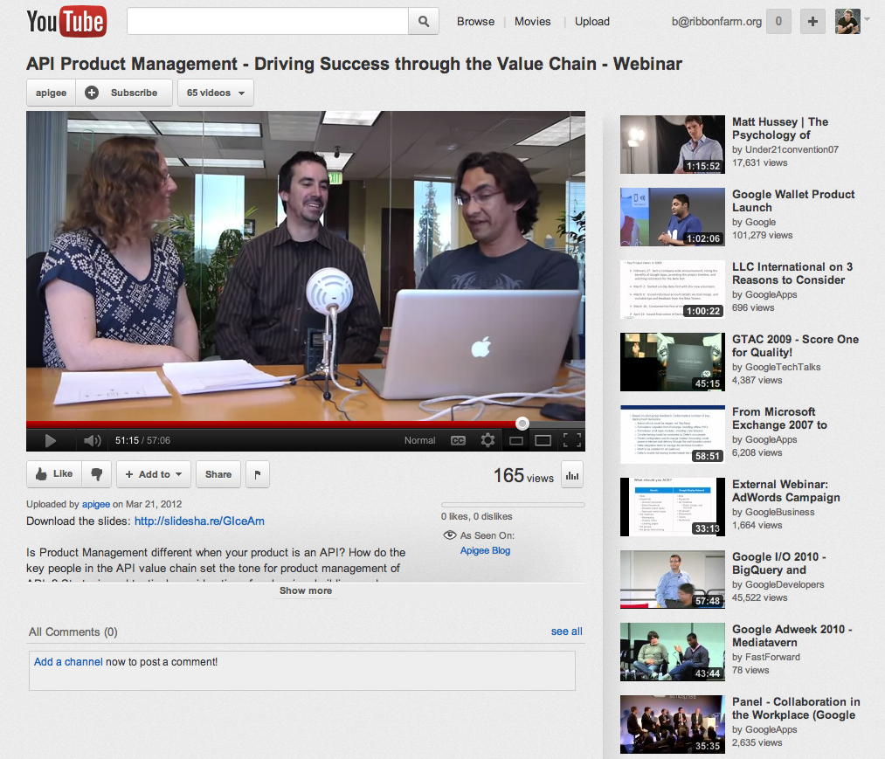
youtube.com/apigee

Slide 3
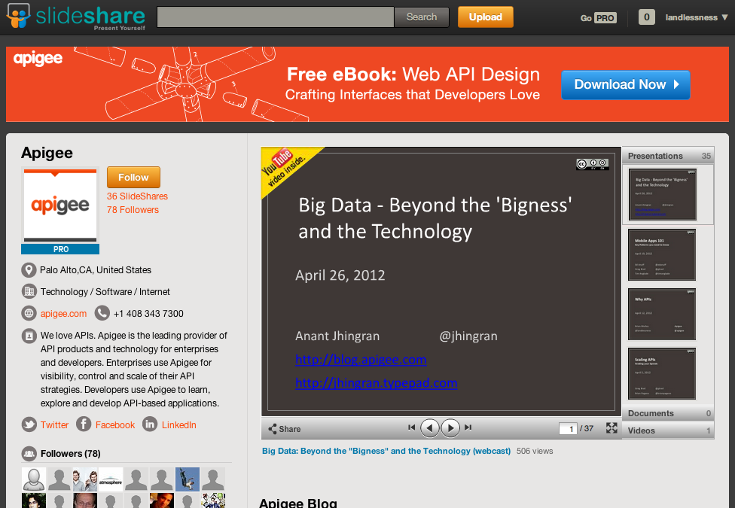
slideshare.net/apigee

Slide 4


@cyberneticlove
Brenda Jin
@timanglade
Tim Anglade

Slide 5
Overview of Google Glass

Slide 6
Wearable computer

Slide 7
Hardware Features
Screen
Camera
Directional Pad
Speaker
Microphone
No GPS!
No radio!
Public release Spring/Summer 2014

Slide 8
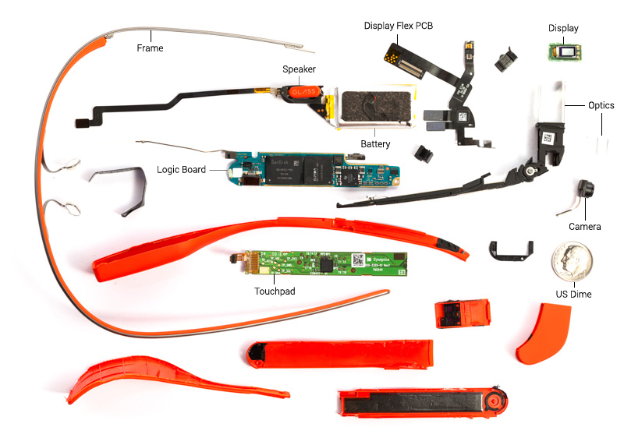
Source: http://www.catwig.com/google-glass-teardown/

Slide 9
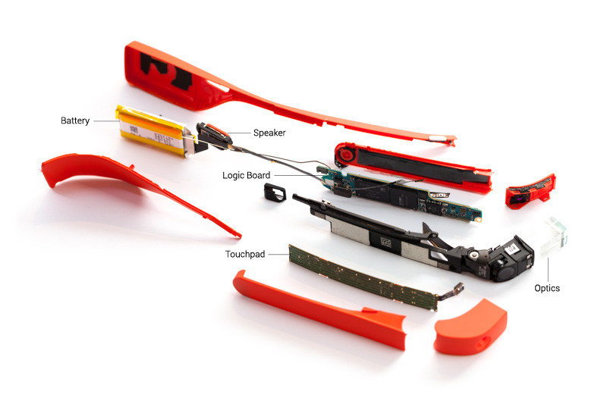
Source: http://www.catwig.com/google-glass-teardown/

Slide 10
Software Features
Notifications
Cards
Directions
Photo/Video
Social

Slide 11
The Best of Glass (so far)

Slide 12
Text/Email

Slide 13
Biking Directions

Slide 14
Google Now Search

Slide 15
Crafting Great Experiences

Slide 16
Glass is extremely mobile but is not a mobile phone

Slide 17
Real estate is limited

Slide 18
Best Glass Experieces
Contextual
Relevant
Quick

Slide 19
Limitations
Battery power
Eye fatigue

Slide 20
Developing for Glass

Slide 21
Built on Android 4.0.4
Notes:
Understanding Android Development will help you build apps. This is not a completely brand new platform that you have to learn from scratch – you can use the same development tools that you’re used to.

Slide 22
No store or formal distribution method for Apps yet

Slide 23
“GDK” will be unveiled next week

Slide 24
.apk Android development or “Mirror API”

Slide 25
Frequent operating system and API updates, as well as forthcoming hardware updates

Slide 26
HTML5 / PhoneGap works!

Slide 27
Developing for Glass

Slide 28
What you need
Google Glass
ADT Bundle or IDE with ADT Plugin http://developer.android.com/sdk/installing/bundle.html
adb $PATH variable setup http://developer.android.com/tools/help/adb.html
PhoneGap (2.7.0+) http://phonegap.com/

Slide 29
Demo
PhoneGap for Google Glass

Slide 30
Starter Example github.com/brendajin/googleglass-phonegap-example

Slide 31
Preparing for Glass

Slide 32
From a UX standpoint, Glass is not mobile From a code standpoint, Glass is mobile enough

Slide 33
All network calls go through phone, so latency/performance/API behavior mostly the same

Slide 34
UX is likely to drive needs for different data, more data, and more contextualized data, but delivery methods will be similar

Slide 35
Is Google Glass more Opportunity than Challenge?

Slide 36
Smartglasses May Begin to Save the Field Service Industry $1 Billion per Year http://www.gartner.com/newsroom/id/2618415

Slide 37
Retail http://www.theverge.com/2013/11/11/5091086/meet-the-first-and-only-company-making-money-through-its-google-glass

Slide 38
Construction http://www.zdnet.com/enterprise-apps-landing-on-google-glass-by-2014-7000017040/

Slide 39
Law Enforcement http://www.policeone.com/police-technology/articles/6586212-Google-Glass-comes-to-law-enforcement/

Slide 40
Healthcare https://www.youtube.com/watch?v=ssldTFWBv3E

Slide 41
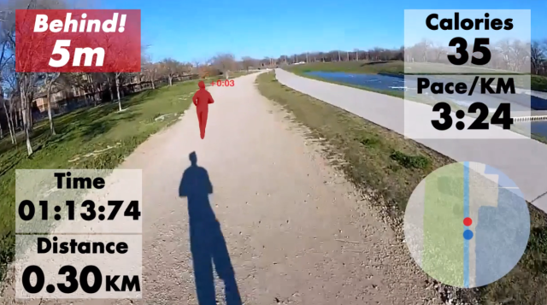
Tons of consumer opportunities… http://techcrunch.com/2013/10/09/race-yourself/

Slide 42
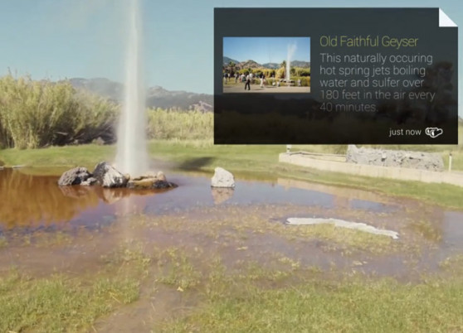
http://venturebeat.com/2013/08/21/field-trip-is-the-coolest-most-inventive-google-glass-app-weve-seen-yet/

Slide 43
What to they have in common?

Slide 44
1. Think of the UX 2. Think of the data you’ll need 3. Make it happen!

Slide 45
Q&A

Slide 46
groups.google.com/group/api-craft
groups.google.com/group/app-craft

Slide 47
THANK YOU
Questions and ideas to:
@cyberneticlove
@timanglade
groups.google.com/group/api-craft
groups.google.com/group/app-craft

