Slide 1
Enter feedback
And the next idea will be from…
Team: StudySesh
Members:
Spencer
Brendan
Christian
Evelyn
Matt

Slide 2
StudySesh
Evelyn, Spencer, Christian, Brendan, Matt

Slide 3

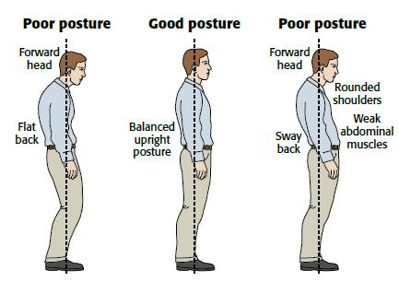
The problem

Slide 4
The target users
Anyone with long consistent hours of studying
High school/college students
Grad students
Those studying for citizenship exams, license tests, etc.
Employed individuals pursuing Continuing Education
Helps with irregular study patterns

Slide 5
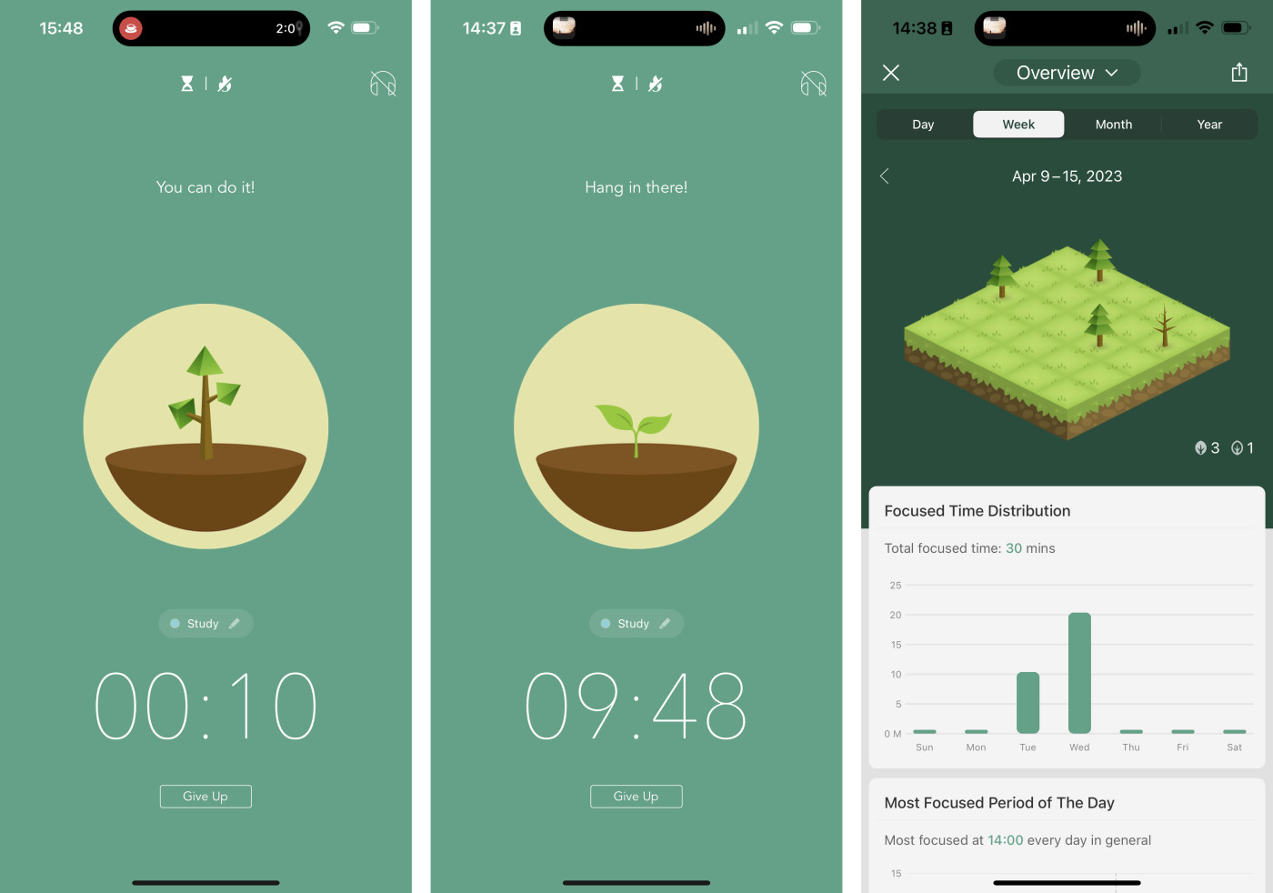
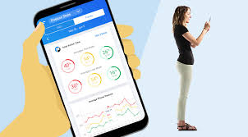
Unique opportunity/approach
fun and encouraging to the productivity timer app
different approach to bland timer apps

Slide 6
The solution
A studying app that accompanies you in study sessions
posture reminders in intervals
will start as a website but will probably move on to become lockdown browser

Slide 7
S.M.A.R.T
Specific: Our specific goal is to have a functional web-based version of the app that incorporates all the features discussed
Measurable: Project progress can be tracked by setting smaller deadlines for developing particular components
Attainable: The app is not overly complex or ambitious, and is more UI-oriented

Slide 8
S.M.A.R.T
Realistic: Development uses a framework that all team members are familiar with
Time-bound: Goal is to have a functional UI by the end of the semester, tracking progress on a week-by-week basis.

Slide 9
Users: What must you learn?
Learn: User study habits, tech usage, problems with current study tools, and health awareness
Limitations: Reluctance to change habits, make time investment, or trust mental health importance
What we’ll do: User interviews, surveys, observations, testing different versions of app, and getting feedback from Health pros

Slide 10
Q&A Study Sesh Evelyn, Brendan, Spencer, Matthew, Christian

Slide 11
Enter feedback
And the next idea will be from…
Team: [Enter your team name]
Members:
[Firstname]
[Firstname]
[Firstname]

