Slide 1

3: Web Optimisation
Web Optimisation
BRENDAN MUNNELLY
brendan@munnelly.com
Copyright ibat College 2019. All rights reserved.

Slide 2
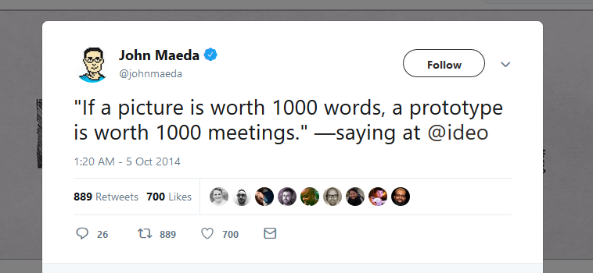

Slide 3

Jason Fried – basecamp.com project management

Slide 4
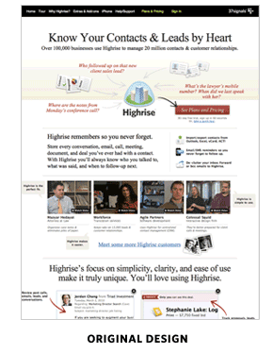
Basecamp.com – Version 1.0. Lots of text.

Slide 5
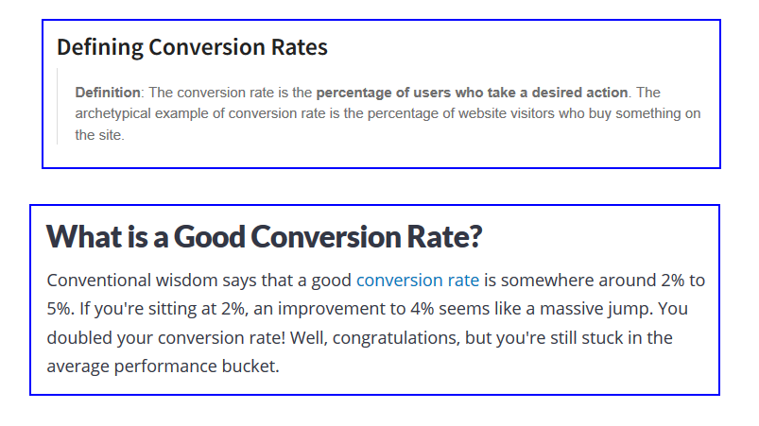
Conversion Rate – Definition

Slide 6
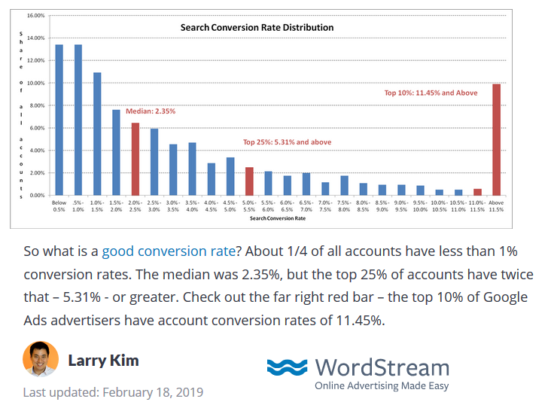
Conversion rate – Variances

Slide 7

Basecamp.com – Version 2.0

Slide 8
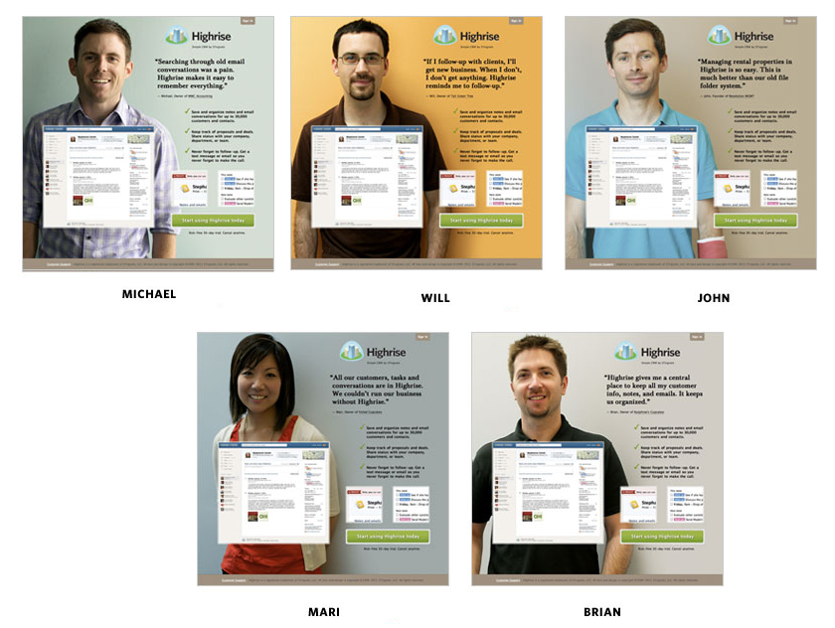
Basecamp.com – More versions!

Slide 9
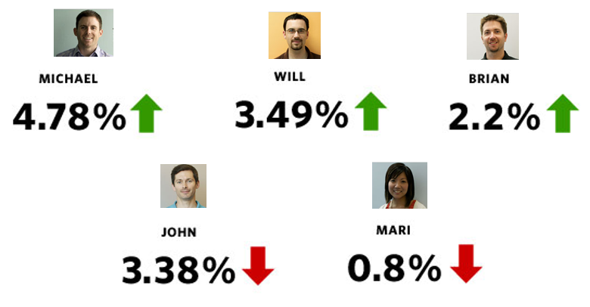
Basecamp.com – People’s Vote

Slide 10
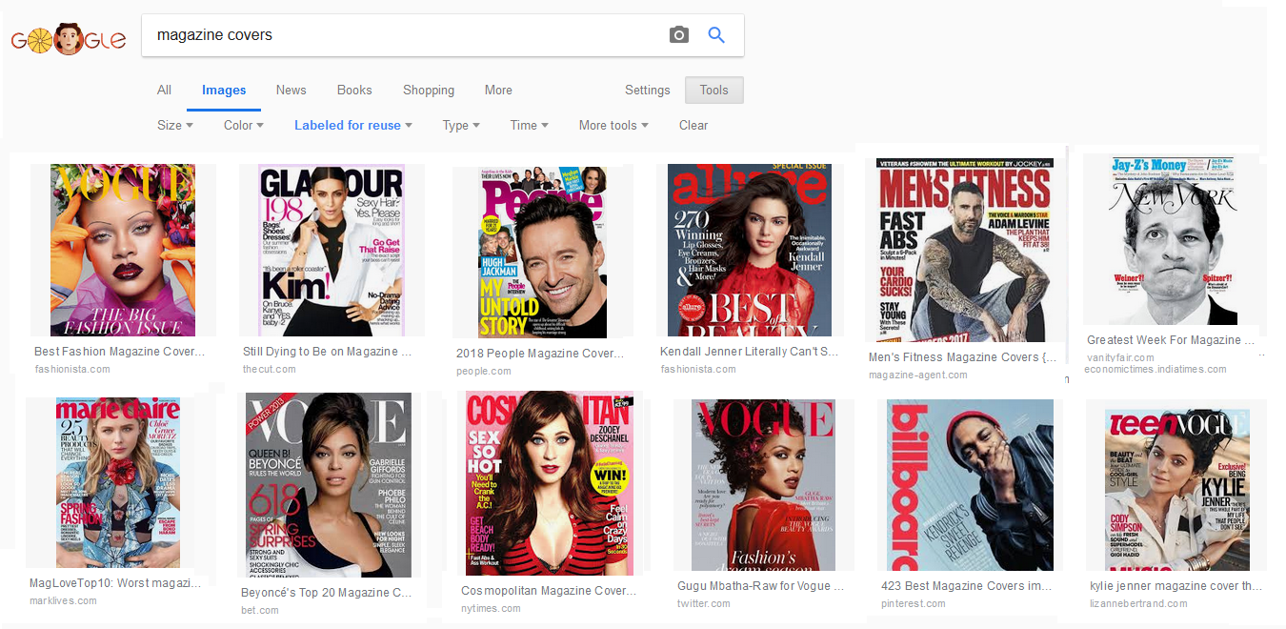
Faces: Attention-magnets

Slide 11
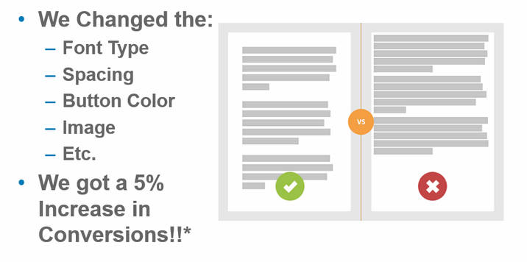
A/B Testing: One change, over same time period

Slide 12
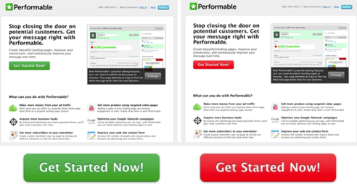
Buttons: Which colour gets the most clicks?

Slide 13
Images: Free stock photographs
Pixabay
Pexels
Unsplash
Gratisography
Morguefile
Stockvault
Picjumbo
Pikwizard
Rawpixel
Reshot
Online Image Editing
BeFunky
Pixlr
LunaPic
remove.bg

Slide 14
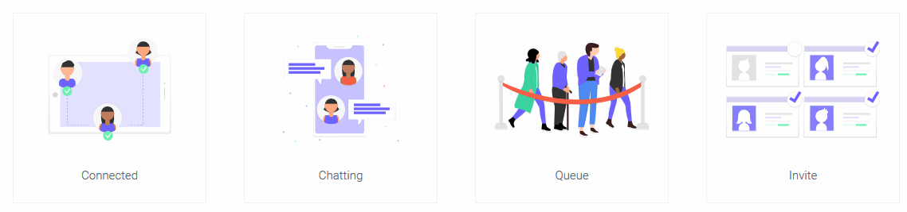
Images: Free illustrations
Undraw.co

Slide 15

Images: Undraw.co – inspired web design

