Slide 1

3: Web Writing
Web Optimisation
BRENDAN MUNNELLY
brendan@munnelly.com
Copyright ibat College 2019. All rights reserved.

Slide 2
Writing for the Web – Contents
1: At a Glance
2: Main Points
3: Two online services
4: Five Characteristics of
successful web writing
5: Microcopy / UX Writing

Slide 3
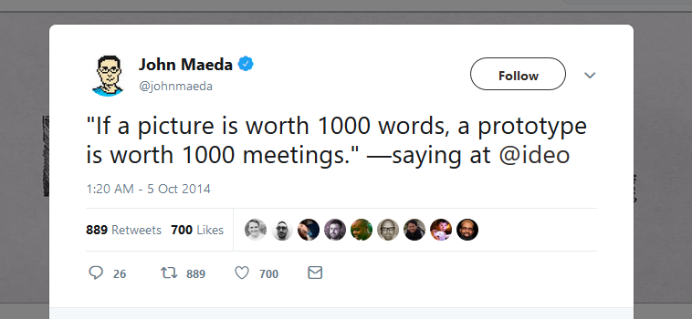

Slide 4
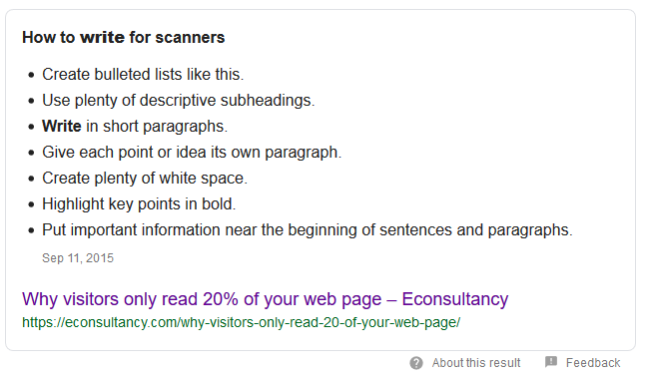
Writing for the Web – At a glance

Slide 5
Writing for the Web – Main Points
Include a Table of Contents
You can start longer webpages with a contents list. This gives readers a quick snapshot of the content they’re going to find on that page.
Keywords first
Put keywords or information-carrying words first, where they’ll catch the eye.
Chunk Content in Short Paragraphs
Short rectangles of text paragraphs are easier to scan.
Also, they get twice as many eye fixations as long paragraphs.

Slide 6
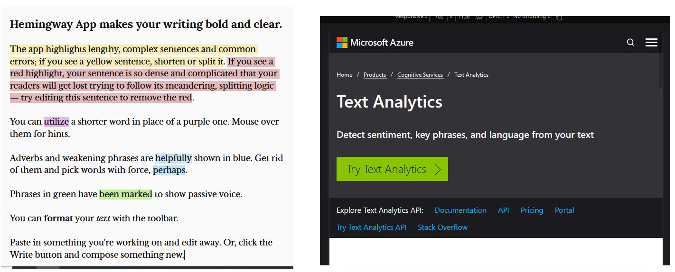
Writing for the Web – Two online services
http://www.hemingwayapp.com/
https://azure.microsoft.com/en-in/services/cognitive-services/text-analytics/

Slide 7
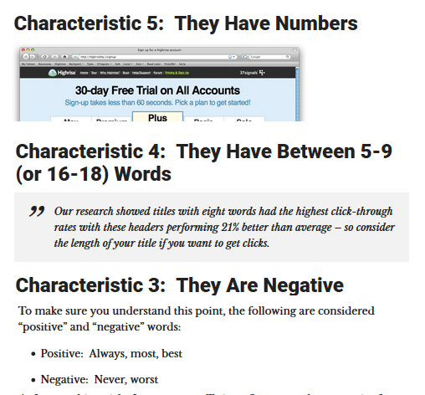
Writing for the Web – 5 Characteristics
conversionXL.com

Slide 8
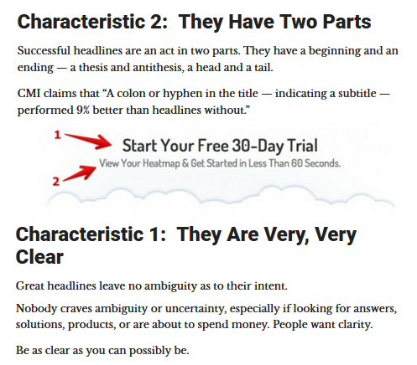
Writing for the Web – 5 Characteristics

Slide 9
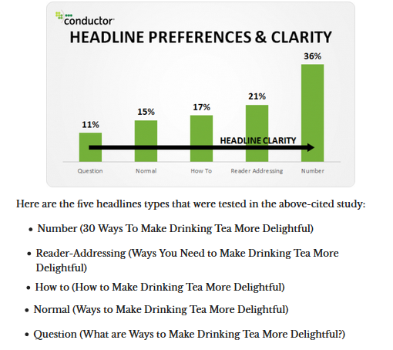
Writing for the Web – 5 Characteristics

Slide 10
Microcopy – What UX writers do
Microcopy is short, contextual text that informs or guides users throughout your product.
You can find it all over the place. On buttons, form fields, success and error messages.

Slide 11
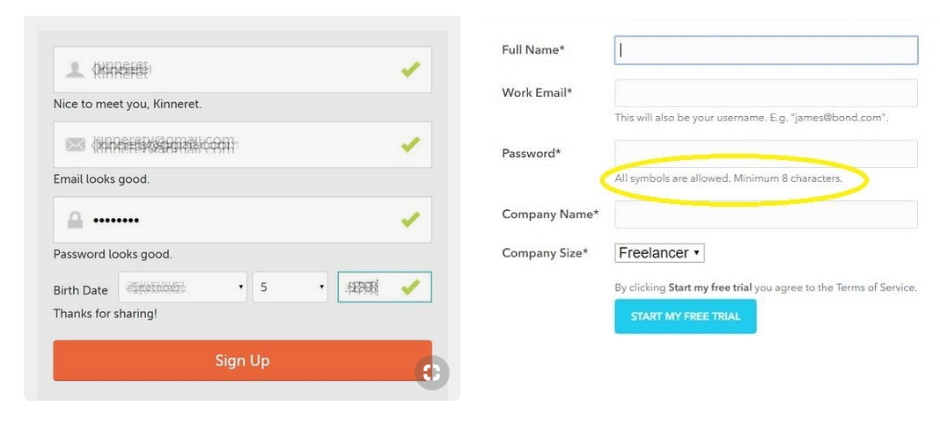
Microcopy – Positive Messages

Slide 12
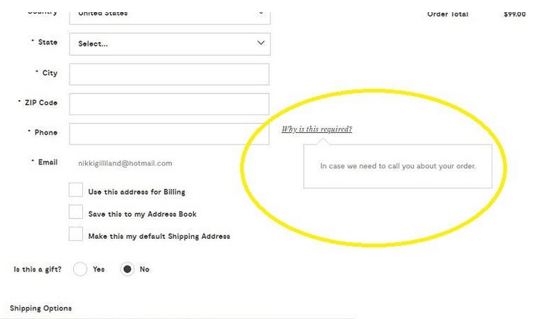
Microcopy – Explanations

Slide 13
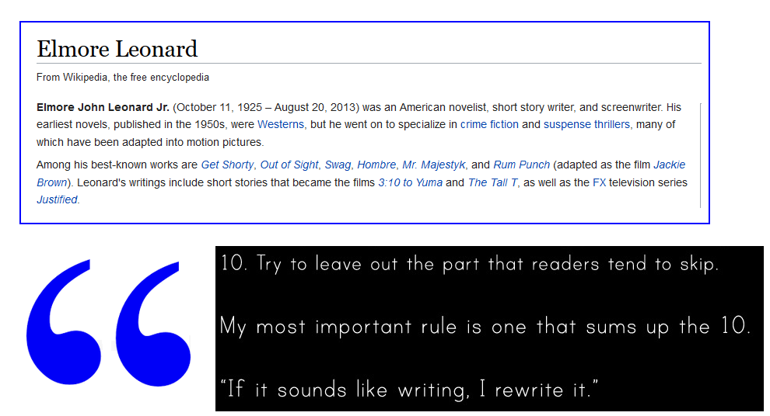
Summary: Advice from Elmore Leonard

