Slide 1

4: Performance Metrics
BRENDAN MUNNELLY
brendan@munnelly.com
Copyright ibat College 2019. All rights reserved.

Slide 2
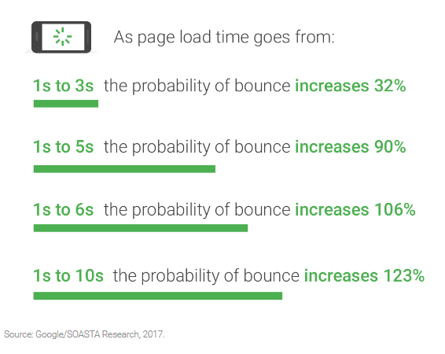
Load times: Faster website, more visitors

Slide 3
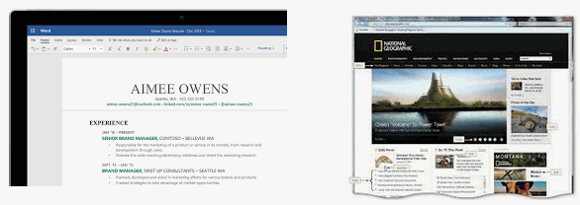
One Web Page: 10–100+ files

Slide 4
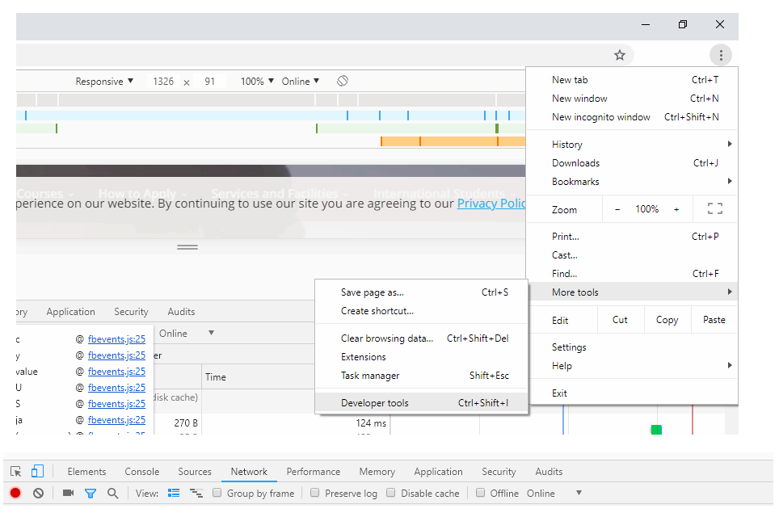
Web Page Inspection – Chrome Dev Tools

Slide 5
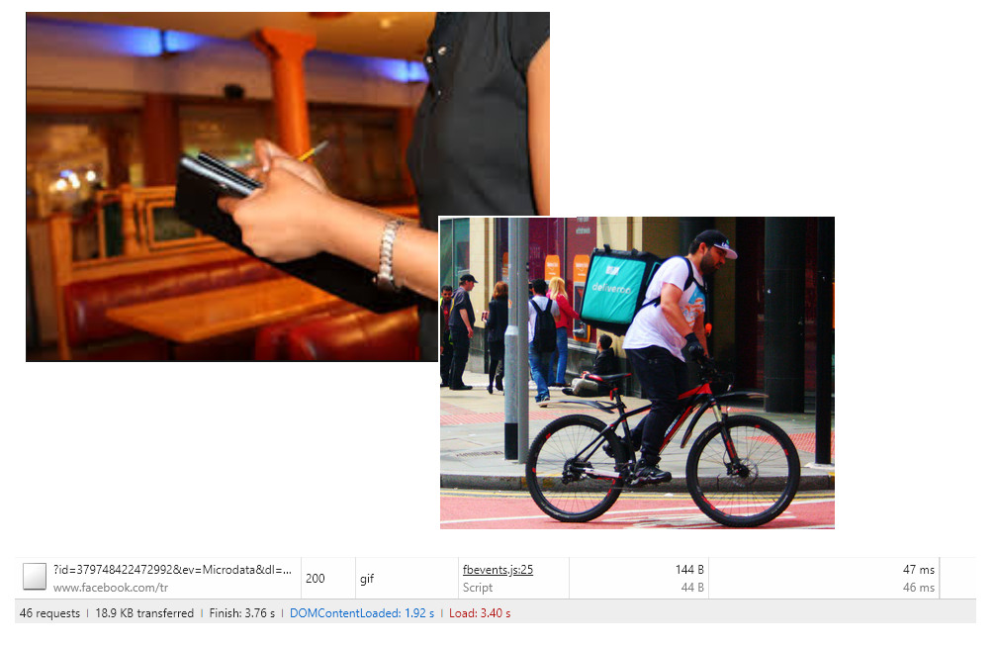
Web Page Inspection – Server Requests

Slide 6
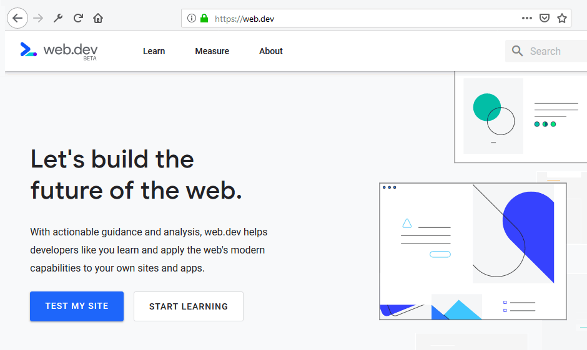
Web Page Inspection – web.dev

Slide 7
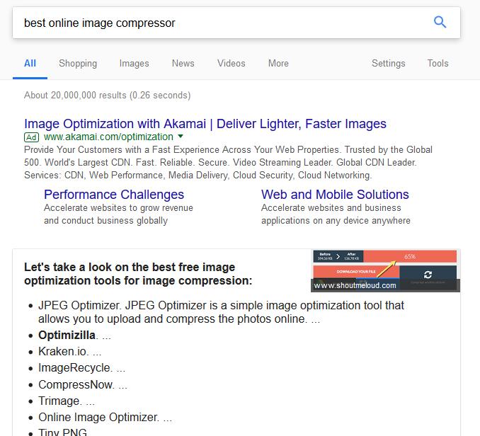
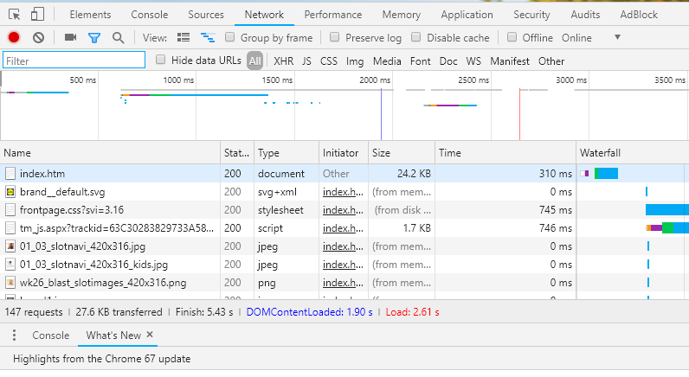
Reducing Load times
Compress images
Reduce requests within web page

