Slide 1
Azure Service Bus
Brendan Richards

Slide 2

About Me
Brendan Richards Lead Engineer @ Azenix
UK -> Australia Java -> .NET
Linux, Open Source,
Event-Driven Code

Slide 3

Core Components
.NET Usage
Azure Function Apps
Message Based Architectures
Infrastructure As Code

Slide 4
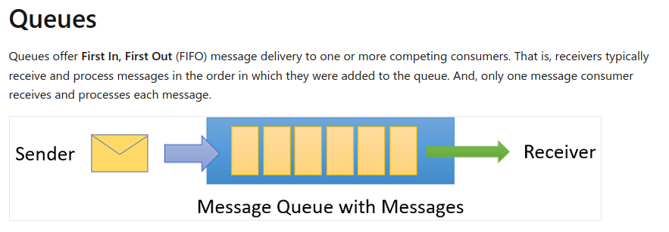

Slide 5
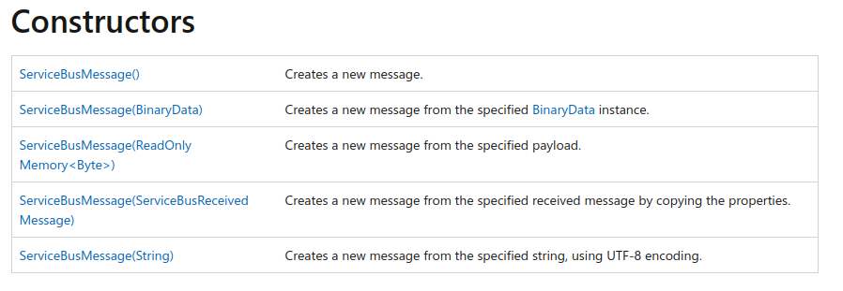
Notes:
https://learn.microsoft.com/en-us/dotnet/api/azure.messaging.servicebus.servicebusmessage?view=azure-dotnet

Slide 6
Each message goes to only one receiver - 2 read modes…
Notes:
https://learn.microsoft.com/en-us/dotnet/api/azure.messaging.servicebus.servicebusmessage?view=azure-dotnet

Slide 7
Receive and Delete
As soon as you get the message it’s already gone from the queue

Slide 8
Peek Lock
A lock is acquired on the message. Receiver can then Complete or Abandon the processing attempt.
At-least-once pattern.

Slide 9
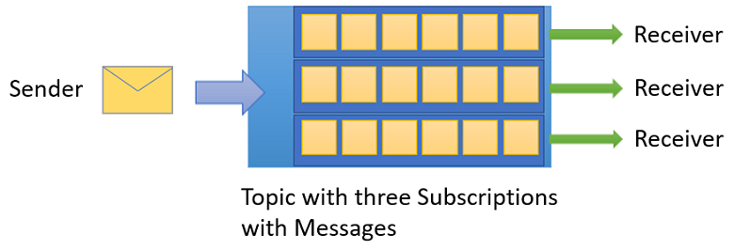

Slide 10
Filters
Can control which messages go to which subscription.
SQL Filters,
Boolean Filters,
Correlation Filters

Slide 11
Actions
Can modify message properties

Slide 12
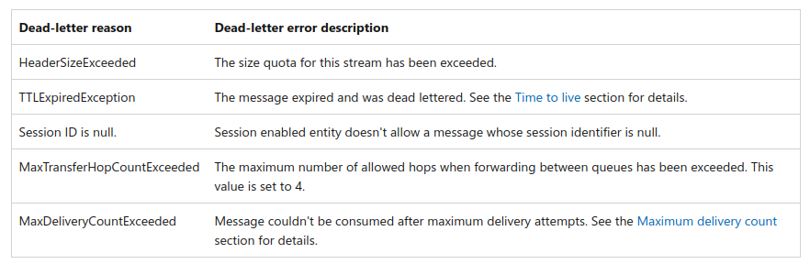
Dead Letter Queue
Shadows every queue and subscription

Slide 13
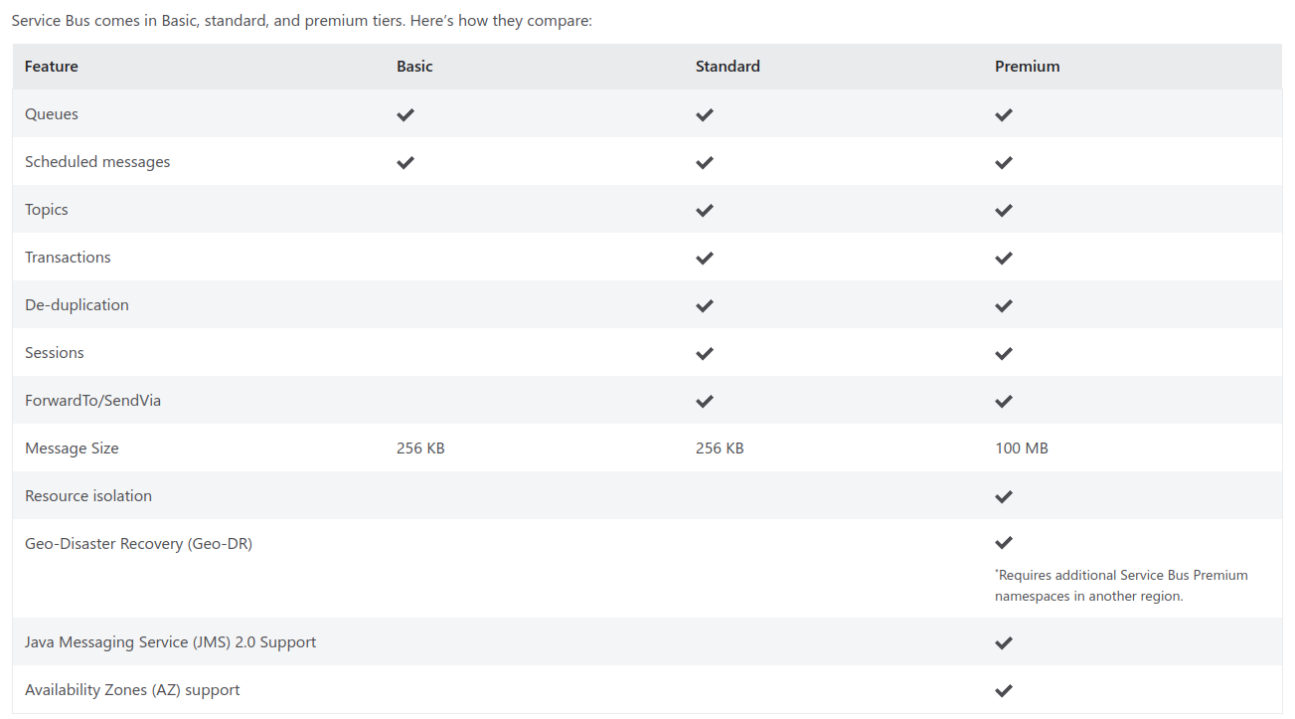

Slide 14
Demo: Azure Portal

Slide 15
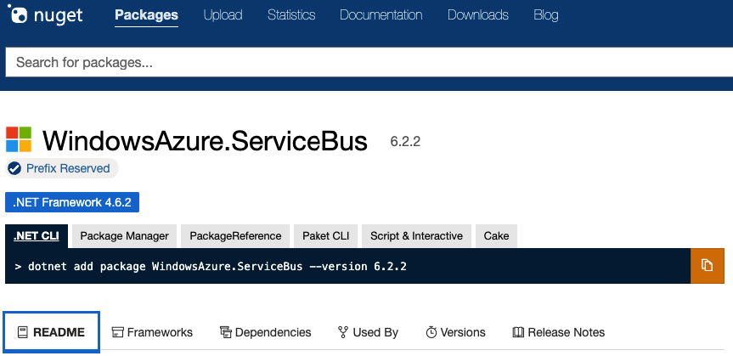

Slide 16
X

Slide 17
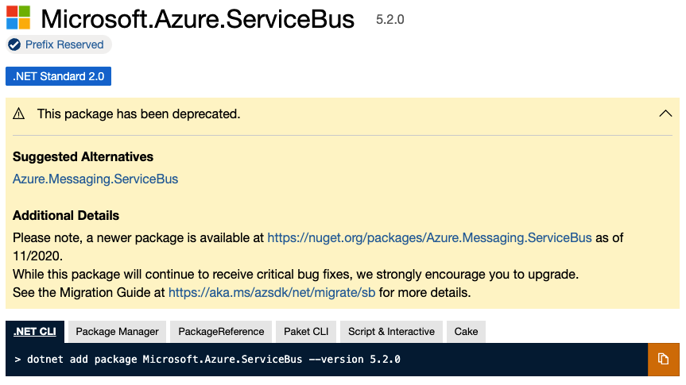

Slide 18
X

Slide 19
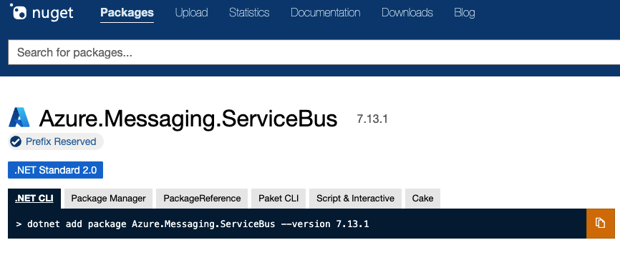

Slide 20
Demo: .NET

Slide 21
Demo: Function Apps

Slide 22
Core Components
.NET Usage
Azure Function Apps
Message Based Architectures
Infrastructure As Code

Slide 23
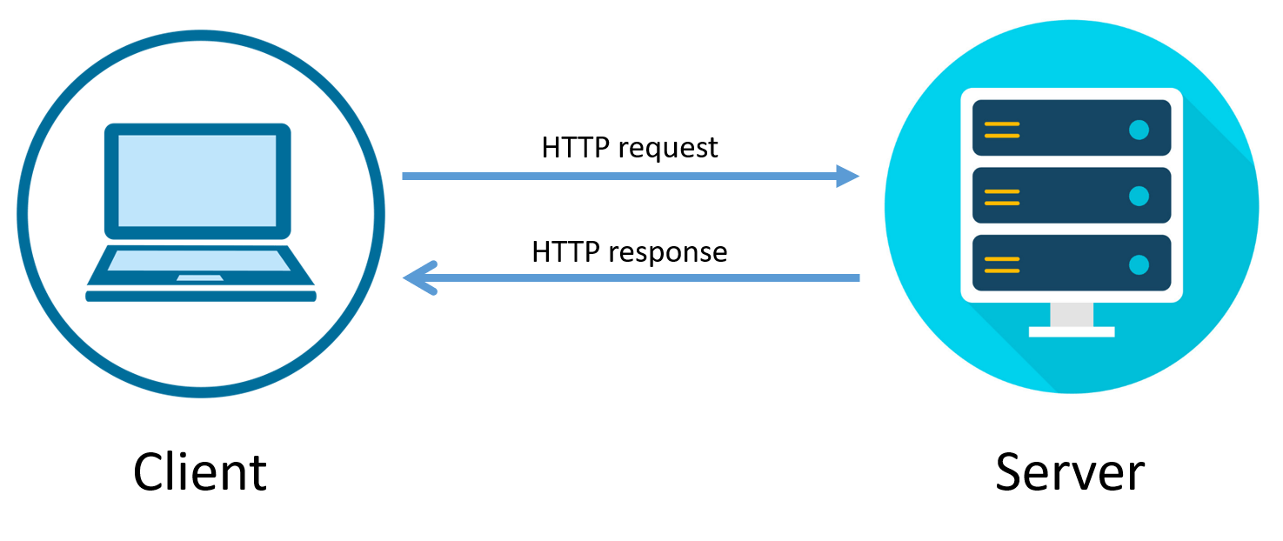

Slide 24
Commands vs Events
Command: ProcessOrder
Tell one other service to do something
Core path
Event: OrderReceived
Notify 0-many services
Side Effects

Slide 25
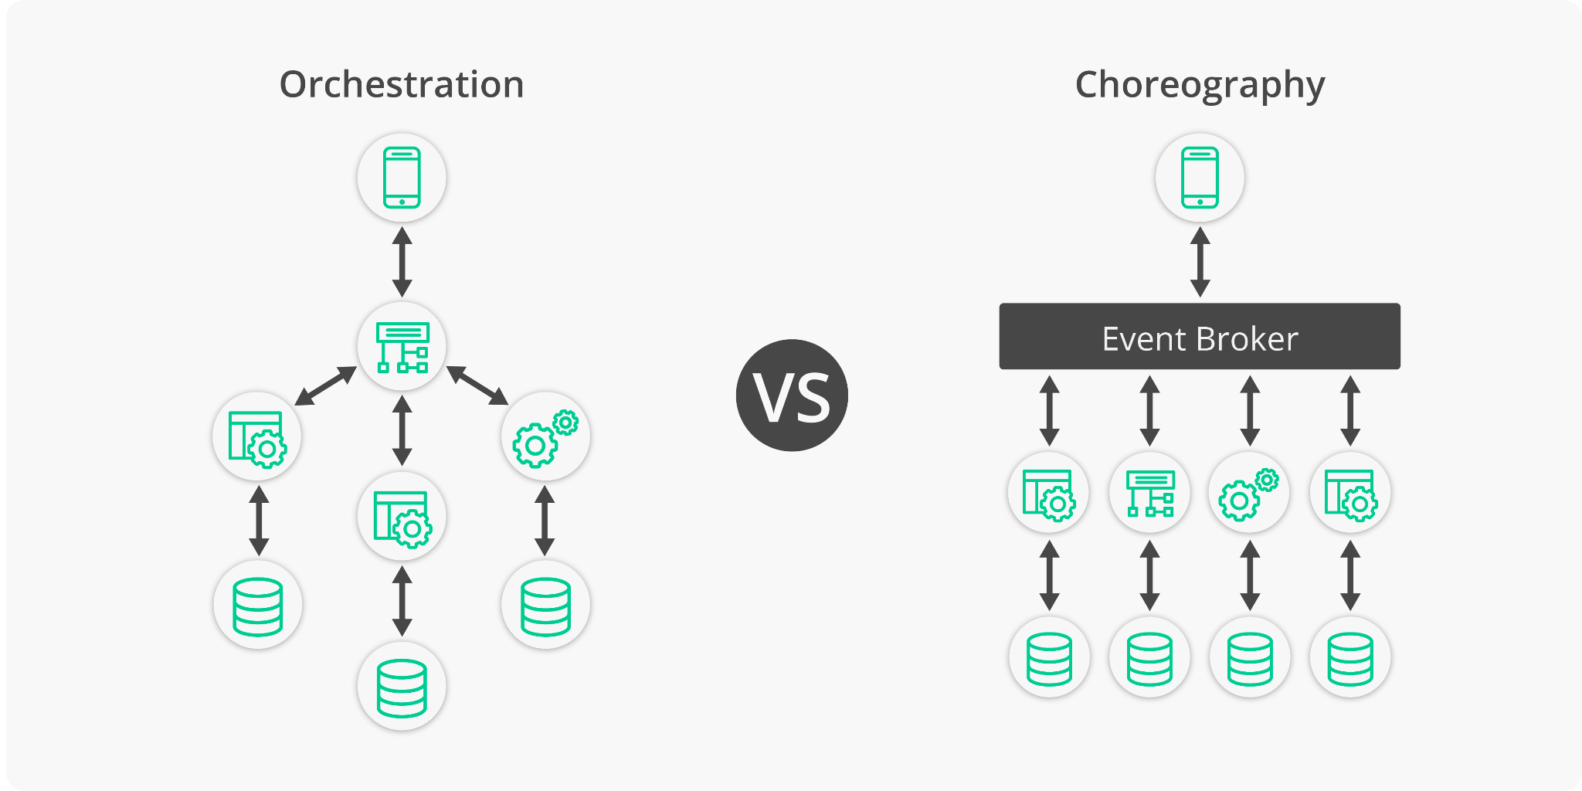

Slide 26
Orchestrator
aka Saga
async request
Dependency
state
async response

Slide 27
Fulfill Order
Service
“Do I have complete details?”
Enrich Order
Dependency
Fulfill Order

Slide 28
Service 1
Tightly Coupled Command: “I want Service 2 to ProcessOrder”
Service Bus
Service 2
Service 3

Slide 29
Service 1
Passive Aggressive Event “I’ve just received this order. I’ll just leave the details here and hope something picks this up”
Service Bus
Service 2
Service 3

Slide 30



Sales Website
Custom Management Tools
Adapter
Service Bus
Event Store
Adapter
Adapter
Monitoring Tools (AppInsights, Seq, Splunk)
ERD
Financial System

Slide 31
Service Bus Deployment
Tools and deployment options
Azure Portal
No local dev options
Service Bus Explorer
Azure CLI
Arm Templates
Bicep
Hashicorp Terraform
Pulumi

Slide 32
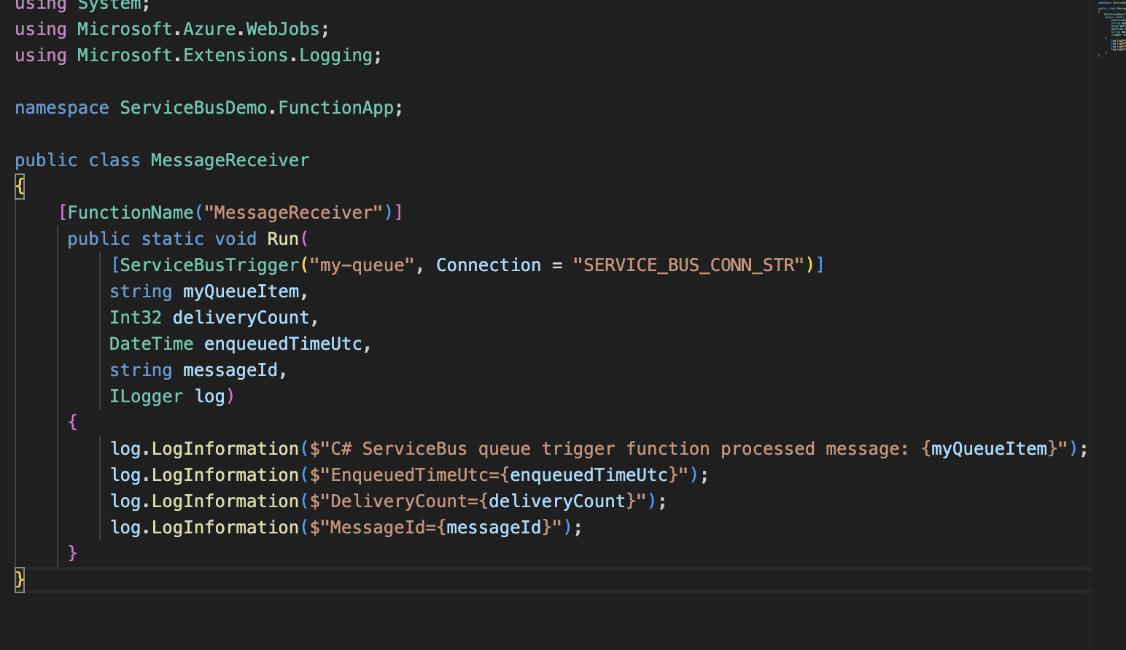

Slide 33
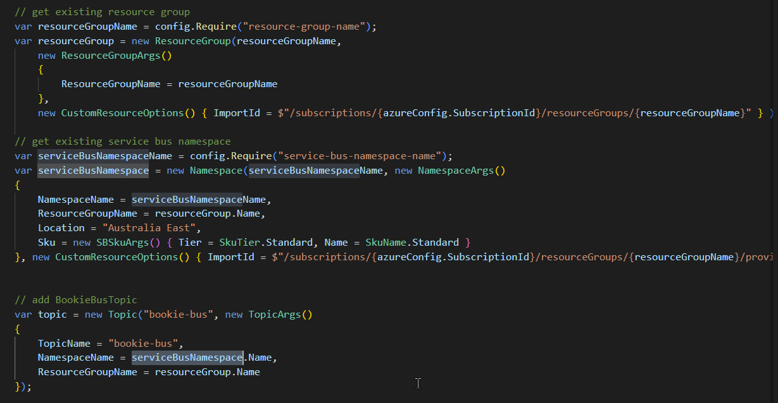

Slide 34
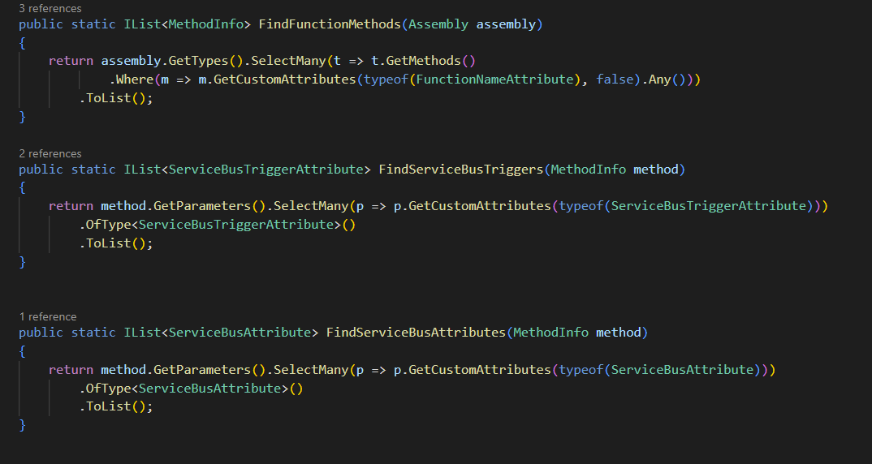

Slide 35
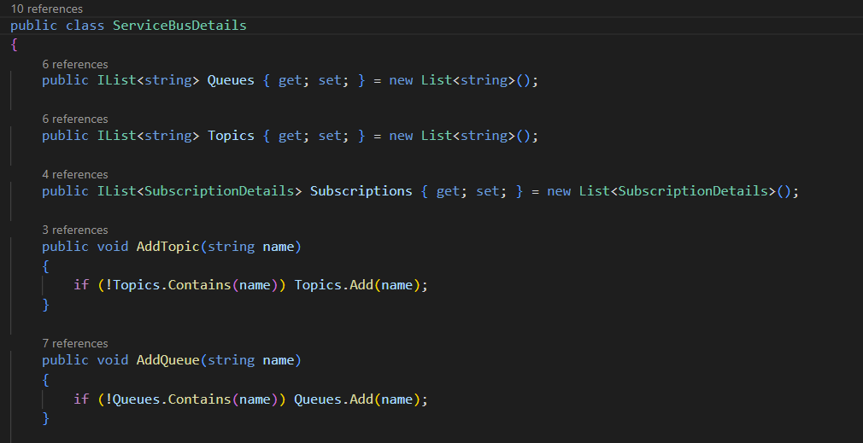

Slide 36
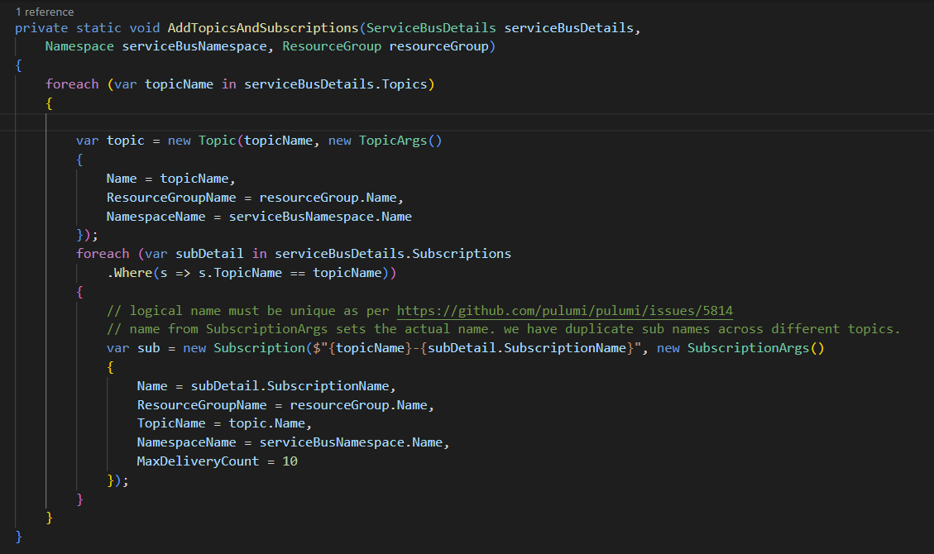

Slide 37
Core Components
.NET Usage
Azure Function Apps
Message Based Architectures
Infrastructure As Code

Slide 39


Links
https://github.com/
brendan-nobadthing/
AzureServiceBus-for-dotnet
www.azenix.com.au
brendan-nobadthing
brendan richards

