Slide 1
CSS for Developers
Colin Bowern (@ColinBowern)

Slide 2
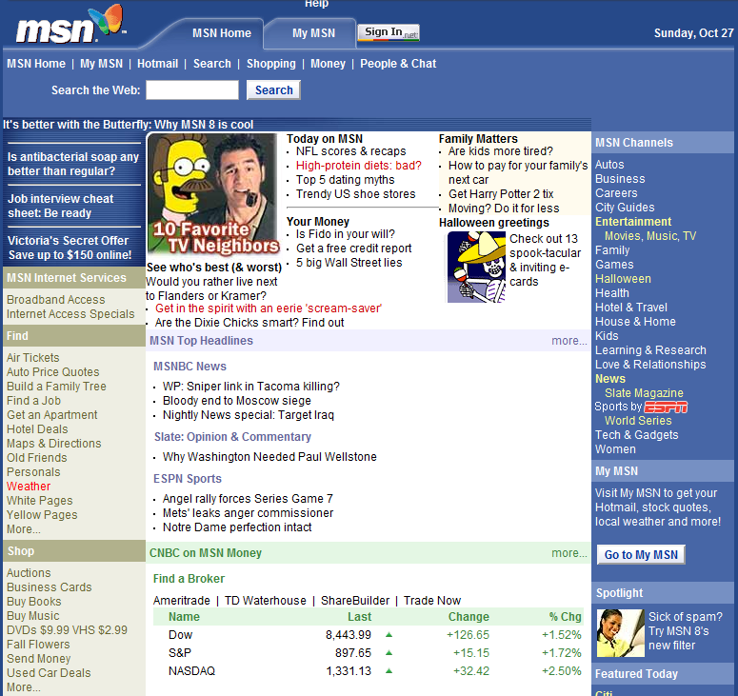
The Web Has Evolved
Static content
Server generated
Minimal interaction
Limited design choices

Slide 3
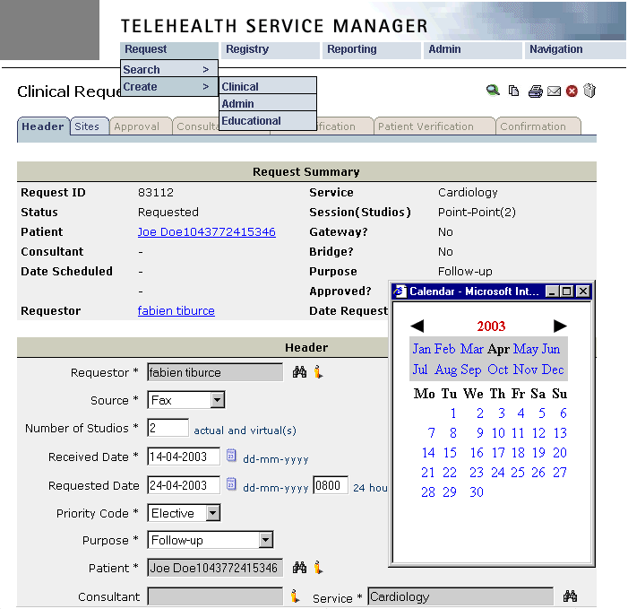
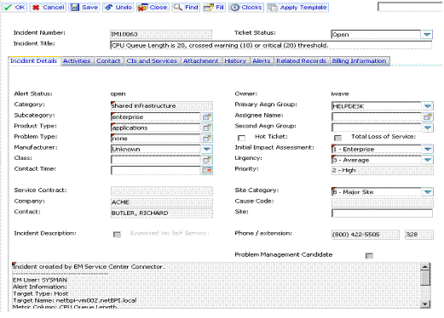
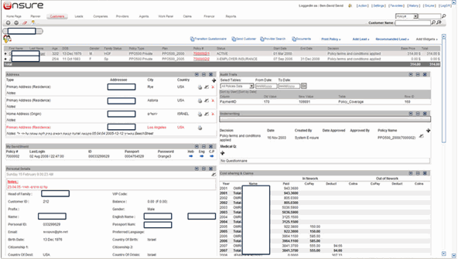
The Web Has Evolved
Functional
Overwhelming
Training required
Bland design
Fails to embrace the web

Slide 4
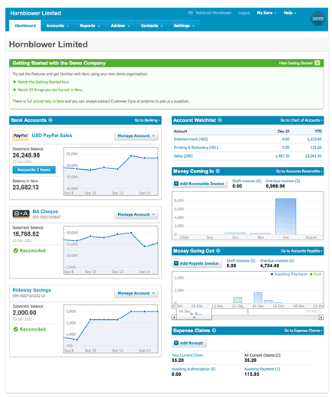
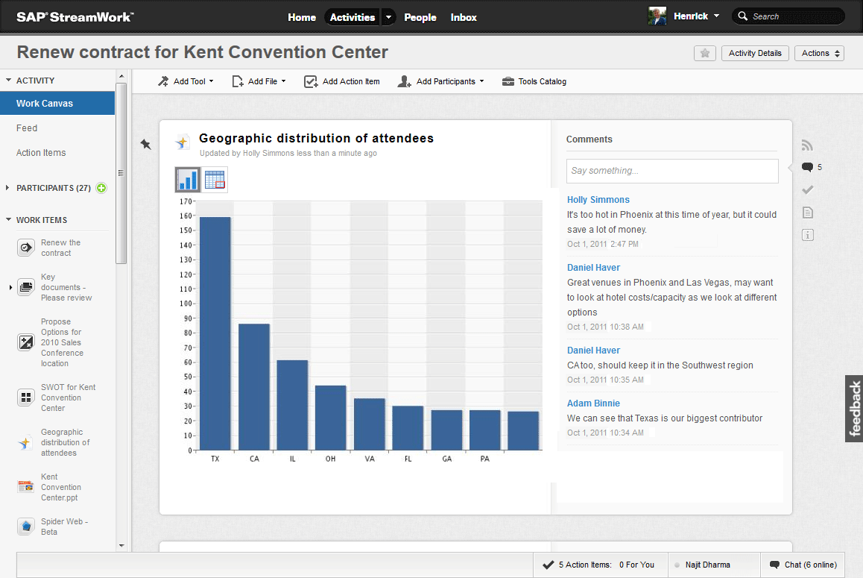
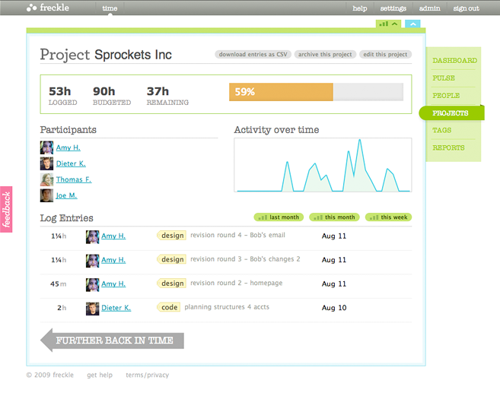
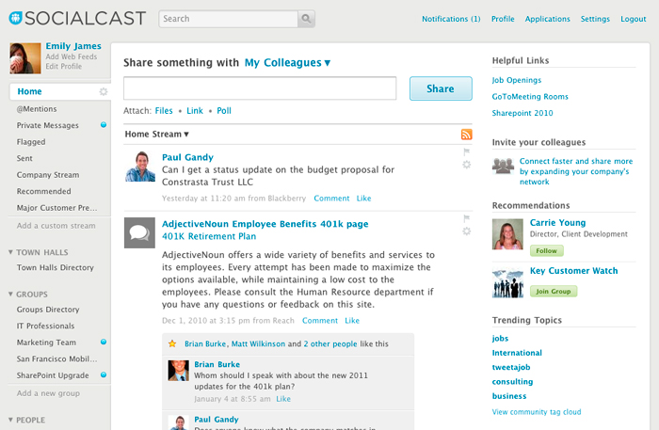
The Web Has Evolved
Responsive interfaces
Visually appealing
Minimal training

Slide 5
HTML5 Content
CSS3
Presentation
JavaScript Behavior

Slide 6





Browsers
Variety of browsers already in your enterprise
Mobile versions catching up very quickly
Cross-browser interop focus over past few years
Web Standards Project ACID tests
ECMAScript Test Suite

Slide 7
Key Concepts
Box Model
Positioning
Selectors

Slide 8
Thinking in Boxes
Margin
Border
Padding
Content

Slide 9
Block vs. Inline Elements
Block
Block
Inline
Inline
Inline

Slide 10
Block Elements
Contain block and inline elements
Formatted with a line break before and after the element:
Width equal to parent container
Height equal to child elements
Margin and padding provide spacing around all sides
Be careful explicitly setting 100% width:
<article>
<aside>
<audio>, <video><canvas>
<dd>, <dl>, <ol>, <ul>
<div>
<footer>
<form>
<h1>…<h6>
<header>, <hgroup>
<hr>
<noscript>
<p>
<section>
<table>, <tfoot>
width: 100%; margin: 10px;
Full list of HTML Block Elements at developer.mozilla.org/HTML/Block-level_elements

Slide 11
Inline Elements
May only contain data and other inline elements
Flows alongside inline elements:
Width equal to content
Height equal to content
Width and height cannot be explicitly set
Top/bottom margin and padding are ignored
Setting display property to “inline-block” to get full control of height/width/margin/padding
<a>
<b>, <strong>
<br>
<button>
<code>
<em>, <i>
<img>
<input>
<label>
<object>
<script>
<select>
<small>
<span>
<textarea>
Full list of HTML Inline Elements at developer.mozilla.org/HTML/Inline_elements

Slide 12
Box Model
Demo

Slide 13
Positioning
Static (default) – flows elements naturally using block/inline rules
Relative – relative to itself; enables z-indexing
Absolute – relative to parent element with either relative or absolute positioning; removed from natural flow
Fixed – positioned at coordinates that stick w/scroll

Slide 14

Floats
Originally intended to allow inline content to wrap around block-level elements
Often misused to make column layouts
Can be reset using the clear property (left, right, both)

Slide 15
Positioning
Demo

Slide 16
Selectors
Rules defined based on ID, Class and/or Elements
Can specify relationships between targets
Pseudo-classes allow you to select elements in a specific state (:hover, :focus, :enabled, :disabled, :checked, …)
Pseudo-elements allow you manipulate content in certain positions (:before, :after, :first-letter, :first-line)
More details at colinb.me/30cssselectors

Slide 17
Selector Priority
Priority determined based on CSS Specificity
Inline Styles – 1,000 points
IDs – 100 points
Classes, Attributes, Pseudo-Classes – 10 points
Elements – 1 point
!important overrides everything (try to avoid)
More details at colinb.me/csspriority

Slide 18
Selectors
Demo

Slide 19
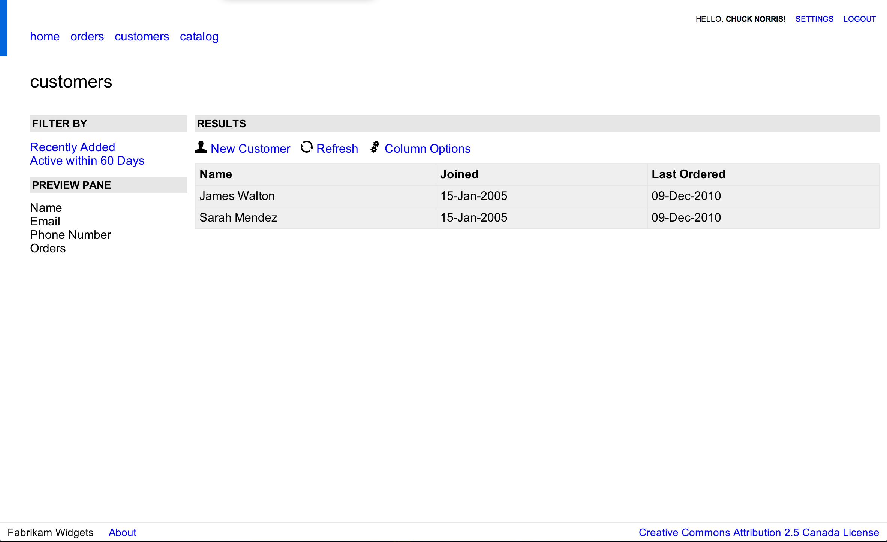
Concepts Applied

Slide 20
Applied CSS
Demo

Slide 21
Other Useful Bits
Be more beautiful with:
Web Fonts
Rounded Corners
Support multiple resolutions with:
Media Queries
Manage complexity with:
Pre-Processors (LESS, SASS)
Frameworks (Bootstrap, Compass, etc…)

Slide 22
Cross-Browser Compatibilty
Three Engines – Gecko, Trident and Web Kit
Comparison of CSS support at colinb.me/cssengines
Experimental CSS properties use vendor prefixes
Use of Normalize and Reset CSS stylesheets reduce headaches with differences in engine baselines
Set the X-UA-Compatibility meta tag to tell IE to use older engine, details at msdn.com/library/cc288325.aspx

Slide 23
Testing Tools
Internet Explorer Compatibility Virtual Machines microsoft.com/download/details.aspx?id=11575
App Virtualization – spoon.net/browsers
Hosted Browser VMs – BrowserStack, Sauce Labs, Adobe Browser Lab, Browserling, …
Real Devices – Device Anywhere Test Center

Slide 24
Resources
Can I Use… caniuse.com
HTML 5 Boilerplate html5boilerplate.com
Web Essentials colinb.me/vswebext
Web Workbench bit.ly/webworkbench
Smashing Magazine smashingmagazine.com
People to follow:
Jakob Nielsen – Designing Web Usability
Steve Krug – Don’t Make Me Think!
Edward Tufte – Data Viz Wiz

