Slide 1
The State of (Corporate) HTML5
Colin Bowern
Principal Consultant - ObjectSharp
@colinbowern
www.colinbowern.com

Slide 2

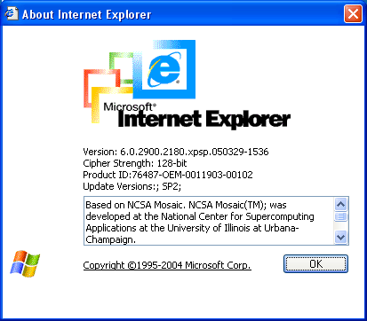
314 days remaining
Notes:
314 days remain until the death of IE (officially)
This doesn’t mean that it will stop working, but for many companies the realization that they are cold, naked and alone when it comes to support and more importantly security patching makes this a risky venture, especially on the web
You could argue that hackers have moved on from IE6, focusing on more widely adopted browsers, but I certainly wouldn’t want to rest on it
The web is an evolving platform. Unlike VB6 whose runtime remains supported on Windows through 2020+, a lack of regular investment in a web app is foolish to say the least.
That being said not all management teams have realized this and continue to perpetuate older web applications. In some cases, not because they want to, but because the upgrade scenario is much more difficult (i.e. commercial solutions that have deep customization such as some older ERP solutions)
The answer isn’t to remain stale and outdated because those laggards do, but to start building and taking advantage of the new.

Slide 3
in this session…
Understand the pace of change on the web
Techniques to “future proof” your web application
Take advantage of the latest, while not breaking the oldest

Slide 4
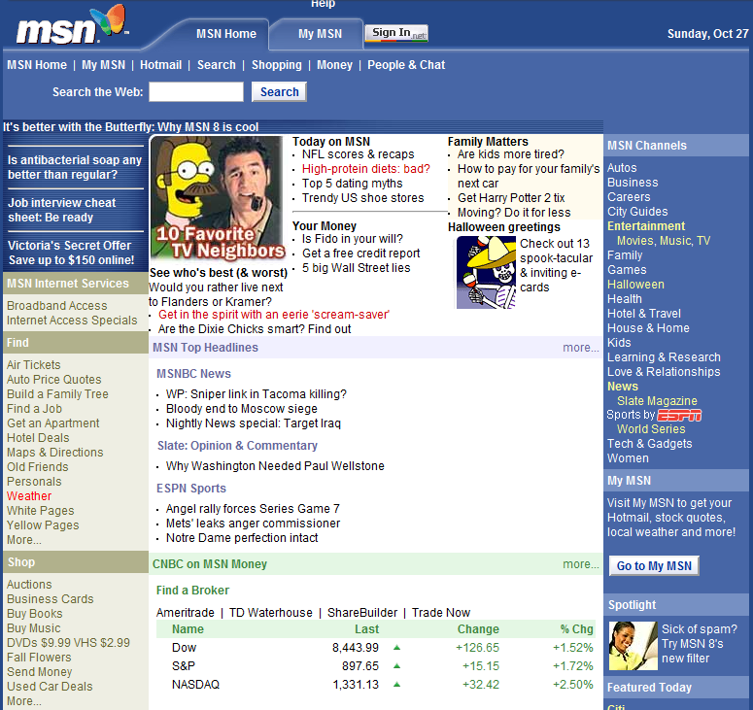
the web has evolved
Static content
Server generated
Minimal interaction
Limited design choices

Slide 5
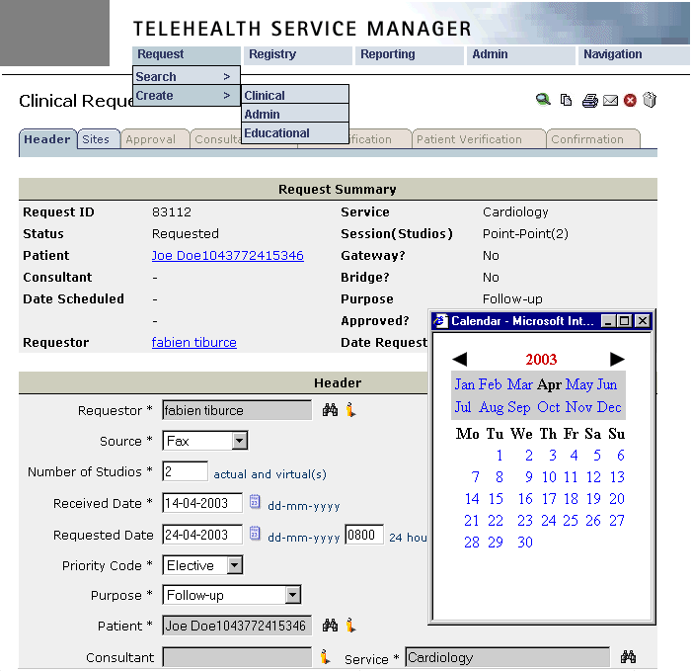
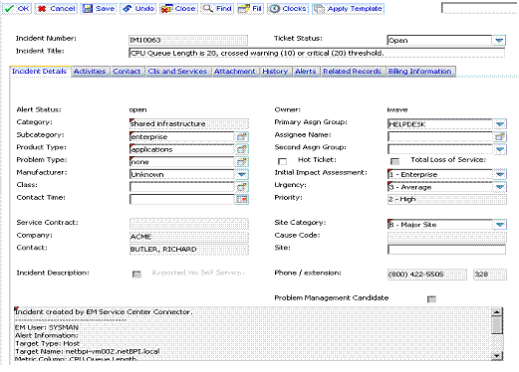
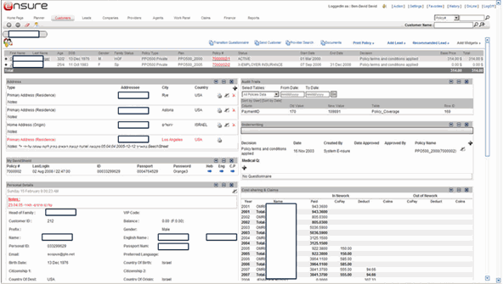
the web has evolved
Functional
Overwhelming
Training required
Bland design
Fails to embrace the web

Slide 6
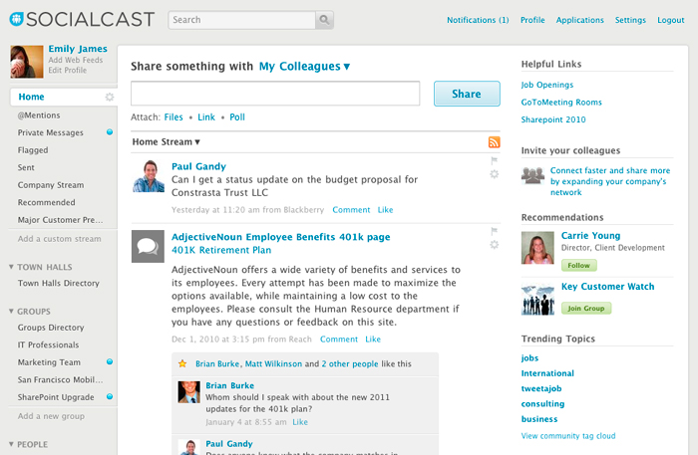
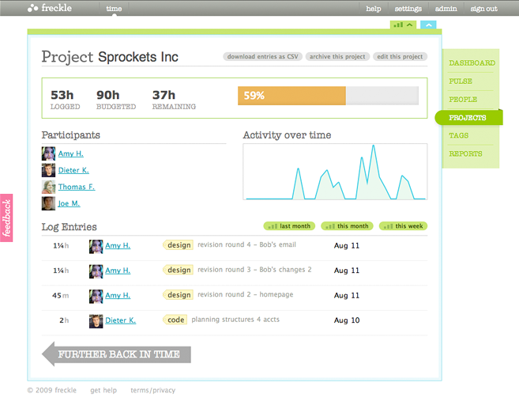
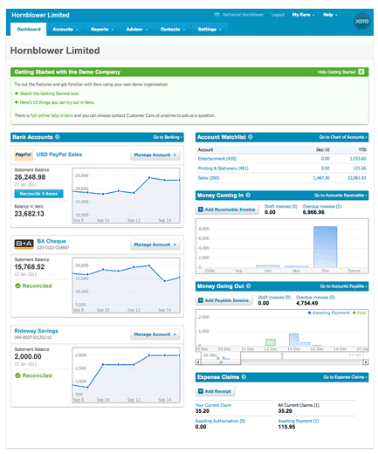
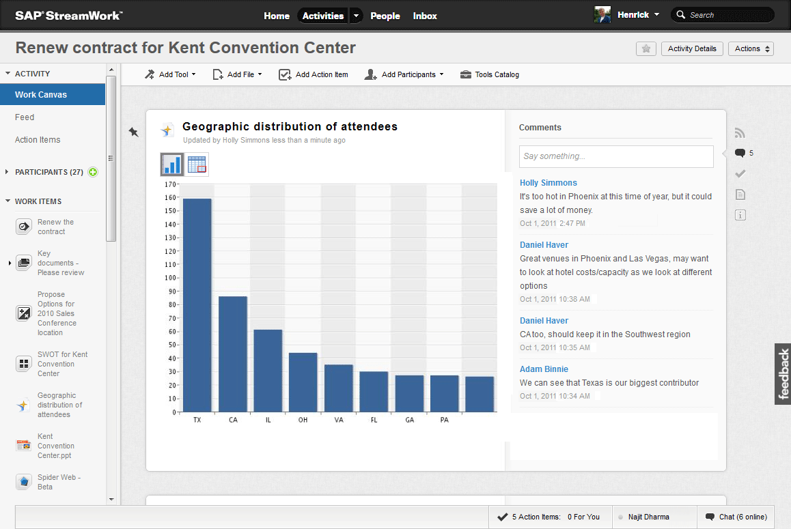
the web has evolved
Responsive interfaces
Visually appealing
Minimal training

Slide 7
we’re pushing to maximum warp!
The real browser race has just begun
Even IE is moving toward automatic updates (if sysadmins allow it)
Internet
Explorer
6
7
8
9
10
11
1
2
3
4
5
6
Safari
Firefox
1
2, 3
4
5-12
13-20
21-29
Chrome
1
2, 3
4-8
9-16
17-23
24-28
2001 | 2002 | 2003 | 2004 | 2005 | 2006 | 2007 | 2008 | 2009 | 2010 | 2011 | 2012 | 2013
Notes:
http://en.wikipedia.org/wiki/Internet_Explorer_versions
http://en.wikipedia.org/wiki/Firefox_release_history
http://en.wikipedia.org/wiki/Safari_version_history
http://en.wikipedia.org/wiki/Google_Chrome
Real browser race has just begun. Sparked by who can be the most HTML5 complaint.

Slide 8
no one will win though…
Device-specific browser lock out prevents one browser from ruling them all
iOS = Safari
Windows RT = IE
Android = Chrome (Android Browser)
Google’s departure from WebKit no longer makes it the holy grail of web development
Not that all Web Kit browsers were created equal anyways…
The success of the web is brought about by the diversity, not a drive towards monoculture
Notes:
Blink

Slide 9
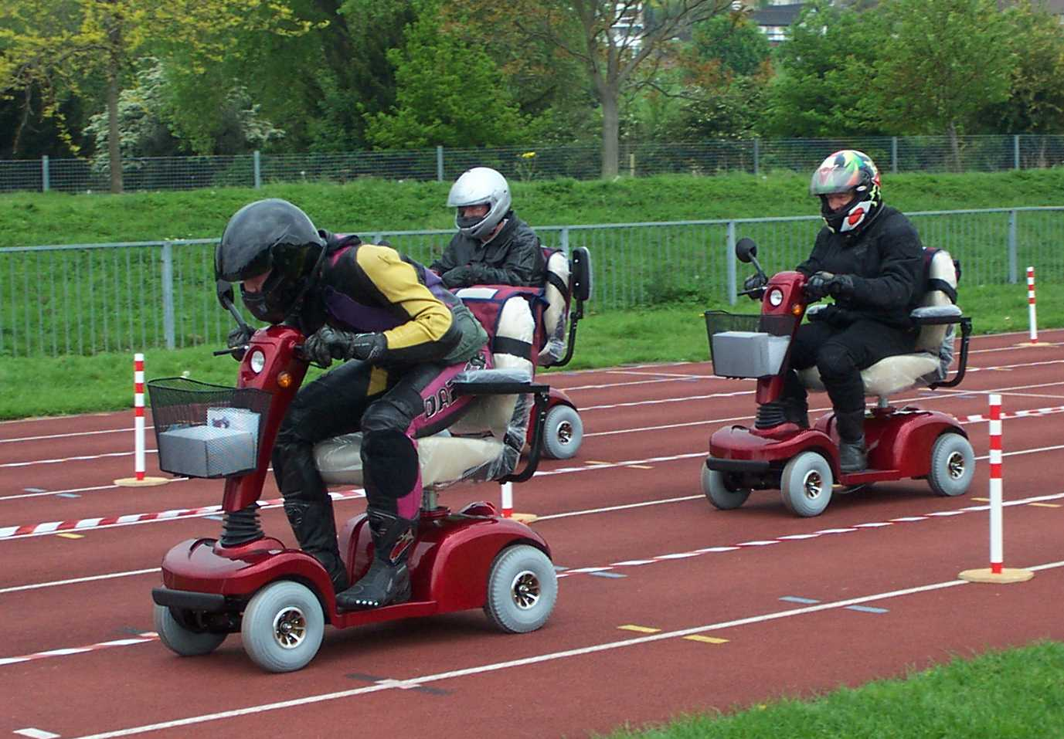
competition is good thing
Promotes innovation
Exposes weakness
Applies learning from failure

Slide 10
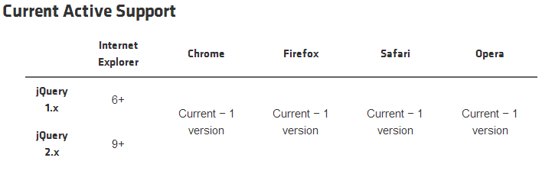
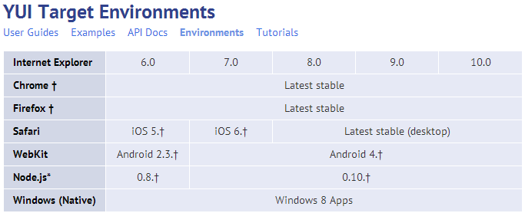
if we could say the web was “n-1”…
Business might rethink how the invest in web applications
Greater pressure by developers on vendors for standards adoption and compliance
Automated smoke tests would be much more important

Slide 11
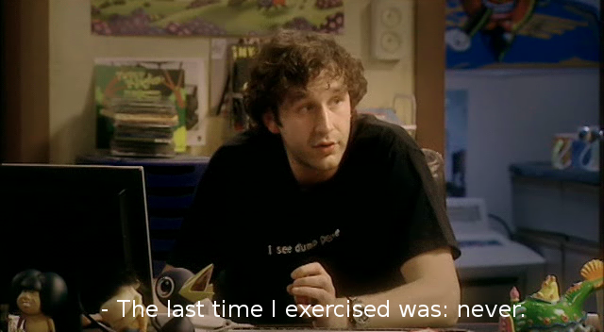
…meanwhile, back in IT land
Standard desktop images evolve at a slow pace
People bring their own devices to workaround IT
IT likes IE because it is predictable… maybe even Firefox because it can be trusted enough
Can’t be too innovative because breaking something = trouble
Understand IT’s constraint is focused on risk (don’t break things)

Slide 12

as a web developer, the reality is…

Slide 13
back to basics
HTML5 Content
CSS3
Presentation
JavaScript Behavior

Slide 14
back to basics
Specifications leave room for interpretation
Cross-browser interop focus has improved in past few years
Web Standards Project ACID tests
ECMAScript Test Suite
Barrier to entry to profession is low
Writing good markup, style sheets and script is hard
Less-than-perfect markup power web apps big and small

Slide 15
shipping standards compliant apps
Pick a DOCTYPE and stick to it
Separate content, presentation and behavior
Encode content properly
Use inline and block elements correctly
Make it easy to read and maintain
*Always* validate markup, style sheets and scripts

Slide 16
shipping standards compliant apps
Pick a DOCTYPE and stick to it.
Strict – no presentation allowed in markup
Transitional – presentation elements still allowed ☹
Be aware of Standards, Almost Standards, and Quirks mode
See colinb.me/QuirksMode
HTML DOCTYPEs | XHTML DOCTYPEs
Elements and attributes are case insensitive (e.g. <h1> is the same thing as <H1>) | Elements and attributes are case sensitive and are all lowercase
Not every element requires a closing tag (<p>), while others should not have a closing tag (<img>) | Elements must be explicitly closed (<p>…</p>), elements without content should be self closing (<img />)
Attribute values do not require quotes | Attribute values must be enclosed by quotes
Shorthand can be used for certain attributes (<input required>) | Full attribute form must be used for all attributes (<input required="required">)

Slide 17
shipping standards compliant apps
Separate content, presentation and behavior
Style sheet references on top (head), scripts on the bottom (before closing html tag)
Win on rendering speed as well as readability
colinb.me/ProperPageIncludes
<html lang="en">
<head> <meta charset="utf-8" />
<title>All About Cats & Dogs</title>
<script>
var x = 1 + 2;
</script>
<body>
<h1><font size="24px">Cats are fun</font></h1>
</body>
</html>
Use external scripts
Use style sheets

Slide 18
shipping standards compliant apps
Encode your content properly
Language is declared in the document root
Character set is first thing declared in the document header
<html lang="en">
<head>
<title>All About Cats & Dogs</title>
<meta charset="utf-8" />
&amp;

Slide 19
shipping standards compliant apps
Use inline and block elements correctly
Browsers permit technically incorrect combinations
“Build on blocks, inline on the inside”
<a href="index.html"><h1>Cats</h1></a>
<h1><a href="index.html">Cats</a></h1>

Slide 20
shipping standards compliant apps
Make it easy to read and maintain
Use consistent intending and casing
Make it easy to implement with tooling
Format Document in Visual Studio
HTML Tidy, CSS Tidy, JS Beautify open source tools
Pick a naming convention and stick to it
No different than server-side coding styles
Jury is still out on hard rule when to reference by ID, class or element name
When planning out styles selector specificity applies

Slide 21
shipping standards compliant apps
*Always* validate markup, style sheets and scripts
Tools available on most fronts:
Web-based - colinb.me/W3CValidators
Browser extensions:
Firefox - colinb.me/HtmlValidatorFirefox
Chrome - colinb.me/HtmlValidatorChrome
VS plugins:
Web Essentials - colinb.me/vswebext
JSLint - colinb.me/JsLint2012
Standalone – www.htmlvalidator.com
Haven’t seen reliable build process validator
Challenged by dynamic nature of markup

Slide 22
Validators in action
Demo

Slide 23
taking advantage of the latest
Supporting older browsers is not as painful these days
Remember, sites don’t need to render the same across all browsers
10+ years to see the light
More smart people focused on the problem
Deeper knowledge and tooling for JavaScript
Use polyfills to close gaps if needed
Manipulate the DOM to enable support of new features
Does have a performance impact – meant to be temporary workarounds rather than permanent fixes
colinb.me/Html5Polyfills

Slide 24
structural elements
header
nav
New elements introduced to address common scenarios seen across most web interfaces
Data elements allow for richer interaction with content (<time>, <command>, <progress>)
Use with older browsers using appropriate polyfill
aside
article
section
footer

Slide 25
Modernizr
Demo

Slide 26
controls
Form controls enable browsers to provide consistent input experience
Dates & Time, Number, Range, Email Address, URL, Color, Search
Descriptive controls allow for behaviour and semantic description
Menu, Figure, Datagrid, Output, Time, Progress, Meter

Slide 27
Polyfills
Demo

Slide 28

layout and styling
Rounded borders, shadowing, font enhancements for polished look-and-feel
Normalize style rules rather than resetting them
LESS, SASS make rules manageable
Avoid table-based layouts which increase render time and reduce responsiveness

Slide 29
drag & drop
Standardizes scenario that has been re-invented many times
Mark elements with draggable attribute
Mark target zones with dropzone attribute
Handle ondrop event to update back-end
Wire into the file and touch events for rich experiences

Slide 30
web sockets
Two-way communication between client and server with persistent TCP connection
Less network overhead than long polling / streaming (Comet) or periodic refreshing (AJAX)
Consider the scalability impact of open connections

Slide 31
SignalR
Demo

Slide 32
data storage
Session and Local Storage used for string values
Similar to HTTP cookies
Session: tied to top-level document
Local: tied to domain
Web Storage provides a SQL-like mechanism for storing and querying complex data structures

Slide 33
JStorage
Demo
Notes:
http://www.jstorage.info/

Slide 34
supporting apps with incompatibilities
Enable IT to move on with a modern browser while supporting legacy applications
Three approaches:
Host modern rendering engine in older browser – Chrome Frame
Host older rendering engine in newer browser – Browsium Ion
Application virtualization of older browser – Microsoft App-V
What are you hearing from IT that prevents them from running the latest browers?

Slide 35
testing across the spectrum
Lots of cross-browser testing tools on the market
colinb.me/XBrowserTest
Automate test runs using open source or commercial tools
Selenium
Telerik Test Studio
Visual Studio Coded UI Tests
Internet Explorer product group publishing great offers:
3 month access to BrowserStack
VMs for Hyper-V, VMware Player/Workstation, VirtualBox, and Virtual PC
*Sold out* Heavily discounted copy of Windows 8 + Parallels for Mac
modern.ie/virtualization-tools

Slide 36
next steps
Use HTML5 and CSS3 today!
Bookmark HTML5 specs – developers.whatwg.org
Subscribe to CSS3 feed – css3.info
Implement feature detection – caniuse.com
Use polyfills when needed – colinb.me/Html5Polyfills
Advocate with stakeholders on
What is possible with sketches (linked to business value)
Cost of supporting older browsers

Slide 37
resources
UIs for Business Web Apps
colinb.me/BizWebAppUI
Top 10 App Design Mistakes
colinb.me/TopUXMistakes
HTML5 Polyfills
colinb.me/Html5Polyfills
HTML5 Rocks
html5rocks.com
HTML5 Boilerplate
html5boilerplate.com
HTML5 Browser-Feature Matrix
caniuse.com

