Slide 1
Enterprise Identity Management for SaaS Applications
Colin Bowern
Principal Consultant - ObjectSharp
@colinbowern
www.colinbowern.com

Slide 2
in this session…
Understand how to play nice with corporate IT when you are ready to move beyond shadow IT
Techniques to integrate with existing corporate identity systems
How to move beyond federated identity to take advantage of the enterprise social graph

Slide 3
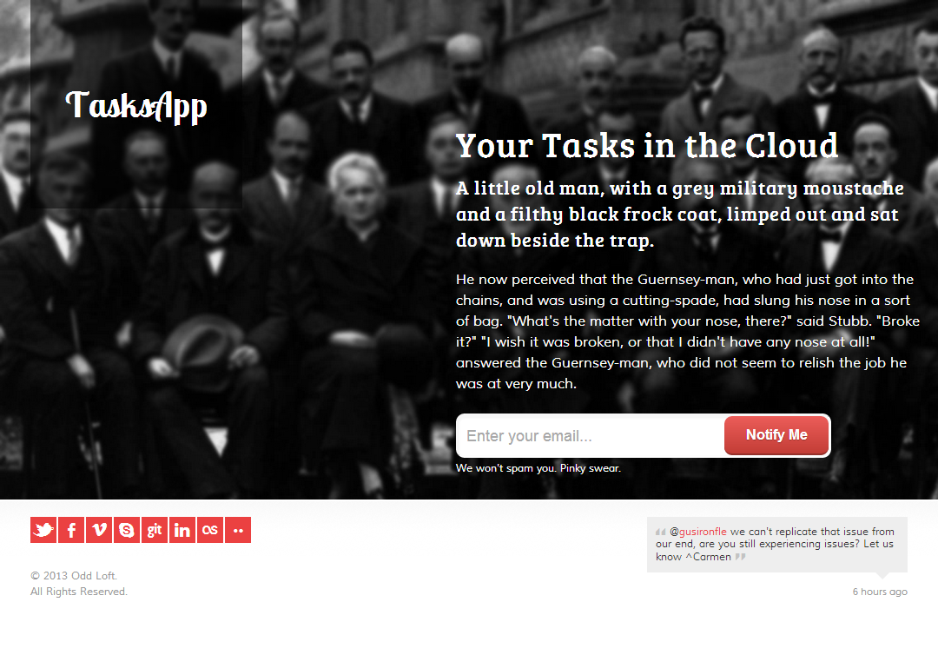
you’ve launched your app

Slide 4

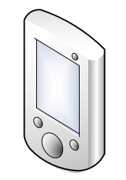
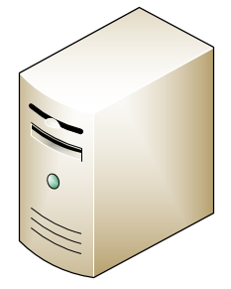
it probably looks like this
Browser
Web Application
Account & Profile Store
Mobile
Web Service API
Server

Slide 5
you used the common identity providers
Local Identity
Username and Password
Social Identity
Facebook
Google
Microsoft
Twitter

Slide 6
now go big (corporate) by offering…
Availability
Customization
Integration
Performance
Security
Multiple Region Hosting
Load Balancing
Look and Feel
Workflow
APIs
Data Extracts
Service Level Agreements
Data Privacy
Maintenance Notification Process
Access Controls
Application and Network Penetration Testing
Service Dashboards
Transactional Performance Metrics
Data Backup and Recovery
Professional Data Centers
Third Party Certifications
Business Rules
Data Import

Slide 7
digging into enterprise class access control
Authentication
Authorization
Accounting
Notes:
At the cross between security and integration is identity management - controlling access to computer resources, enforcing corporate policies, auditing usage, and ultimately feeding information necessary to bill for services
Authentication - identity lifecycle management
Authorization - role modeling, governance, provisioning
Accounting - attestation, automated remediation of access

Slide 8
corporate IT wants to know…
What type of identity management solution is provided?
Is Single Sign-On (SSO) provided, if so what types of SSO options are available (SAML, WS-Trust, OAuth)?
Can your app be integrated with an existing Identity Management system?
What type of user store is available and can it be integrated with Active Directory?
What type of user security, authentication and authorization options are available?

Slide 9
…if you offer federated identity
Federation Provider (FP)
2
Identity Providers (IdP)
Issuer Registry
Active
Directory
STS
ADFS
1
4
7
5
6
8
Web Application
User
9
Relying Parties (RP)
3
Notes:
Chuck tries to access the Tasks app
App doesn’t see any valid login token so it redirects Chuck to its trusted security token service, in this scenario known as the federation provider
Chuck tells the FP where he is coming from (this can be from an email address, selecting from a list of trusted identity providers, a special URL, etc…) and the FP redirects Chuck to the trusted identity provider for his company, in this case Active Directory Federation Services
The IdP verifies Chuck is Chuck (i.e. look at existing AD login token, username/password, smartcard, whatever), then issues a token to Chuck and redirects him back to the FP
The FP sees a token, signed by a trusted IdP, issues an application token then redirects Chuck back to the Web Application

Slide 10
first step is to think in claims
Claims are things that others say about you:
My name is Colin
My email is colin@bowern.com
I live in Canada
My manager is Gisele
Claim are made up of:
Issuer
Type
Value
Claim validity depends on whether you trust the issuer

Slide 11
.net 4.5 bakes claims into the core
IIdentity
GenericIdentity
FormsIdentity
ClaimsIdentity
WindowsIdentity
IPrincipal
GenericPrincipal
FormsPrincipal
ClaimsPrincipal
WindowsPrincipal

Slide 12
claims are passed around in a token
SecurityTokenHandler
Kerberos
RSA Key Pair
SAML
X509
SAML2
Username
New to the party:
JSON Web Token
Simple Web Token

Slide 13
tokens are issued by identity providers
Social
Facebook
Corporate
Active Directory Federation Services
Twitter
Microsoft
Google
Open ID
OneLogin
Ping Federate
SiteMinder Federation
Azure Active Directory
…
…
Your Own
Windows Identity Foundation
Identity Server
…
Notes:
Social
Facebook, Twitter, Microsoft, Google, OpenID, …
Corporate
Active Directory Federation Services, OneLogin, Ping Federate, SiteMinder Federation, …
Your Own
Provide local accounts for users who are unwilling or unable to use other identity providers

Slide 14
tokens are transformed into claims principals
Get Security Token
Token Handlers
Issuer Token Resolver
Validate Token Issuer
Token Handlers
Issuer Name Registry
Generate Claims Principal
Token Handlers
Authenticate Claims Principal
Generate Session Token
Authorize Claims Principal
Claims Authentication Manager
Session Security Token
Claims Authorization Manager
Add app-specific claims here
Dynamic issuer validation in here

Slide 15
putting it all together
Identity Provider (IdP)
Account Store
1
Security Token Service
4
Relying Party (RP)
3
User
Web Application
2
5
Notes:
RP and STS establish trust through sharing service identity and token signing artifacts (X.509 certificate)
User attempts to access RP
RP directs user to STS to obtain a security token for the app
User signs in with the STS, is provided a token and redirected back to the application
RP verifies STS token signature and creates an application session for the user

Slide 16
Outsourcing Identity
DEMO

Slide 17
technologies at play
Web Services Federation (WS-Federation)
Negotiate and exchange security tokens
Supports conversations between relying parties and security token services
Builds upon WS-Security, WS-Trust, WS-MetadataExchange, …
Security Assertion Markup Language (SAML) Tokens
XML message for claims and security-related data (signatures, token issuer)
SAML 2.0 goes beyond tokens to provide a protocol (SAML-P) with functionality similar to WS-Federation
Watch for Open ID Connect
Built on OAuth 2 with JSON/REST-based interfaces
Notes:
WS-Security
OASIS standard
Defines mechanisms to construct security protocols.
How to sign, validate and encrypt messages.
How to bind security tokens to SOAP messages.
Intended to be sufficiently flexible to use a variety of security models and tokens
PKI, Kerberos, TLS, etc.
WS-Trust
Defines protocols to issue, renew and cancel WS-Security tokens.
WS-Trust is agnostic with to the type of token.
To WS-Trust, a SAML assertion is just another kind of token.
A requestor acquires a token issued by a security token service (STS), and can present it to a web service.
A requestor learns of a web service’s or STS’ security policy through WS-Policy.
An STS may in turn require some token from another STS for issuing its own tokens; this permits brokering between different trust domains.

Slide 18
need help explaining claims for identity?
Identity 2.0
colinb.me/Identity20

Slide 19
handling multiple identity providers
Federation Provider (FP)
2
Identity Providers (IdP)
Issuer Registry
Active
Directory
STS
ADFS
1
4
7
5
6
8
Web Application
User
9
Relying Parties (RP)
3
Notes:
RP and FP-STS establish trust through sharing service identity and token signing artifacts (X.509 certificate)
FP-STS and IdP establish trust through sharing service identity and token signing artifacts (X.509 certificate)
User attempts to access RP
RP directs user to FP-STS to obtain a security token for the app
User identifies their preferred IdP, FP redirects user to IdP
User signs in with the IdP, is provided a token and is redirected to the FP
FP verifies the IdP token, issues its own token and redirects user to the RP
RP verifies FP token signature and creates an application session for the user

Slide 20
federation providers simplify relationships
Identity Providers
Social
Corporate
Custom
Relying Parties
Web Apps
Native Apps
Services
User
Single Identity

Slide 21
Federating with Identity Providers
DEMO

Slide 22
not all scenarios addressed by federation
user provisioning / de-provisioning
ability to view “all users” in my organization
delegated administration
While enterprises working to consolidate identity management on premise, cloud apps are fragmenting identity… again

Slide 23

extending directory access to apps
Cloud
app
Enables federated identity and extends access to rich directory information
Apps can read and/or write to the directory via role-based access controls
Integrates cloud-based app identity without exposing on premise infrastructure
Azure
AD
Cloud
app
Cloud
app
Sync/Fed
AD

Slide 24
from a business perspective
Enterprises extend existing AD to support cloud apps
Manage users, groups in AD, changes synchronized to Azure AD
On-premises applications use AD
Cloud applications use Azure AD
Smaller businesses use Azure AD as primary identity system
No on-premises applications or AD
Use Azure AD to manage users, groups
Cloud application use Azure AD

Slide 25
under the covers Azure AD provides
Federation provider for cloud-based applications
Based on Windows Azure Access Control Services
Directory Graph API for access to directory data
Think LDAP, but at internet scale with REST-based API
Provide applications with read-only or read/write capabilities
Broad protocol support
WS-Federation, SAML-P, OAuth2, Open ID Connect (future)

Slide 26
enables developer opportunities
Connect with customers who have Azure AD
Single sign on integration instead of separate username/password
Query directory graph for user information, provisioning
Use Azure AD as primary app identity system
Use Azure AD as local account store
Connect with customers using popular web identities
Connect with customers who have Azure AD

Slide 27
Leveraging the Directory
DEMO

Slide 28
protocols used by Azure AD
Protocol | Purpose | Details
REST/HTTP | CRUD operations on directory objects, relationships | OData 3.0 compatible OAuth 2.0 authentication
OAuth 2.0 | Service authentication Delegated access | JWT Token Format
Open ID Connect† | Web application authentication Rich client authentication | JWT Token Format
SAML 2.0 | Web application authentication | SAML 2.0 Token Format
WS-Federation 1.3 | Web application authentication | JWT SAML 1.1, SAML 2.0 Token Formats
†Currently under investigation for future release

Slide 29
resources
Understanding WIF 4.5
colinb.me/UnderstandWIF45
Windows Azure Active Directory
colinb.me/AzureAD
Identity Server
thinktecture.github.io
Vittorio Bertocci
cloudidentity.com
Dominick Baier
leastprivilege.com
Open ID Connect
openid.net/connect

