Slide 1
Intro to Protovis 04/14/2011 v0.1 Brendan Sterne Labs Architect, Bazaaarvoice

Slide 2
Table of Contents
Background
Marks
Scales
Interactivity
Techniques
References
Working Examples:
https://github.com/brendan-sterne/Protovis-Tutorial

Slide 3
Background
JavaScript Library
From Stanford Visualization Group
Free and open-source, provided under the BSD License
Uses a Data-Driven Declarative syntax
Gallery: http://vis.stanford.edu/protovis/ex/
Charting Libraries:
FusionCharts, Flot, HighCharts, JSChart
Protovis
Drawing Libraries, APIs:
Canvas, SVG, Raphael, Processing, etc

Slide 4
Pros Cons
Powerful
Flexible
Interactive
Concise
Programmer Efficiency
Excellent Examples and Documentation
SVG Not supported on IE6 – IE8
Can be difficult to debug
Poor Text Styling
No Gradient Fills
Can be slow to render frames of an animation with lots of data points

Slide 5
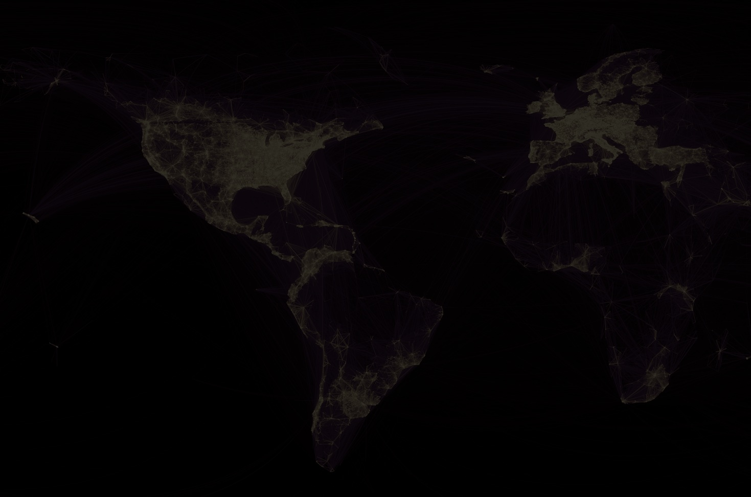

An Empty Panel
<div id="barchart"></div>
<script type="text/javascript"
src="http://vis.stanford.edu/protovis/protovis-r3.2.js">
</script>
<script type="text/javascript+protovis">
var panel = new pv.Panel()
.canvas('barchart')
.width(100)
.height(100)
.fillStyle('#EEE');
panel.render();
</script>

Slide 6
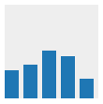
Hello World Bar Chart
var reviews = [10, 12, 17, 15, 7];
var panel = new pv.Panel()
.canvas('barchart')
.width(100)
.height(100)
.fillStyle('#EEE');
panel.add(pv.Bar)
.data(reviews)
.bottom(0)
.left(function() this.index * 20)
.height(function(d) d * 3)
.width(15);
panel.render();

Slide 7
Shorter Anonymous Functions
<script type="text/javascript”>
panel.add(pv.Bar)
.height( function(d) {return s(d.foo)*35} )
</script>
<script type="text/javascript+protovis">
panel.add(pv.Bar)
.height( function(d) s(d.foo)*35 )
</script>

Slide 8
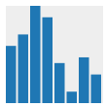
Scales
var reviews = [10, 12, 17, 15, 7, 2, 8, 5];
var w = 100, h = 100,
x = new pv.Scale.linear(0,reviews.length).range(0,w),
y = new pv.Scale.linear(0,pv.max(reviews)).range(0,h);
…
panel.add(pv.Bar)
.data(reviews)
.bottom(0)
.left(function(d) x(this.index))
.height(function(d) y(d))
.width(w/reviews.length-2);
http://vis.stanford.edu/protovis/docs/scale.html

Slide 9

Other Marks - Area
var reviews = [10, 12, 17, 15, 7, 2, 8, 5];
var w = 100, h = 100,
x = new pv.Scale.linear(0,reviews.length-1).range(0,w),
y = new pv.Scale.linear(0,pv.max(reviews)).range(0,h);
…
panel.add(pv.Area)
.data(reviews)
.bottom(0)
.left(function(d) x(this.index))
.height(function(d) y(d))
.width(w/reviews.length-2);

Slide 10
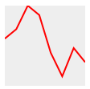
Other Marks - Line
var reviews = [10, 12, 17, 15, 7, 2, 8, 5];
var w = 100, h = 100,
x = new pv.Scale.linear(0,reviews.length-1).range(0,w),
y = new pv.Scale.linear(0,pv.max(reviews)).range(0,h);
…
panel.add(pv.Line)
.data(reviews)
.bottom(0)
.left(function(d) x(this.index))
.height(function(d) y(d))
.width(w/reviews.length-2);
.lineWidth(2)
.strokeStyle("red")

Slide 11
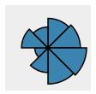
Other Marks - Wedge
var reviews = [10, 12, 17, 15, 7, 2, 8, 5];
var w = 100, h = 100,
maxr = Math.min(w,h)/2-5,
r = new pv.Scale.root(0,pv.max(reviews)).range(0,maxr)
…
panel.add(pv.Wedge)
.data(reviews)
.bottom(h/2)
.left(w/2)
.angle(Math.PI * 2 / reviews.length)
.outerRadius(function(d) r(d))
.fillStyle("steelblue")
.strokeStyle("black")

Slide 12
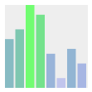
Styling Colors
var reviews = [10, 12, 17, 15, 7, 2, 8, 5];
var w = 100, h = 100,
x = new pv.Scale.linear(0,reviews.length).range(0,w);
y = new pv.Scale.linear(0,pv.max(reviews)).range(0,h);
c = new pv.Scale.linear(0,pv.max(reviews))
.range("rgba(0,0,255,0.1)","rgba(100,255,100,0.9)");
…
panel.add(pv.Bar)
.data(reviews)
.bottom(0)
.left(function(d) x(this.index))
.height(function(d) y(d))
.width(w/reviews.length-2);
.fillStyle(function(d) c(d))

Slide 13
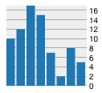
Axis Ticks & Labels
var reviews = [10, 12, 17, 15, 7, 2, 8, 5];
var w = 100, h = 100,
x = new pv.Scale.linear(0,reviews.length-1).range(0,w);
y = new pv.Scale.linear(0,pv.max(reviews)).range(0,h);
panel.add(pv.Rule)
.data(y.ticks())
.strokeStyle("#AAA")
.bottom(function(d) y(d))
.anchor("right").add(pv.Label)
.text(x.tickFormat);
panel.add(pv.Bar)
.data(reviews)
.bottom(0)
.left(function(d) x(this.index))
.height(function(d) y(d))
.width(w/reviews.length-2);
http://vis.stanford.edu/protovis/docs/label.html

Slide 14
Data Objects – Part 1
var reviews = [
{label:'Product A', count:10},
{label:'Product B', count:12},
{label:'Product C', count:17},
…
];
var w = 100, h = 100,
x = new pv.Scale.linear(0,reviews.length).range(0,w);
y = new pv.Scale.linear(0,pv.max(reviews,function(d) d.count))
.range(0,h);
panel.add(pv.Bar)
.data(reviews)
.bottom(0)
.left(function(d) x(this.index))
.height(function(d) y(d.count))
.width(w/reviews.length-2)

Slide 15
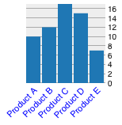
Data Objects – Part 2
var reviews = [
{label:'Product A', count:10},
{label:'Product B', count:12},
…
];
panel.add(pv.Bar)
.data(reviews)
.bottom(0)
.left(function(d) x(this.index))
.height(function(d) y(d.count))
.width(w/reviews.length-2)
.anchor('bottom').add(pv.Label)
.text(function(d) d.label)
.font("11px sans-serif")
.textAlign('right')
.textBaseline('top')
.textAngle(-Math.PI / 4)
.textStyle("blue")

Slide 16
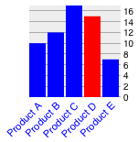
Hover and Click
var hoverindex = -1;
panel.add(pv.Bar)
.data(reviews)
.bottom(0)
.left(function(d) x(this.index))
.height(function(d) y(d.count))
.width(w/reviews.length-2)
.fillStyle(function(d) {
return hoverindex == this.index ? "red" : "blue”})
.event("mouseover", function() {
hoverindex = this.index; this.render(); })
.event("mouseout", function() {
hoverindex = -1; this.render(); })
.event('click',function(d) {
alert(’Clicked ' + d.label + ' with ' + pv.event) })
http://vis.stanford.edu/protovis/docs/interaction.html

Slide 17
Multiple Series
var reviews = [
{label:'Product A', reviews:10, questions: 5},
{label:'Product B', reviews:12, questions: 12},
{label:'Product C', reviews:17, questions: 4},
{label:'Product D', reviews:15, questions: 13},
{label:'Product E', reviews:7, questions: 5},
];

Slide 18
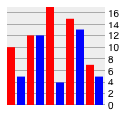
Multiple Series – Common Axis 1
var max = Math.max(pv.max(reviews,function(d) d.reviews),
pv.max(reviews,function(d) d.questions)),
y = new pv.Scale.linear(0,max).range(0,h);
panel.add(pv.Bar) // Reviews
.data(reviews)
.bottom(0)
.left(function(d) x(this.index))
.height(function(d) y(d.reviews))
.width(w/reviews.length/2-2)
.fillStyle("red")
panel.add(pv.Bar) // Questions
.data(reviews)
.bottom(0)
.left(function(d) x(this.index)+w/reviews.length/2)
.height(function(d) y(d.questions))
.width(w/reviews.length/2-2)
.fillStyle("blue")

Slide 19
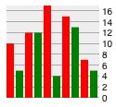
Multiple Series – Common Axis 2
var max = Math.max(pv.max(reviews,function(d) d.reviews),
pv.max(reviews,function(d) d.questions)),
y = new pv.Scale.linear(0,max).range(0,h);
var series = [
{property: 'reviews', color: 'red'},
{property: 'questions', color: 'green'},
]
panel.add(pv.Panel)
.data(series)
.left(function() this.index*w/reviews.length/2)
.add(pv.Bar)
.data(reviews)
.bottom(0)
.left(function(d) x(this.index))
.height(function(d,p) y(d[p.property]))
.width(w/reviews.length/2-2)
.fillStyle(function(d,p) p.color)

Slide 20
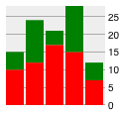
Multiple Series – Stacked
function baseline(datum,property) {
total = 0;
for (i=0; series[i].property!=property; i++) {
total += y(datum[series[i].property])
}
return total;
}
panel.add(pv.Panel)
.data(reviews)
.left(function(d) x(this.index))
.width(w/reviews.length-2)
.add(pv.Bar)
.data(series)
.bottom(function(s,d) baseline(d,s.property))
.height(function(s,d) y(d[s.property]))
.fillStyle(function(s,d) s.color)

Slide 21
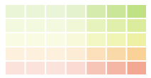
2D Background Grid
var hues = ["#f36c4f", "#fbb05e", "#e2e577", "#c0dd6a", "#91c946"];
var saturations = [0.2, 0.2, 0.2, 0.25, 0.4, 0.5, 0.6];
panel.add(pv.Panel)
.data(saturations)
.left(function() this.index*w/saturations.length)
.width(w/saturations.length-2)
.add(pv.Bar)
.data(hues)
.bottom(function() this.index*h/hues.length)
.height(h/hues.length-2)
.fillStyle(function(d,p) pv.color(d).alpha(p))

Slide 22
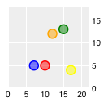
Multiple Series – Scatterplot
var w = 100, h = 100,
x = new pv.Scale.linear(0,pv.max(reviews,function(d) d.reviews)+5)
.range(0,w),
y = new pv.Scale.linear(0,pv.max(reviews,function(d) d.questions)+5)
.range(0,h),
c = pv.colors("red", "orange", "yellow", "green", "blue", "violet");
…
panel.add(pv.Dot)
.data(reviews)
.left(function(d) x(d.reviews))
.bottom(function(d) y(d.questions))
.size(30)
.strokeStyle(function(d) c(this.index))
.fillStyle(function(d) c(this.index).alpha(0.5))

Slide 23
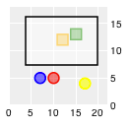
2D Selection – Part 1
/* Handle select and drag */
var selection = [{x:-100, dx:0, y:-100, dy:0}];
var dots = panel.add(pv.Dot)
.data(reviews)
.left(function(d) x(d.reviews))
.bottom(function(d) y(d.questions))
.size(30)
.strokeStyle(function(d) c(this.index))
.fillStyle(function(d) c(this.index).alpha(0.5))
.shape(function(d) {
if (selection[0].x < x(d.reviews) &&
selection[0].x+selection[0].dx > x(d.reviews) &&
selection[0].y < h-y(d.questions) &&
selection[0].y+selection[0].dy > h-y(d.questions)) {
return "square"
} else {
return "circle"
}})
http://vis.stanford.edu/protovis/jsdoc/symbols/pv.Behavior.select.html

Slide 24
2D Selection – Part 2
function update(d) {dots.render()}
var handle = panel.add(pv.Panel)
.data(selection)
.fillStyle("rgba(0,0,0,.001)")
.cursor("crosshair")
.event("mousedown", pv.Behavior.select())
.event("select", update)
.add(pv.Bar)
.left(function(s) s.x)
.width(function(s) s.dx)
.top(function(s) s.y)
.height(function(s) s.dy)
.fillStyle(function() {return "hsla(255,255,255,.5)"})
.strokeStyle("black")
.lineWidth("2px")
.cursor("pointer")
.event("mousedown", pv.Behavior.drag())
.event("drag", update)

Slide 25
References
Background Paper: “Protovis: A Graphical Toolkit for Visualization” http://vis.stanford.edu/files/2009-Protovis-InfoVis.pdf
Protovis Documentation: http://vis.stanford.edu/protovis/docs/
Tutorial: “Protovis Javascript Charts [5 parts] – Knight Digital Media Center” http://multimedia.journalism.berkeley.edu/tutorials/protovis-javascript-charts-part-1/

