Slide 1

Importance of Star Power in Sports
Brendan Zhou

Slide 2

Motivation
Brendan Zhou
Superstars significantly drive fan engagement, which brings revenue and viewership, in professional sports.
These superstars bring substantial followings that could reshape the WNBA’s economic landscape, as it has the most potential to grow right now.
How does the presence of superstar players affect game attendance across seasons and teams?
Question

Slide 3
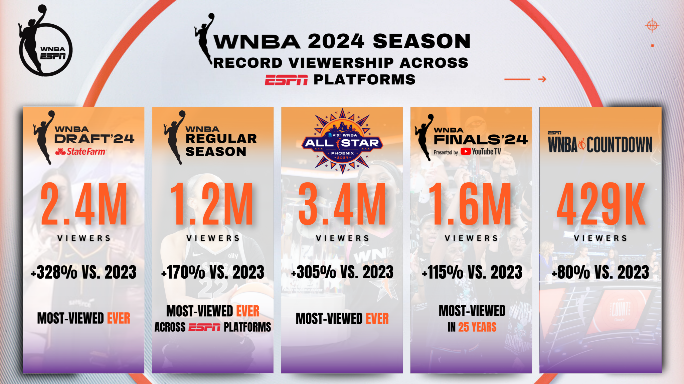
Context
Brendan Zhou
Image source: ESPN Press Room (2024)

Slide 4
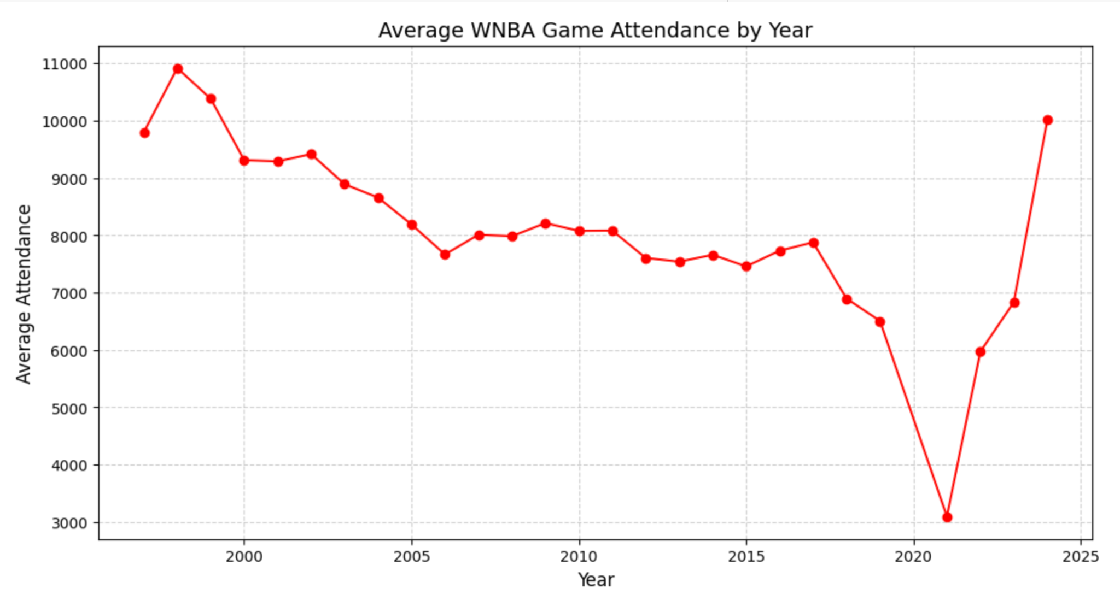

Data
Brendan Zhou
Source
Years Covered: 1997–2024
Scope: Regular-season & playoff games
Focus: Home game attendance for 2024 playoff teams

Slide 5


Indiana Fever
Caitlin Clark
Kelsey Mitchell
Brendan Zhou

Slide 6
Methodology
Brendan Zhou
Event Study
Lead-lag Analysis
Dynamic Treatment Effect Estimation

Slide 7
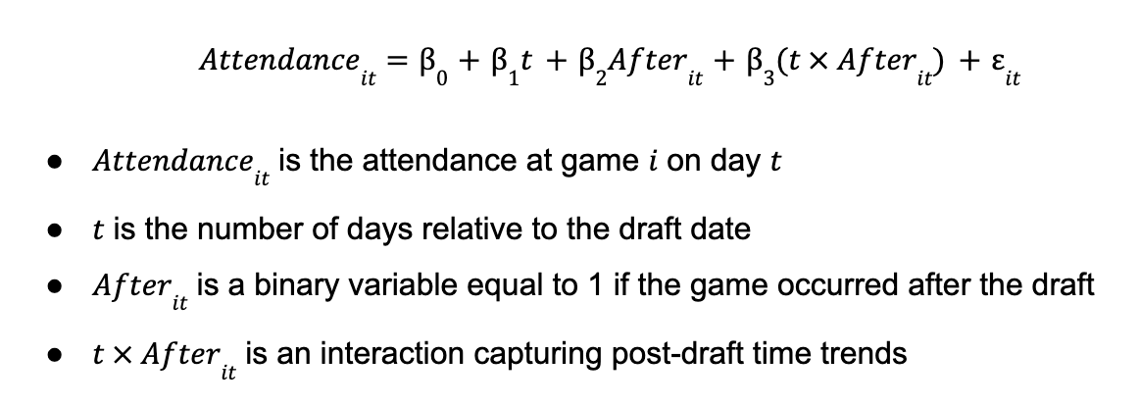
Brendan Zhou
Event Study

Slide 8
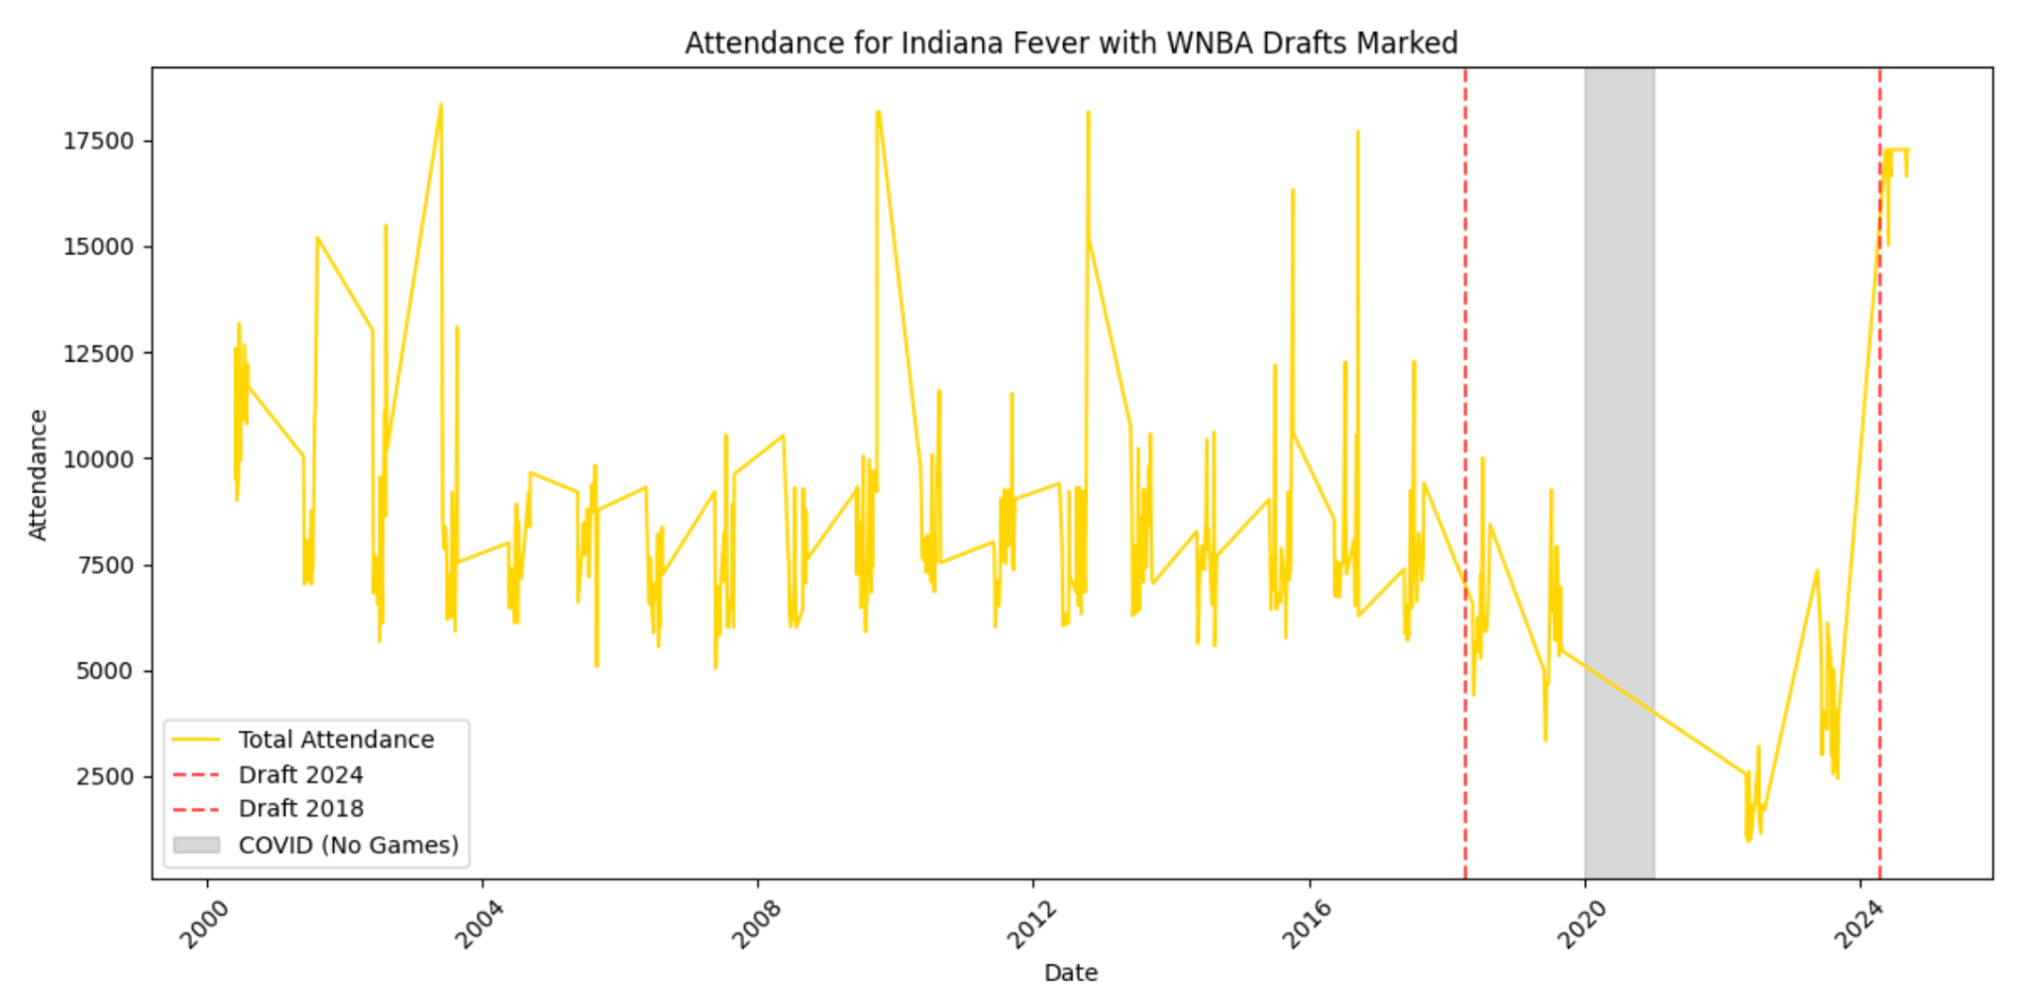
Brendan Zhou

Slide 9
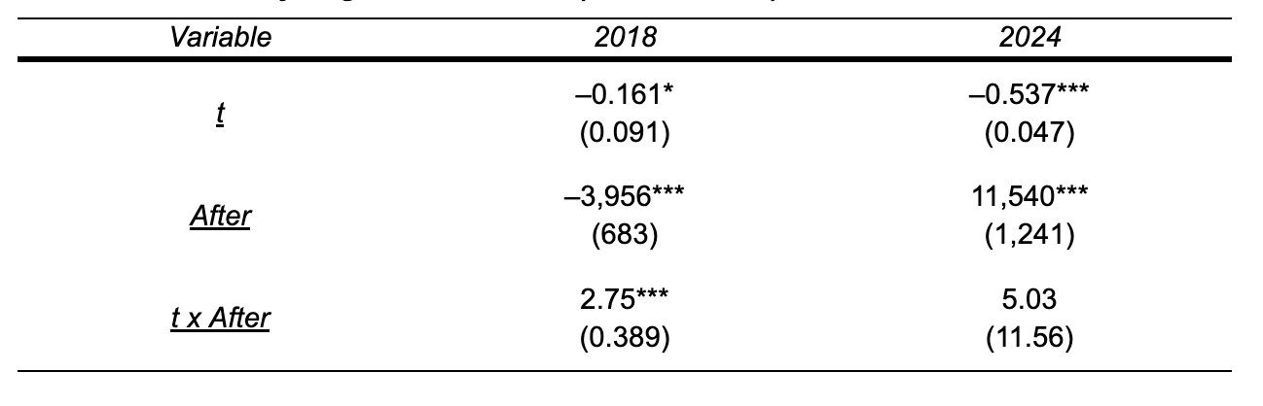
Brendan Zhou

Slide 10
Methodology + Results
Brendan Zhou
Event Study
Lead-lag Analysis
Dynamic Treatment Effect Estimation

Slide 11
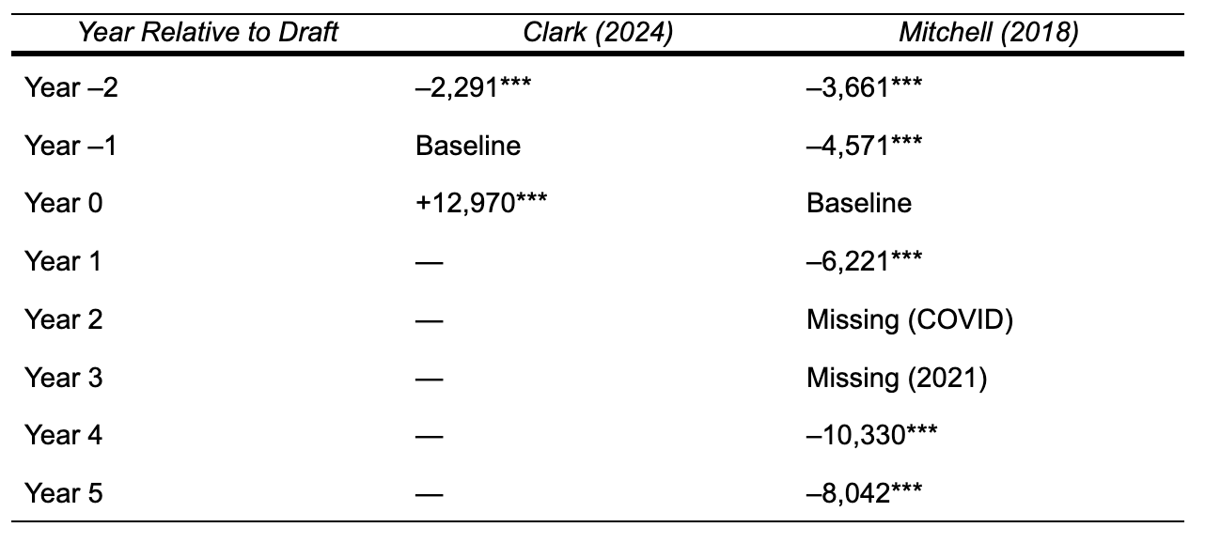
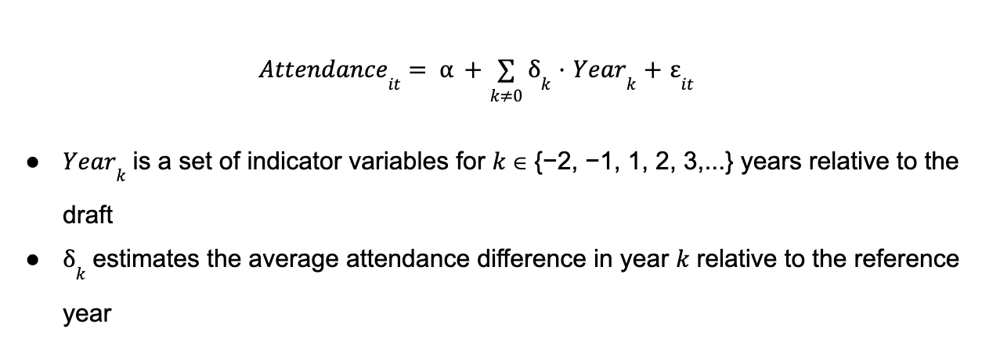
Brendan Zhou
Lead-lag Analysis

Slide 12
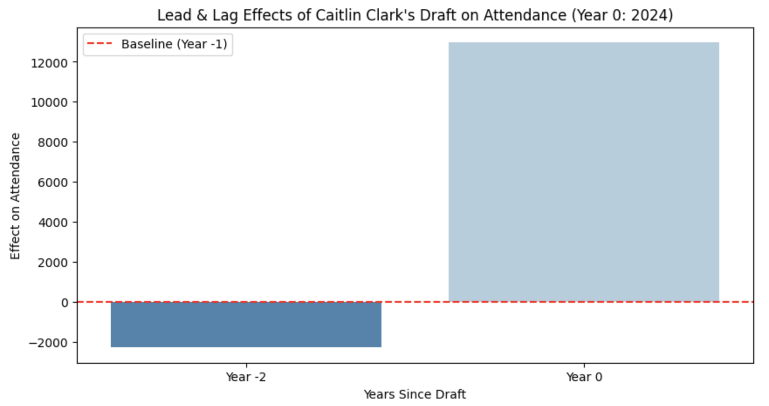
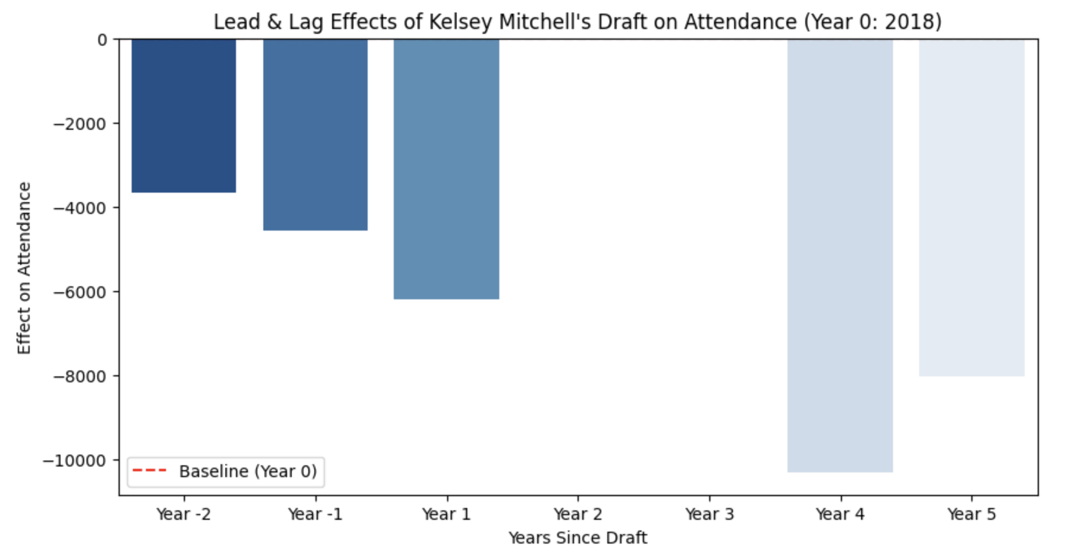
Brendan Zhou

Slide 13
Methodology
Brendan Zhou
Event Study
Lead-lag Analysis
Dynamic Treatment Effect Estimation

Slide 14
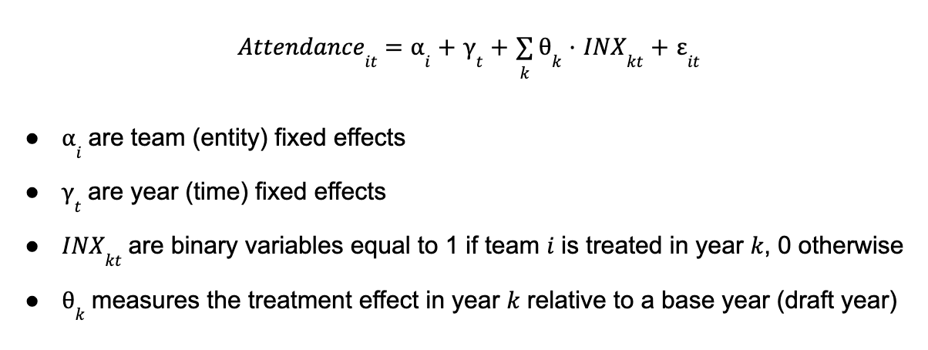
Brendan Zhou
Dynamic Treatment Effect Estimation

Slide 15
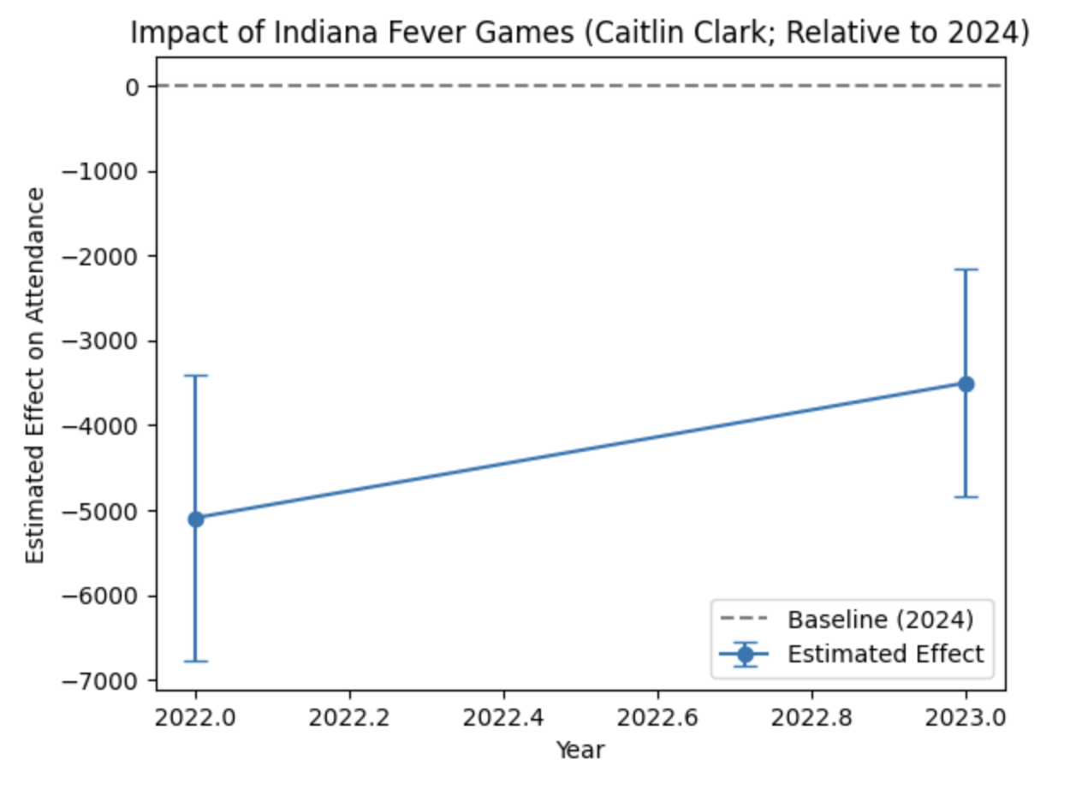
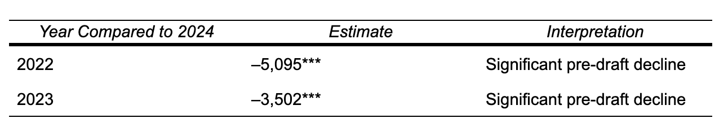
Caitlin Clark
Brendan Zhou

Slide 16
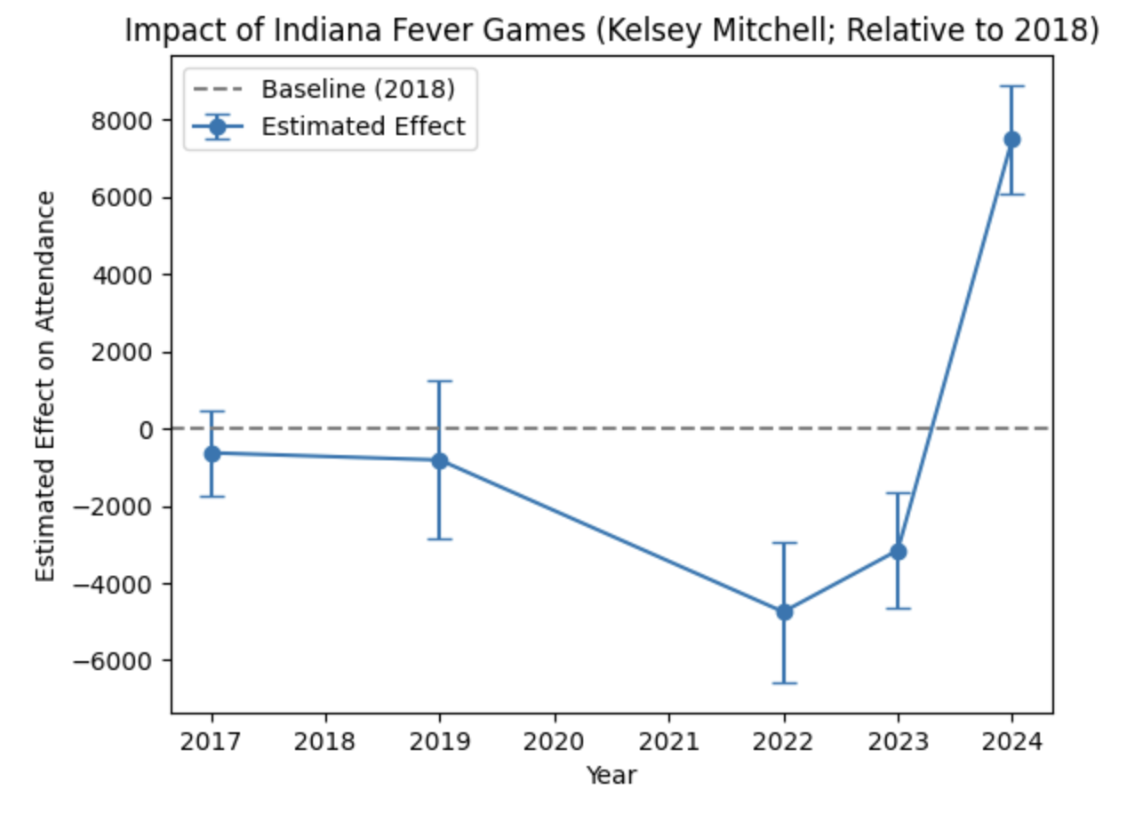
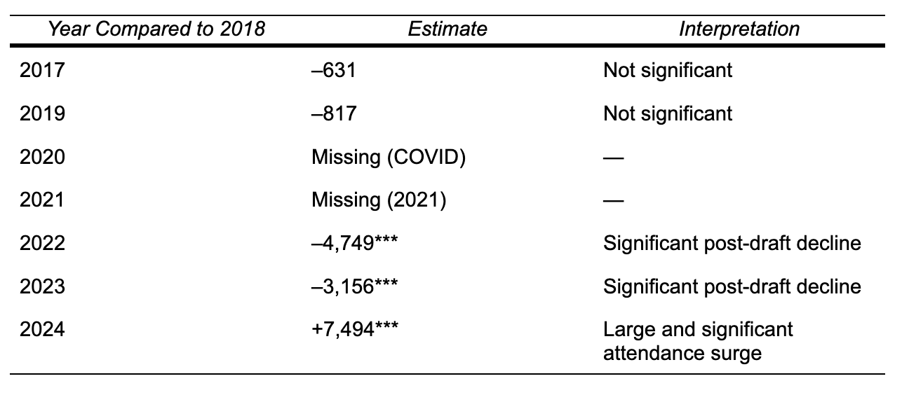
Kelsey Mitchell
Brendan Zhou

Slide 17
Conclusion
Brendan Zhou
Key Takeaway: Superstar arrivals can significantly boost attendance, but the effect varies.
Clark’s 2024 draft created an unprecedented spike in interest for the Indiana Fever.
Mitchell’s case highlights that performance alone is not enough.
  Media narratives?
  Pre-established fanbase?
  Timing?
Limitations
Missing 2021 game data for Indiana Fever
Cannot fully separate superstar effect from general league trends
What’s next?

Slide 18
References
Brendan Zhou
ESPN Press Room. (2024, October 25). The 2024 WNBA season delivers record viewership across ESPN platforms [Press release image]. https://espnpressroom.com/us/press-releases/2024/10/the-2024-wnba-season-delivers-record-viewership-across-espn-platforms/
Across the Timeline. (n.d.). WNBA Data Explorer. Retrieved May 3, 2025, from https://www.acrossthetimeline.com/wnba/data.html

