Slide 1
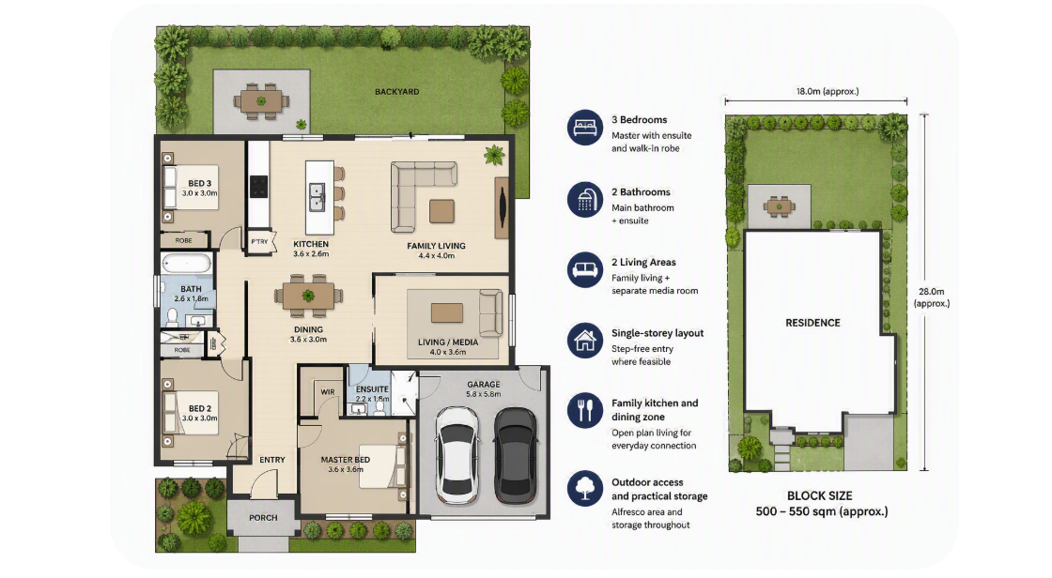
Product Definition: What Is Being Delivered
A traditional Aussie detached family home
Defined product standards turn policy intent into a buildable, auditable housing unit.
Product settings based on income_title_outline.txt and procurement framing in procurement.txt.
Notes:
This slide answers a simple question: what exactly are we delivering?
Income Title is not a broad subsidy for whatever the market supplies. It is a defined home product with fixed minimum standards.
That matters for execution. Standardisation improves procurement comparability, reduces design churn, and helps keep quality and cost inside clear bounds.
For households, these are normal family homes: three bedrooms, two bathrooms, two living zones, single-storey form, and practical liveability.
For government and delivery partners, the product is measurable and auditable. That supports faster approvals, cleaner tendering, and reliable scale-up.

