Slide 1
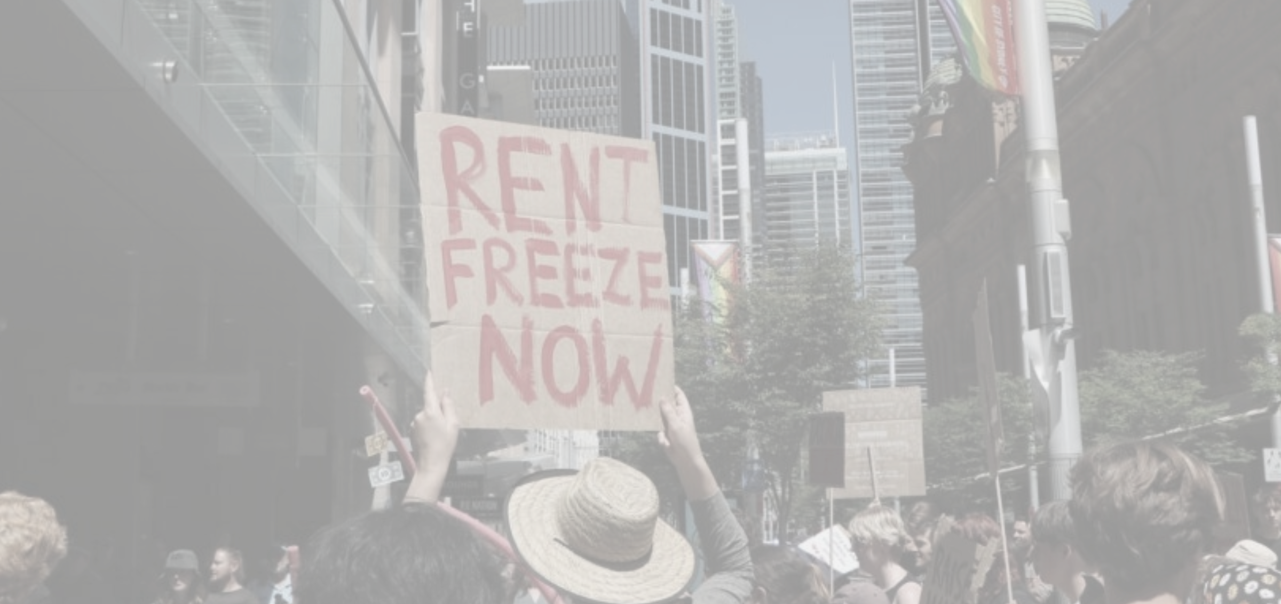
Housing Crisis Perspectives - Fix The Housing Rally
“Public housing is a human right.” — Protest slogan at Sydney housing rally
“While renters are being hit with astronomical rent increases… banks, big investors and dodgy developers are getting rich off the housing crisis.”
— Statement from housing advocacy rally speakers
“We’ve got no hope really of being able to afford a place of our own.”
— Young Australian couple interviewed on housing affordability
“There is a huge issue… where housing is seen as an asset, not a human right.”
— Interviewee describing systemic housing problems
“Renters and owner‑occupiers are being squeezed by cost of living and the housing crisis.”
— Statement from student/union housing campaign representatives
Notes:
Use this as a full-page emotional anchor slide before diagnosis. Pause after reading the quote to let the audience absorb the human consequence framing.

Slide 2

March for Australia - Brisbane 2025
“They're creating voting blocks in 15 minute cities where your kids will never see a backyard.” “You’re a young worker, that’s right — and I used to tell the mate, “In a year, you’ll be full-time. Save the house deposit. Get a home in Ipswich, right?” I can’t sell that dream to my workmates, and it’s not bloody good enough. He ran on the last election this year. He said he was going to reduce immigration. He absolutely lied to all of us. People of good faith voted for that guy because they were sick to death of what the Liberal Party’s been doing, because both of them are as bad as each other.
They dragged us through COVID together. They locked us down. They sent families broke. The families aren’t having as many children because they can’t afford it. How you gonna pay for an $800,000 mortgage? How many people in this country earn over $100,000?
It’s not fucking real. Only 6% of people could afford houses now. How you gonna put a ring on a young lady’s finger and give her security and a family, marry her and have kids, if you can’t put a roof over your bloody head? It’s not good enough. That’s why we’re here. I work in the industry. We can’t build enough homes to house the people in the country. There’s bloody tent cities in this city everywhere.
We’ve had enough. They need to listen to us. Across this country, right now, people are protesting.”
Notes:
Use this as a full-page emotional anchor slide before diagnosis. Pause after reading the quote to let the audience absorb the human consequence framing.

