Slide 1
Brendan Kowitz, Microsoft
Flattening the Curve
Implementing the SQL on FHIR ViewDefinition in .NET
Notes:
Welcome everyone. This is a technical retrospective — I built something real, from scratch, to spec, and I want to walk you through what that actually looked like. Not the happy path. The whole path.

Slide 2


Who am I?
Brendan Kowitz
EM for FHIR OSS, Azure Health Data Services (FHIR)
Originally from Australia; lived in the Pacific Northwest for the past 10+ years
github.com/brendankowitz
GitHub
github.com/brendankowitz/FHIRDevDays2026
Notes:
Quick context on me so you know where this is coming from. I run an engineering team at Microsoft on Azure Health Data Services — the FHIR server. Ignixa is my open-source research stack where I build things like this from first principles. Everything you'll see today is open source and on NuGet.

Slide 3


SQL on FHIR libraries exist. Just not in .NET.
THE ECOSYSTEM TODAY
JavaScript
✓
HL7 reference implementation
Python
✓
Community libraries
Java
✓
Production tooling
.NET
Notes:
I'm not going to explain what SQL on FHIR is — you're here, you know the spec. What I want to talk about is where .NET sits. JavaScript has the HL7 reference implementation. Python has libraries. Java is well covered. Search for SQL on FHIR plus .NET and you find workarounds and people asking the same question. That's the gap this session is about.

Slide 4
You're on .NET and want SQL on FHIR.
BEFORE THIS PROJECT
A few options…
A
B
C
Run the reference impl out-of-process
Build the ViewDefinition layer yourself
Use database view architecture
Shell out to the JS/Python runner — now you're running a non-.NET runtime inside a .NET stack.
You own the flattening and every spec-conformance edge case — and re-own it each release.
Translate ViewDefinitions to SQL inside a FHIR-native database. Powerful — but a full architectural commitment that may not fit your .NET stack.
Notes:
Quick show of hands — how many of you have done Option B? Yeah. You write a little FHIRPath, it works, then six months later someone adds a new resource type and the extraction breaks. These options all have real, recurring costs.

Slide 5
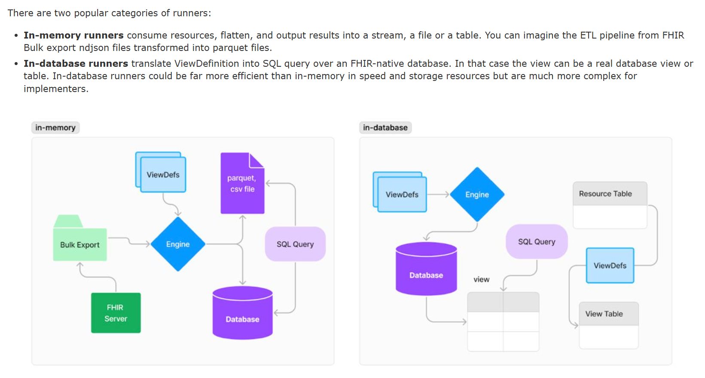
https://build.fhir.org/ig/FHIR/sql-on-fhir-v2/

Slide 6


Ignixa.SqlOnFhir
INTRODUCING
Native .NET 9/10
get started
No JVM. No Python. No sidecar.
# library
dotnet add package Ignixa.SqlOnFhir
# cli (global tool)
dotnet tool install -g \
Ignixa.SqlOnFhir.Cli
# run your first view
ignixa-sqlonfhir r4 preview \
--views patient-view.json
Multi-version
STU3 · R4 · R4B · R5 · R6-ballot - one codebase.
MIT licensed
Open source. Contributions welcome.
Conformance-tested
Passes the official SQL on FHIR v2 test suite.
Notes:
Two minutes to integrate. The NuGet package gives you the evaluator as a library. The CLI is a tool you can run in pipelines and CI right now. Five FHIR versions from one codebase. MIT. Let me tell you why you should trust it.

Slide 7
What is “Ignixa”
Ignixa started as a personal open-source project for rethinking FHIR/.NET from a clean slate.
Research
A proving ground for new FHIR/.NET ideas, built to learn and explore. Tackling even advanced parts of the spec.
Architecture
Rethinks FHIR on modern .NET:
Ground up Parsing, Specification, Serialization, FHIRPath with clean, modular packages.
Publishing 20+ nuget packages. FHIRPath Engine has 45K downloads
Built with frontier AI
8+ years of my own experience, distilled into code with the latest AI coding tools.
Notes:
Each layer is a standalone NuGet package. Just need the FHIRPath engine? Take Ignixa.FhirPath. Want ViewDefinition evaluation in your app? Take Ignixa.SqlOnFhir. The CLI is the full stack as a tool. This modularity is also how we unit-test each layer independently — which is how the conformance suite is built.

Slide 8
Modular. Pick what you need.
PACKAGE ANATOMY
Ignixa.Abstractions
IElement, ISourceNavigator — no dependencies
Ignixa.Serialization · Ignixa.Specification · Ignixa.FhirPath
JSON → navigator · version-aware schema · compiled FHIRPath
Ignixa.SqlOnFhir · Ignixa.SqlOnFhir.Writers
ViewDefinition parser + row evaluator · Parquet / CSV / NDJSON
Ignixa.SqlOnFhir.Cli
dotnet global tool (ignixa-sqlonfhir)
Notes:
Each layer is a standalone NuGet package. Just need the FHIRPath engine? Take Ignixa.FhirPath. Want ViewDefinition evaluation in your app? Take Ignixa.SqlOnFhir. The CLI is the full stack as a tool. This modularity is also how we unit-test each layer independently — which is how the conformance suite is built.

Slide 9
Fast enough for $export pipelines
FHIRPath performance
Not a wrapper — a ground-up, visitor-pattern engine with optimization passes at parse time and fast paths at run time.
Compile time
Run time
Constant folding 1 + 2 → 3
Short-circuit false and f() → skip
Algebraic simplify x.where(true) → x
Static type-checking bad path → error
Cached delegates 2nd eval skips compile
Allocation-free paths
Interpreter fallback
One AST, many visitors — the optimizer, analyzer, and delegate compiler are all just visitors.

Slide 10



Parse → Evaluate → Write
THREE STAGES. CLEAN SEPARATION.
1 · Parse
2 · Evaluate
3 · Write
ViewDefinitionExpressionParser
.Parse()
SqlOnFhirEvaluator
.Evaluate(view, resource)
ParquetFileWriter
Csv · Ndjson · Create your own
Compiles all FHIRPath upfront. Fail fast - invalid FHIRPath is caught here, not at evaluation time.
WHERE filters · SELECT extracts · forEach unnests arrays into rows · %resource reaches the root. Pure & stateless.
Consumes the row stream.
Notes:
The separation matters for two reasons. First, you can validate ViewDefinitions without running them — the validate command uses the Parse stage only. Second, Evaluate is pure and stateless, so you parallelize across resources trivially. Writers are sinks, not evaluation logic.

Slide 11
A ViewDefinition example
THE SHAPE OF THE THING
patient-view.json
{
"resourceType": "ViewDefinition",
"resource": "Patient",
"where": [{ "path": "active = true" }],
"select": [{ "column": [
{ "name":"id", "path":"id", "type":"string" },
{ "name":"family_name", "path":"name.where(use='official').first().family" },
{ "name":"given_name", "path":"name.where(use='official').first().given.first()" },
{ "name":"birth_date", "path":"birthDate", "type":"date" },
{ "name":"gender", "path":"gender", "type":"string" }
] }]
}
Notes:
Nothing exotic. WHERE filters to active patients. SELECT pulls scalar columns with standard FHIRPath. If you've used the HL7 JS reference implementation, this is the same syntax — deliberately. Portability of ViewDefinitions across implementations is a spec goal; this shows it working.

Slide 12
One resource. Many rows.
FOREACH EXAMPLE
name-rows.json
Result — one row per name
id | name_use | family | given
pt-001 | official | Smith | Alice
pt-001 | maiden | Jones | Alice
{
"resource": "Patient",
"select": [
{ "column": [
{ "name":"id", "path":"id" } ] },
{ "forEach": "name", "column": [
{ "name":"name_use", "path":"use" },
{ "name":"family", "path":"family" },
{ "name":"given_name", "path":"given.first()" }
] }
]
}
The first select group emits id once.
The forEach group repeats per element
in the name array — standard SQL
unnesting, expressed as a ViewDefinition.
Use %resource inside a forEach to
reference the root resource.
Notes:
This is the operation that makes FHIR analytics actually work. A Patient has an array of names. forEach gives you one row per name — standard SQL unnesting, expressed as a ViewDefinition. First group produces id once; the forEach group repeats per name element.

Slide 13
No subprocess. No tables. <10 lines.
FROM C#
Program.cs
var schema = FhirVersion.R4.GetSchemaProvider();
var viewDef = JsonSourceNodeFactory.Parse(
File.ReadAllText("patient-view.json")).ToSourceNavigator();
var patient = JsonSourceNodeFactory.Parse(
File.ReadAllText("patient.json")).ToElement(schema);
var evaluator = new SqlOnFhirEvaluator();
foreach (var row in evaluator.Evaluate(viewDef, patient))
Console.WriteLine($"{row["id"]} — {row["family_name"]}, {row["birth_date"]}");
Notes:
This is the entire API surface you need to evaluate a ViewDefinition from C#. GetSchemaProvider is the only place FHIR version enters. ToSourceNavigator gives the lightweight structure; ToElement adds typing via the schema. The result is IEnumerable of dictionaries — flat rows you write anywhere.

Slide 14
Works with Firely SDK too.
FROM THE FIRELY SDK
Program.cs
using Ignixa.Extensions.FirelySdk;
var schema = FhirVersion.R4.GetSchemaProvider();
var viewDef = JsonSourceNodeFactory.Parse(
File.ReadAllText("patient-view.json")).ToSourceNavigator();
// Parse with the Firely SDK, then bridge into Ignixa
ISourceNode node = FhirJsonNode.Parse(File.ReadAllText("patient.json"));
var patient = node.ToElement(schema);
var evaluator = new SqlOnFhirEvaluator();
foreach (var row in evaluator.Evaluate(viewDef, patient))
Console.WriteLine($"{row["id"]} — {row["family_name"]}, {row["birth_date"]}");
Notes:
This is the entire API surface you need to evaluate a ViewDefinition from C#. GetSchemaProvider is the only place FHIR version enters. ToSourceNavigator gives the lightweight structure; ToElement adds typing via the schema. The result is IEnumerable of dictionaries — flat rows you write anywhere.

Slide 15

Let’s run it.
DEMO · CLI
preview → validate → run → batch
# data pre-staged in demo/data/ (NDJSON patients +
# a patient ViewDefinition, generated by Ignixa.FhirFakes)
$ ignixa-sqlonfhir r4 preview --views patient-view.json
The test data is generated with Ignixa.FhirFakes — full story in “Fluent, Fast, and Fake” — tomorrow (Jun 17), 9:15 AM · Ski-U-Mah
Notes:
[Switch to terminal. Data files are pre-staged in demo/data/.] I've got a patient ViewDefinition and NDJSON patients ready — generated by Ignixa.FhirFakes from Seattle demographics, which I'll show in the next session. Start with preview so you see the schema before touching any data.

Slide 16
CLI quick reference
KEEP THIS UP DURING THE DEMO
Command | What it does
ignixa-sqlonfhir r4 preview --views <file> | Show schema without data
… preview --views <f> --input <f> --rows 10 | Show sample rows
ignixa-sqlonfhir r4 validate --views <dir> | Validate all ViewDefinitions
… run --views <dir> --input <dir> --out d/ --format csv | Batch CSV output
--var name=value | Override ViewDefinition constants at runtime
Pattern: <version> <command> [options] Versions: stu3 r4 r4b r5 r6
Notes:
[Leave this up during/after Demo 1.] The version is always first. Then the command. The rest is flags. Preview is schema-only without --input, adds sample rows with it. Validate catches errors before you run. Run produces the output.

Slide 17





What this unlocks for .NET
$EXPORT → VIEWDEFINITIONS → PARQUET → DATA LAKE
BI dashboards
CI validation
Power BI / Fabric on Parquet directly — no ETL middleware
Validate ViewDefinitions against schema before deployment
Research cohorts
Multi-version
Reproducible ViewDefinitions as the extraction contract
Same ViewDefinition, different FHIR version flag
Data lake pipelines
RELATED TALK · WED, JUNE 17
Real-Time SQL Views: Subscriptions × SQLonFHIR
Jared Erwin · 3:45 PM · Johnson Great
$export NDJSON → ViewDefinitions → Parquet, one command
Notes:
The pipeline this enables: your FHIR server's $export gives you NDJSON. Your ViewDefinitions give you a version-controlled schema. The CLI turns NDJSON into Parquet with one command. Every analytics tool reads Parquet. FHIR server to BI-ready without leaving .NET and without writing custom ETL.

Slide 18

Try it.
THREE COMMANDS TO GET STARTED
terminal
GitHub
# library
dotnet add package Ignixa.SqlOnFhir
# cli
dotnet tool install -g Ignixa.SqlOnFhir.Cli
# run your first ViewDefinition
ignixa-sqlonfhir r4 preview \
--views patient-view.json
github.com/brendankowitz/ignixa-fhir
Docs
brendankowitz.github.io/ignixa-fhir
MIT licensed
Notes:
That's it. Three commands. The GitHub repo has the ViewDefinition samples, the docs walk through CLI options, and the NuGet package drops into any .NET 9 project. Thank you.

Slide 19
Contact
You can find / reach me here:
Speaker's Gallery
Via the DevDays app
Email
bkowitz@microsoft.com
Bluesky
@brendankowitz.bsky.social
GitHub
github.com/brendankowitz/FHIRDevDays2026
Notes:
Everything is open source. Reach me on GitHub, the docs site has the full CLI reference and ViewDefinition samples, and both packages are on NuGet.

Slide 20
Q&A
GitHub
github.com/brendankowitz/FHIRDevDays2026

Slide 21
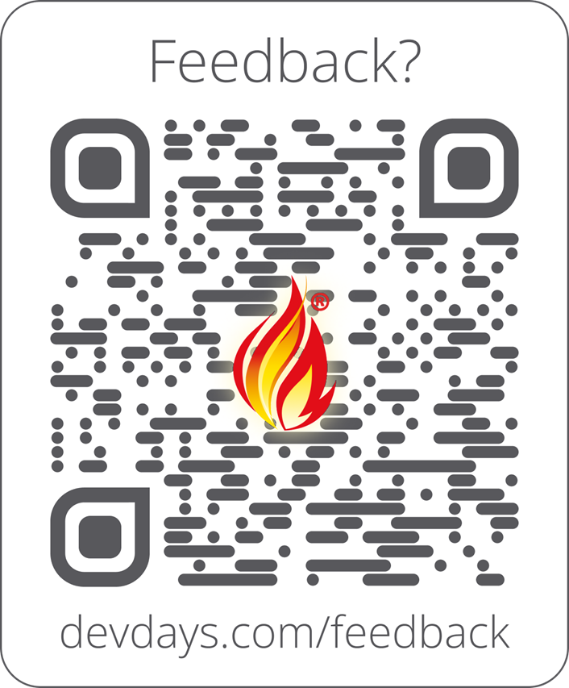
Feedback
Enjoyed this talk? I’d love your feedback — it genuinely helps.
Scan the QR code, or visit:
www.devdays.com/feedback
Notes:
Please leave feedback on the talk and on DevDays — it genuinely helps shape next year. The QR code and link are here. Thank you, and enjoy the rest of DevDays.

