Slide 1
Brendan Kowitz, Microsoft
Fluent, Fast, and Fake
.NET Synthetic FHIR Data for Developer Happiness

Slide 2


Who am I?
Brendan Kowitz
EM for FHIR OSS, Azure Health Data Services (FHIR)
Originally from Australia; lived in the Pacific Northwest for the past 10+ years
github.com/brendankowitz
GitHub
github.com/brendankowitz/FHIRDevDays2026

Slide 3
THE PROBLEM
Every FHIR dev hits this wall.
You need test data.
You’re writing a test. You need a Patient with type-2 diabetes — 3 conditions, 2 medications, realistic vitals over 5 years. Every option in front of you feels a little unsatisfying.
1
2
3
Hand-craft JSON
Bespoke scripts / generator??
Fire up Synthea
Hours of work. Breaks on every model change. Zero clinical realism.
Likely produces unrealistic data or hard to model
JVM dependency. Minutes per run. Built for cohorts, not unit tests.
There is a better way — built for .NET, by a .NET developer.

Slide 4
THE REQUIREMENTS NOBODY WROTE DOWN
What developers actually need.
Requirement
Hand-crafted
Synthea
FhirFakes
Fast
✓
✕
✓
Can be deterministic per test
✓
✕
✓
Native .NET / NuGet
✓
✕
✓
Realistic options
✕
✓
✓
Fluent C# API
✕
✕
✓
FHIR-valid output
✕
✓
✓
Population-scale
✕
✓
✓
The missing piece between static JSON and Synthea

Slide 5
INTRODUCING
Ignixa.FhirFakes
Native .NET synthetic FHIR data — fluent, fast, and deterministic.
Native .NET 9/10
FHIR-valid
Multi-version
MIT · open source
No JVM. Generates in milliseconds.
Passes schema + binding validation.
STU3 · R4 · R4B · R5 · R6-ballot2
Inspired by Synthea.
$ dotnet add package Ignixa.FhirFakes
$ dotnet tool install -g Ignixa.FhirFakes.Cli

Slide 6
What is “Ignixa”
Ignixa started as a personal open-source project for rethinking FHIR/.NET from a clean slate.
Research
A proving ground for new FHIR/.NET ideas, built to learn and explore. Tackling even advanced parts of the spec.
Architecture
Rethinks FHIR on modern .NET:
Ground up Parsing, Specification, Serialization, FHIRPath with clean, modular packages.
Publishing 20+ nuget packages. FHIRPath Engine has 45K downloads
Built with frontier AI
8+ years of my own experience, distilled into code with the latest AI coding tools.
Notes:
Each layer is a standalone NuGet package. Just need the FHIRPath engine? Take Ignixa.FhirPath. Want ViewDefinition evaluation in your app? Take Ignixa.SqlOnFhir. The CLI is the full stack as a tool. This modularity is also how we unit-test each layer independently — which is how the conformance suite is built.

Slide 7
Modular. Pick what you need.
PACKAGE ANATOMY
Ignixa.Abstractions
IElement, ISourceNavigator — no dependencies
Ignixa.Serialization · Ignixa.Specification · Ignixa.FhirPath
JSON → navigator · version-aware schema · compiled FHIRPath
Ignixa.FhirFakes
Schema faker · builders · scenarios · population generators
Ignixa.FhirFakes.Cli
dotnet global tool (ignixa-fhirfakes)
Notes:
Each layer is a standalone NuGet package. Just need the FHIRPath engine? Take Ignixa.FhirPath. Want ViewDefinition evaluation in your app? Take Ignixa.SqlOnFhir. The CLI is the full stack as a tool. This modularity is also how we unit-test each layer independently — which is how the conformance suite is built.

Slide 8
THE CORE DESIGN
Four layers. Pick your level.
1
A valid Patient resource in three lines
Layer 1 · Random Valid Resources
Each layer builds on the one below.
Schema-driven, binding-aware
2
Wellness visit, 15% chance of hyperlipidemia
▴ more control
more realism
▾
Use as much — or as little — as the test needs.
Layer 2 · Clinical Scenarios
Fluent C# — express clinical intent
3
50-year-old with metabolic syndrome, full history
Layer 3 · Patient Lifecycles
A full life simulated, birth to today
4
ignixa-fakes r4 population --from Seattle --count 1000
Layer 4 · Population Generation
Realistic cohorts — US Census demographics

Slide 9
LAYER 1 · SCHEMA-DRIVEN
Random — but valid.
▸ SchemaBasedFhirResourceFaker — generates any FHIR resource type from schema metadata, not JSON templates
▸ Binding-aware — picks codes from the correct value sets, not random strings
▸ Semantically valid — a Patient gets a valid gender code; an Observation a valid LOINC code
▸ All FHIR versions — STU3, R4, R4B, R5, R6
BindingCodeMapper
value set → terminology
observation-codes → LOINC
condition-code → SNOMED CT
medication-codes → RxNorm
vaccine-code → CVX
procedure-code → SNOMED CT
allergyintolerance → SNOMED CT
Not just structurally valid — semantically valid.

Slide 10
THE HARD PART
Clinical correlation is a design constraint.
Random ≠ realistic. Vitals can’t be independent random values.
▸ BMI must correlate with obesity-related conditions
▸ Blood glucose must track the diabetes diagnosis
▸ HbA1c > 6.5 if diabetic; systolic BP up with hypertension
▸ Lab values must be physiologically plausible together
The FHIR spec tells you the schema.
Clinical medicine tells you the constraints.
BMI 18 + type-2 diabetes + normal glucose is valid FHIR — and useless for testing. Any test relying on correlation would pass for the wrong reason.
VitalSignCorrelationEngine models the physiology explicitly.

Slide 11
LAYER 1 IN PRACTICE
Three lines.
C#
var schema = FhirVersion.R5.GetSchemaProvider();
var faker = new SchemaBasedFhirResourceFaker(schema);
var patient = faker.Generate("Patient");
// Valid R5 Patient — correct structure,
// valid coded values

Slide 12
LAYER 2 · FLUENT BUILDERS
Express clinical intent in C#.
ScenarioBuilder is a fluent composition API. You don’t construct JSON — you describe what happened to a patient.
BEHIND THE FLUENT CALLS
ProbabilisticBranchState
.AddProbabilisticBranch(…)
15% chance of hyperlipidemia — matches real-world prevalence
▸ .WithPatient(p => p.WithAge(55))
▸ .AddEncounter("Annual wellness visit")
▸ .AddSubScenario(CommonScenarios.LipidPanel())
▸ .AddProbabilisticBranch(0.15, ...)
VitalSignCorrelationEngine
// applied automatically
BMI correlates with conditions; labs stay physiologically plausible
CommonScenarios
CommonScenarios.LipidPanel()
Reusable fragments: RecordVitalSigns, LipidPanel, BloodGlucose
The fluent API reads like a clinical protocol.

Slide 13
LAYER 2 IN PRACTICE
Fluent syntax for complex scenario building.
C#
var ctx = new ScenarioBuilder(schema)
.WithPatient(p => p.WithAge(55).WithGender(g => g.Male))
.AddEncounter("Annual wellness visit")
.AddSubScenario(CommonScenarios.RecordVitalSigns())
.AddSubScenario(CommonScenarios.LipidPanel())
.AddProbabilisticBranch(
probability: 0.15,
trueState: new ConditionOnsetState { Code = Conditions.Hyperlipidemia })
.Build();
55-year-old male · wellness visit · vitals · 15% hyperlipidemia — correlated, not random.

Slide 14
LAYER 3 · PATIENT LIFECYCLES
A full life, simulated.
▸ PatientLifecycleGenerator — age-based event scheduling, birth to today
▸ DiseaseRiskCalculator — evidence-based, age-adjusted onset probabilities
▸ Wellness schedules — realistic visit frequency, pediatric vs adult
ARCHETYPE · METABOLIC SYNDROME
0 → 50 years, full trajectory
40–45
3–6
encounters
medications
PRE-BUILT ARCHETYPES
150+
100+
▸ Healthy child (0–18)
▸ Typical adult (0–45)
▸ Pediatric asthma · Elderly multi-morbidity
vitals & labs
total resources
Childhood visits → obesity → diabetes → escalation.

Slide 15
LAYER 3 IN PRACTICE
One patient. A full lifecycle.
C#
var lifecycle = new PatientLifecycleGenerator(schemaProvider)
.WithBirthYear(1980)
.WithGender("female")
.WithGivenName("Jennifer")
.WithFamilyName("Martinez")
.AddWellnessSchedule(pediatric: true, adult: true)
.AddImmunizationSchedule()
// Probabilistic Type 2 Diabetes (15% overall probability ages 40-65)
// Uses age-dependent risk calculation: age 45 baseline ~10%
.AddProbabilisticCondition(
"Type 2 Diabetes",
onsetAges: 40..65,
probability: 0.15,
scenarioFactory: sp => new ScenarioBuilder(sp)
.AddConditionOnset(FhirCode.Conditions.DiabetesType2, severity: 2)
.AddMedicationOrder(FhirCode.Medications.Metformin500mg, isChronic: true, frequency: "BID", reasonCode: FhirCode.Conditions.DiabetesType2))

Slide 16
LAYER 4 · POPULATIONS
Model populations at scale.
▸ PopulationGenerator — large-scale cohort creation
▸ 11 cities —2020 demographics
▸ EthnicNameGenerator — culturally appropriate names via Bogus locales
▸ Full history per patient — birth to current age
CityDemographics
City
Pop.
0–17
65+
New York
8.3M
21%
10%
Chicago
2.7M
21%
9%
Boston
676K
17%
12%
Seattle
737K
16%
12%
Boston race split: 53% White · 25% Black · 19% Hispanic · 9% Asian
Boston ≠ Seattle ≠ Amsterdam
different age, race & disease prevalence — the risk model is demographically aware

Slide 17
DEMO 1
Let’s generate some patients.
resource → scenario → population
$ ignixa-fakes r4 population --from Seattle --count 50 --ndjson --out ./output

Slide 18
CLI REFERENCE
One tool, every shape of data.
Command
Output
ignixa-fakes r4 resource Patient
Single Patient JSON
ignixa-fakes r4 resource Observation BloodGlucose
Observation with predefined state
ignixa-fakes r4 scenario DiabeticPatient
Bundle with full clinical scenario
ignixa-fakes r4 population --from Seattle --count 100
Transaction bundle — temp urn:uuid refs
ignixa-fakes r4 population --count 100 --resolved-references
Resolved batch bundle — real IDs
ignixa-fakes r4 population --count 100 --ndjson
NDJSON — ready to test $import
ignixa-fakes help scenarios
List all available scenarios
ignixa-fakes help cities
List cities + demographics
Always: <version> <command> --out <folder> [options]

Slide 19
Known limits & roadmap.
1
CapabilityStatement · StructureDefinition · SearchParameter
Infrastructure & metadata
STILL COVERED
Conformance & definition resources
2
PlanDefinition · Measure · ActivityDefinition
Patient, Observation, Encounter — unaffected.
Validated STU3–R6. Money & ElementDefinition next. #119
Workflow & decision support
Plan / measure / action structures
3
ClaimResponse · ExplanationOfBenefit · PaymentNotice
Financial & billing
Nested Money-type cardinality
4
TestScript · TestReport · Questionnaire
Testing & scenarios
Deep setup / teardown nesting

Slide 20
GET STARTED
Try it.
# library
$ dotnet add package Ignixa.FhirFakes
# CLI
$ dotnet tool install -g Ignixa.FhirFakes.Cli
# generate your first patient
$ ignixa-fakes r4 resource Patient --from Seattle --out ./output
GitHub
Docs
License
github.com/brendankowitz/ignixa-fhir
brendankowitz.github.io/ignixa-fhir
MIT

Slide 21
Contact
You can find / reach me here:
Speaker's Gallery
Via the DevDays app
Email
bkowitz@microsoft.com
Bluesky
@brendankowitz.bsky.social
GitHub
github.com/brendankowitz/ignixa-fhir

Slide 22
Q&A

Slide 23
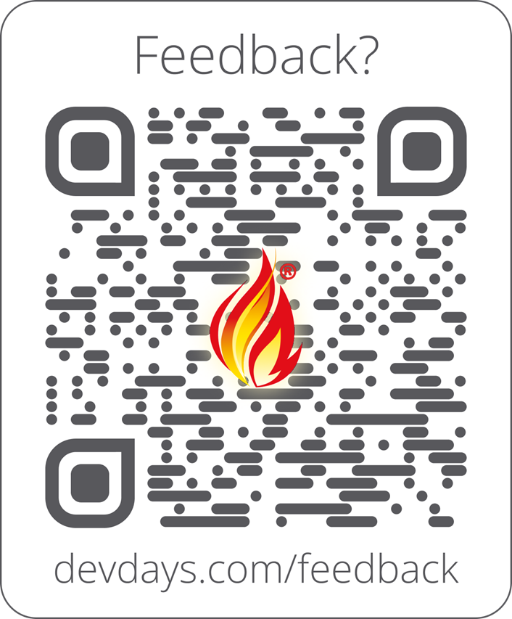
Feedback
Enjoyed this talk? I’d love your feedback — it genuinely helps. Scan the QR code, or visit:
https://www.devdays.com/feedback/

