Slide 1
Hangman
By Brendan Krafty, Justin Heyer and Mohammad Tuffaha

Slide 2
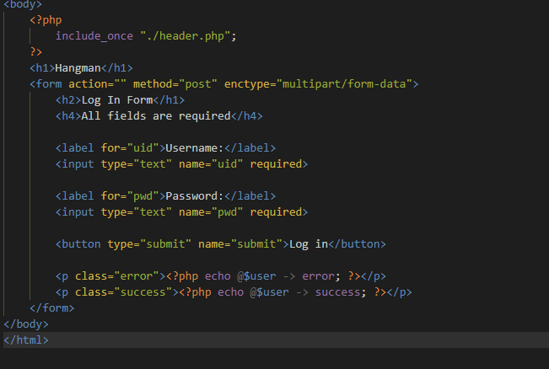
Plan of Action / Problem
Our mission was to create the classic hangman game with four levels of difficulty.
We started off by creating a Login and registration page for users. This was used to create a leaderboard and display the top contenders and winners for the hangman game.
Log in page source code

Slide 3
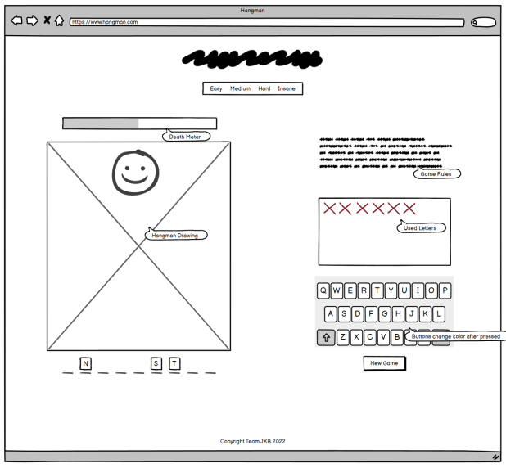
Design Sketch
We decided that we will do Hangman with different levels of difficulty, this was our sketch for what we wanted it to look like.

Slide 4
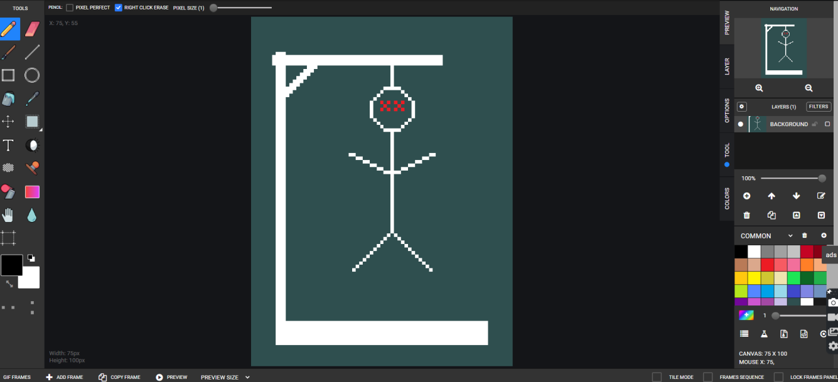
Pixilart.com to design the hangman parts

Slide 5
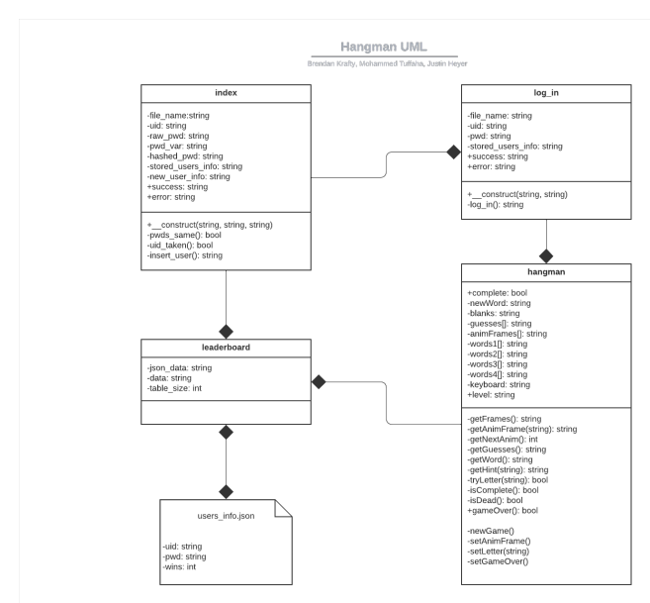
UML Model

Slide 6
Input
Output
Registration Information
Login information
Letter input for hangman
Registration/login successful
Hangman after login
Parts of Hangman
Win/Loss
Leaderboard

Slide 7
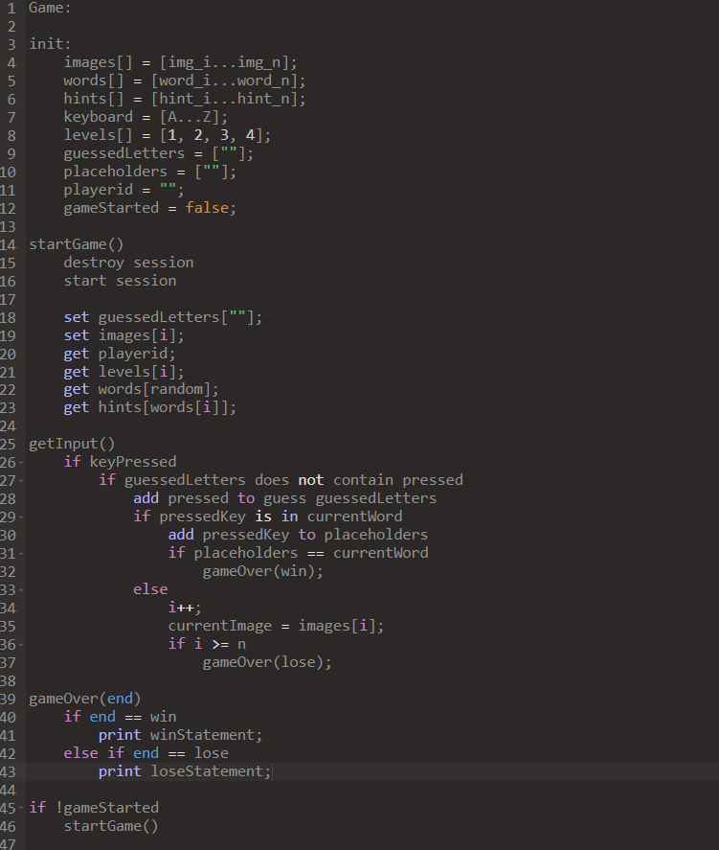
Pseudo code

Slide 8
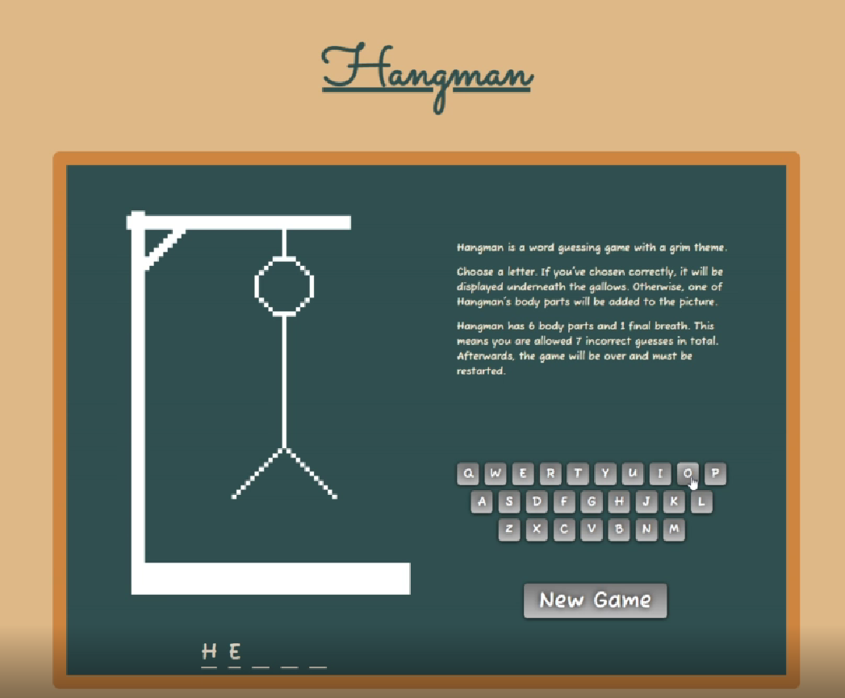
Testing
Our testing was pretty straight forward since our project was hangman. We made sure that the game worked through demos and that our login and account creation did not have any issues.

Slide 9
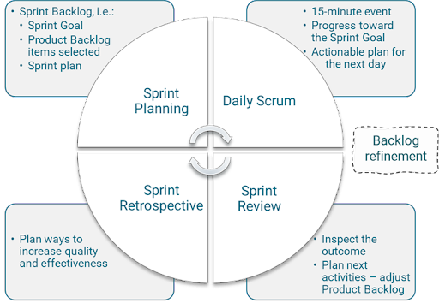
Scrum Framework
We applied the scrum framework by communicating effectively and holding meetings after we completed each step of the the project and tested out its respective steps’ effectiveness and tackling issues at hand.
Dividing our scrum team into three parts allowed us to continuing working without being hung up on another part. Our frequent team meetings allowed us to understand what we need to tackle next.

Slide 10
Thank you for listening!

