Slide 1

Waste Reduction
and
Online "Shopping"
Combined

Slide 2



Problem
Why Re-Gift?
75% of gifts get thrown in the trash
Giftee is already in possession of the gifted item
Giftee does not have a use for the item or simply does not like it
Significant environmental impact
Waste gets consolidated in landfills or undergoes incineration
Problem
User perspectives
Ministry of the Environment and Water Resources (MEWR) survey found that convenience was one of the most commonly cited reasons by Singaporeans for recycling regularly

Slide 3

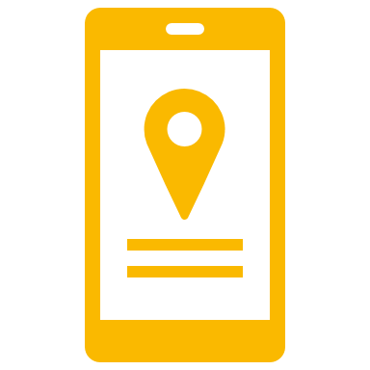
Problem
Create a platform for Donating and Receiving gifts
Mobile Application + Website
Take full advantage of technology to target a wider audience
Simple and easy to use interface
Keep an organized database of items available
Systematic collection and donation process
Solution
Treasure Box Machine
Conveniently located in every mall in Singapore
Operates like a normal vending machine + drop off point >> Easy to use

Slide 4

Competitive Analysis
Currently no direct competitors in this field
Other organizations in this line of work focus heavily on donating these items to a specific target group
Some examples of other organizations
Salvation Army
Limitations:
Low accessibility due to limited branches around Singapore
Only targeted at people willing to donate
Primary focus is on charity instead of reducing waste
Some items get exported to developing countries, where they eventually end up in landfills as waste.
Pass It On
Limitations:
Primary focus is on charity instead of reducing waste
Only targeted at people willing to donate
Donor has to hold on to the item until an organization needs it

Slide 5



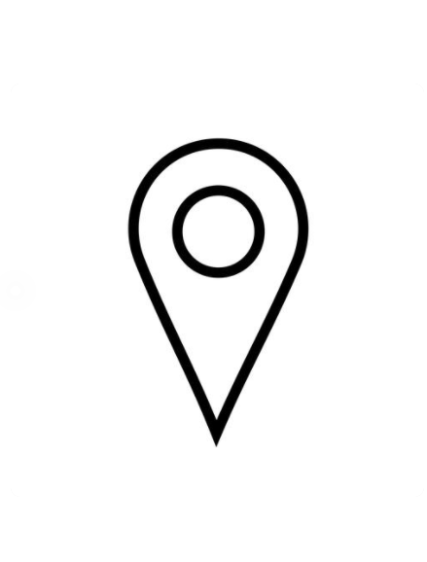

What makes us different?
Heavy focus on waste reduction
Use of each item is maximized based on who truly needs or wants it
Speedy drop-off and collection
Drop-off and collect items whenever you want
Easily accessible across Singapore
Placed in convenient locations across Singapore (i.e. Malls, MRTs, Schools, etc)
Minimal manpower required
Self-sustaining ecosystem >> Users drop off and collect items themselves

Slide 6
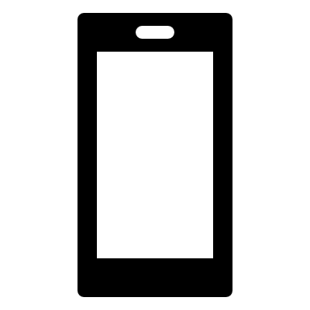



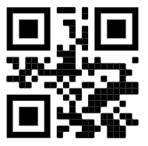
Collecting an Item Donating an Item
Step 1
Step 2
Step 3
Step 4
Select and reserve desired item on app.
Scan QR code through smartphone app for verification.
Head over to the Treasure Box as stated in the app.
Collect your present!
Step 1
Step 2
Step 3
Step 4
Create a listing for the item to be donated on our app.
Scan QR code through smartphone app for verification.
Head over to the
treasure box you have chosen.
Drop off item!

Slide 7

User Appeal
Donation Side
Collection Side
Convenience: Drop off item at the nearest location
Feel good about reducing wastage, helping with environmental efforts and giving their item a new lease of life
Convenience: Variety of items available near you
Free: Take whatever you want
E-Commerce experience: Browse for items on the app or website easily using search filters >> Find exactly what you want

Slide 8
Thank You!

