Slide 1
Investigating the Application of a Recommender System for Irish College Courses
Masters Thesis Presentation
Principal Investigator: Brendan McCann
Supervised by: Prof Owen Conlan
Date 25/03/2026

Slide 2
Motivation
2024: 79% of Irish students entered college from secondary school^{[1]}
“What college course should I study?”
Difficult to answer
2018: 31% Irish graduates: “not likely” to study their course again^{[2]}
Many influences/reasons
Research question: “How can a Recommender System assist an Irish student in their college course decision-making process”?

Slide 3
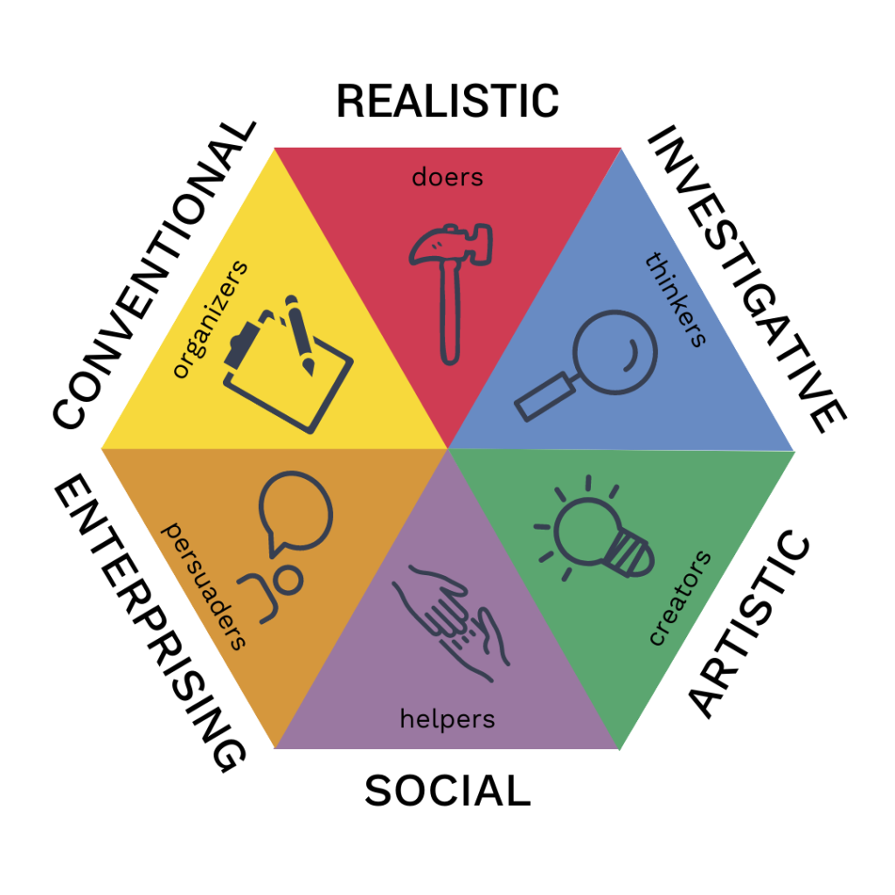
Background
Holland’s RIASEC Model^{[3]}
6 vocational personality traits
Most studied career theory^{[4]}
“What college course should people
study?”
Academic Interests^{[5][6]}
Salary^{[5][7]}
Meaning^{[5]}

Slide 4
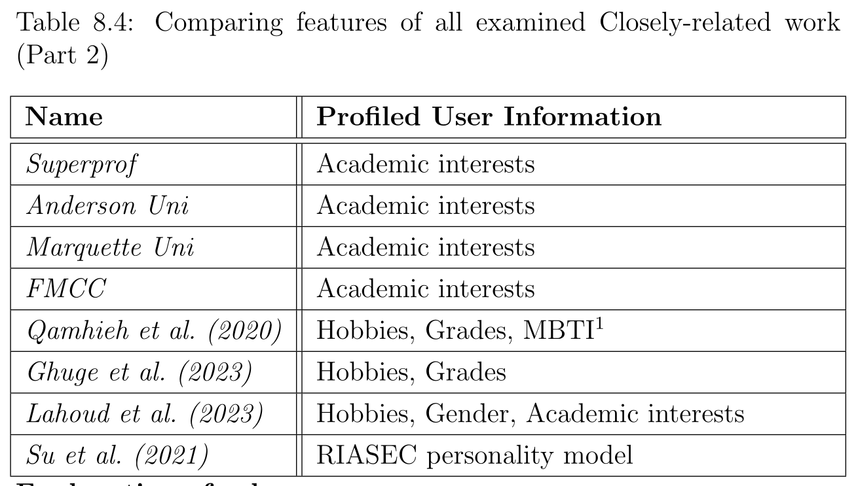
Related Work
What information do we profile from the user to make personalised college course recommendations?
Research Gap: RIASEC + Academic Interests

Slide 5
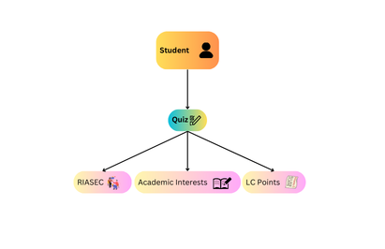
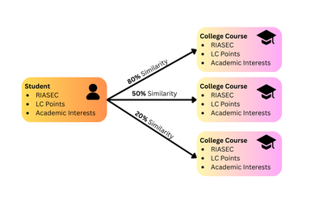
Design
What information do we profile off a user?
student’s RIASEC Model + LC Points + Academic Interests

Slide 6
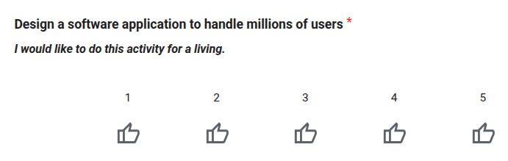
Implementation
21 “Academic Interest” categories
6 questions per “Academic Interest”
Targeting different RIASEC traits
Quiz:
Academic Interests
Agriculture
...
Computers
Healthcare
...
Welfare
“Investigative” RIASEC Quality
“Computers” Academic Interest

Slide 7
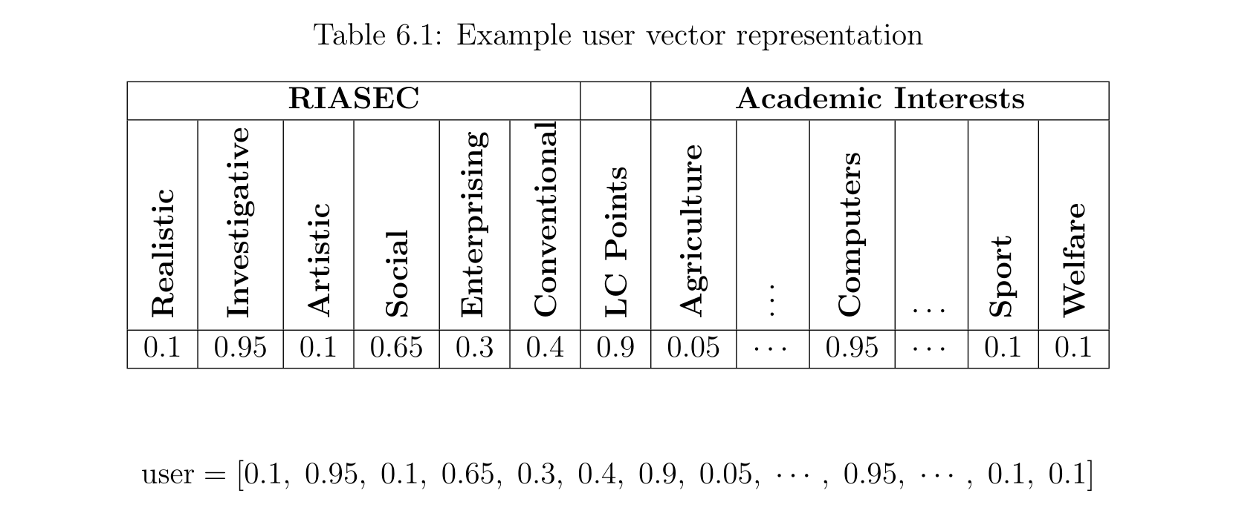
Implementation
Every user is a 28-dimensional vector
Values normalized between 0.0 and 1.0

Slide 8
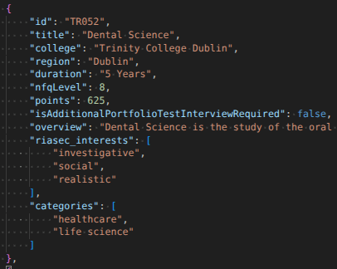
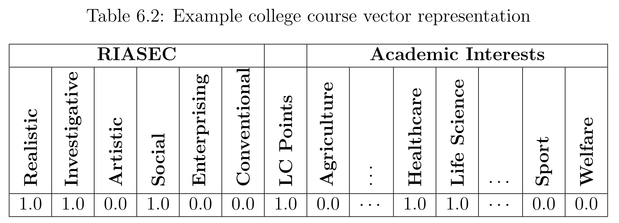
Implementation
Every college course is also a 28-dimensional vector

Slide 9
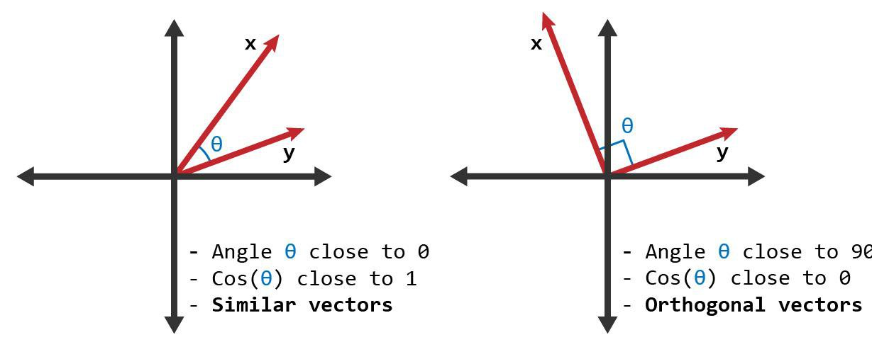

Implementation
similarityScore = cosineSimilarity(user, collegeCourse)
Return 20 college courses

Slide 10
Implementation
Giving 20 “computer science” courses isn’t exactly helpful…
Courses with identical names are not recommended
e.g. you won’t get recommended 2 “Computer Science” courses
Courses are recommended across the user’s top 5-scored categories
Keeps diversity across different areas of study
Diversity leads to more exploration – revisit RQ!

Slide 11
Experiment
Participants aged 18-24 who applied to college through the CAO system
Participants were sought opportunistically
Ethics approved
N = 31
Participants got 2 recommendation sets:
Actual
Baseline
Top courses sorted by LC points
Participants provided their original college application list

Slide 12
Demo of Project

Slide 13
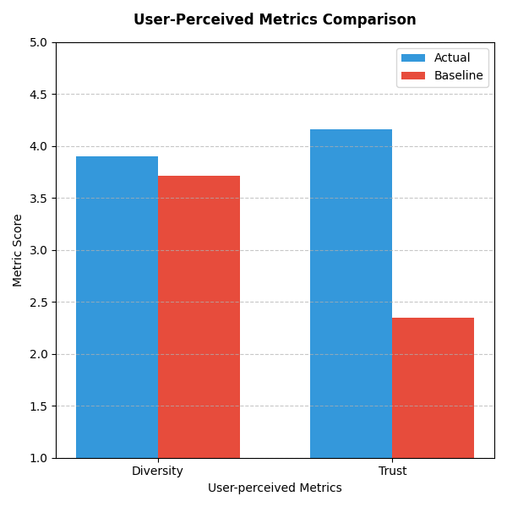
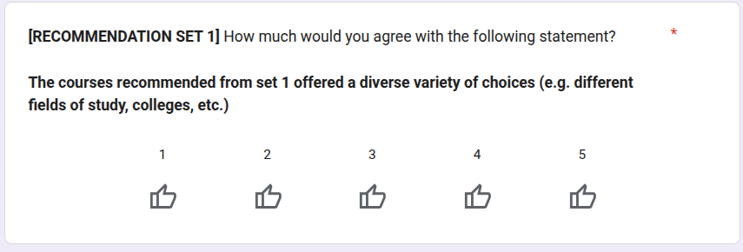
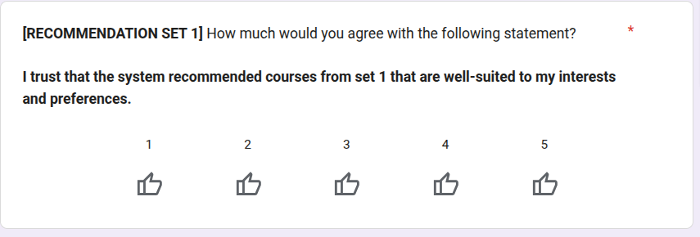
Evaluation

Slide 14
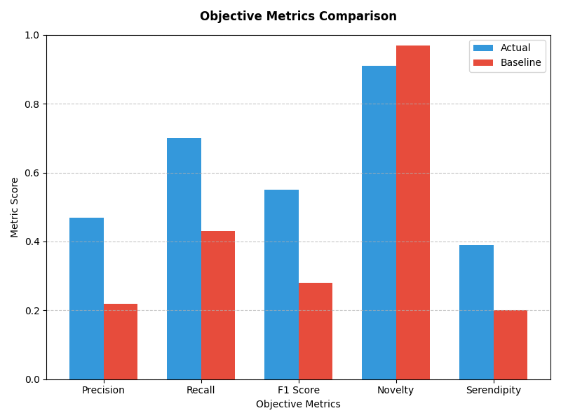
Evaluation

Slide 15
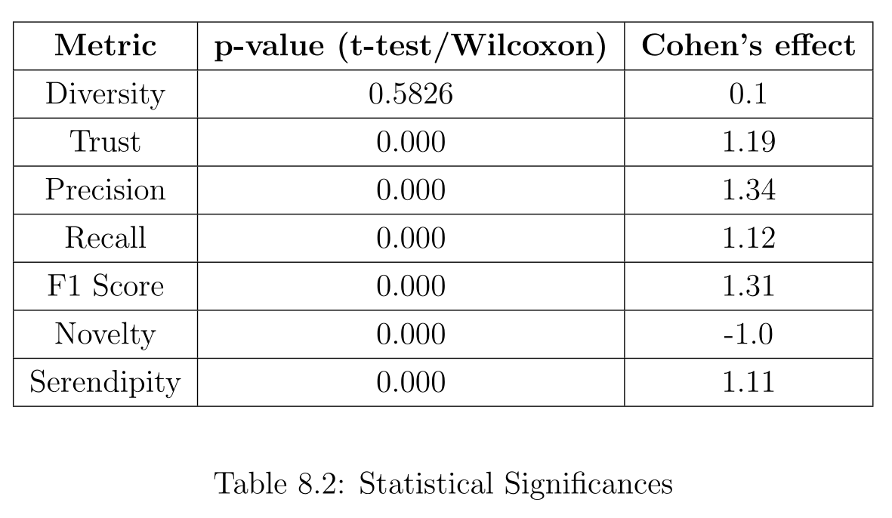
Evaluation
Diversity = insignificant differences between actual and baseline
Novelty = significant improvement of baseline compared to actual
Everything else = significant improvements of actual compared to baseline

Slide 16
Conclusions
Research question: “How can a Recommender System assist an Irish student in their college course decision-making process”
By recommending college courses that:
Are relevant to their preferences
They would not have seen otherwise
Future work:
“Academic Interests” were too broad, e.g. Economics being classed under social science
Subject & Grade requirements

Slide 17
Questions ?

Slide 18
Thank You

