Slide 1
Investigating the Application of a Recommender System for Irish College Courses
Masters Thesis Presentation
Principal Investigator: Brendan McCann
Supervised by: Prof Owen Conlan
Date 25/03/2026

Slide 2
Motivation
2024: 79% of Irish students entered college
“What college course should I study?”
Difficult to answer
2018: 31% Irish graduates: “not likely” to study their course again
Many influences/reasons
Research question: “How can a Recommender System assist an Irish student in their college course decision-making process”?

Slide 3
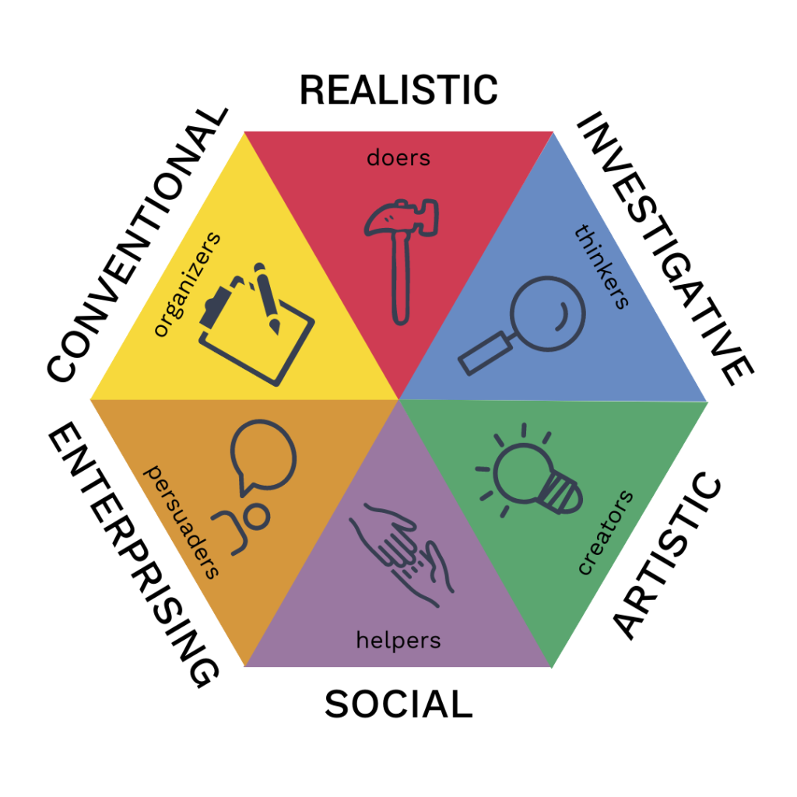
Background
Holland’s RIASEC Model
Most studied career theory
“What college course should people
study?”
Academic Interests
Salary
Meaning

Slide 4
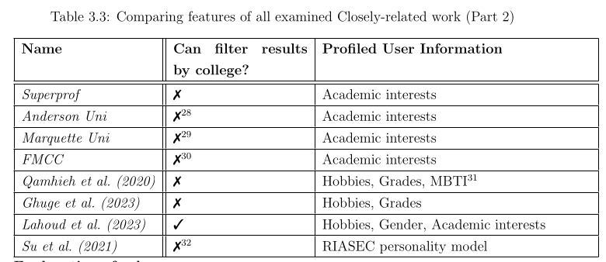
Related Work
How do we make personalised college course recommendations?
Research Gap: RIASEC + Academic Interests

Slide 5
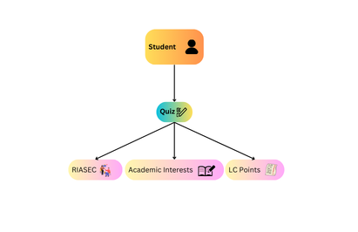
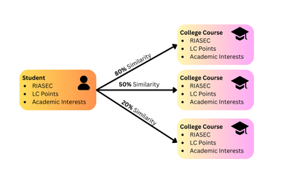
Design
What information do we profile off a user?
student’s RIASEC Model + LC Points + Academic Interests

Slide 6
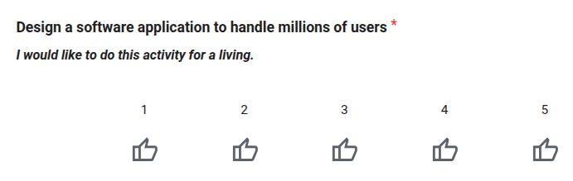
Implementation
21 “Academic Interest” categories
Quiz
Academic Interests
Agriculture
...
Computers
Healthcare
...
Welfare
“Investigative” RIASEC Quality
“Computers” Academic Interest

Slide 7
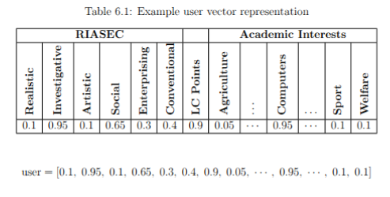
Implementation
Every user is a 28-dimensional vector
Values normalized between 0.0 and 1.0

Slide 8
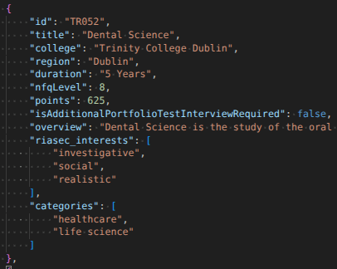
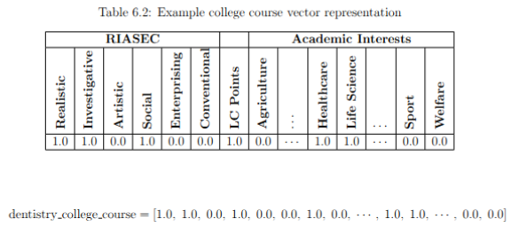
Implementation
Every college course is also a 28-dimensional vector

Slide 9
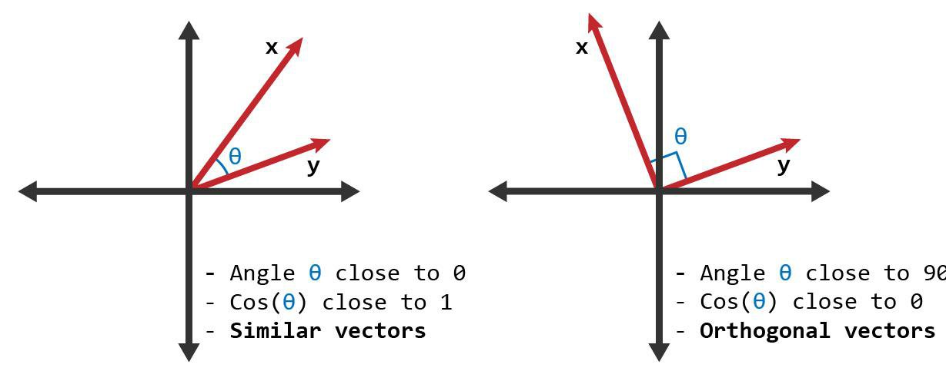

Implementation
similarityScore = cosineSimilarity(user, collegeCourse)
Return Top 20 matches

Slide 10
Demo of Project

Slide 11
Evaluation
Diagrams
Resolution of diagrams should be adequate i.e. lines should not be blurred, fonts should be easily readable
Axes on graphs should have names and units
Graphs should have legends
Owen: data should result in findings – link this back to RQ!

Slide 12
Conclusions
Lessons learnt
Reflection

Slide 13
Questions ?

Slide 14
Thank You

