Slide 1
Term 2 + term 3 – projects!

Slide 2
Plan for the rest of the year
Including today's class, we have 5 lessons left to create our projects
Show posters from last year to get a refresher
In May, we will present our posters to the parents

Slide 3
Plan for today
Find the group partner that you found a few weeks ago
Settle on a research area
Figure out a research question
You don't need to have this fully figured out by today, sometimes it can take weeks!
Find a dataset in your research area that could answer your research question

Slide 4
Find a group partner
You will be working in pairs for the rest of the term
Find a group partner to work together with
If you haven't found a person, let the educators know and we can assign you to a group
For Brendan, Victoria & Lalith – fill out Google sheets of groups!

Slide 5
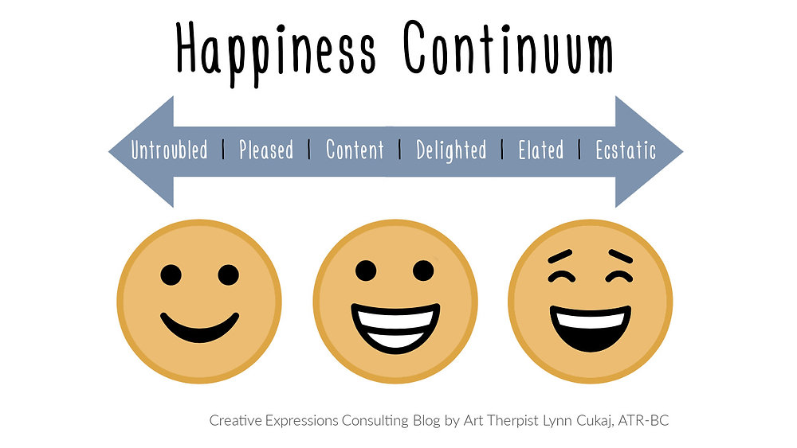
Research area
With your group partner, pick a research area you are both interested in analysing
Start off with your hobbies and what you both like, for example:
Movies
Sports (e.g. Football, Basketball)
Airplanes or Trains
Lego
You could also pick something else that you think could be cool:
Social Media usage
Happiness levels in different countries
How people use transport to get to school e.g. car, bike, walk

Slide 6
Research question
You should now have a research area figured out – if not, you still have time now to figure it out
You should now think of an interesting research question, for example:
If you chose movies, your research question could be "What movie genres have the highest ratings on average?"
If you chose Happiness Levels, your research question could be "What country has the highest happiness levels on average?"
If you chose Trains, your research question could be "How punctual are train arrivals in Ireland?"

Slide 7
FINDING A DATASET
You should have your research question figured out – if not, that's ok. You have time to figure it out.
e.g. "Do books with more pages have higher ratings?"
You should also have your research area figured out
e.g. Books
You now need to find a dataset that could help you answer your research question!
Check Kaggle (https://www.kaggle.com/)
I like books, so I'll check Kaggle for a dataset on books

