Slide 1
A
1980s
B
2000s
C
U/U_{MSY}
Bristol Bay
D
S/S_{MSY}
E
F
G
Skeena
H
I
J
K
Fraser
L

Slide 2
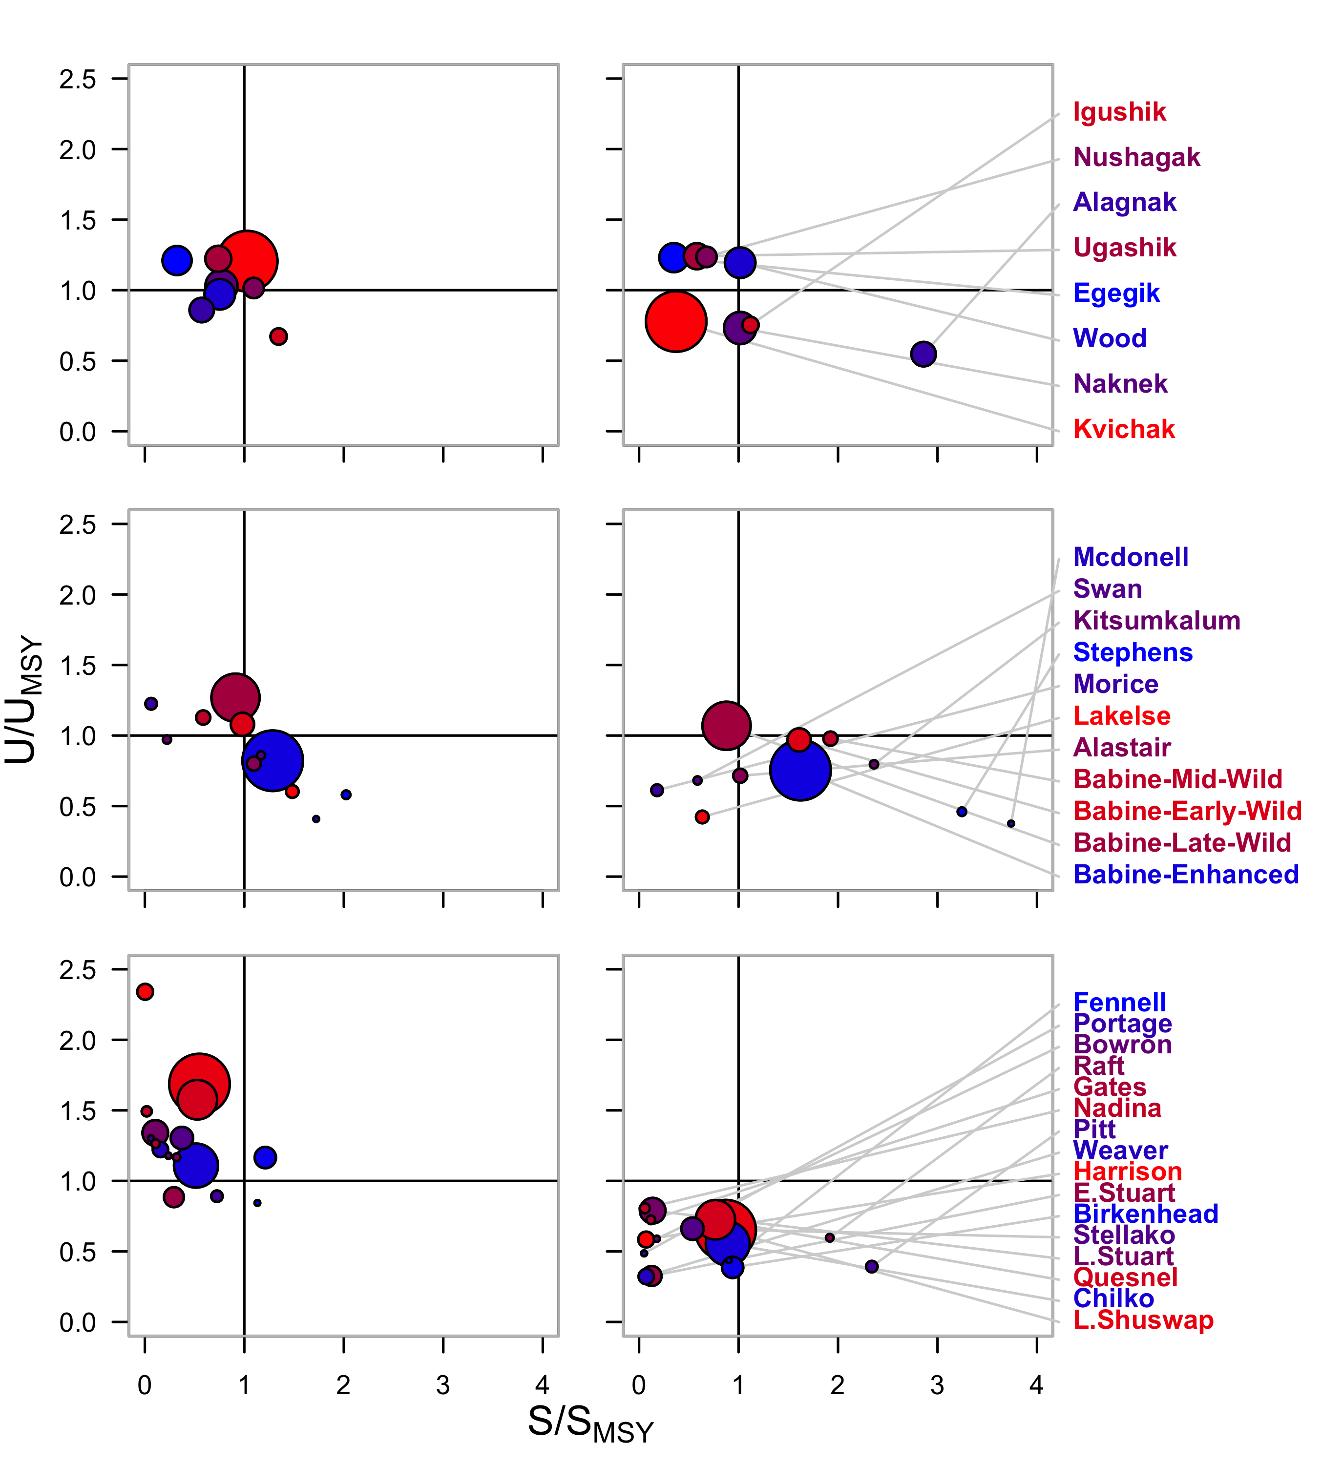
1980s
2000s
Bristol Bay
Skeena
Fraser

