Slide 1
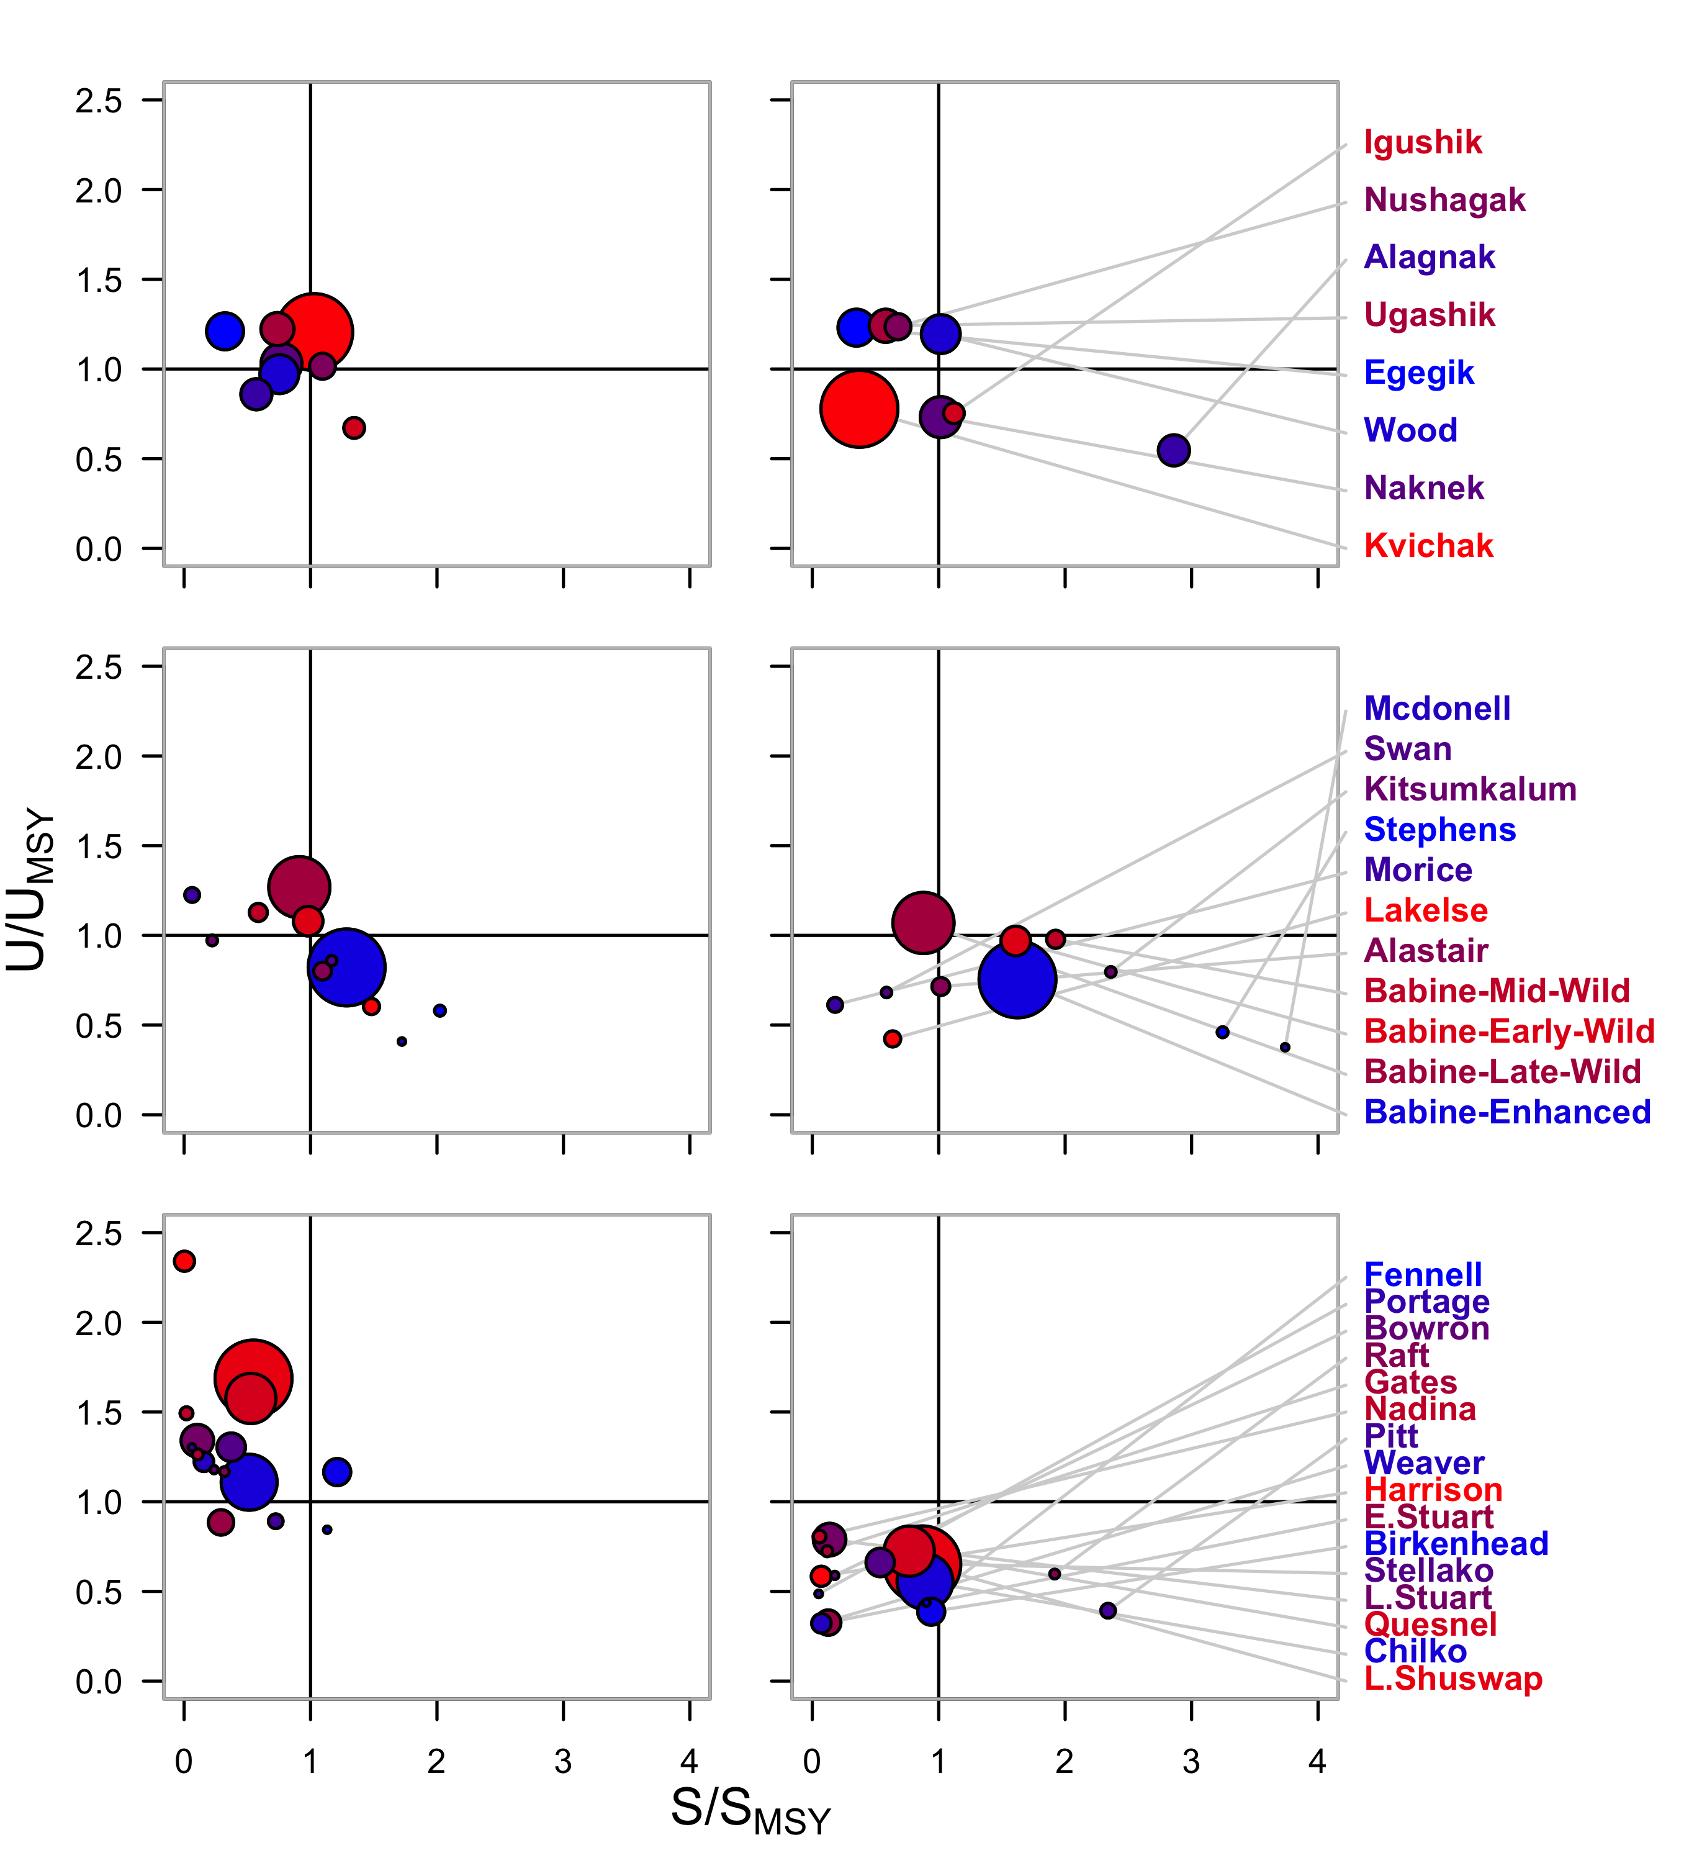
1980s
2000s
Bristol Bay
Skeena
Fraser

