Slide 1
Analysis of“Gain Scheduled Attitude Control of Fixed-Wing UAV with Automatic Controller Tuning”
Adam Lobo & Brendan Neal

Slide 2

Motivation
Fixed-wing UAVs are becoming increasingly popular in many applications in the United States and around the world.
Examples include military, surveillance, search and rescue, delivery of goods, and entertainment.
UAVs do not have an onboard pilot flying them (as the name suggests).
They are controlled either directly by an operator on the ground, or in more current instances, autonomously by software.
Maintaining complete control over these devices important to the success of their operations and the safety of civilization.
Consequences to loss of control of UAVs are dire and include failed tasks, lost revenue, damage to/loss of the vehicle anything carried by it, destruction to buildings, structure, and the environment, great bodily harm, and loss of life.

Slide 3
Background
PI controllers integrate well into linear systems.
PI controllers have two components:
Proportional gain: addresses current behavior, scales it by a gain constant (Kp).
Integral gain: examines past behavior by summing previous error, scales it by a gain constant (Ki).
Due to varying conditions and system parameters, standard PI controllers do not work well for nonlinear systems.

Slide 4
Background (Continued)
Gain scheduling is an adaptive control based modification to PI controllers aimed at addressing non-linearity.
This sets a different constant value for different thresholds of each condition present in the system.
For example, in a UAV that operates at different airspeeds, there will be a different Kp and Ki constant for different ranges of speeds.
When the dynamics of the system cross from one threshold range to another, the constants are automatically changed to the pre-tuned values for the new threshold.
Values can be tuned theoretically through calculations or through a technique involving relay feedback oscillatory experiments, examining the frequency response under each condition, and calculating the gain.

Slide 5
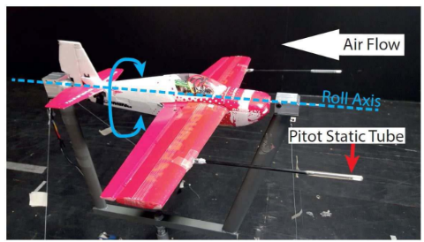
Simulation - Setup and Goals
The experiments performed in the paper “Gain Scheduled Attitude Control of Fixed-Wing UAV with Automatic Controller Tuning” were performed on a real life UAV in a wind tunnel.
Our goal is to simulate these experiments in Simulink by applying our theoretical models and equations to reproduce similar results.
UAV fixed so that it can only roll.
Only ailerons used to control the roll rate and roll angle.

Slide 6


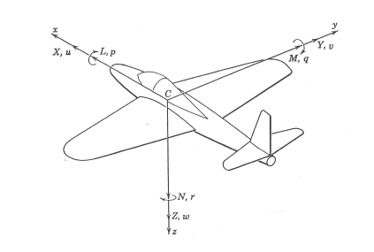
Simulated Roll Dynamics
Roll rate and roll angle both modeled as single integrator equations:
Aileron Deflection
Air Density
Airspeed
Wing Platform Area
Wingspan

Slide 7
Simulation - Tests Performed
Tune inner-loop controllers through relay feedback.
Tune outer-loop controllers through relay feedback.
Evaluate performance of gain-scheduled controller vs. traditional cascaded PI controller:
Cascaded PI step and zero reference tests.
Gain scheduled step and zero reference tests.

Slide 8
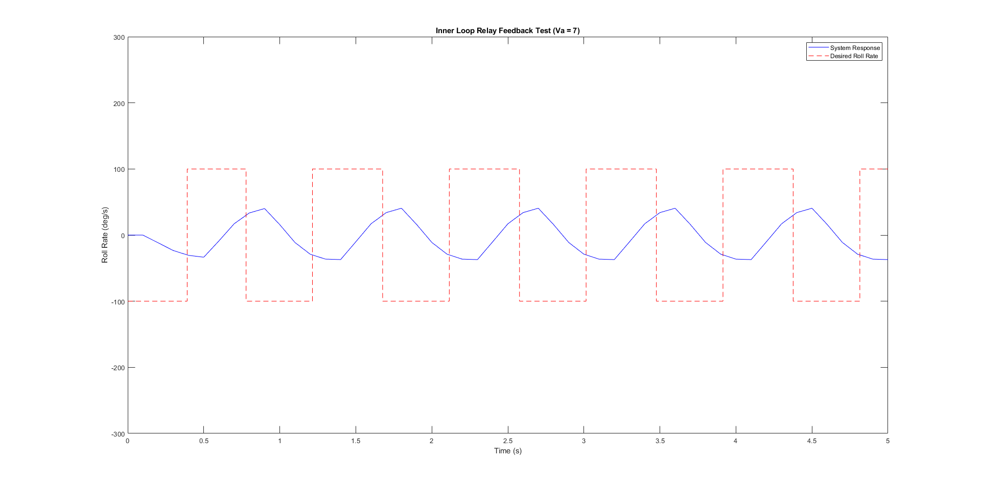
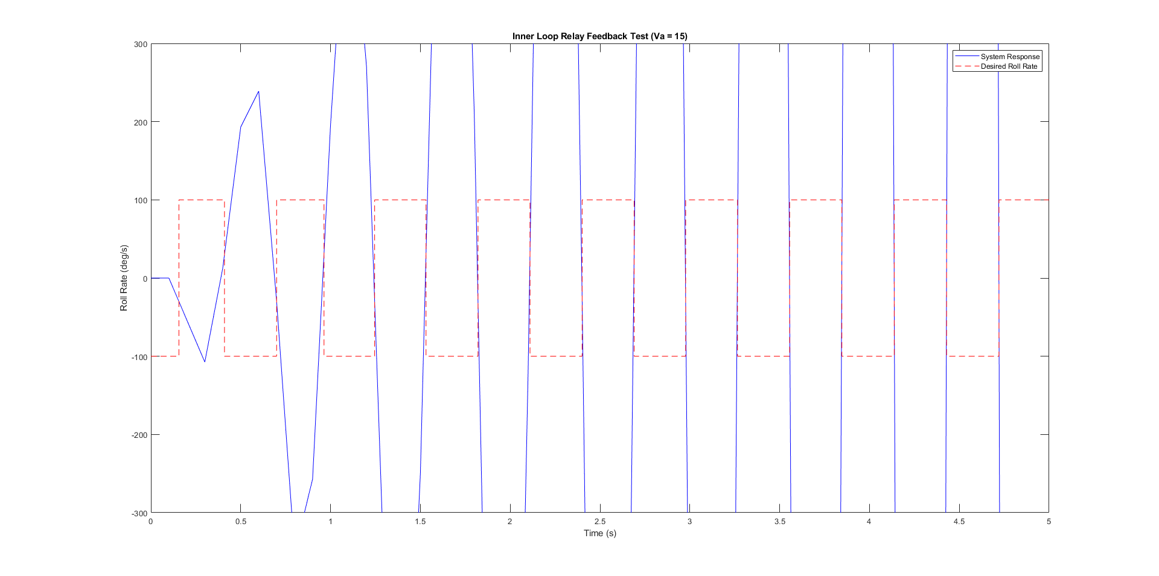
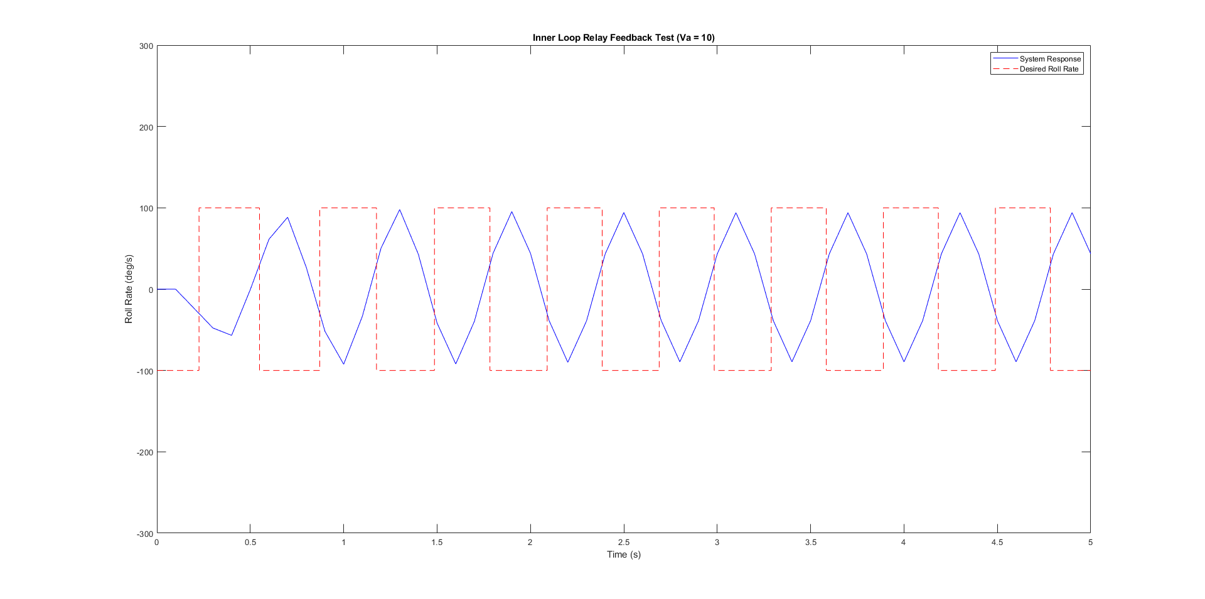
Simulation - Inner-Loop Relay Feedback
7 m/s Test
15 m/s Test
Performing a Fourier amplitude/frequency analysis of these three responses allow us to back out the controller gains for the inner loop (gain scheduled) controller:
7 m/s:
Kp =0.92 , Ki = 0.095
10 m/s:
Kp =0.23 , Ki = 0.146
15 m/s
Kp =0.19 , Ki = 0.178
10 m/s Test

Slide 9
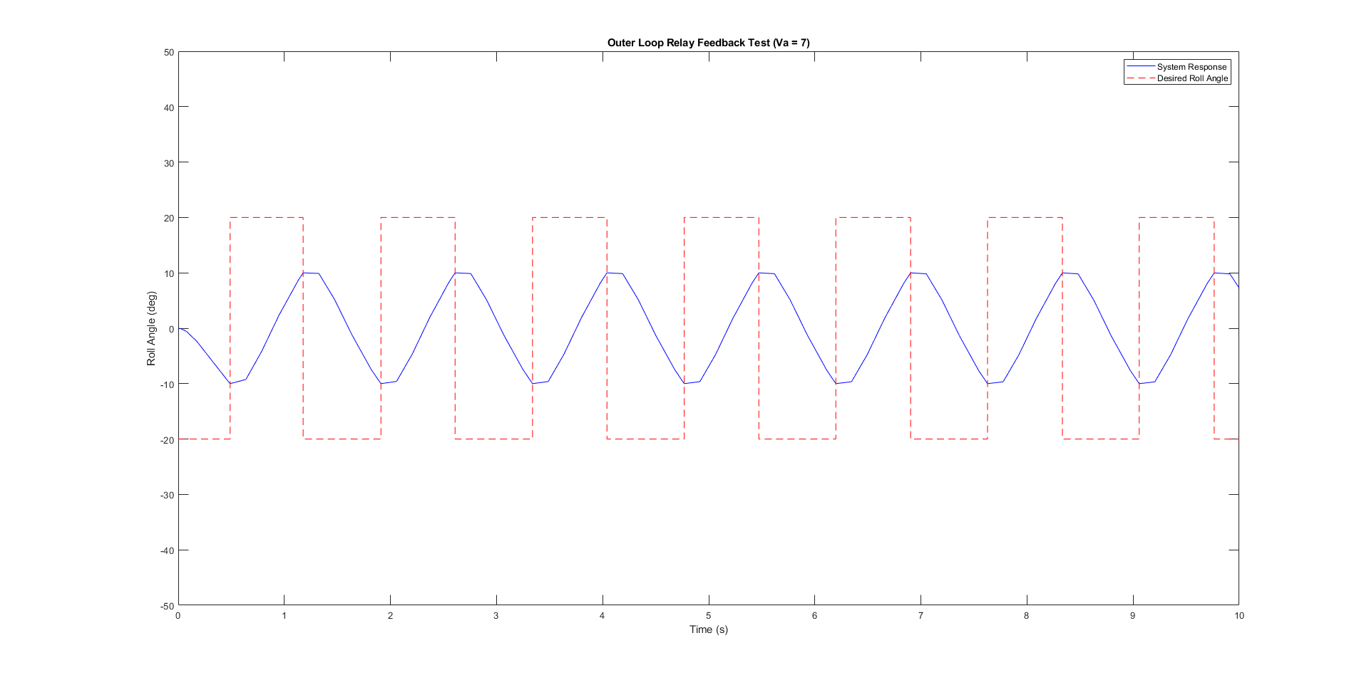
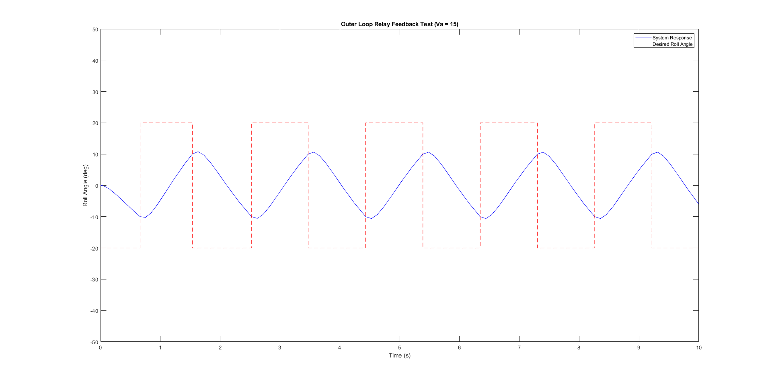
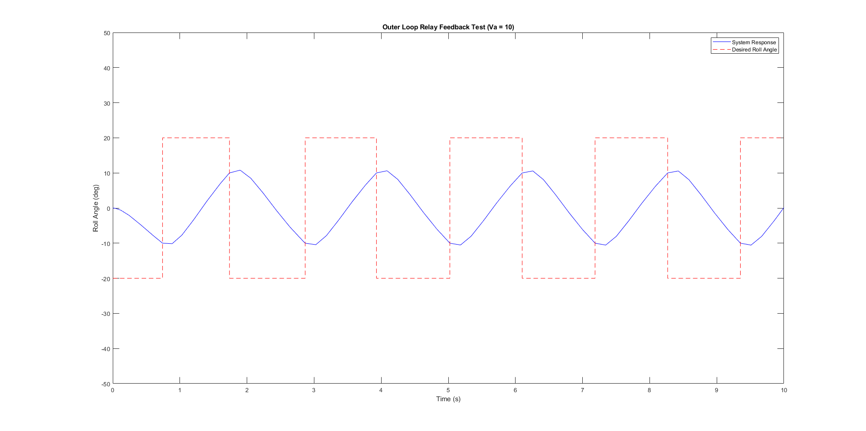
Simulation - Outer-Loop Relay Feedback
7 m/s Test
15 m/s Test
Performing a Fourier amplitude/frequency analysis of these three responses allow us to back out the controller gains for the outer loop controller:
Kp = 7.67 , Ki = 24.12
Because the amplitudes and frequencies of all three responses are similar, only the inner loop controller has to be gains scheduled.
10 m/s Test

Slide 10
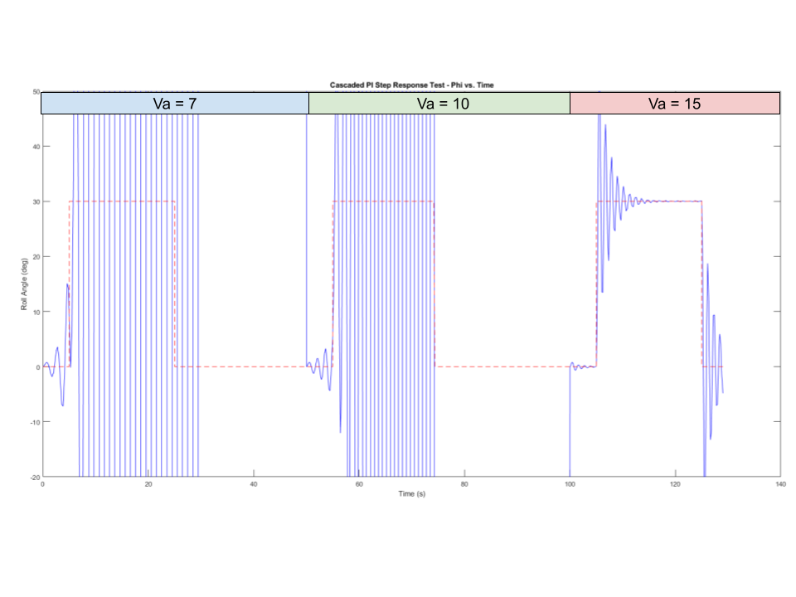
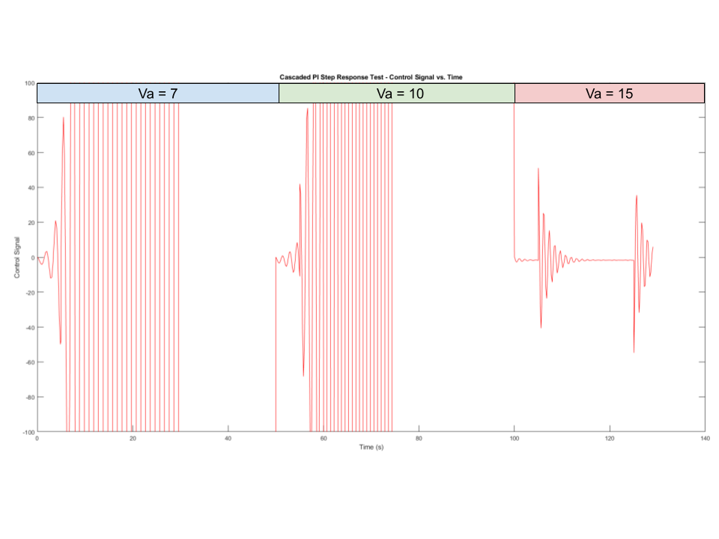
Simulation - Cascaded PI Controller - Step Response Test
System Response
Control Input
Unstable at 7 m/s and 10 m/s, stable with high oscillation at 15 m/s.

Slide 11
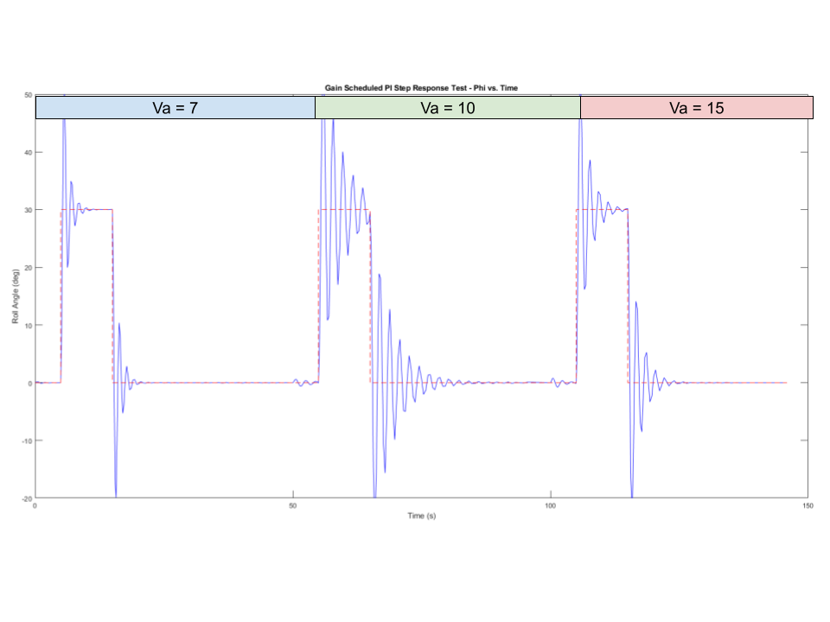
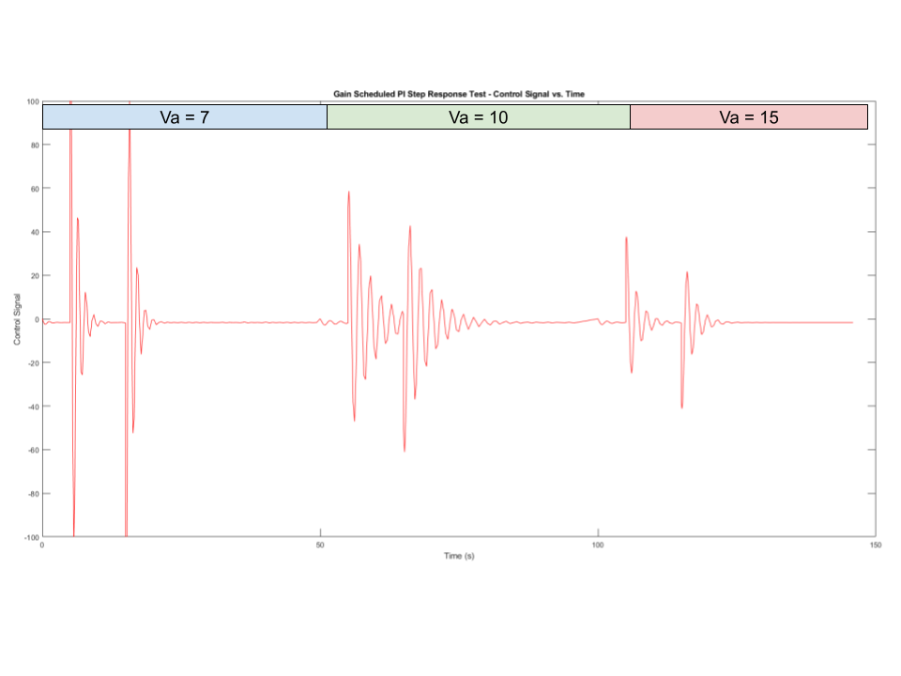
Simulation - Gain Scheduled Controller - Step Response Test
System Response
Control Input
Stable at all three operating points. High CI, fast response at 7 m/s, lower CI more oscillation at 10 and 15 m/s.

Slide 12
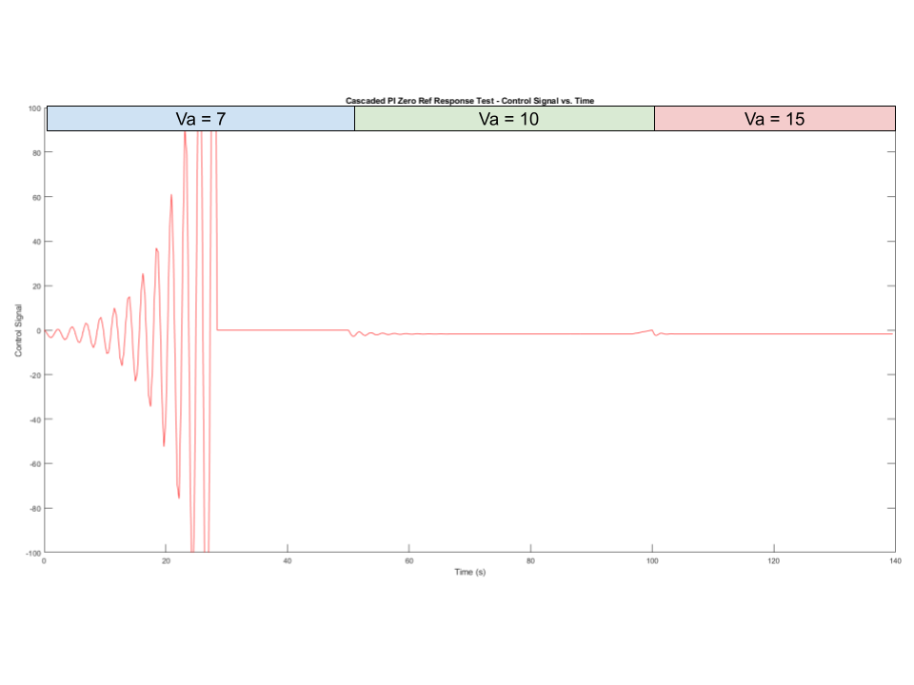
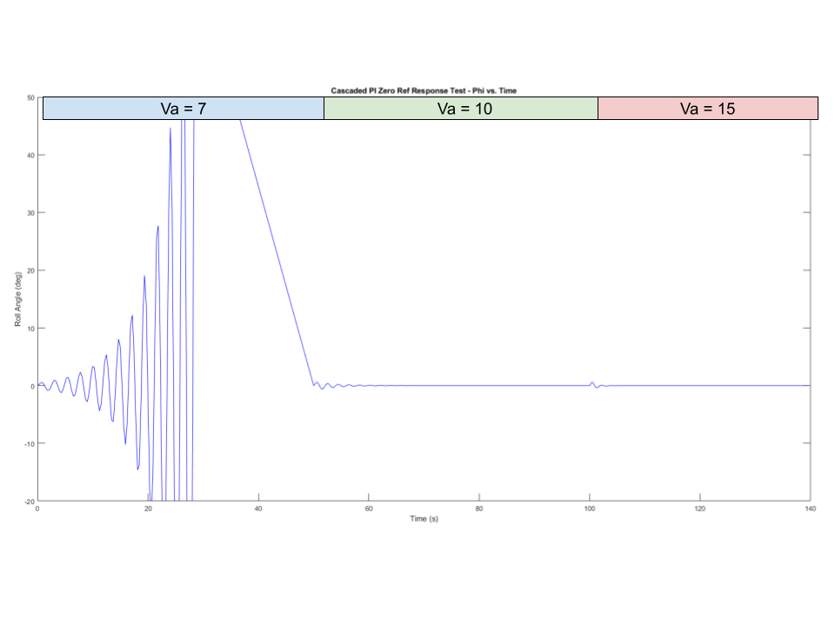
Simulation - Cascaded PI Controller - Zero Reference Test
System Response
Control Input
Unstable at 7 m/s, maintains reference angle at 10 m/s and 15 m/s.

Slide 13
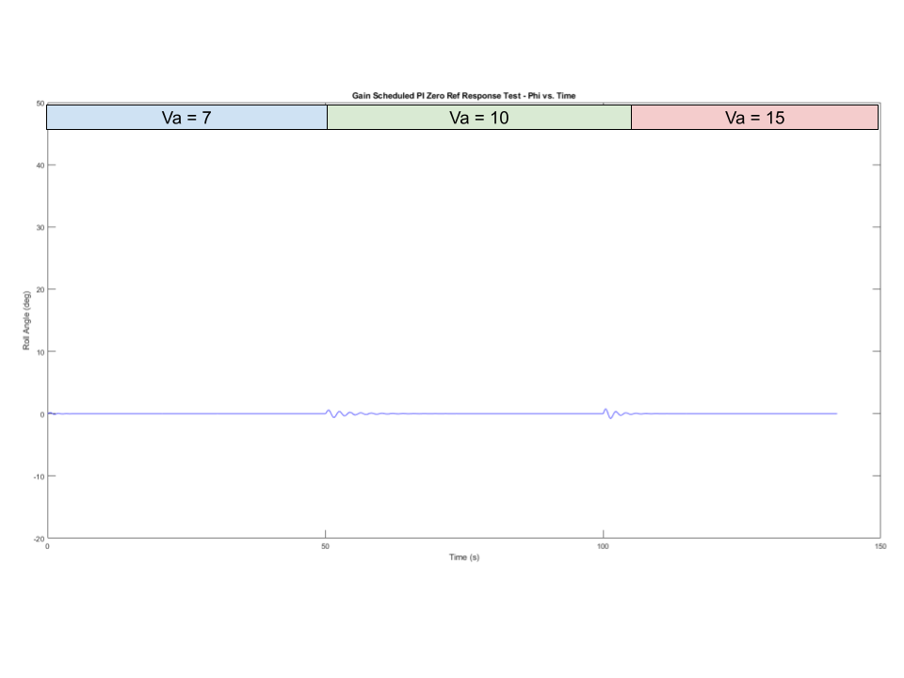
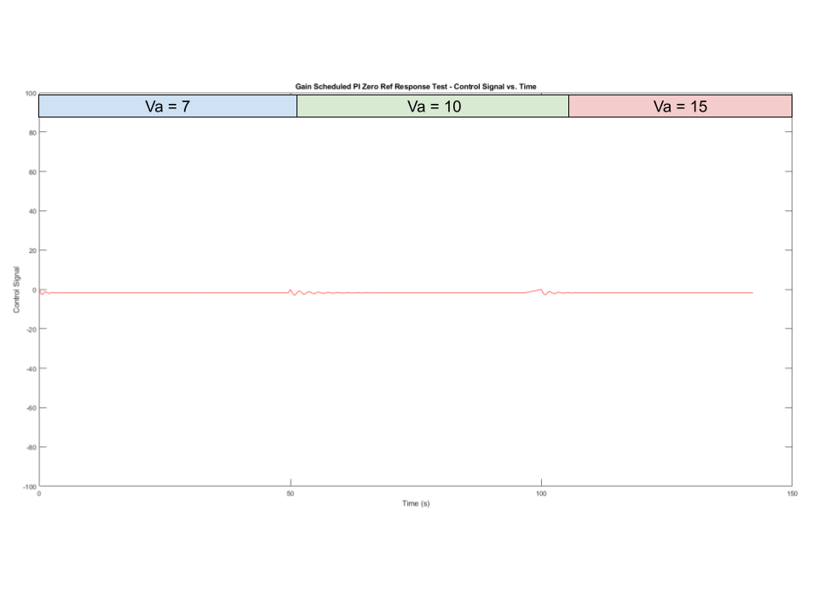
Simulation - Gain Scheduled Controller - Zero Reference Test
System Response
Control Input
Stable and maintains reference under all three operating conditions.

Slide 14
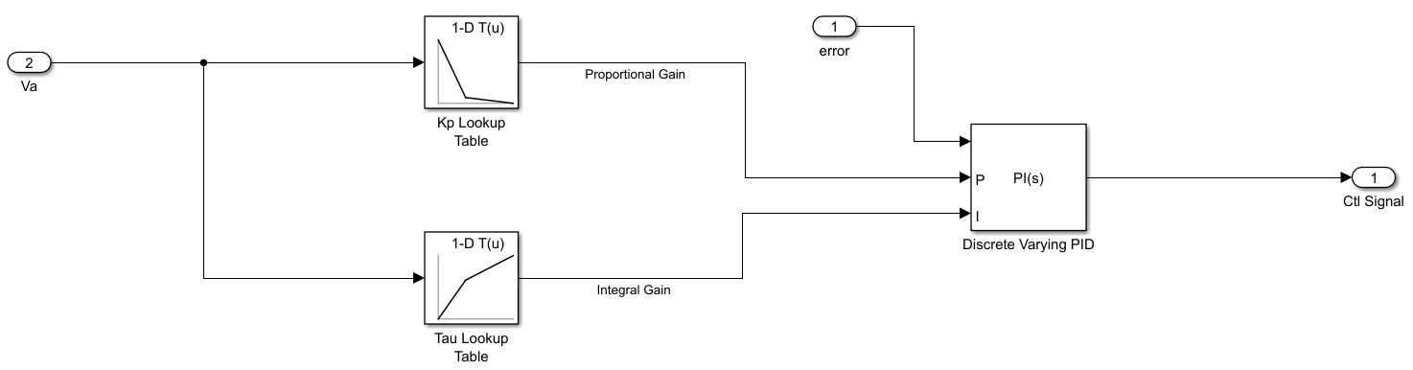
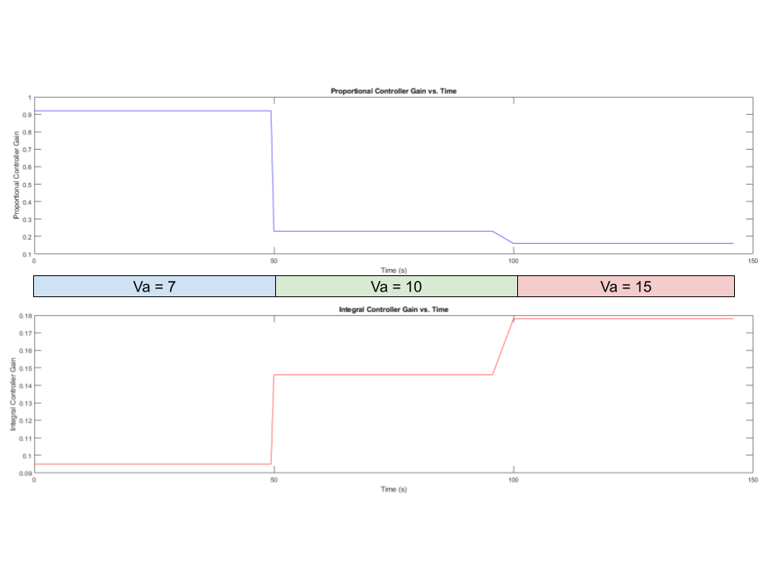
Simulation - Gain Scheduled Controller - Verify Gain Scheduling Success
No set block in Simulink for gain scheduling.
Had to create our own using 2 1-Axis lookup tables:
Either exactly matches gains based on airspeed or interpolates based on function.
Figure to the right verifies that as the airspeed changes, so do the controller gains.
Controller Gains vs. Time

Slide 15
Discussion of Results
Link to Simulation Videos: https://youtu.be/B__ND9OzVRY
We were unable to perfectly replicate the results in the paper [10].
There were a few constraints we encountered that logistically prevented us from getting perfect results.
Missing crucial aerodynamic derivative coefficients to model the plant’s behavior.
We utilized coefficients provided in another paper [3] for a larger-scale aircraft as a baseline for sign (+/-) and proportional relativity.
We performed a grid search to find the values that produced the best matching results across all tests
There were values we found that produced near-perfect results on one test while producing instability on another test.

Slide 16
Discussion of Results (Continued)
Physical hardware vs theoretical simulation testing:
Our results in simulation were smoother due to introduced uncontrollable variables introduced by hardware testing:
These include error in actual wind-speed and time delay between sensors and actuators.
Sensor noise.
Wind tunnel startup and steady state.
Our simulation setup architecture might not have matched what [10] implemented in their physical experiments (i.e. only block diagrams provided, no detailed description of code).

Slide 17
Discussion of Results (Continued)
Even though we did not perfectly replicate results, our simulation followed similar patterns to [10].
ILRF Test: Increasing amplitudes with increasing airspeed, verging on instability at 15 m/s.
OLRF Test: Similar amplitudes and frequencies across all three airspeeds.
Cascaded PI Tests: Unstable at some operating conditions, not ideal at others.
Gain Scheduled Tests: Stable at all operating conditions with better responses than Cascaded PI.

Slide 18
Conclusion
The conclusion that [10] came to was that gain scheduling is a necessary and effective method to stabilize the highly nonlinear UAV system under different airspeed operating conditions.
Even though our results did not match exactly, we were able to come to the exact same conclusion despite our ad-hoc methods of filling in information not presented in the original paper.

Slide 19
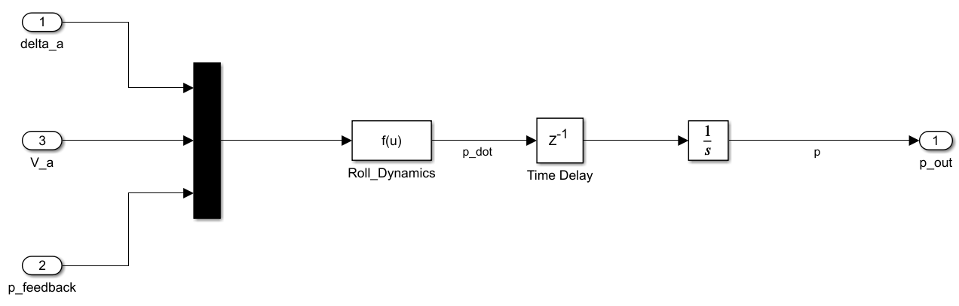
Appendix – Inner Loop Plant Dynamics

Slide 20
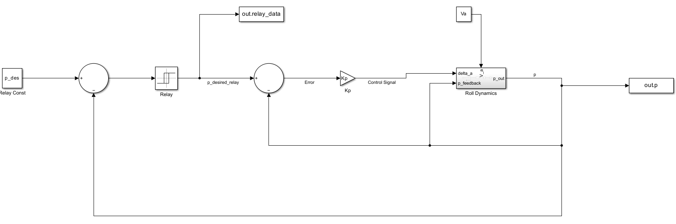
Appendix – Inner Loop Relay Feedback Diagram

Slide 21
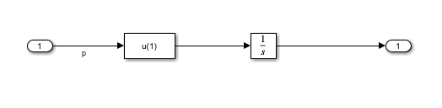
Appendix – Outer Loop Plant Dynamics

Slide 22
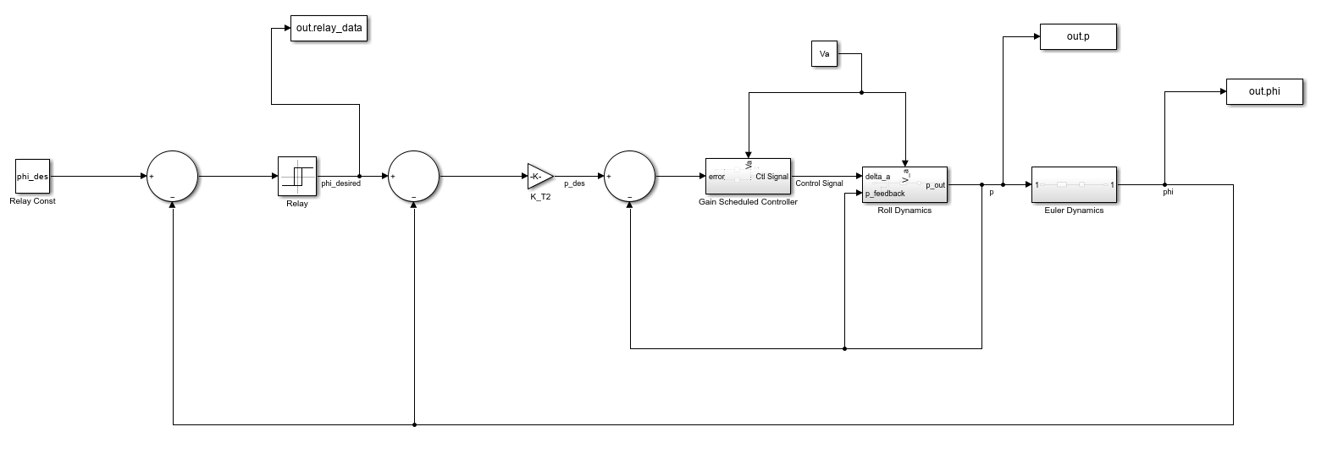
Appendix – Outer Loop Relay Feedback Diagram

Slide 23
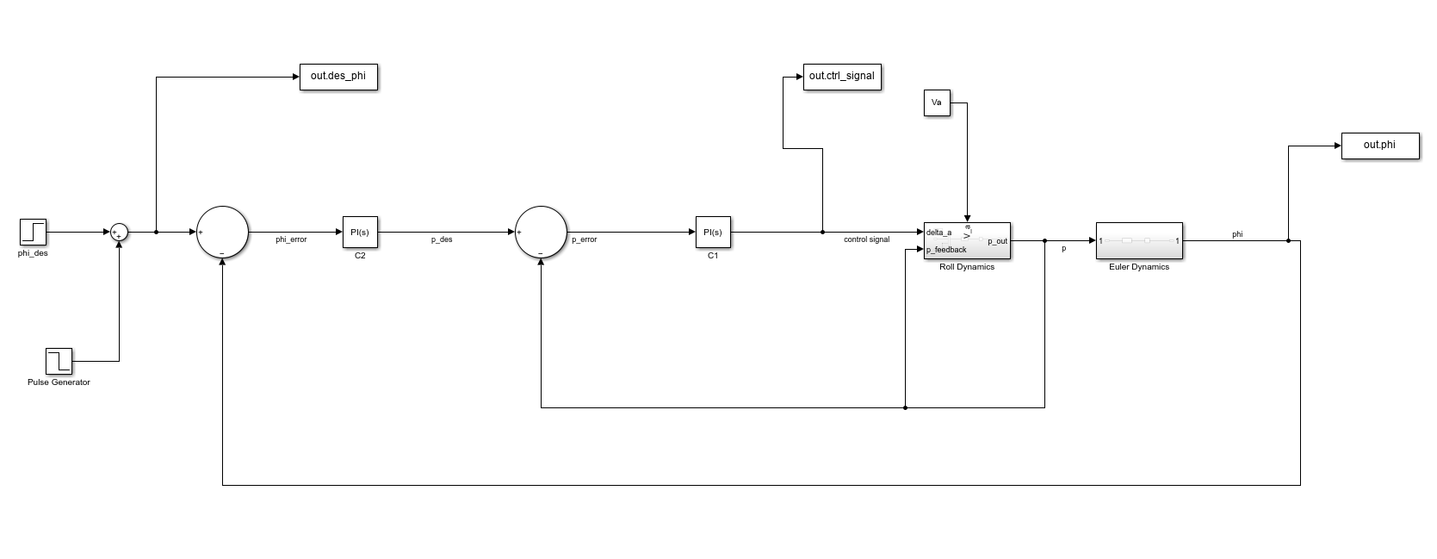
Appendix – Cascaded PI Step Diagram

Slide 24
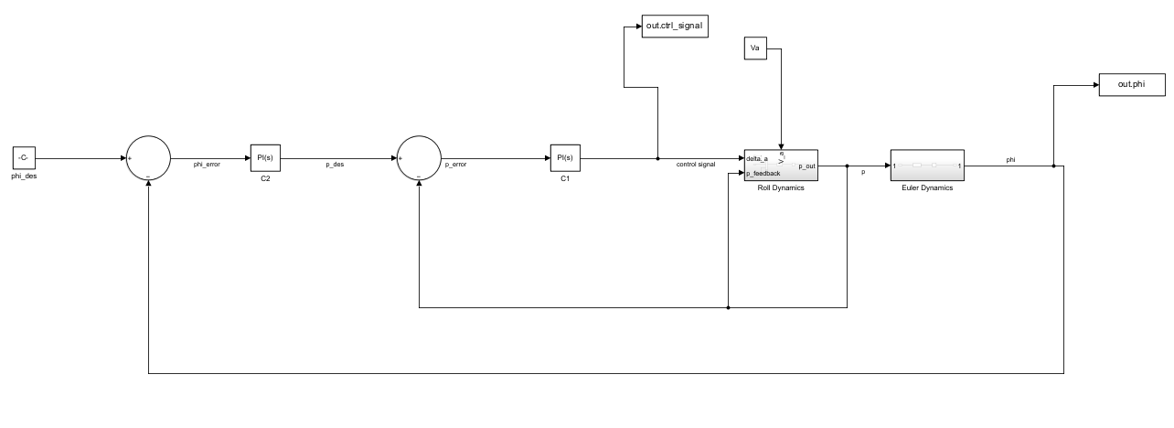
Appendix – Cascaded PI Zero Reference Diagram

Slide 25
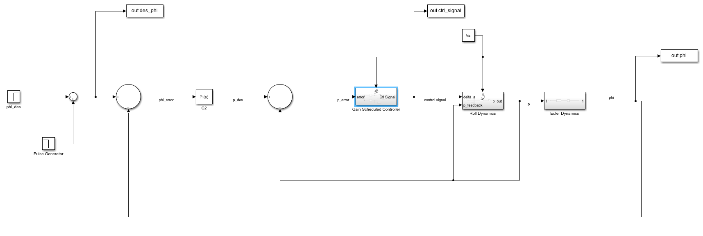
Appendix – Gain Scheduled Step Diagram

Slide 26
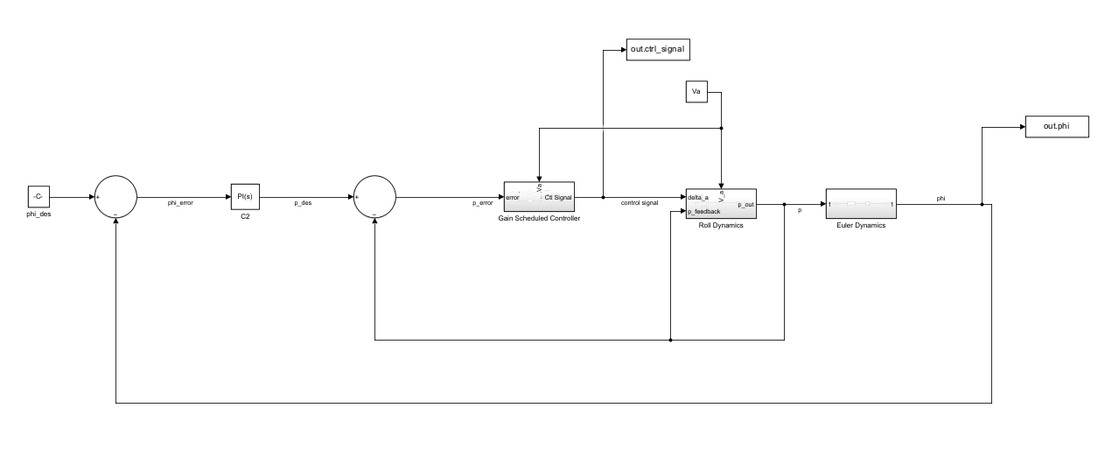
Appendix – Gain Scheduled Zero Reference Diagram

