Slide 1
Gesture Recognition Part I
Brendan O’Connor

Slide 2
Prefold Results
Depth | Nodes | AUC | EER
10 | 5 | 0.9925 | 0.05833
10 | 10 | 0.99833 | 0.00833
10 | 15 | 0.99375 | 0.05
20 | 5 | 0.99 | 0.091667
20 | 10 | 0.99708 | 0.041667
20 | 15 | 0.99833 | 0.008333
30 | 5 | 0.99167 | 0.05
30 | 10 | 0.99667 | 0.05
30 | 15 | 1 | 0

Slide 3
Prefold Results
The results show that the performance increases not surprisingly when the depth of the tap delay is extended and more nodes are added. We note that the results were consistently pretty high even at the lower observed parameter values. Ultimately though once the depth of the tap delay reaches the length of the gesture (30 samples) we get a perfect ROC curve.

Slide 4
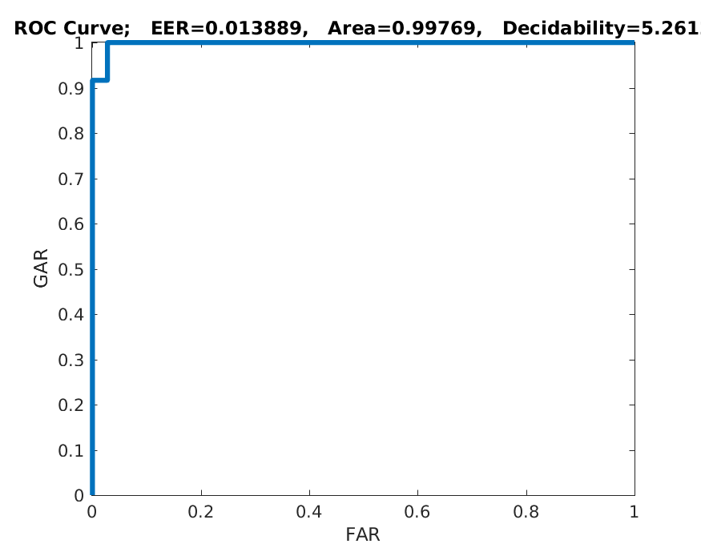
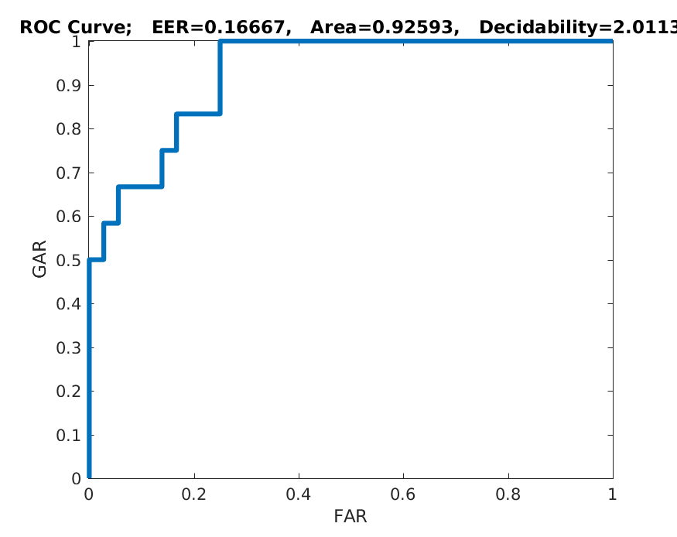
Subject Specific Results
We see the perfect ROC curve for all but the
First (top) and third (bottom) subject seen on the right.
This seems to indicate very high accuracy (due to
likely low variance for each subject).

Slide 5
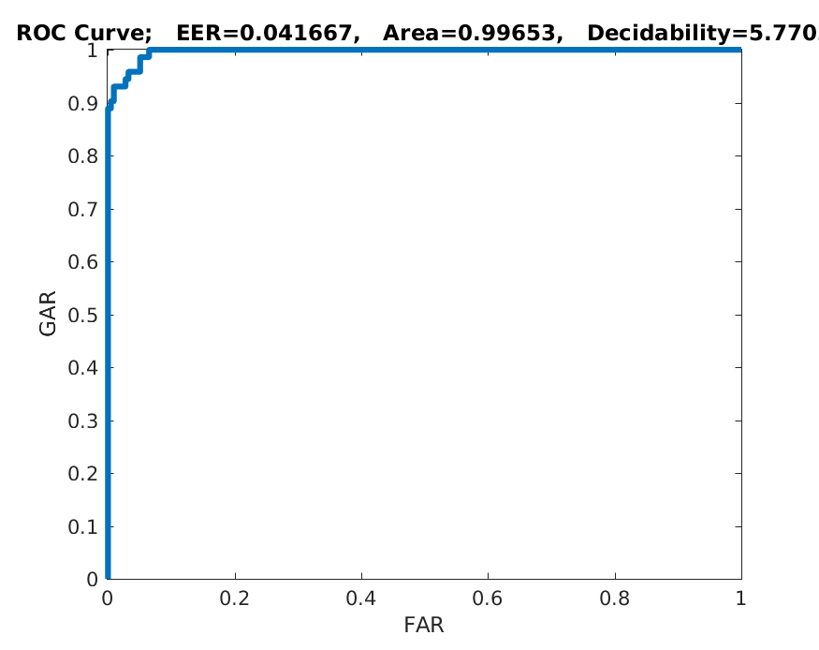
Subject Specific Results
We see the overall ROC here:
The result is nearly perfect save
The averaged in results from 1 & 3.

Slide 6
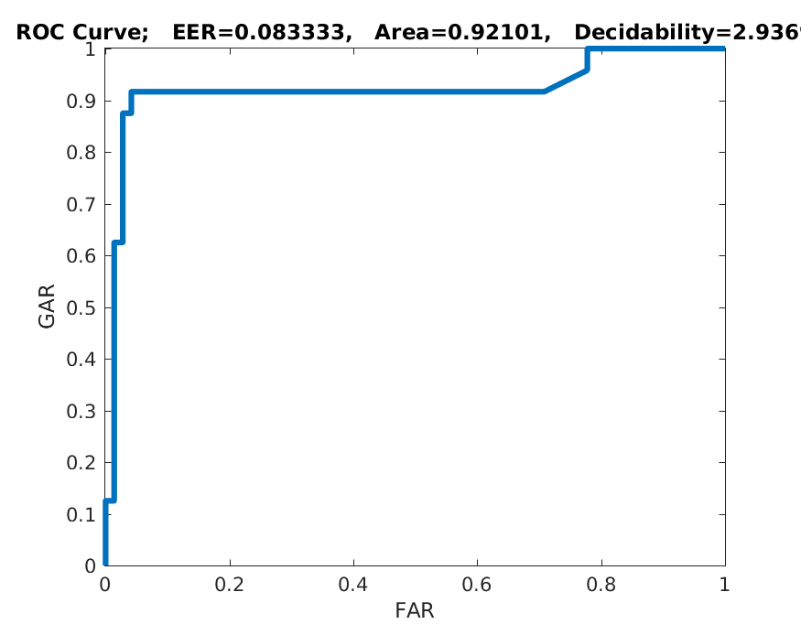
Subject Independent Results
However when we look at the overall ROC
For the subject independent testing the
Network performance drops considerably.
This is likely due to high variance in how the
Gesture is performed person to person.

Slide 7
Final Discussion
We see that performance is incredibly high when trained on subject specific data and drops off considerably when we train the network independent of the specific subject. This indicates that individual subjects likely perform the same gestures in very similar manners however different subjects likely perform the same gesture in a different manner than another subject.

