Slide 1
MiniProject2
Brendan O’Connor

Slide 2
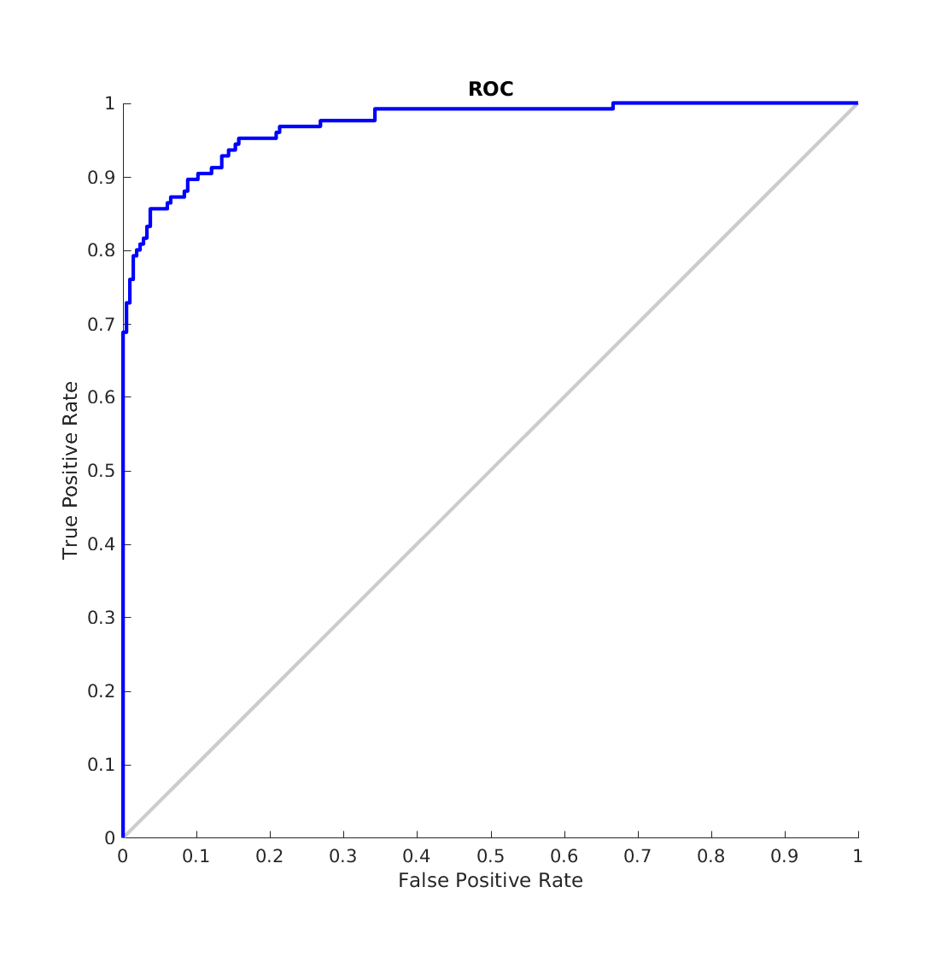
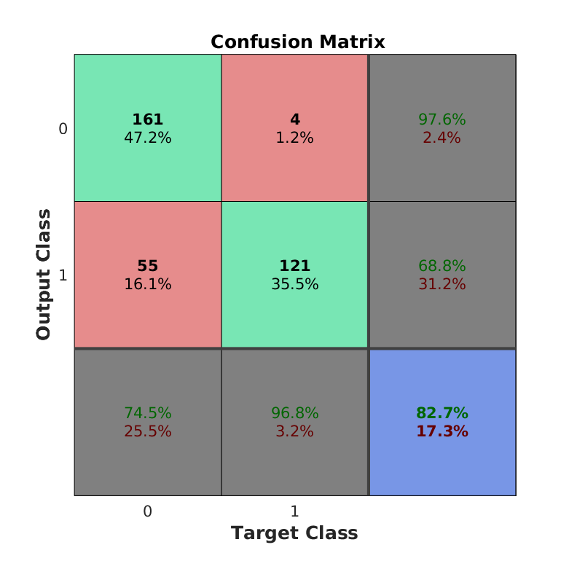
NEWRB Train

Slide 3
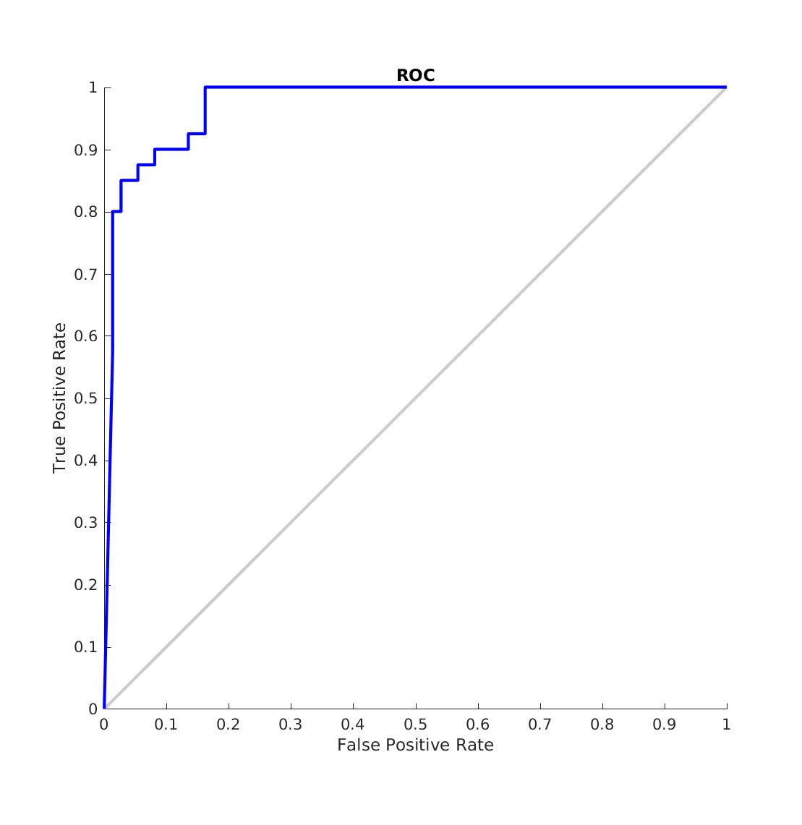

NEWRB Validation

Slide 4
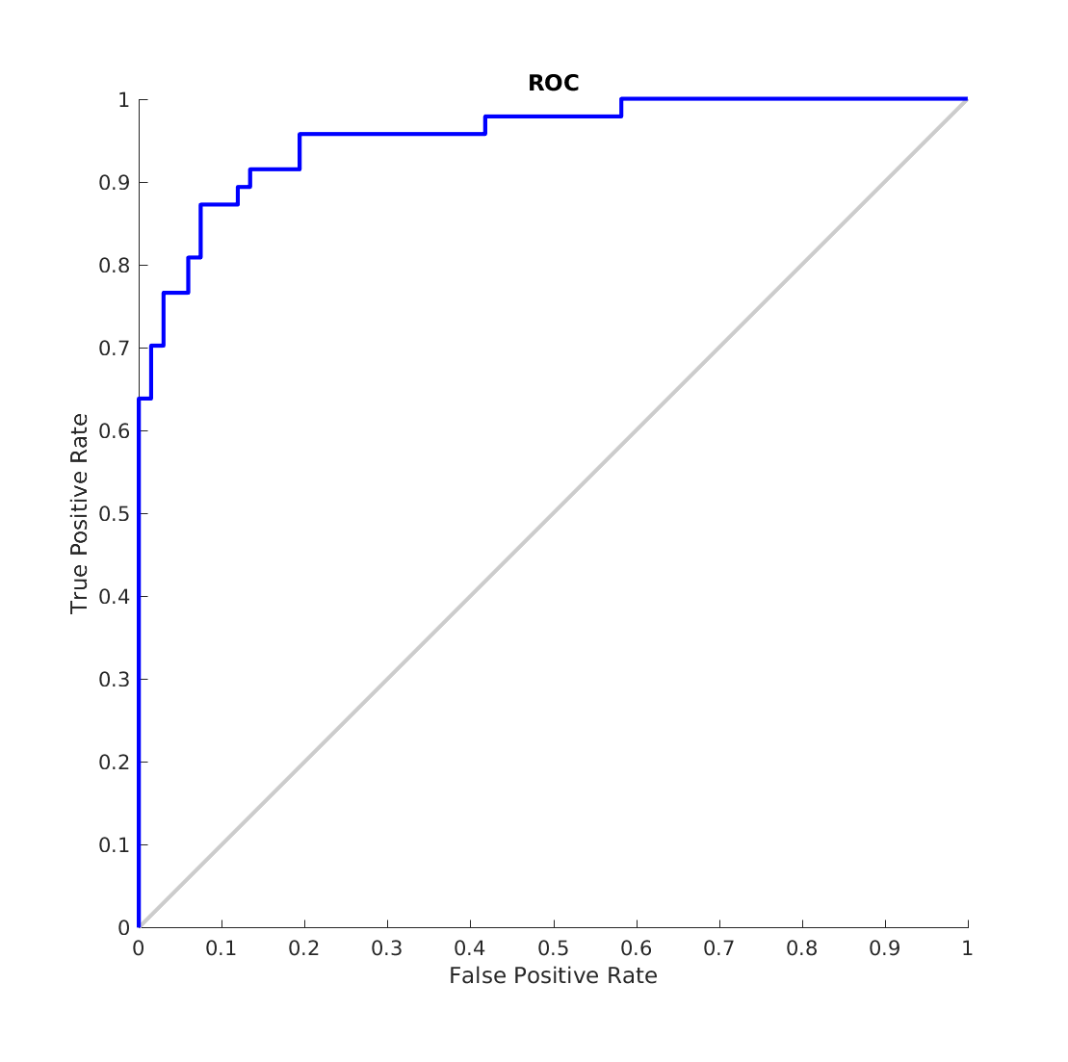

NEWRB Test

Slide 5
NEWRB Results
Spread = 100
neurons = 0
Goal = .7
"train:0.4964"
"vald:0.51463"
"test:0.56762"

Slide 6
NEWRB Discussion
We see the above results for training newrb. The network size was zero this is as a result of trying to produce the high result of .5 validation mse. It can be easily shown with small error goals the network will require more neurons.

Slide 7
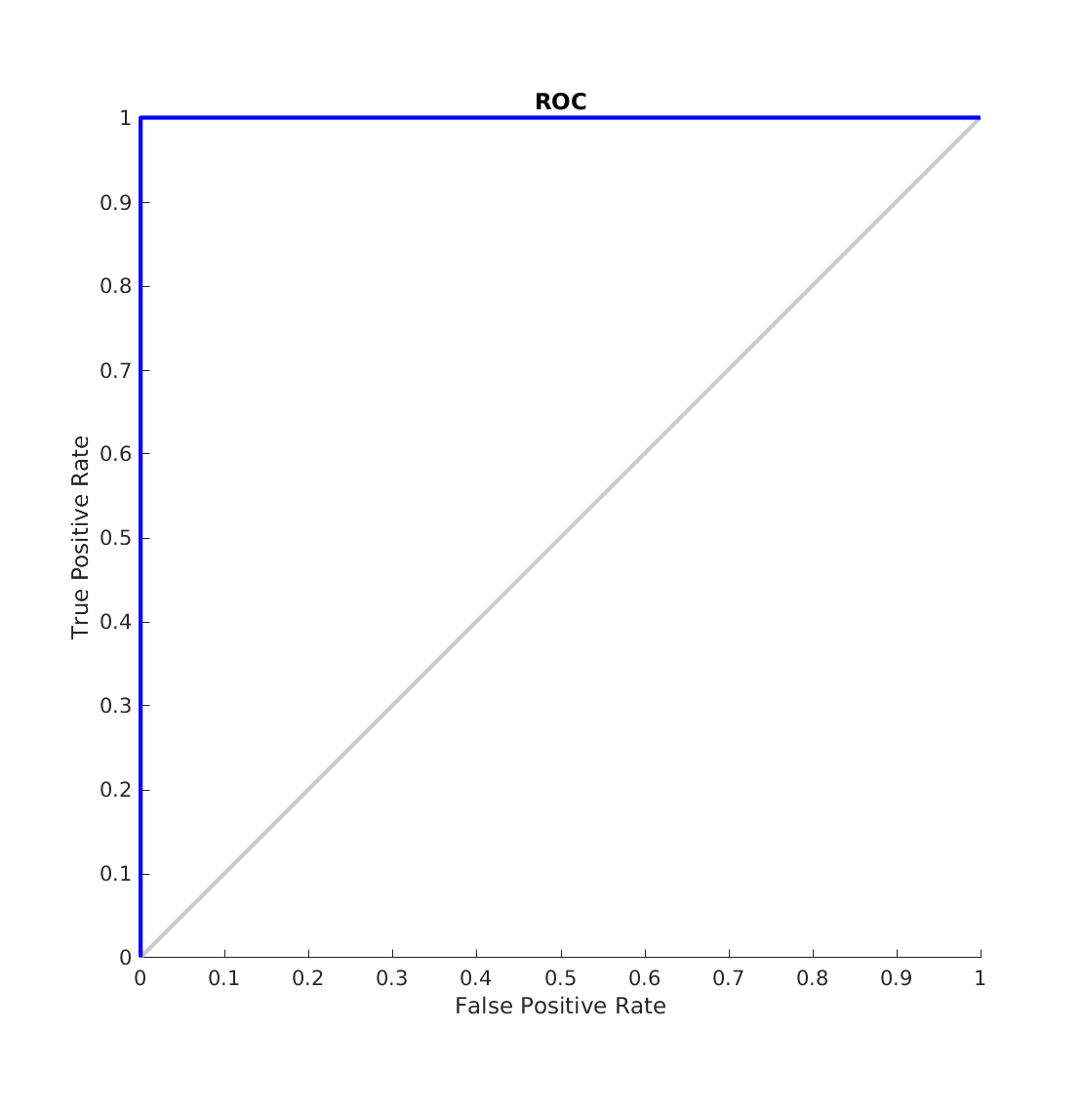
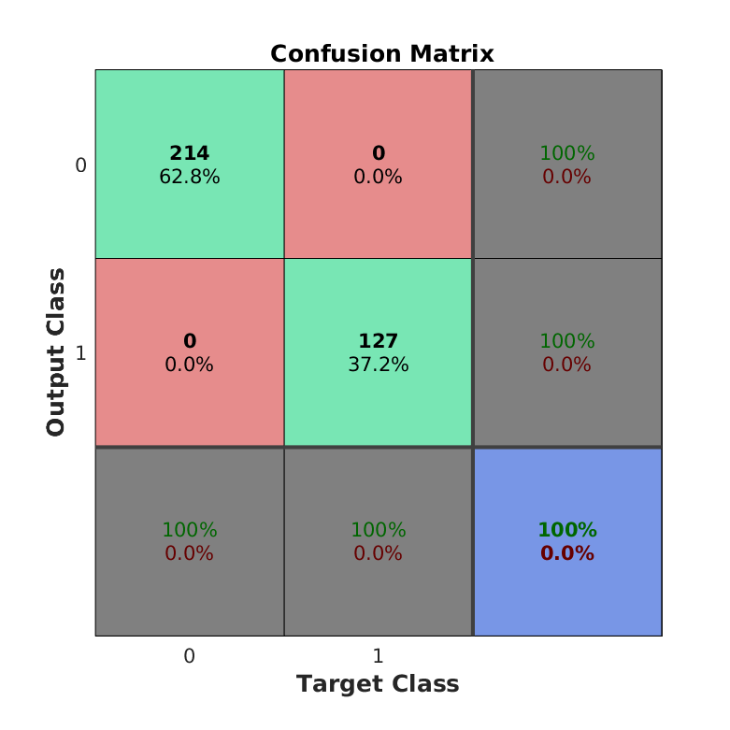
NEWRBE Train

Slide 8
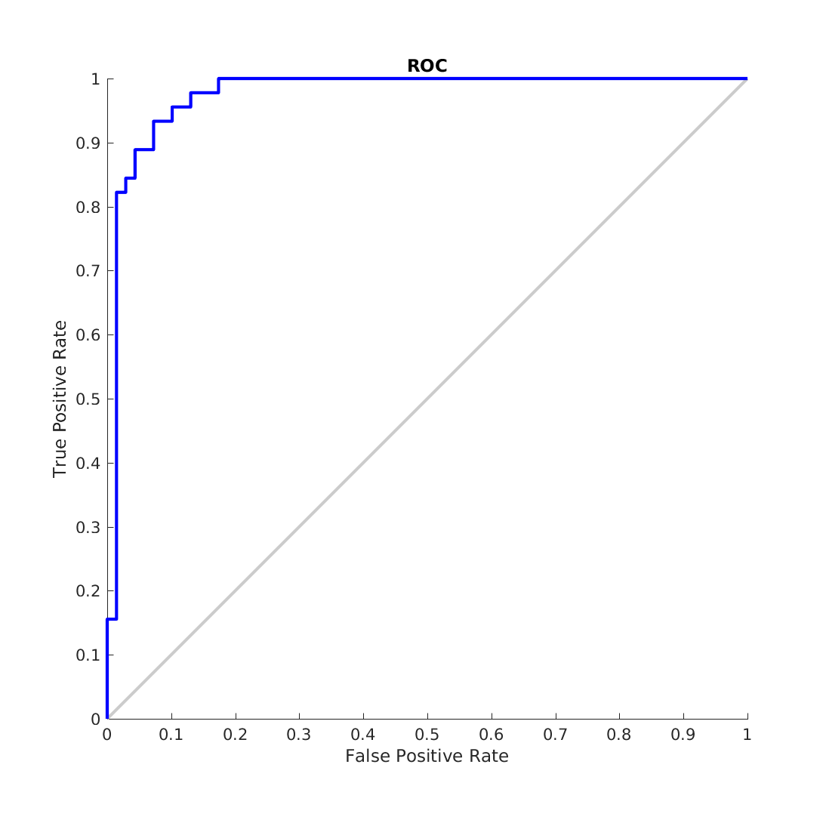

NEWRBE Validation

Slide 9
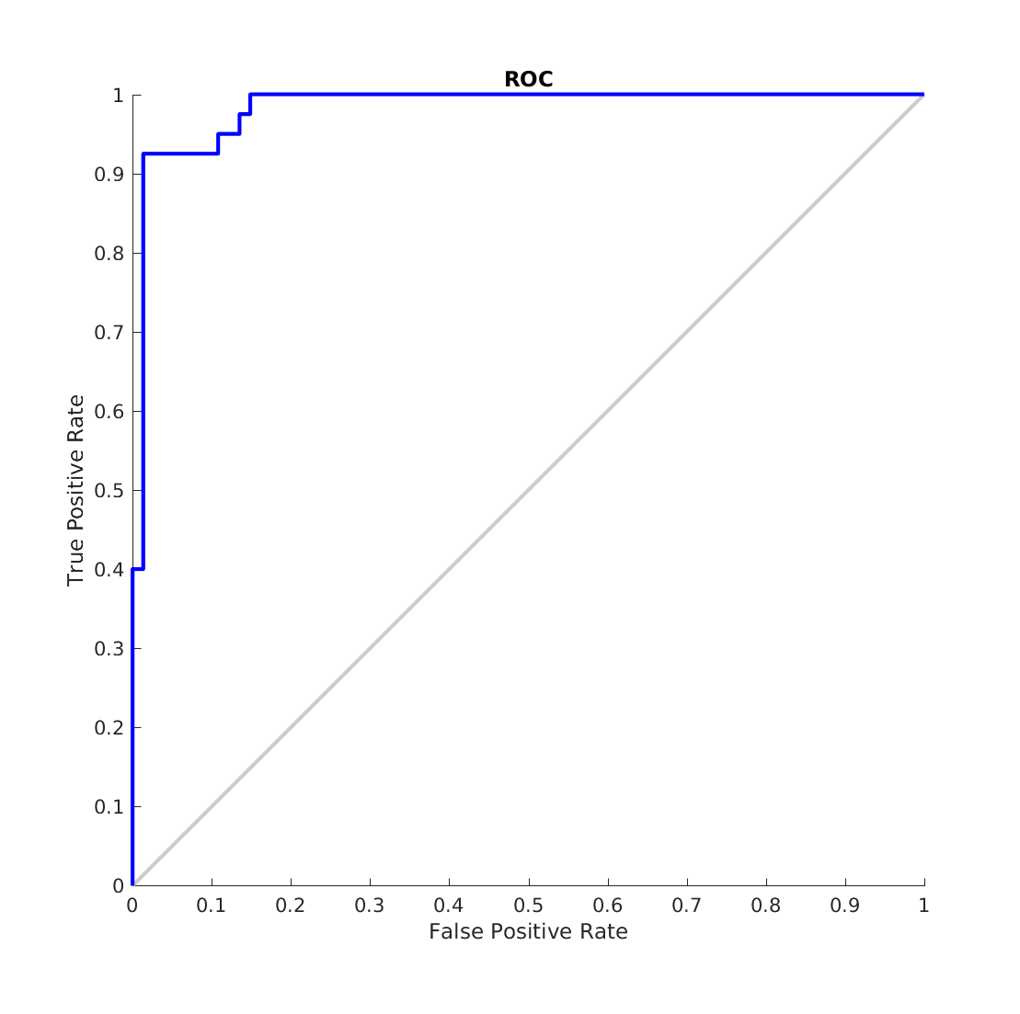

NEWRBE Test

Slide 10
NEWRBE Results
spread = 40
"train:1.2402e-27"
"vald:0.5173"
"test:0.36165"

Slide 11
NEWRBE Discussion
We see that the roc for the training data is a perfect curve. This is expected as the exact version creates a network the same size as the number of data samples and trains it to zero error thus the abnormal/overtrained roc curve/training mse.

Slide 12
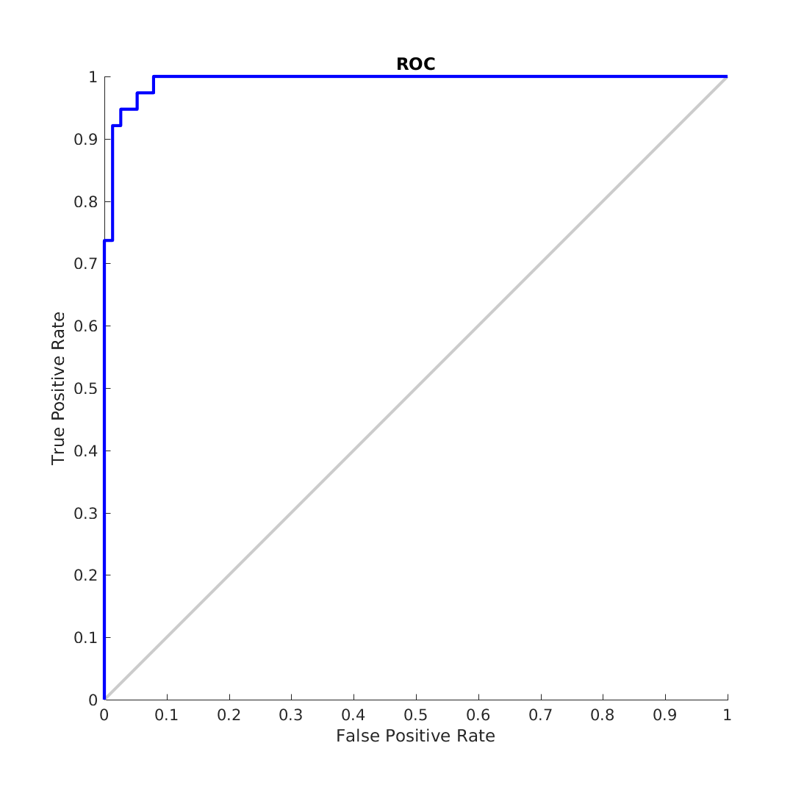
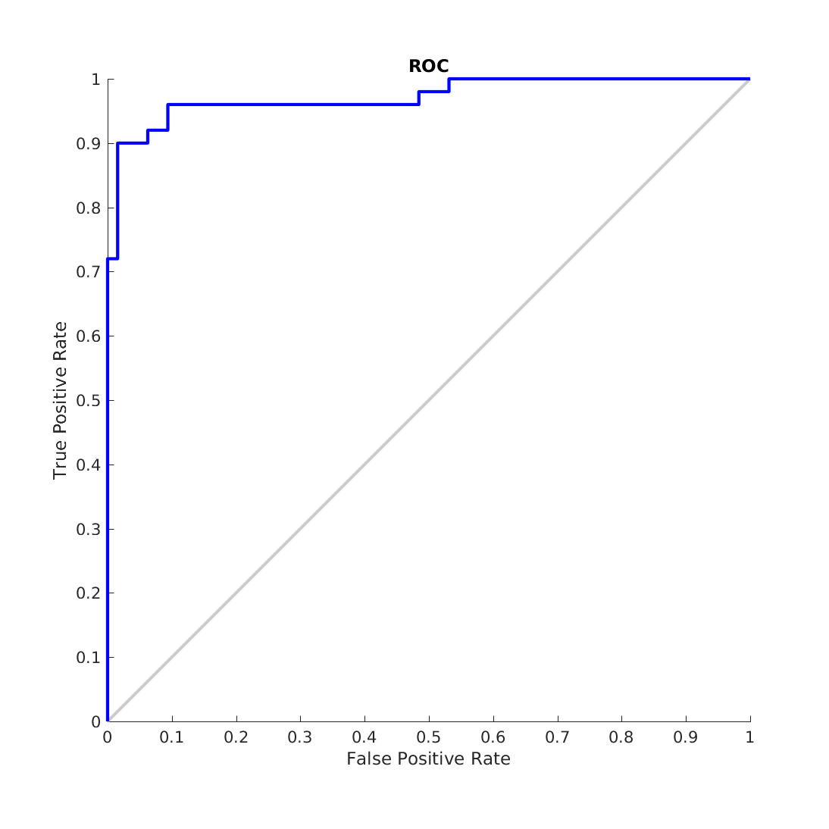
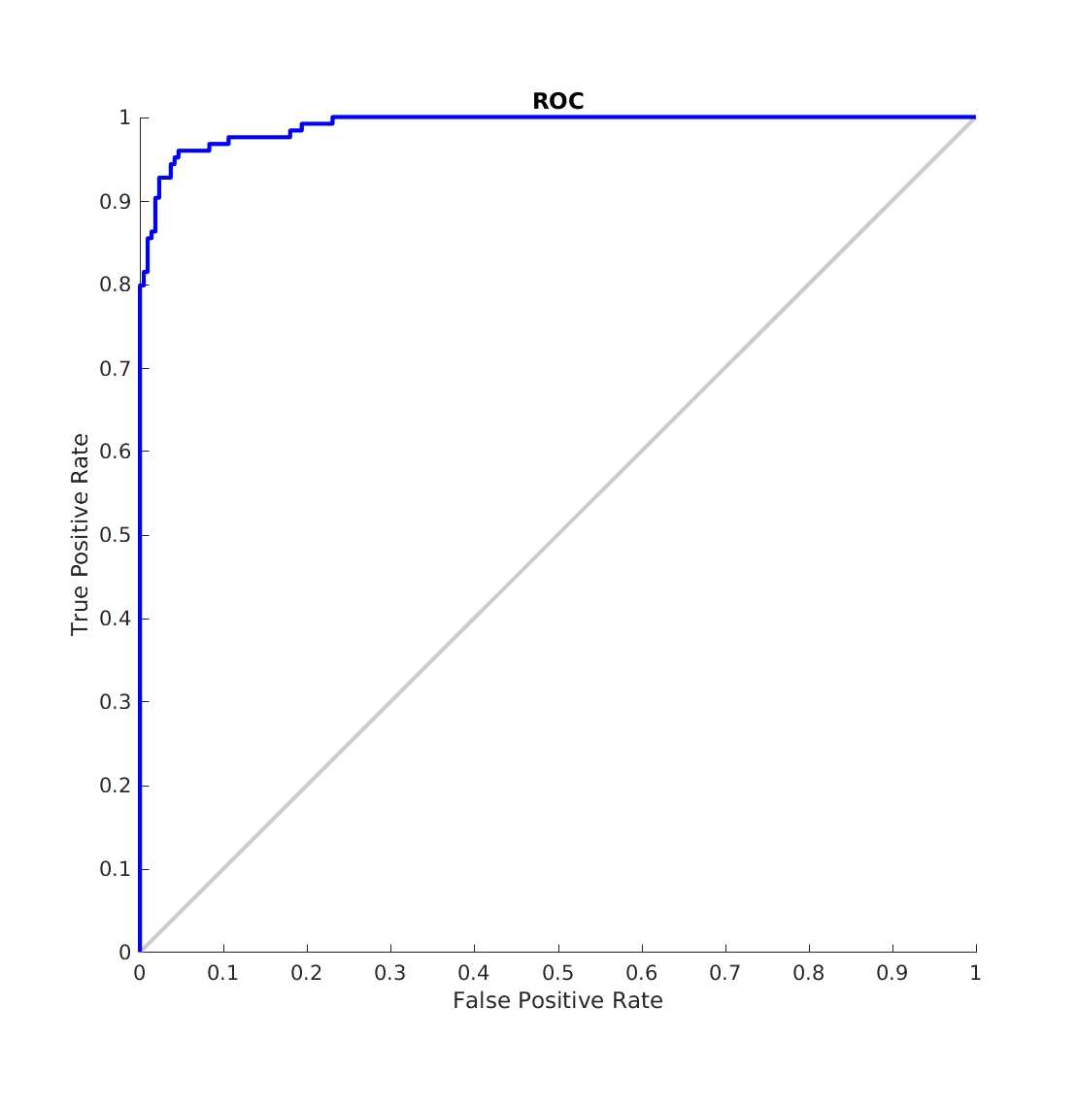
Validation Early Stopping: Train, Vald, Test

Slide 13
Validation Early Stopping: Train, Vald, Test
optimal spread: 75
optimal nodes: 51
min vald error: 0.15439
Train: 0.15309
Vald: 0.15439
Test: 0.2566

Slide 14
Final Discussion
ROC's are going to be biased because the values are typically between -1 and 1.
Whereas ROC’s should be used with probabilities (values between 0 and 1). Additionally these are approximations so we will see values greater than
1 and less than -1. If one were to constrain the classification values to
1 and 0 the distance is so small it would be incredibly difficult to produce
a model with a mse of .5 because this would require on average being a
distance of ~.7 (sqrt(.5)) from the target. To achieve this you would
actively have to try to improperly train your model.

